Slide 1

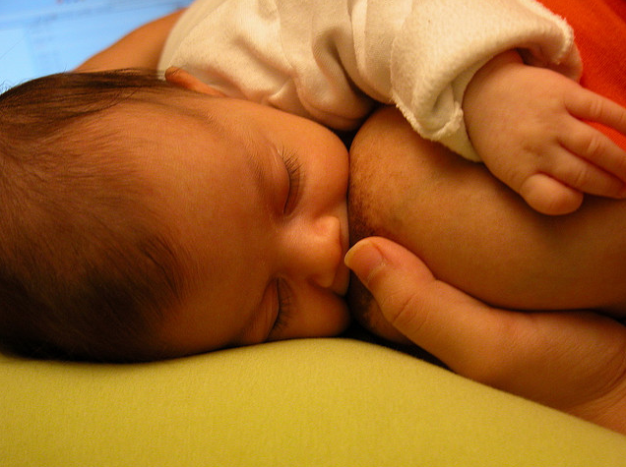
Chronic Breast Pain in Lactating Women: Development of a Clinical Protocol
Michele Lorenz (Med2 UWSMPH)
Mentor: Dr. Anne Eglash

Slide 2
Overview
Chronic Breast Pain Protocol
Background: Chronic pain
ABM process
Challenges
Accomplishments
Future work

Slide 3
Chronic pain:
The need for a clinical protocol
Chronic Breast Pain Protocol
Pain >1 week
Early weaning risk
Compromised health of mom + baby
3-33% of lactating women
> 6 months of
breastfeeding
Eglash A et al. 2006; Delgado et al. 2009.

Slide 4
Chronic pain:
The need for a clinical protocol
Chronic Breast Pain Protocol
Not the usual “mastitis” symptoms:
Acute mastitis
Erythema, warmth
Wedge-shaped
Infectious mastitis/bacterial lactiferous duct infection
No localized erythema
(Usually) bilateral
Indurated
Deep, aching, pulling pain
Systemic symptoms
Sharp, shooting pain
Nipple pain
(Usually) unilateral
Eglash A et al. 2006; ABM Protocol Committee 2008

Slide 5
Chronic pain:
The need for a clinical protocol
Chronic Breast Pain Protocol
Treatment strategies:
Acute mastitis
Breast drainage
Comfort measures
Antibiotics (symptoms persist > 24 hrs)
Analgeisa (ibuprofen)
?
(Does not resolve with standard mastitis treatment)
Infectious mastitis/bacterial lactiferous duct infection
Eglash A et al. 2006; ABM Protocol Committee 2008

Slide 6
ABM:
Academy for Breastfeeding Medicine
Chronic Breast Pain Protocol
Promotion, protection + support of BF
Physician education
Facilitation of optimal breastfeeding practices
Exchange of information among organizations
central goal: Development of clinical protocols

Slide 7
ABM:
Academy for Breastfeeding Medicine
Chronic Breast Pain Protocol
Clinical protocol process:
  Definition of need
  Draft bibliography + purpose
  Annotated bibliography (literature review)
    Submission to Protocol Committee
  Draft protocol
    Submitted to Committee Chair
    Peer review, revisions
  Final protocol
    Published, translated, updated every 5 years

Slide 8
Protocol:
Challenges
Chronic Breast Pain Protocol
Literature review w/o well-established search terminology
Complicated etiology + research methods
ideal terms, few results vague search terms, many results
“infectious mastitis” “mastitis” “breast infection”
“chronic breast pain” “breast pain” “nursing” (profession/BF)
“lactiferous duct infection”
etiology methods
(?) s. aureus/s. epidermidis reliable detection of possible agents
(?) biofilms (yeast + bacteria) characterization of pathophys process
(?) milk stasis/overproduction lack of RCTs, large studies
(?) previous antibiotic use applicability of txs for similar infections

Slide 9
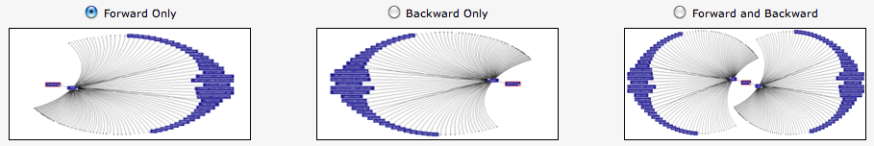
Protocol:
Challenges
Chronic Breast Pain Protocol
Overcoming search issues:
  PubMed MeSH terms
  Web of Knowledge Citation Map (forward/backward)
  ClinicalTrials.gov
  Expert opinion/guidance

Slide 10
Protocol:
Challenges
Chronic Breast Pain Protocol
Complex issue to review:
Causative agent(s)
Interpreting culture results
Defining diagnostic criteria
Potential of untested therapies
Controversy re: detection of agents
Standardizing sample collection methods
Value of tested therapies (few RCTs)

Slide 11
Protocol:
Annotated bibliography
Chronic Breast Pain Protocol
Background for clinical protocol (~review):
  40 annotations (as of 09/2011)
  Example:

Slide 12
Protocol Future Work:
Drafts, Review + Submission
Chronic Breast Pain Protocol
Draft protocol w/ ann bib content
  Collaboration between physician-researchers in WI, NC
Reviews + revisions
Publication, translation, 5-yr updates
(use in practice!)

Slide 13
References:
Chronic Breast Pain Protocol
ABM Protocol Committee. ABM Clinical Protocol #4: Mastitis. Breastfeeding Medicine. 2008; 3(3): 177-178.
Delgado S, Arroyo R, Jiménez E, Fernández L, Rodríguez JM. Mastitis infecciosas durante la lactancia: un problema infravalorado (I) Acta Pediatr. Esp. 2009: 67(2): 77-84.
Eglash A, Plane MB, Mundt M. History, Physical and Laboratory Findings, and Clinical Outcomes of Lactating Women Treated With Antibiotics for Chronic Breast and/or Nipple Pain. Journal of Human Lactation. 2006; 22(4): 429.

