Slide 1


Health Literate Communication Training for Health Care Workers:
Competencies and Best Practices
Cliff Coleman, MD, MPH
Assistant Professor
Department of Family Medicine
Oregon Health & Science University
colemanc@ohsu.edu
2013 Wisconsin Health Literacy Summit: Changing Systems, Changing Lives April 9, 2013

Slide 2
“Communication works for those who work at it”
-- John Powell, composer

Slide 3
Disclosure statement
Funding support:
National Cancer Institute grants number 5K07 CA121457-05 and 3K07 CA121457 04S2 (Behavioral & Social Sciences as Core Elements of the Medical School Curriculum)
Health Resources and Services Administration grant number 1D58 HP15234 01-00 (Curriculum Activities for Learning Mood Disorders and Community Approaches to Residency Education (CALM CARE))

Slide 4

Learning objectives
1. Describe a set of measurable health literacy best practices for health professionals.
2. Identify the educational competencies which underpin health literacy best practices.
3. Understand how health literacy competencies and best practices can be used in the design and implementation of training curricula for health professionals.

Slide 5

Overview
Background: why a consensus study?
Consensus study design and results
Examination of selected best practices
  Practical applications
  Best practice wording
  Associated educational competencies
Limitations, opportunities, and next steps

Slide 6
Background: why a consensus study?

Slide 7
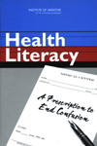
IOM health literacy report, 2004
“Health professionals and staff have limited education, training, continuing education, and practice opportunities to develop skills for improving health literacy”
“Professional schools and professional continuing education programs in health and related fields, including medicine, dentistry, pharmacy, social work, anthropology, nursing, public health, and journalism, should incorporate health literacy into their curricula and areas of competence”
(Neilsen-Bohlman et al, 2004, p161)

Slide 8

Current state of health care
Health professionals generally lack adequate health literacy awareness, knowledge, and skills
Many best practices for effective communication with low health literacy patients are not routinely used by physicians
  (Coleman, 2011)

Slide 9
Current state of health care education
Increasing calls for improving training about health literacy for health professionals
Proliferation of HL curricula for health professionals
HL curricula can positively influence learners’ knowledge, skills and attitudes
(Coleman, 2011)

Slide 10
Current state of health care education
At least 30% of U.S. medical schools are not teaching about health literacy
(Coleman & Appy, 2012)
Less than half of Family Medicine residency programs are teaching about health literacy
(Coleman & Nguyen, unpublished)
Little known about other health professions

Slide 11
Current state of health care education
No published guidelines for the recommended content or structure of health literacy curricula for health professionals
Very little empiric data to inform what to teach, or how and when to teach it
(Coleman, 2011)

Slide 12
Health literacy competencies
The knowledge, skills and attitudes which health professionals need in order to address low health literacy among consumers of health care and health information
(Coleman, Hudson & Maine, Unpublished)

Slide 13
Health literacy practices
Patient-centered protocols and strategies to minimize the negative consequences of low or limited health literacy
(Barrett et all, 2008)

Slide 14
Consensus study

Slide 15
Selection of potential competencies
Literature review (2010) yielded a diverse array of recommendations (i.e., “best practices”)
  24 Knowledge items
  28 Skill items Competencies
  11 Attitude items
  32 Practice items
Some overlap between domains

Slide 16
Methods
Specific Aim:
To develop a consensus agreement on a common set of core health literacy competencies for U.S. health professions school graduates

Slide 17
Methods
Design:
Modified Delphi consensus process
A commonly used method to capture expert opinions of groups
Useful when empiric evidence is lacking
Use is well described in healthcare competencies work
“Modified” in that the panel met in person initially

Slide 18
Delphi: how it works
Identify proposed competencies (literature review)
Convene expert panel
Individuals anonymously rate their agreement with items on the list
Predetermined levels of “agreement”
Facilitated group discussion helps “move the needle” on items prior to re-rating
  Participants’ opinions important
  Modifications suggested
Process stops when diminishing returns reached

Slide 19
Translating best practices into measurable competencies – 3 examples
Best practice | Domain(s) | Competency. The learner… | Operationalization. The learner…
1. Use common words when speaking to patients | Knowledge Skills Practices | Knows which kinds of words, phrases, or concepts may be “jargon” to patients | Selects jargon words from a list Explains why jargon terms may be misinterpreted
2. Speak clearly and at a moderate pace | Skills Practices | Demonstrates ability to speak slowly and clearly with patients | Speech is perceived as appropriate pace, volume and clarity. Speech is always intelligible
3. Confirm patients understand what they need to know and do by asking them to teach back directions | Knowledge Skill Practices | Routinely uses a “tech back” or “show me” technique to check for understanding | Confirms patient’s understanding by asking patient to explain back in their own words (or show) what they have heard/seen at end of encounter Puts onus on self, by saying “I don’t always explain things well. Tell me what you’ve heard.”

Slide 20
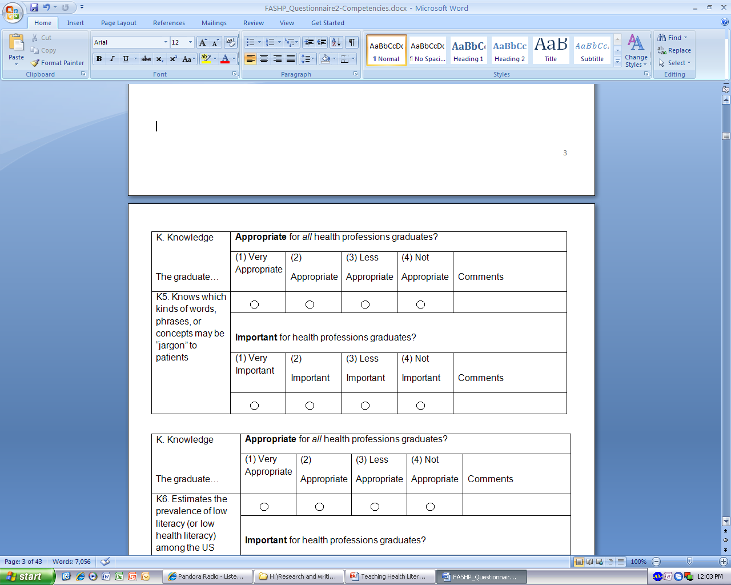
Example of consensus project rating scheme: knowledge item

Slide 21
Methods
Sample:
Executive leadership representatives from member organizations of the Federation of Associations of Schools of the Health Professions (FASHP):
  American Association of Colleges of Nursing
  American Association of Colleges of Osteopathic Medicine
  American Association of Colleges of Pharmacy
  American Dental Education Association
  Association of Academic Health Centers
  Association of American Medical Colleges
  Association of Chiropractic Colleges
  Association of Schools & Colleges of Optometry
  Association of Schools of Allied Health Professions
  Association of Schools of Public Health
  Association of University Programs in Health Admin
  National League for Nursing
  Physician Assistant Education Association
Attendees of a 2-day meeting on teaching health literacy to health professions students
St Louis, MO, October 2010
Hosted by Health Literacy Missouri and Saint Louis College of Pharmacy

Slide 22
Results
22 FASHP participants
Age, mean (n=22) | 51.9 years
Female (n = 21) | 15 (71.4 %)
White Non-Hispanic | 21 (95.5%) 21 (95.5%)
Years in health professions education, mean (n = 22) | 19.1 years
Background in direct patient care (n = 21) | 19 (90.5%)
Highest level of education attained (n= 20) Bachelor’s Master’s Doctorate | 1 (5%) 1 (5%) 18 (90%)
“Would your peers consider you to have expertise on the topic of health literacy?” (n = 22) YES NO | 16 (72.7%) 6 (27.3%)

Slide 23
Results
62 competencies and 32 best practices accepted after 4 rounds
 |  | Round One | Round Two | Round Three | Round Four | Total Accepted
Competencies | Knowledge Items | 19/24 | 5/5 | -/- | -/- | 24/24
 | Skills Items | 21/28 | 2/4* | 2/3† | 2/3 | 27/29
 | Attitude Items | 11/11 | -/- | -/- | -/- | 11/11
 | Competencies Total | 51/63 | 7/9 | 2/3† | 2/3 | 62/64
 | Practice Items | 26/32 | 4/6 | 2/3** | 0/1 | 32/33
 | Total | 77/95 | 11/15 | 4/6 | 2/3 | 94/97

Slide 24
Selected Best Practices

Slide 25
Example best practices
Spoken communication:
Focus on 1-3 key “need-to-know” items
Avoid medical jargon
Elicit questions in a patient-centered manner
Assess understanding using teach back

Slide 26

Example 1. Focus on 1-3 key “need-to-know” items
Patients typically retain < 50% of information
Illness and stress are major barriers to learning
      Focus on what patients need to do, not on facts
        Provides action-oriented knowledge
      Arrange for follow-up to add new information
(Sheridan et al, 2011; Schwartzberg et al, 2007; AMA, 1999)

Slide 27
Example 1. Focus on 1-3 key “need-to-know” items
Best Practice:
Routinely emphasizes one to three “need-to-know” or “need-to-do” concepts during a given patient encounter (P10)
Underlying Competencies:
Knows that patients learn best when a limited number of new concepts are presented at any given time (K19)
Demonstrates ability to emphasize one to three “need-to-know” or “need-to-do” concepts during a given patient encounter (S22)
(P=practice, K=knowledge, S=skills, A=attitudes)

Slide 28

Example 2. Avoid medical jargon
Even experienced clinicians use jargon
(Castro et al, 2007)
  Research shows that all patients prefer simple “plain language” health information
  (AMA, 1999)
        Define and teach important unavoidable jargon
        (e.g., “hemoglobin A1c”)

Slide 29
Video
http://www.youtube.com/watch?v=IOK0Vc_Hg7U

Slide 30
But jargon is complex!
Words
Phrases
Concepts
Numeracy
Obvious
or
subtle
Unfamiliar
Misunderstood
Misinterpreted
Type of Jargon | Description | Examples
 |  | Words | Phrases | Concepts
Technical | Words, phrases or concepts with meaning only in a clinical context | Glucometer Cardiologist Insomnia Abdomen Cath lab Ortho | Acronyms: GERD COPD UTI | Follow-up Referral Chronic PRN PCP Contagous
Quantitative | Words, phrases or concepts requiring clinical judgment or knowledge | Unlikely Increased Tablespoon Fever | Excessive wheezing Twice daily | Risk
Lay | Words, phrases or concepts with two or more meanings or interpretations, one of which is medical | Stable Abnormal Stool Frequency Salt | Idioms: Come down with Break out Run a fever | Metaphors: ?

Slide 31
Example 2. Avoid medical jargon
Best Practice:
Consistently avoids using medical “jargon” in oral and written communication with patients, and defines unavoidable jargon in lay terms (P14)
Underlying Competencies:
Knows which kinds of words, phrases, or concepts may be “jargon” to patients (K5)
Demonstrates ability to use common familiar lay terms, phrases and concepts, and appropriately define unavoidable “jargon,” and avoid using acronyms in oral and written communication with patients (S1)
Demonstrates ability to recognize, avoid and/or constructively correct the use of medical “jargon,” as used by others in oral and written communication with patients (S2)
(P=practice, K=knowledge, S=skills, A=attitudes)

Slide 32
Example 3. Elicit questions in a patient-centered manner
No: “Do you have any questions?”
  Implies that you expect them to “get it” (if they don’t, something must be wrong with them…)
  Patients do not answer this honestly
Yes: “What questions do you have?”
  Implies an expectation that patients should have questions!
(DeWalt et al, 2010)

Slide 33
Example 3. Elicit questions in a patient-centered manner
Best Practice:
Consistently elicits questions from patients through a “patient-centered” approach [e.g., “what questions do you have?”, rather than “do you have any questions?”] (P24)
Underlying Competencies:
Demonstrates ability to effectively elicit questions from patients through a “patient-centered” approach (e.g., asks “what questions do you have?” rather than “do you have any questions?”) (S19)
(P=practice, K=knowledge, S=skills, A=attitudes)

Slide 34
Example 4. Assess understanding using teach back
Stop asking, “do you understand?”
Implies that patients should understand (if they don’t, something must be wrong with them…)
Start using a “Teach Back” or “show me” technique
  Ask patient to explain back what they are going to do.
  Say “I want to make sure I have explained things well. Please tell me in your own words how you are going to use this medicine.”
  Ask “how would you tell a friend to take this medicine?”
  “Show me how you use this inhaler.”
  (DeWalt et al, 2010; NQF, 2008; Schillinger et al, 2003)

Slide 35
Video
http://www.nchealthliteracy.org/teachingaids.html

Slide 36

http://www.nchealthliteracy.org/teachingaids.html

Slide 37
Example 4. Assess understanding using teach back
Best Practice:
Routinely uses a “teach back” or “show me” technique to check for understanding and correct misunderstandings in a variety of health care settings (P29)
Underlying Competencies:
Knows the rationale for and mechanics of using a “teach back” or “show me” technique to assess patient understanding (K23)
Demonstrates effective use of a “teach back” or “show me” technique for assessing patients’ understanding (S15)
Expresses the attitude that every patient has the right to understand their health care, and that it is the health care professional’s duty to elicit and ensure patients’ best possible understanding of their health care (A9)
(P=practice, K=knowledge, S=skills, A=attitudes)

Slide 38
Example best practices
Written communication:
Select written materials at 5th-6th grade level
Write for easy understanding

Slide 39
Example 1. Select written materials at 5th-6th grade level
The average US adult reads at an 8th grade level
(Kutner et al, 2005)
Over 1500 studies show that health information is typically written well above the average reading level!
(Rima Rudd, 3rd Annual Health Literacy Research Conference, 10/18/11)
“Most patients will not understand the majority of the educational handouts, consent forms, medical-history questionnaires, and insurance papers they receive”
(Weiss & Coyne, 1997)

Slide 40
Example 1. Select written materials at 5th-6th grade level
Best Practice:
Consistently locates and uses literacy-appropriate patient education materials, when needed and available, to reinforce oral communication, and reviews such materials with patients, underlining or highlighting key information (P27)
Underlying Competencies:
Knows that the average US adult reads at an 8th-9th grade reading level, but that most patient education materials are written at a much higher reading level (K7)
Demonstrates ability to recognize “plain language” principles in written materials produced by others (S4)
(P=practice, K=knowledge, S=skills, A=attitudes)

Slide 41

Example 2. Write for easy understanding
Content
Format
State the purpose
Plain jargon-free language
1-2 syllable words
5th-6th grade level
“Need-to-know” info first
Focus on action items
Lots of white space
Subject headings
Short simple sentences
Bulleted lists
12-point font or larger
Serif-style font
Reinforcing pictures
Use an online health literacy style manual: “How to Write Easy-to-Read Health Materials” http://www.nlm.nih.gov/medlineplus/etr.html
Test your product before distribution
(Doak et al, 1996)

Slide 42
April 16, 2010
Dear _________
Your bloodwork is unremarkable without any signs to suggest parasitic
infection, inflammation of blood vessels or other problems. I suspect your
symptoms are functional in nature and not due to a specific disease process.
I doubt that further testing would be productive. You may want to consider
getting a second opinion and I would be happy to assist in arranging one.
Please let me know if I can be of help in that regard.
Sincerely,
___________, MD

Slide 43
April 16, 2010
Dear _________
Your bloodwork is unremarkable without any signs to suggest parasitic
infection, inflammation of blood vessels or other problems. I suspect your
symptoms are functional in nature and not due to a specific disease process.
I doubt that further testing would be productive. You may want to consider
getting a second opinion and I would be happy to assist in arranging one.
Please let me know if I can be of help in that regard.
Sincerely,
___________, MD
Years of formal education
Needed to easily understand
this text = 10.8
(http://www.editcentral.com)

Slide 44
April 16, 2010
Dear _________
Your blood test was normal. I think your symptoms are not due to a
specific disease. I do not think that more tests will help. You may want
to get a “second opinion” from another doctor. I would be happy to help
set that up. Please let me know if I can be of help with that.
Sincerely,
___________, MD
Years of formal education
Needed to easily understand
this text = 5.9
(http://www.editcentral.com)

Slide 45
Example 2. Write for easy understanding
Best Practices:
Consistently follows principles of easy-to-read formatting when writing for patients (P15)
Routinely writes in English at approximately the 5th-6th grade reading level (P17)
Consistently avoids using medical “jargon” in oral and written communication with patients, and defines unavoidable jargon in lay terms (P14)
Underlying Competencies:
Knows best practice principles of “plain language” and “clear health communication” for oral and written communication (K18)
Demonstrates ability to follow best-practice principles of easy-to-read
formatting and writing in written communication with patients (S3)
Demonstrates ability to write in English at approximately the 5th-6th grade reading level (S6)
(P=practice, K=knowledge, S=skills, A=attitudes)

Slide 46
Limitations
The 32 identified practices, and 62 underlying competencies are not in rank order
Validated measurement tools do not exist for assessing the practices and underlying competencies

Slide 47
Opportunities
For the first time we have a comprehensive list of health literacy practices
Practices and competencies are theoretically measurable
Individuals and organizations can use the list as a “menu” of options

Slide 48
Next steps
Consensus group with health literacy experts to prioritize items
Empiric studies tracking patient-centered outcomes of health literacy training interventions for health professionals

Slide 49
“Communication works for those who work at it”
-- John Powell, composer

Slide 50
References
Ali N. Are we training residents to communicate with low health literacy patients? Journal of Community Hospital Internal Medicine Perspectives 2012, 2: 19238 - http://dx.doi.org/10.3402/jchimp.v2i4.19238. Accessed 4/1/13
AMA (American Medical Association), Ad Hoc Committee on Health Literacy for the Council on Scientific Affairs. Health literacy: report of the Council on Scientific Affairs. JAMA 1999; 281(6):552-7
Barrett SE, Puryear JS, Westpheling K. Health literacy practices in primary care settings: examples from the field. January 2008. Available at http://www.commonwealthfund.org
Castro CM, Wilson C, Wang F, Schillinger D. Babel Babble: Physicians’ use of unclarified medical jargon with patients. Am J Health Behav 2007;31(Suppl 1):S85-S95

Slide 51
References
Coleman C. Teaching Healthcare Professionals about Health Literacy: A Review of the Literature. Nursing Outlook 2011;59:70-78
Coleman C, Appy S. Health literacy teaching in U.S. medical schools, 2010. Family Medicine, 2012;44(7):504-7
Coleman C, Hudson S. Health Literacy Practices for Health Professionals: A Consensus Study. In review
Coleman C, Hudson S, Maine L. Health Literacy Educational Competencies for Students of the Health Professions: A Consensus Study. In review
Coleman C, Nguyen N. Health literacy teaching in U.S. Family Medicine Residencies, 2011. Unpublished.

Slide 52
References
DeWalt DA, Callahan LF, Hawk VH, Broucksou KA, Hink A, Rudd R, et al. Health Literacy Universal Precautions Toolkit. (Prepared by North Carolina Network Consor­tium, The Cecil G. Sheps Center for Health Services Research, The University of North Carolina at Chapel Hill, under Contract No. HHSA290200710014.) AHRQ Publication No. 10-0046-EF) Rockville, MD. Agency for Healthcare Research and Quality; April 2010
Doak CC, Doak LG, Root J. Teaching patients with low literacy skills, 2nd ed. Philadelphia: J.B. Lippincott, 1996
Kutner M, Greenberg E, Baer J. A first look at the literacy of America's adults in the 21st century. Washington, D.C.: National Center for Education Statistics, Department of Education; December 2005. Available at http://nces.ed.gov/NAAL/PDF/2006470.pdf. Accessed 8/6/2012

Slide 53
References
(NQF) National Quality Forum. Safe practices for better healthcare. Washington, DC: National Quality Forum, 2003. Available at http://www.ahrq.gov/qual/nqfpract.pdf. Accessed 27 November, 2008
Nielsen-Bohlman L, Panzer AM, Kindig DA, eds. Health literacy: a prescription to end confusion. Institute of Medicine of the National Academies, Board on Neuroscience and Behavioral Health, Committee on Health Literacy. Washington, D.C.: The National Academies Press, 2004

Slide 54
References
Schillinger D, Piette J, Grumbach K et al. Closing the loop. Physician communication with diabetic patients who have low health literacy. Arch Intern Med 2003;163:83-90
Schwartzberg JG, Cowett A, VanGeest J, Wolf MS. Communication techniques for patients with low health literacy: a survey of physicians, nurses, and pharmacists. Am J Health Behav 2007;31(Suppl 1):S96-S104
Sheridan SL, Halpern DJ, Viera AJ, Berkman ND, Donahue KE, Crotty K. Interventions for individuals with low health literacy: a systematic review. J Health Communication 2011;16:30-54
Weiss BD, Coyne C. Communicating with patients who cannot read. NEJM 1997;337(4):272-4

