Slide 1
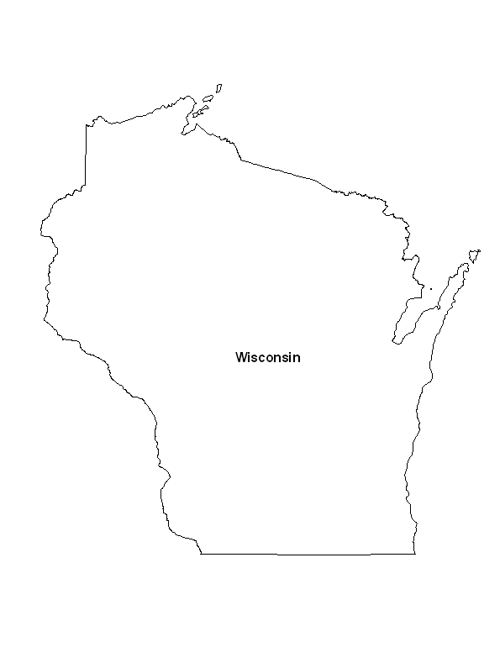
Family
Physicians
Making a Difference in Wisconsin Communities

Slide 2
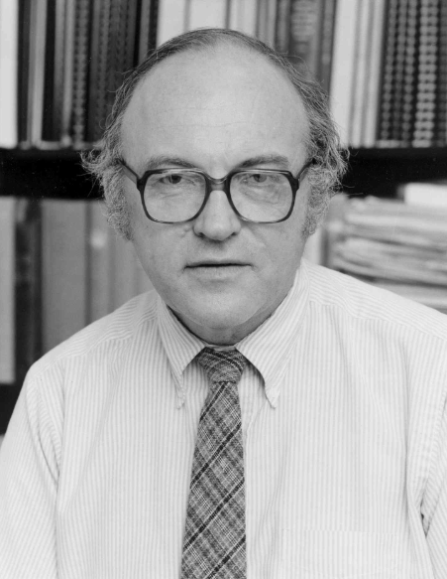
a vision
“In the mid 1960s, General Practice, which had been the backbone of medicine, was dying. General physicians, especially in rural communities, were aging rapidly and not being replaced. Biomedicine was still being invented, but had already transformed health care with ever increasing speed. Clinical specialization was becoming more and more predominant, especially in academic medical centers. There were almost no programs designed to prepare young doctors for ‘primary care.’ Medical schools, their students and faculty, were still predominately male. Health care ‘teams’ with cooperating professions and disciplines were rarely, if ever, explicit or patient centered.”
Marc F. Hansen, MD

Slide 3
1965 | Redesign of UW Pediatric Department’s Well Baby Clinic led to the creation of the first team practice which evolved into the University Family Health Service, combining pediatrics, internal medicine and obstetrics in one location to serve the whole family, i.e. Primary Care. Third- and Fourth-year medical students completed pediatric rotations in community practices.

Slide 4
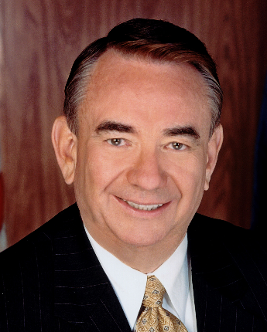
1968 | The Elroy Question—During his first year as an Assemblyman, Tommy Thompson approached the UW Medical School about training doctors for Elroy, Wisconsin. Dean Peter Eichman sent Assemblyman Thompson to Dr. Hansen. After discussing what was necessary to improve and expand the training of physicians who could provide health care in small communities, the discussion of needed resources arose. As a new Assemblyman, Thompson could have one bill of his choice, which was approved and provided the initial $50,000 to plan for the expansion of primary care teaching programs and training in family medicine in Wisconsin. Gerald Derus, from the state AAFP helped establish relationships to create a family practice program and locations were suggested. St. Mary’s, under the leadership of Sister Rebecca Wright, was selected as it offered space, funding and a strong family physician medical staff.

Slide 5
“The UW Medical School was visited by Leland Blanchard, MD and Lynn Carmichael, MD, both national family practice leaders, who had been selected by the AAFP and the AMA to ‘go on the road’, to ‘sell’ the idea of training programs in Family Practice to academic medical centers. Faculty at the University Family Health Service were anxious to speak with them as we were already doing this. We met, they encouraged us to apply for approval as a family practice training program, our application was accepted and Wisconsin became one of the first 15 programs approved for residency training in family medicine.” Marc Hansen, MD

Slide 6
“The future of health care in small communities would depend on the training of new generalists”

Slide 7
Timeline: 1970’s
1970 | The Madison Family Practice Residency Program is created Dr. Hansen recruits Dr. John Renner to lead the program
1971 | Our first two residents enter the program: Drs. David Kuter and Richard Larson The Wingra Clinic opens in Alumni Hall
1972 | The Verona Clinic opens
1973 | The UW Medical School approves the creation of a Department of Family Medicine and Practice The Northeast Clinic opens
1973-78 | Residency Programs open in Milwaukee, Waukesha, Eau Claire and Wausau
1978 | Dr. Renner resigns and Dr. William Scheckler becomes the Interim Chair, then Chair The Milwaukee and Waukesha residency sites join the Medical College of Wisconsin

Slide 8
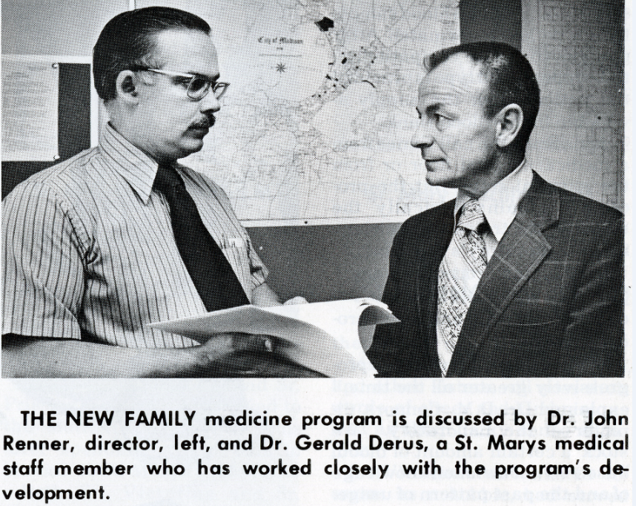
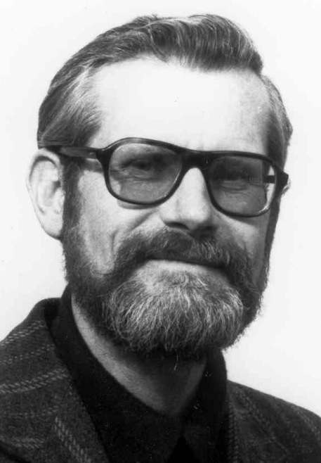
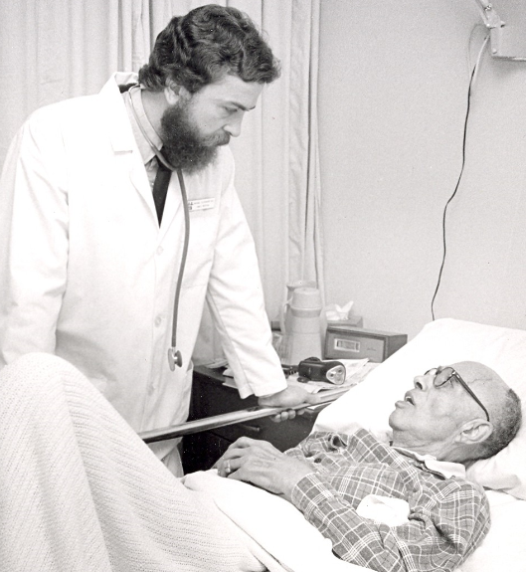
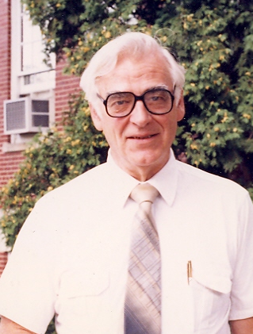
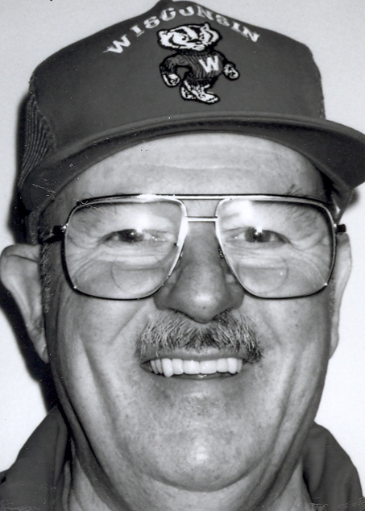
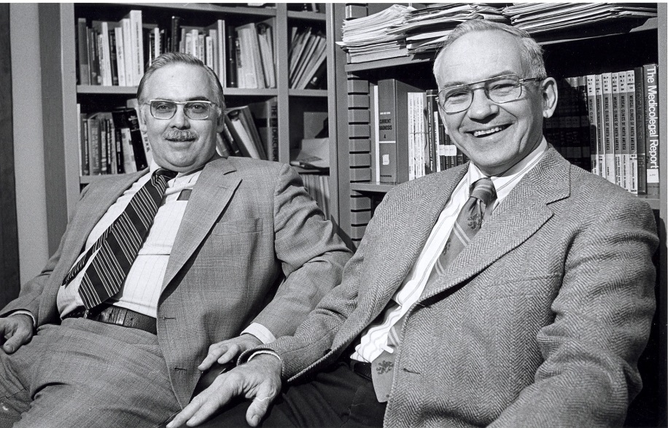

Slide 9
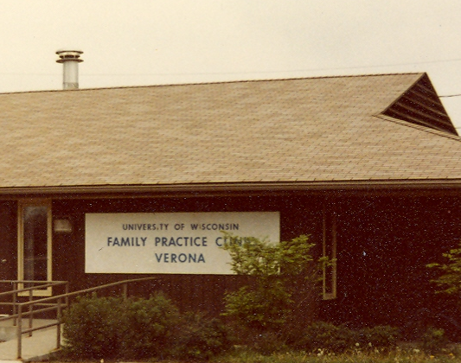
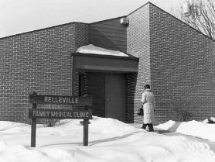
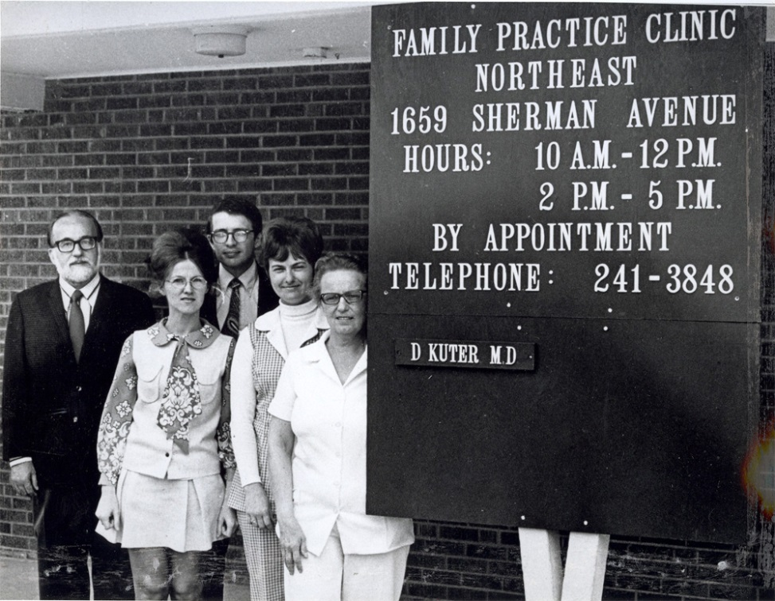
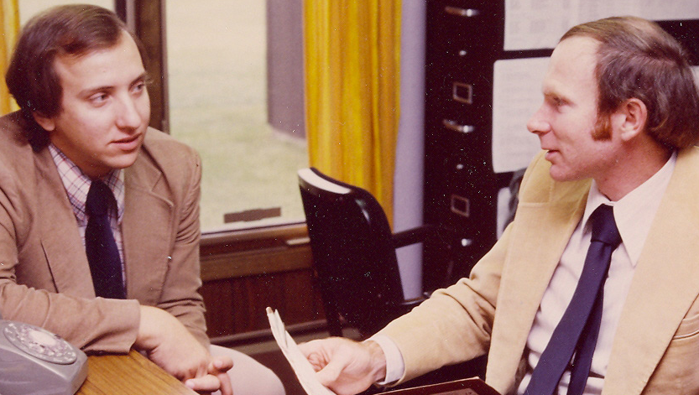

Slide 10
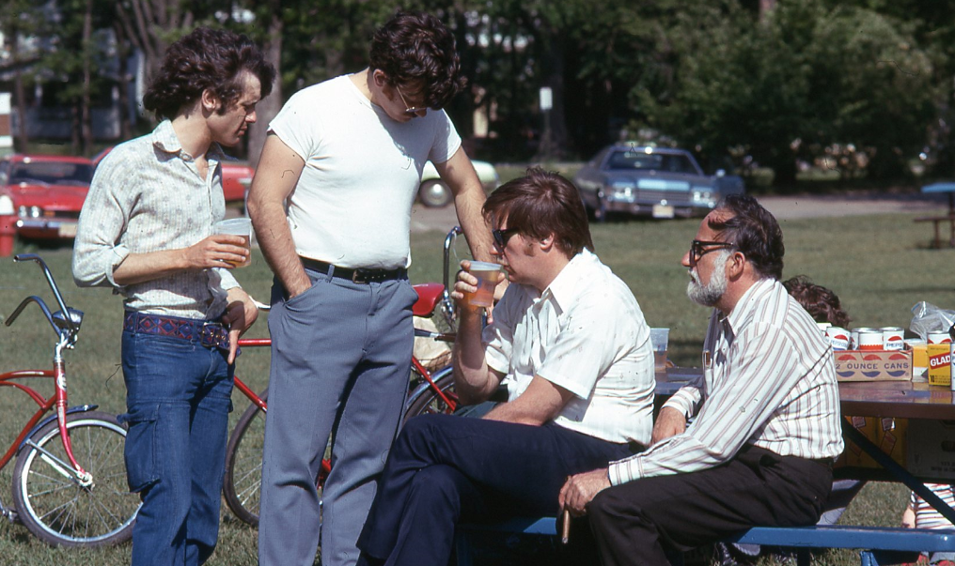
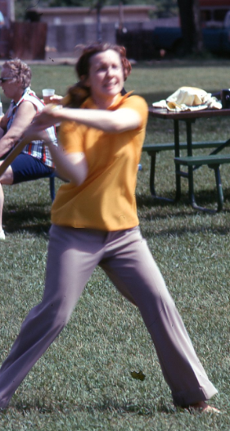
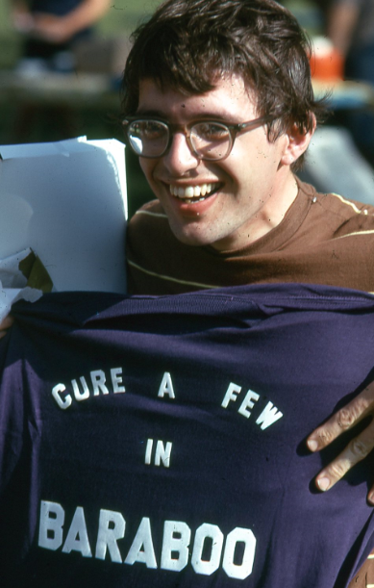
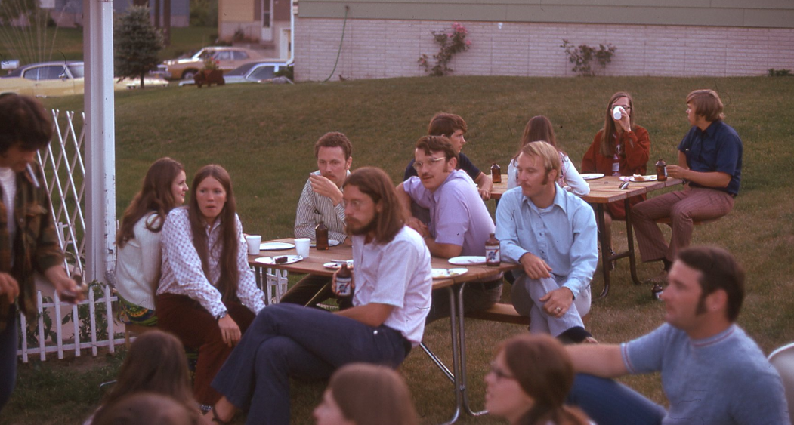
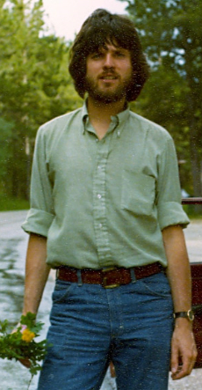
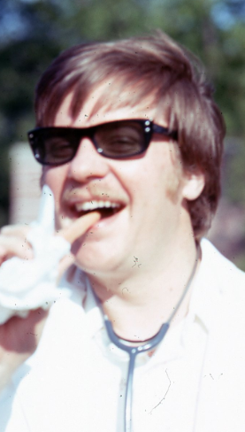

Slide 11
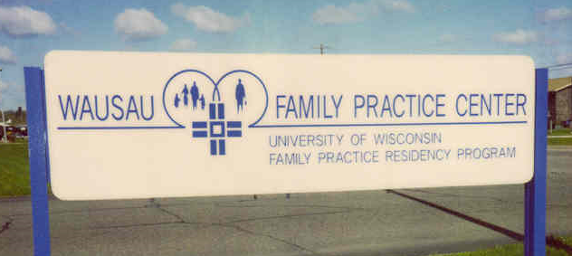
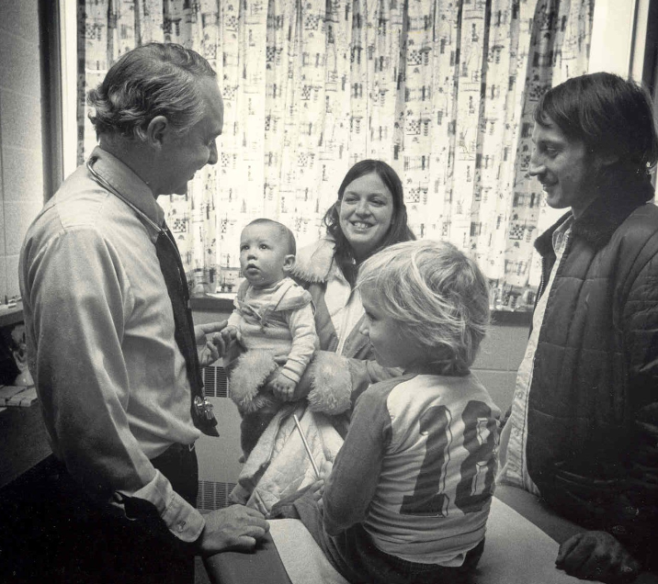
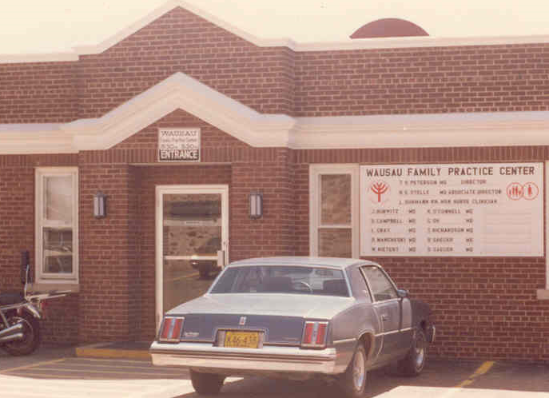
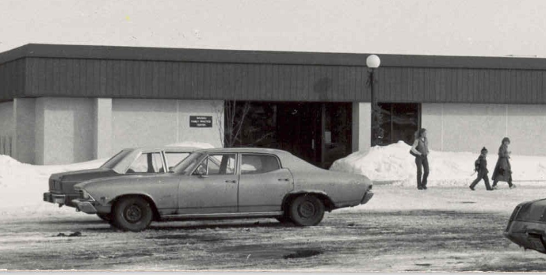

Slide 12
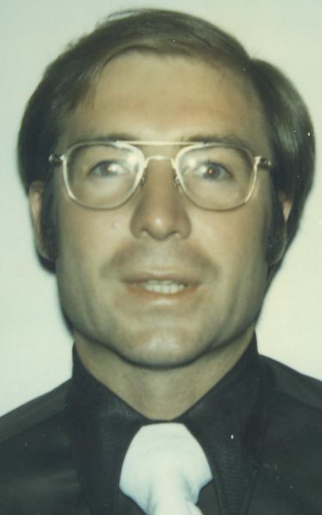
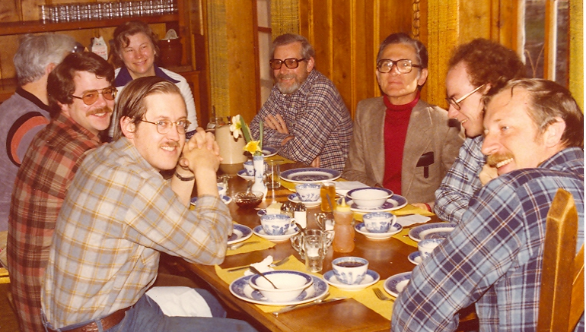
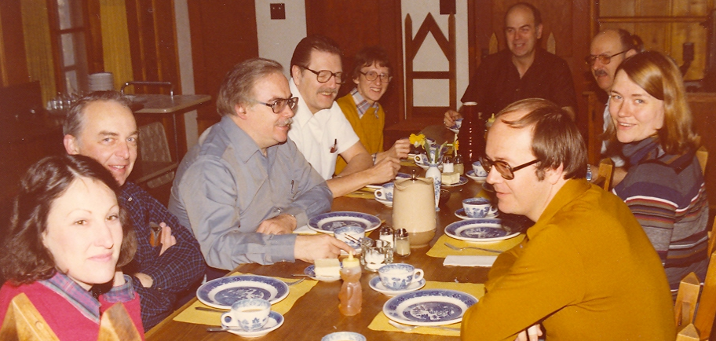
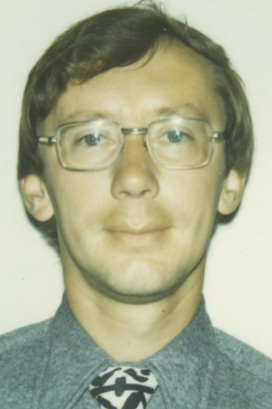

Slide 13
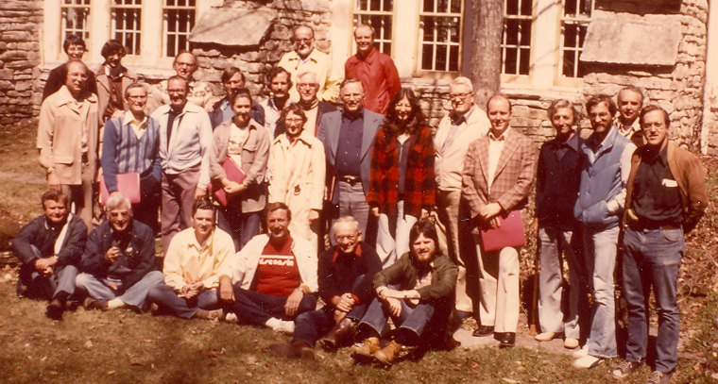

Slide 14
Timeline: 1980’s
1980 | Appleton residency opens Third-year medical student electives first offered
1982 | Dr. Eugene Farley is hired as Chair
1984 | Our Research Division is established Drs. Michael Fleming, Pat McBride and Jim Davis begin to attract major funding
1985 | Wisconsin Research Network (WReN) established by department members
1988 | Outreach and Development Division established with external funds Correctional medicine and Community Oriented Primary Care Projects begun
1989 | St. Luke’s Residency in Milwaukee joins the department

Slide 15
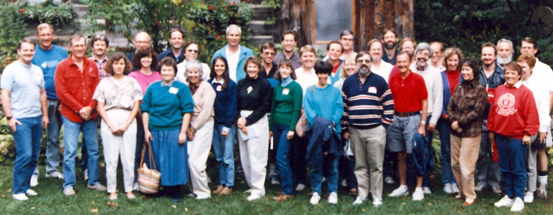
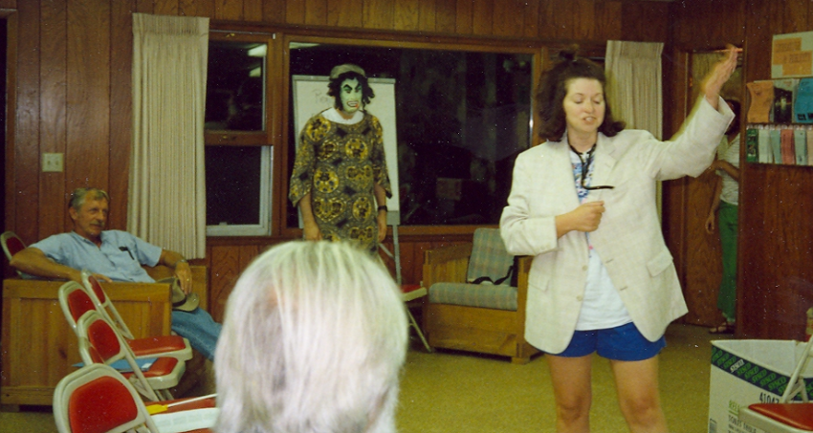
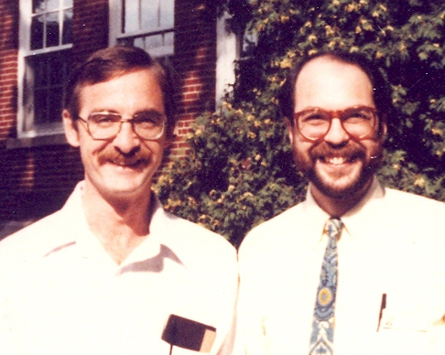

Slide 16
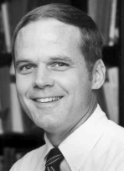
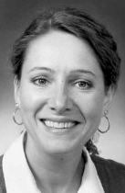
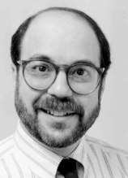
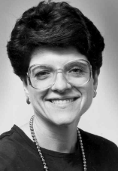
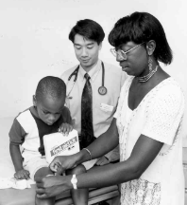
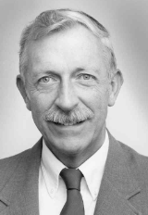
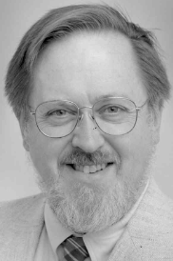
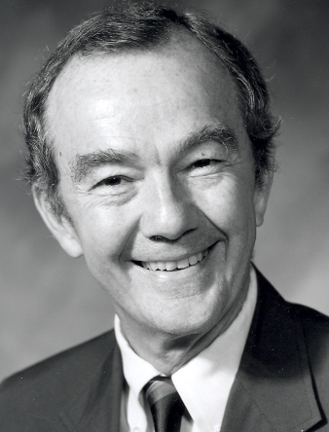
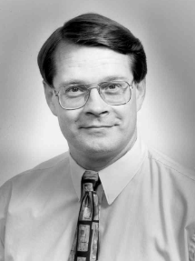
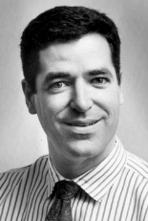
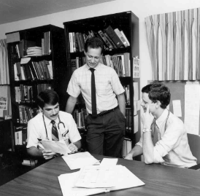
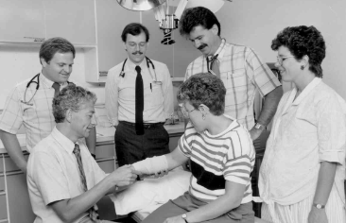
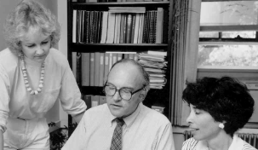

Slide 17
Timeline: 1990’s
1990 | Physician Assistant Program joins department UW Medical School (UWMS) approves a new primary care requirement for third year students
1991 | First Advanced Life Support in Obstetrics (ALSO) Course offered
1992 | Dr. Farley steps down; Dr. Richard Roberts becomes Interim Chair
1993 | Dr. John Frey becomes Chair
1995 | 25th Anniversary
1996 | First Rural Training Track established in Baraboo
1998 | Physician’s Plus Medical Group merges with UWMS adding over 50 practicing physicians to the department Almost every residency clinic in the state is remodeled or rebuilt Research fellowships expanded Department faculty in medical leadership positions in UWMS Department faculty recognized nationally and internationally

Slide 18
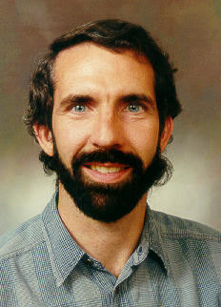
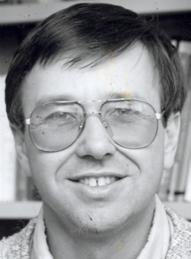
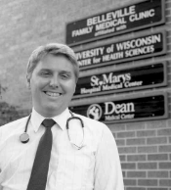
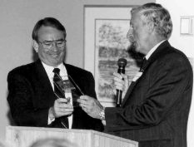
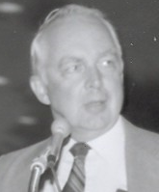
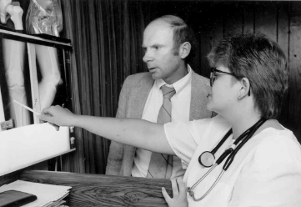






Slide 19








Slide 20












Slide 21











Slide 22
Timeline: 2000’s
2006 | Dr. Frey steps down as Chair. Dr. James Davis serves as Interim Chair
2008 | Dr. Valerie Gilchrist becomes Chair

Slide 23






Slide 24





Slide 25




Slide 26





Slide 27






Slide 28




Slide 29








Slide 30
Timeline: 2010’s
2010 | 40th Anniversary
2015 | The Department is approved to change our name to the Department of Family Medicine and Community Health The Department’s Office of Community Health is created 45th Anniversary Celebration!

Slide 31





Slide 32





Slide 33







Slide 34






Slide 35




Slide 36










Slide 37




Slide 38






Slide 39




Slide 40





Slide 41


