Slide 1
The Evidence Base for Improving Primary Care
_____________________________
Mark W. Friedberg, MD, MPP
March 10, 2014

Slide 2
Outline
Definitions
Conceptual framework
Tour of representative studies
Conclusions
2

Slide 3
Definitions: Evidence, Improving, Primary Care
What do we mean by “Primary Care”?
  Health care providers who are trying to fulfill four cardinal functions of primary care:
    First contact care in the ambulatory setting
    Coordinated care
    Comprehensive care
    Long-term person-focused care
  Near environment for these providers: primary care practices
    Wide range of sizes, specialties, organizational and market contexts, and patient populations
3

Slide 4
Definitions: Evidence, Improving, Primary Care
What do we mean by “primary care”?
What do we mean by “Improving”?
  Four dimensions of improvement:
    Better technical quality and outcomes of patient care
    Better patient experience
    Greater efficiency of care
    Better professional satisfaction among primary care providers
4

Slide 5
Definitions: Evidence, Improving, Primary Care
What do we mean by “primary care”?
What do we mean by “improving”?
What do we mean by “Evidence”?
  Tour, not an exhaustive review
  Sticking to peer-reviewed quantitative and qualitative research of reasonably high quality
5

Slide 6
Conceptual model: repurposing Donabedian*
Structure
Characteristics of individual providers (e.g., credentials) and provider organizations
Process
Care services delivered to patients
Example: process measures of quality
Outcomes
Effects on patient health, patient experience, efficiency of care, and provider experience
*Classic Donabedian framework for quality measurement
6
Donabedian A. Milbank Q 1966;44(3):166-203

Slide 7
Interventions to improve primary care
Structure
Characteristics of individual providers (e.g., credentials) and provider organizations
Process
Care services delivered to patients
Example: process measures of quality
Outcomes
Effects on patient health, patient experience, efficiency of care, and provider experience
Interventions to improve performance in primary care act directly on the structure of primary care practices
It is not possible to act directly on processes or outcomes
This is the difference between a “vision” and an “intervention”
7

Slide 8
Evidence supports structural interventions only when they lead to better outcomes
Structure
Characteristics of individual providers (e.g., credentials) and provider organizations
Process
Care services delivered to patients
Example: process measures of quality
Outcomes
Effects on patient health, patient experience, efficiency of care, and provider experience
?
?
8

Slide 9
Three general categories of evidence on structural interventions
Studies of practices that have developed new structures de novo
  Highly customized
  Addressing problems that the practice prioritizes highly enough to commit scarce resources
Studies of structural changes to practices prescribed by somebody outside the practice
Studies of environmental/contextual factors that help or hinder approaches #1 and #2
9

Slide 10
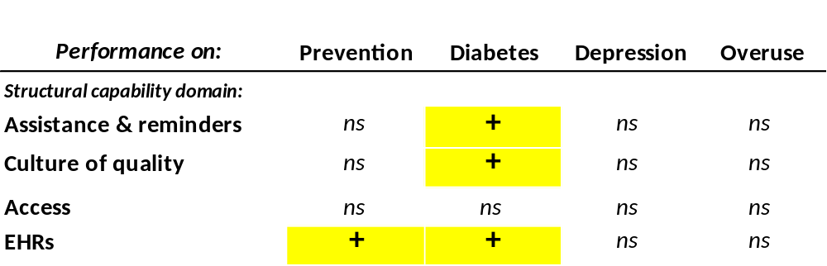
De novo interventions: How much do individual structural capabilities matter?
Analysis of ~300 Massachusetts primary care practices in 2007 showed…
+ = significant positive association for ≥1 individual capability
ns = no significant associations for any individual capability
Friedberg MW, et al. Associations between structural capabilities of primary care practices and performance on selected quality measures. Ann Intern Med 2009;151:456-63.

Slide 11
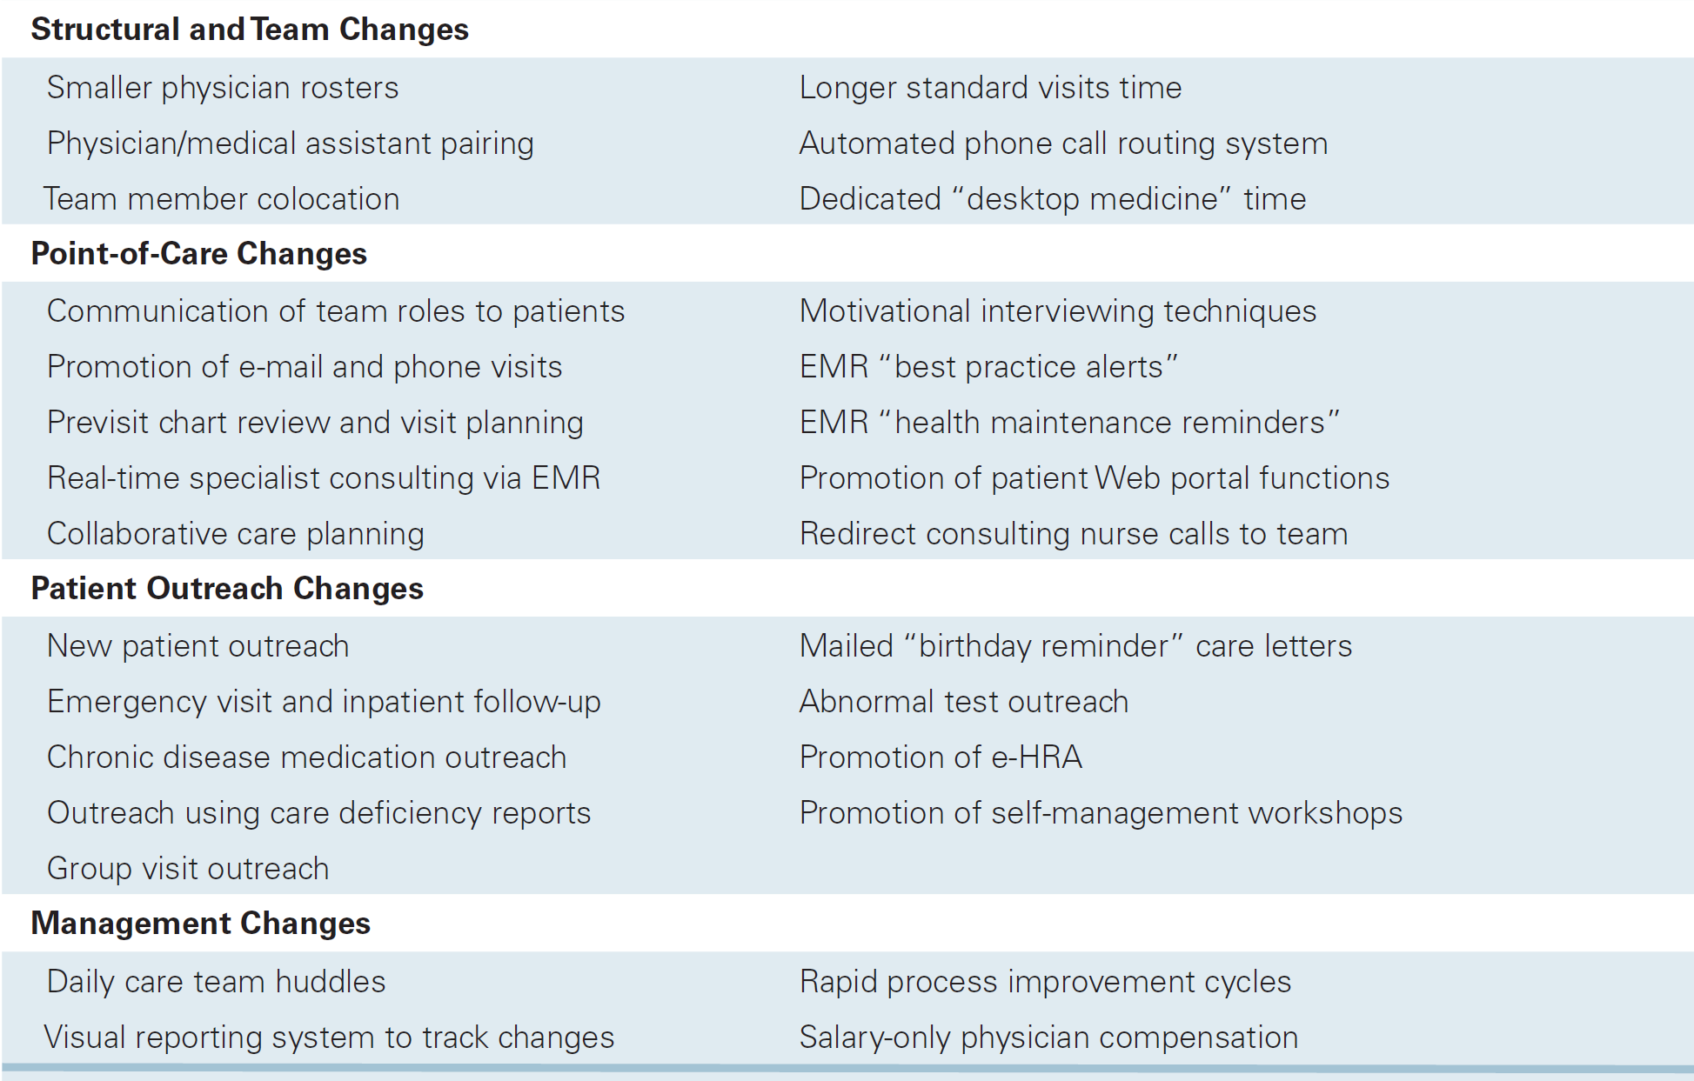
De novo intervention: Group Health Collaborative
Reid RJ, et al. Patient-centered medical home demonstration: a prospective, quasi-experimental, before and after evaluation. AJMC 2009;15(9):e71-87.
11

Slide 12
De novo intervention: Group Health Collaborative
There were improvements on all 4 dimensions by the second year of the intervention
  Higher quality (global composite)
  Better patient experience (nearly all scales)
  Estimated savings $10 per patient per month
  Less provider burnout
A grand slam!
  …in one practice
  …but has this been replicated?
  …and does it really look like more widespread medical home interventions?
Reid RJ, et al. The Group Health medical home at year two: cost savings, higher patient satisfaction, and less burnout for providers. Health Aff 2010;29(5):835-843.
12

Slide 13
Prescribed within-practice interventions:
Medical homes
Many medical home pilots in the United States underway
Key components:
  New resources for primary care practices
    Technical assistance
    In-kind contributions
    Enhanced payment
  New requirements
    Practice transformation
    Demonstrate “medical homeness”
Reid RJ, et al. The Group Health medical home at year two: cost savings, higher patient satisfaction, and less burnout for providers. Health Aff 2010;29(5):835-843.
13

Slide 14
Prescribed within-practice interventions:
Medical homes
Two recent, rigorous evidence reviews reached the same conclusions:
  Small to moderate improvements in some measures of technical quality and patient experience (moderate strength of evidence)
  Moderate improvement in provider experience (low strength of evidence)
  Reduction in ED but not hospital utilization (low strength of evidence)
  Scant evidence on costs
These reviews included “proto-PCMH” interventions, before the current wave of evaluations began to report findings
Peikes D, Zutshi A, Genevro JL, Parchman ML, Meyers DS. Early evaluations of the medical home:
building on a promising start. Am J Manag Care. 2012;18(2):105-116.
Jackson GL, Powers BJ, Chatterjee R, et al. The patient-centered medical home: a systematic review. Ann Intern Med. 2013;158(3):169-178.
14

Slide 15
Southeast Region of the Pennsylvania Chronic Care Initiative (PA CCI)
32 practices, 6 payers, 3-year intervention: June 2008 - 2011
Key components
  Inputs:
    Technical assistance from the state
      Teaching practices to apply Chronic Care model, PCMH
      Focused on diabetes for adults, asthma for children
    Incentive payments
  Requirements:
    Obtain NCQA medical home recognition (level 1 or higher) within first 12 months
    Participate in learning collaborative and report registry-based performance data
15

Slide 16
PA CCI Southeast Region Enhanced Payments
$20K per-practice infrastructure fee in year 1
Annual payment per physician or CRNP upon certification
NCQA recognition incentivized heavily
  Actual payments also depend practice payer mix
  Overall, average enhanced payment was $92,000 per FTE PCP over the 3 years (range, $21,000 – $152,000)
 | Practice Size
NCQA status | 1 PCP FTE | 2-4 PCP FTE | 5-9 PCP FTE | 10-20 PCP FTE
Level 1 Recognition | $40,000 | $36,000 | $32,000 | $28,000
Level 2 Recognition | $60,000 | $54,000 | $48,000 | $42,000
Level 3 Recognition | $95,000 | $85,500 | $76,000 | $66,500
16

Slide 17
Among Pilot Practices, There Was Structural Transformation Targeting Quality
All changes significant at P<0.05
17

Slide 18
Impact on Patient Care: Summary of Findings
Domain | Findings
Quality (HEDIS) | Statistically significant improvement on 1 process measure of diabetes care (nephropathy monitoring) Non-significant trends towards improvement on 3 additional process measures of diabetes care No differences for measures of diabetes disease control or screening
Utilization | No statistically significant differences
Costs | No statistically significant differences
Friedberg MW, Schneider EC, Rosenthal MB, Volpp KG, Werner RM. Association between participation in a multipayer medical home intervention and changes in quality, utilization, and costs of care. JAMA 2014;311(8):815-825 .
18

Slide 19
Conclusions: Southeast PA
In a relatively large and well-resourced multi-payer medical home pilot, participating practices achieved structural transformation and NCQA recognition
Effects on patient care were limited
  Improvement on process measures of diabetes care
  No changes on measures of utilization or costs
Results similar to those in other recent evaluations of early medical home pilots:
  Werner RM, et al. The patient-centered medical home: an evaluation of a single private payer demonstration in New Jersey. Med Care. 2013;51(6):487-493
  Fifield J, et al. Quality and efficiency in small practices transitioning to patient centered medical homes: a randomized trial. J Gen Intern Med. 2013;28(6):778-786
  Rosenthal MB, et al. Effect of a multipayer patient-centered medical home on health care utilization and quality: the Rhode Island chronic care sustainability initiative pilot program. JAMA Intern Med. 2013;173(20):1907-1913
19

Slide 20
Studies of environmental/contextual factors
ACO and medical neighborhood pilots underway
In the meantime, two recent qualitative reports have identified facilitators and barriers to improvement
  Sinsky: Joy In Practice report (2013)
    Dr. Sinsky will be speaking with you tomorrow
  RAND/AMA: Factors affecting physician professional satisfaction and their implications for patient care, health systems, and health policy (2013)
    I’ll talk about this now
20

Slide 21
RAND/AMA study of physician professional satisfaction
Collecting data from 30 practices in 6 states
Over 200 qualitative interviews: in-depth data collection allowed detection of unanticipated findings
Quantitative surveys to further explore qualitative results
Size |  | Specialty |  | Ownership
Large (>50 physicians) | 9 | Multi-specialty | 15 | Physician-owned or partnership | 19
Medium (10-49) | 11 | Primary care | 10 | Hospital or other owner | 11
Small (<9) | 10 | Single specialty | 5
21

Slide 22
Perceived Quality of Care is Closely Related to Professional Satisfaction
Being able to provide high-quality patient care is satisfying to physicians
Obstacles to high-quality care are major sources of dissatisfaction
Similar results in quantitative analysis
  Significant predictors of better satisfaction:
    Feeling like it’s possible to provide high quality care
    Practice tries out ideas to improve quality
    Receiving useful feedback about quality of care
  Feeling overwhelmed by patient needs predicted significantly worse overall professional satisfaction
22

Slide 23
Perceived Quality of Care is Closely Related to Professional Satisfaction
Being able to provide high-quality patient care is satisfying to physicians
Obstacles to high-quality care are major sources of dissatisfaction
Physicians as “canaries in the coal mine” for quality
  Sources of dissatisfaction can also be threats to quality
    Investigate and verify what physicians are saying
  Solutions not just important to physicians
Practices need more slack to improve, or even maintain performance
23

Slide 24
EHRs: Both Positive and Negative Effects
EHRs improve professional satisfaction in 3 main ways
  Better access to patient data (within a single EHR)
  Improve some aspects of quality
  Better communication within the practice
With [hundreds of] docs, I’m able to look at anybody’s note, anytime, on any patient that I’m interested in or that has seen me for something. I think [the EHR] just erases a lot of potential for medical errors and so forth because everything is clearly documented, [and] there’s not handwriting issues and so forth.
—orthopaedic surgeon
24

Slide 25
EHRs: Both Positive and Negative Effects
EHRs improve professional satisfaction in 3 main ways
The current state of EHR technology worsens professional satisfaction in several ways
  Time-consuming data entry
  User interfaces do not match clinical workflow
  Interference with face-to-face patient care
  Lack of health information exchange between EHRs
  Information overload
  Expensive, threatening practice finances
  Inefficient and less fulfilling work content
  Template-based notes degraded the quality of clinical documentation
25

Slide 26
EHRs: Both Positive and Negative Effects
EHRs improve professional satisfaction in 3 main ways
The current state of EHR technology worsens professional satisfaction in several ways
  What’s really happened since going on [the EHR] is that I’ve really taken on the responsibility of transcription as well as billing, in addition to the other things… It’s given me more mundane clerk-like duties to do. The derogatory term, I guess, in residency, was “scutwork.” And that’s what [the EHR] has done.
  —primary care physician
26

Slide 27
EHRs: Both Positive and Negative Effects
EHRs improve professional satisfaction in 3 main ways
The current state of EHR technology worsens professional satisfaction in several ways
  Every screen’s got 50 different things, you know, that are changing. It slows me down. So, I do a lot of my charting at night. …But, the problem is I’m spending more hours doing it than I would have before. We have Dragon, which you have to be careful of, because I just [dictated] a ‘Patient’s prostate is bothering him’ and it turned out ‘Patient’s prostitute is bothering him.’ You really have to read that carefully, because I can end up going to court with that stuff.
  —primary care physician
27

Slide 28
EHRs: Both Positive and Negative Effects
EHRs improve professional satisfaction in 3 main ways
The current state of EHR technology worsens professional satisfaction in several ways
  As with all electronic medical records, I greatly dislike the document that’s produced. … We have been forced to abandon [a way of documentation] that was always very effective and very succinct. … These new documents are unreadable because you’ve got to skim through them really quickly and say “Where’s the meat here?”
  —cardiologist
28

Slide 29
Putting it all together
The origins of improvement efforts may be important to their effectiveness
Efforts originating within practices: likeliest to successfully improve on all desired dimensions?
  But most practices probably need resources, customized guidance, and enough organizational slack to do meaningful change
  In primary care, creating slack probably means a substantial departure from fee-for-service payment (a la Group Health)
29

Slide 30
Putting it all together
More prescriptive, uniformly applied approaches haven’t done as well so far, possibly because they:
  reach or exceed the limits of what can be pre-specified, given the heterogeneity of primary care practice
  limit practices’ ability to customize solutions to local needs
  actually degrade performance when changes that are poorly designed or mismatched to practices’ pre-intervention states are pushed out with strong incentives
30

Slide 31
Thank you
Contact:
Mark Friedberg, MD, MPP
mfriedbe@rand.org
31

Slide 32
Advice for navigating the medical home policy space
When people say “medical home,” ask what they mean, exactly
  A theoretical concept?
  A real-world intervention? What are the ingredients?
  There are many definitions. Don’t assume two people talking about the “medical home” are talking about the same thing.
32

Slide 33
Advice for navigating the medical home policy space
When people say “medical home,” ask what they mean, exactly
When you hear about medical home “evidence,” scrutinize the intervention and the methods
  What definition of “medical home” was studied?
  Are the methods credible? Are they even published?
  Don’t rely on summaries and abstracts. Get into the weeds.
33

Slide 34
Advice for navigating the medical home policy space
When people say “medical home,” ask what they mean, exactly
When you hear about medical home “evidence,” scrutinize the intervention and the methods
Pay attention to health system context
  The strongest evidence in favor of primary care comes from area-level studies
  Primary care medical homes may need cooperation from hospitals, subspecialists, etc.
    “Medical neighborhood”
    Accountable care organizations, or other large providers taking global payment
34

