Slide 1

Human Factors Contributions to
Patient and Family Engagement
Richard J. Holden, PhD
Vanderbilt University
3.11.14

Slide 2
Human factors contributions…
Human factors can contribute
to healthcare what it has done for aviation, nuclear power, etc.
Human factors can contribute to primary care what it has done for aviation, nuclear power, etc.
Human factors can contribute to patients and families what it has done for professionals (pilots, MDs, RNs, etc.)
2

Slide 3
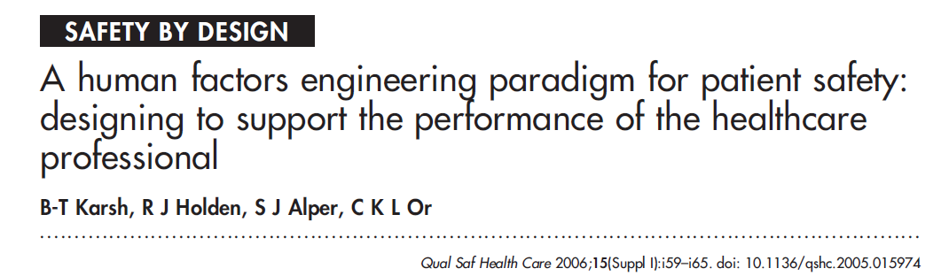
Human factors
“The road to patient safety runs through the provider, so design work systems to support performance and hazard reduction: an alternative patient safety paradigm”
3

Slide 4
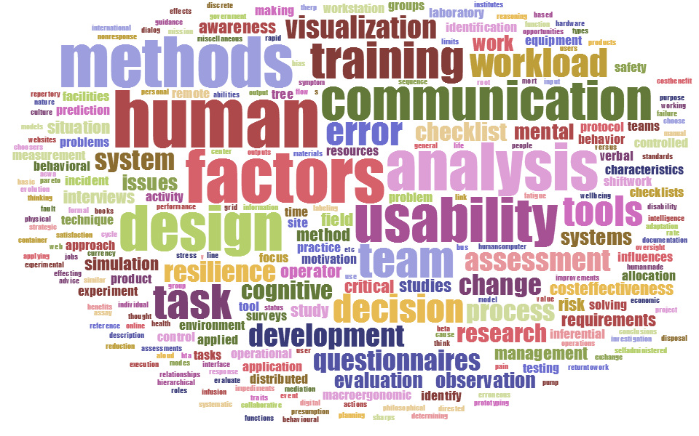
Human factors methods
(Gawron, 2000; Stanton et al, 2013; Wickens et al, 2004; etc.)
Source: Word cloud of tables of content for human factors methods books and chapters (edited)
4

Slide 5
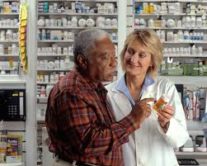
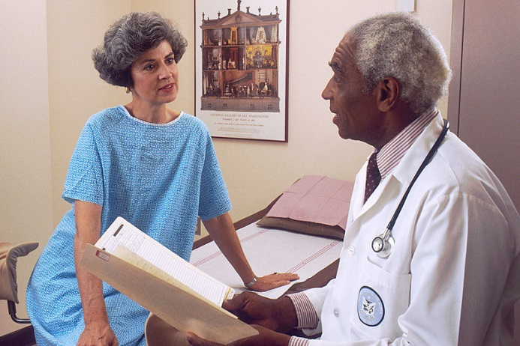
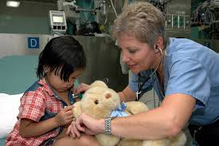
-
Human factors
5

Slide 6
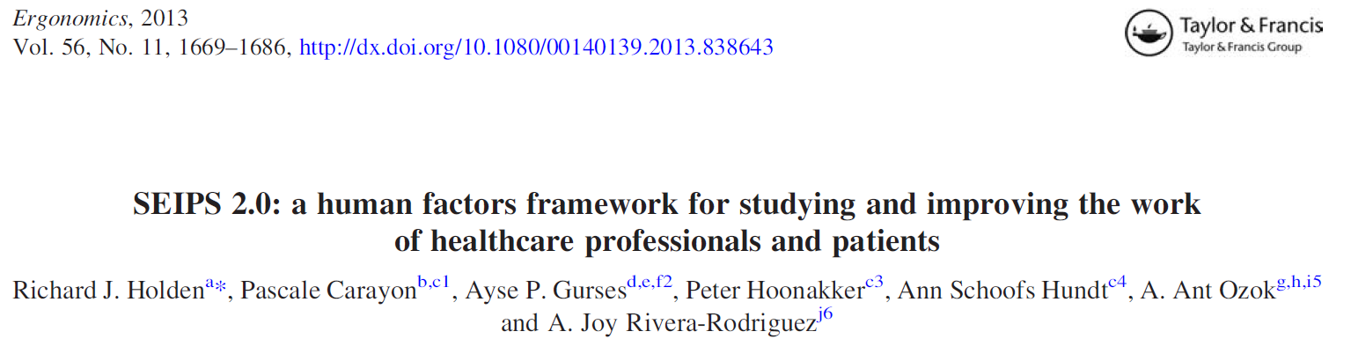
Human factors
6

Slide 7
“SEIPS 2.0”
[Systems Engineering Initiative for Patient Safety]
Holden, R. J., Carayon, P., Gurses, A. P., Hoonakker, P., Hundt, A. S., Ozok, A. A., & Rivera-Rodriguez, A. J. (2013). SEIPS 2.0: A human factors framework for studying and improving the work of healthcare professionals and patients. Ergonomics, 56(11), 1669-1686.

Slide 8
Patient-engaged human factors
Patient-engaged human factors
“The application of human factors
theories and principles, methods and tools, analyses, and interventions
to study and improve
work done by patients and families,
alone or in concert with healthcare professionals.”
(Holden & Mickelson, 2013; Holden et al., 2013)
8

Slide 9
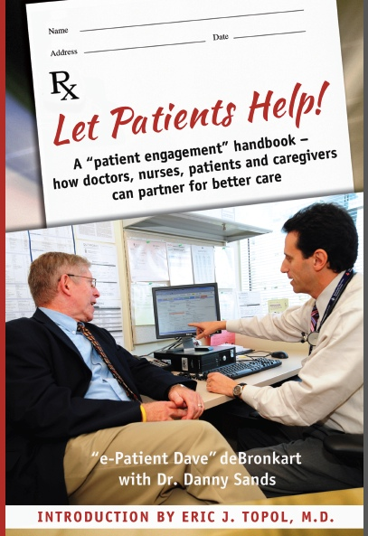
Patient-engaged human factors
9

Slide 10
Patient-engaged human factors
Patients can (and should) be “empowered, engaged, equipped, enabled”
Patients and families are the most underused resource in healthcare
Healthcare is shifting away from the paternalistic model (culturally & legally)
There are ongoing efforts to support patient engagement, including through electronic tools
Patients and family members already engage in decision making, information management, etc.
AMA Code of Medical Ethics
  1847 (original): The obedience of a patient to the prescriptions of his physician should be prompt and implicit. He should never permit his own crude opinions . . . to influence his attention to them.
  2012-13 (current): Physician and patient are bound in a partnership that requires both individuals to take an active role in the healing process
10

Slide 11

Patient-engaged human factors
Help patients help!
Help patients work!
11

Slide 12
Patient-engaged human factors
Not new, but much needed
  Patient-clinician-technology trust, communication (Montague)
  Family-centered pediatric rounds (Carayon, Cox)
  Patient health information search (Marquard)
  Human factors of home care and IT (Zayas Cabán, Brennan, Valdez)
  User-centered IT design to support med adherence (Ozok, Siek)
  HF design of labels, charts, reminders for ill elderly (Morrow)
  Control theory applied to diabetes self-management (Altman Klein)
  Resilience engineering and medication taking (Furniss, Barber)
  Care pathways for chronically ill elderly (Waterson, Eason)
  Use, usability of personal health records (Czaja, Pak)
  Technology for aging in place (Rogers, Fisk, Mitzner)
  Instructional design and education for patients (McLaughlin)
  Etc.
12

Slide 13
(Five) contributions of human factors
to patient and family engagement
The systems model
Work/task/process analysis
Workload and situation awareness tools
Teamwork-facilitating methods
Incident capture and analysis
Physical ergonomics, load stress evaluation, facilities dx
Individual/team training, expert/novice differences
Adaptive automation, augmented reality
Human-computer interaction, user interface design
User-centered design process, usability testing
Simulation, VR, microworlds
(& lots more!)
13

Slide 14
(Five) contributions of human factors
to patient and family engagement
The systems model
Work/task/process analysis
Workload and situation awareness tools
Teamwork-facilitating methods
Incident capture and analysis
Outpatients with heart failure
NIA/NIH K01AG044439, PI: Holden
Patients and family members
describing nonroutine episodes of care
PCORI IP2 PI000072-01, PI: Weinger
14

Slide 15



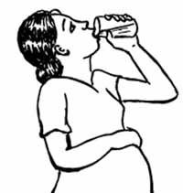




#1. The systems model
Hazards/barriers to optimal self-care adherence?
Vs.
External
Environment
15

Slide 16
Barriers to self-care (from > 3100 references)
#1. The systems model
Barrier | # barrier subtypes | % pts w/ barrier (N=30) | Avg. # per patient
Person (patient) | 63 | 100% | 40.3
Person (caregiver) | 17 | 67% | 5.5
Task | 22 | 100% | 10.4
Tool/technology | 17 | 83% | 5.8
Physical-spatial | 13 | 83% | 3.8
Socio-cultural | 14 | 90% | 4.9
Organizational | 41 | 100% | 17.0
Interaction | 22 | 93% | 7.7
Total = 209
(Holden & Mickelson, 2013)
16

Slide 17
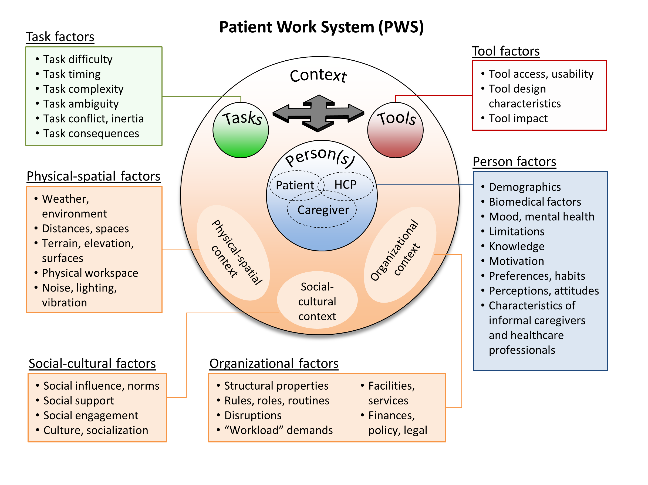
Self-care performance is shaped by specific
“work system” factors
17

Slide 18
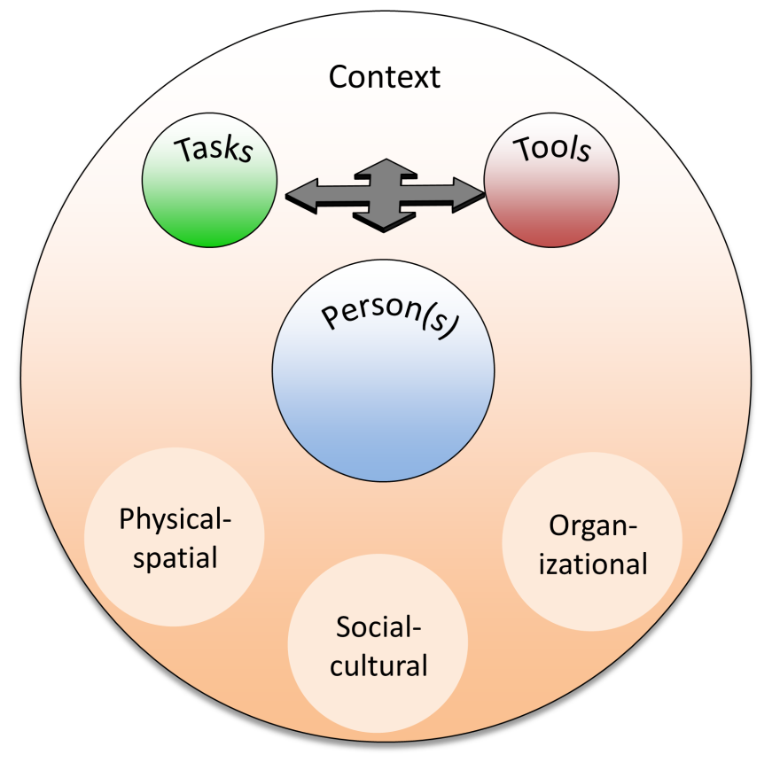
An 85 year old woman with heart failure
1
Although she knows importance of exercise
2
and is motivated to exercise,
3
walking is difficult for the patient
4
due to physical impairment and fatigue.
3
5
7
5
However, she can swim
6
and has access to an outdoor community pool.
Patient
Son
7
Although she has no car,
1
4
8
2
8
her son drives her there in the summer.
9
6
When the weather gets cold,
9
12
10
this outdoor pool is closed.
10
11
She does have access to a local gym w/ pool.
11
12
However, she chooses not to go there because the gym’s other patrons tend to be younger and she is self-conscious about what they will think when they see all her surgical scars.
#
facilitating factor
#
impeding factor
18

Slide 19
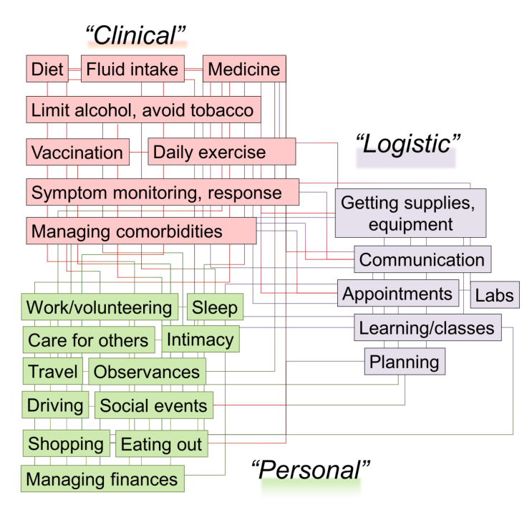
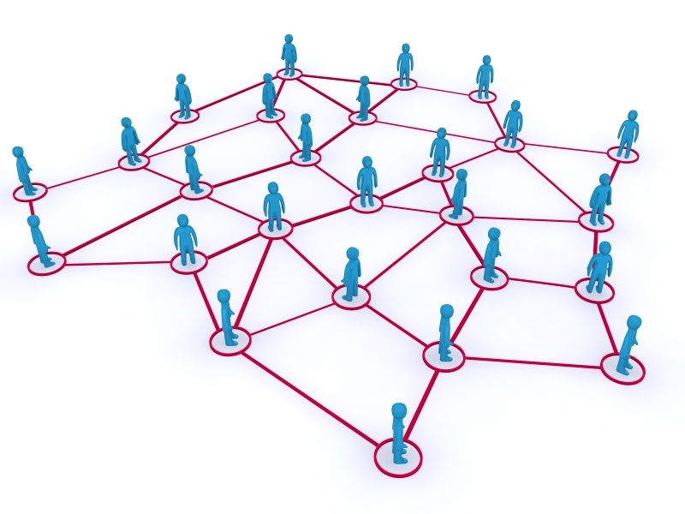
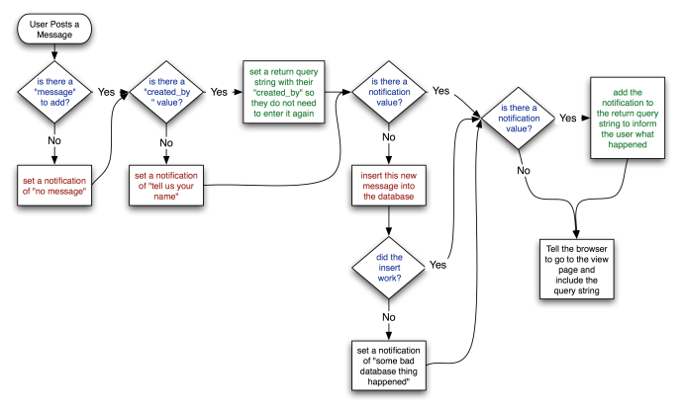
#2. Work/task/process analysis
What do patients and families do? How? When? Why? Where? With whom?
What are key variances?
19

Slide 20
#2. Work/task/process analysis
Wake up
Go out for day
Weigh self
Drink coffee
Take meds
Check for swelling
home
Go to sleep
Prepare meal
Other vitals
Bath-room
Write down
Extra diuretic
Sleep
Caregiver
Take meds
Wake

Slide 21
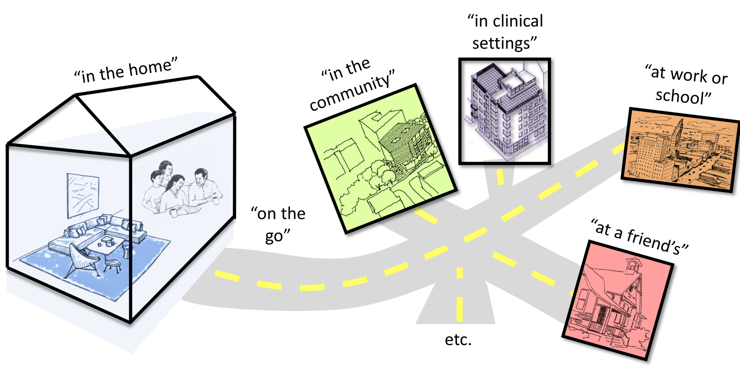
#2. Work/task/process analysis
21

Slide 22
#2. Work/task/process analysis
22

Slide 23
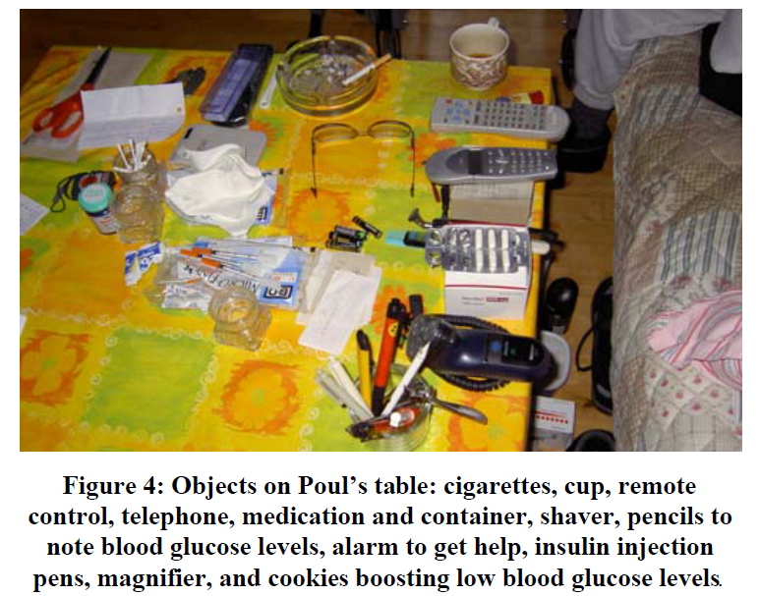
#2. Work/task/process analysis
Aarhus & Ballegaard, 2010
23

Slide 24
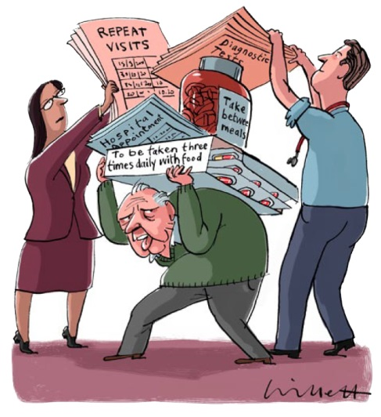
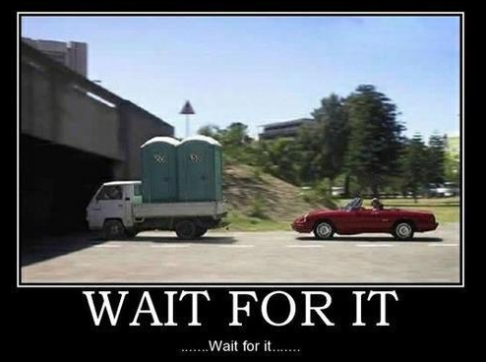
#3. Workload and situation awareness
What are the demands on patients/families, relative to available resources?
How aware are patients/families of what happened, what is happening, what might happen? Can we optimize workload and situation awareness?
(May et al, 2009)
24

Slide 25

#3. Workload and situation awareness
Demands
Work volume
Work complexity
Time required
Number of tasks
Inefficiency
(Situational)
Constraints
Distractions
Task switch cost
Processing costs
Task complexity, timing
Task conflict
Resources
Assistance from others
Time, energy
Skill/abilities
Technology
Simplifying routines
Familiarity/expertise
Holden et al, 2010
25

Slide 26
#3. Workload and situation awareness
Demands
Work volume
Work complexity
Time required
Number of tasks
Inefficiency
(Situational)
Constraints
Distractions
Task switch cost
Processing costs
Task complexity, timing
Task conflict
“I started coming out here, taking my blood pressure, taking my weight, and sugar count, so forth 'til I feel like a secretary… it aggravates the fool out of me. I get up in the mornings, it takes me 30 minutes to put my clothes on, get all my scales, and get into the kitchen at my little table back there I've got, and take all this stuff, pressures, blood pressures, uh, sugar count, and I, I ought to get me a degree, you know, I, I'm almost a doctor.”
Resources
Assistance from others
Time, energy
Skill/abilities
Technology
Simplifying routines
Familiarity/expertise
26

Slide 27
#3. Workload and situation awareness
Situation awareness
“The perception of elements in the environment within a volume of time and space, the comprehension of their meaning, and the projection of their status in the near future“ (Endsley, 1995)
or
“What? So what? Now what?” (Tenney & Pew, 2006)
27

Slide 28

#3. Workload and situation awareness
“I was in the ER (emergency room) one time with a horrible case of strep throat, and my throat was literally closing up. And the nurse just came in and she gave me an IV, and some pills, and said, “I'll come back and check on you,” right?
And I got to the point where if I leaned back, I couldn't breathe at all. I had to sit up to breathe.
So, I literally, I mean, I was in there probably an hour just sitting by myself, and I had a pad, and I wrote out, “What do we do when I cannot breathe anymore?”
What do we do when I cannot breathe anymore??

Slide 29
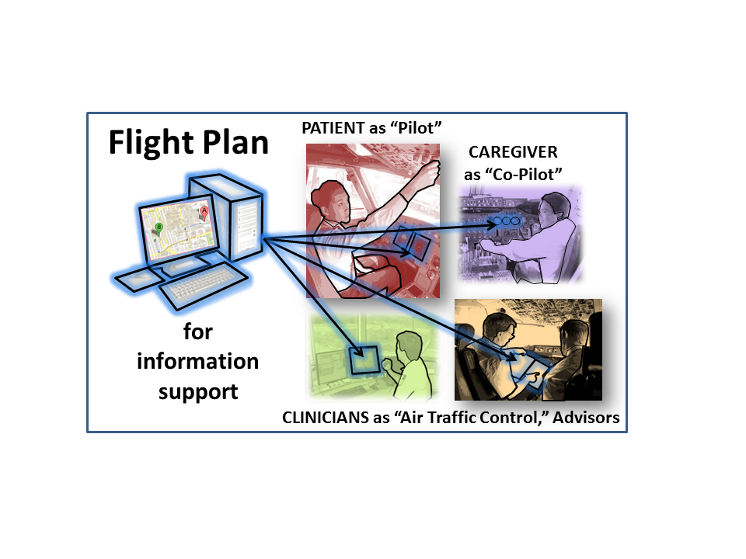
#4. Teamwork-facilitating methods
Are patients and families truly part of a “team” with professionals?
How can patient/family-professional collaboration be measured, improved?
29

Slide 30
#4. Teamwork-facilitating methods
Characteristics of successful teams (Salas et al., 2000, 2008)
Characteristic | Are we there yet? | Can HFE help?
Interdependence | ❐ | ☑
Common goals | ❐ | ☑
Shared situation awareness | ❐ | ☑
Common ground (e.g., shared lingo, ideas) | ❐ | ☑
Strong coordinating mechanisms | ❐ | ☑
Leadership-subordination | ❐ | ☑
Reliable communication systems | ❐ | ☑
Specific, timely, reliable feedback | ❐ | ☑
Adaptable, flexible | ❐ | ☑
Strong interpersonal relations | ❐ | ☑
Deference to expertise during decisions | ❐ | ☑
…
30

Slide 31
#4. Teamwork-facilitating methods
Nurse: Using your Spiriva inhaler?
Patient: Yeah....that's blue, ain’t it?
Nurse: I don't know.
Patient: Yeah, only though, not like the blue one all the time. What you call it?
Nurse: I don't know. I don't, I don't know what those look like.
MD: So mom says she needs...
Patient: Maximillistine, I can’t say it, you know.
MD: Well, it’s Maxaltine, but you’re not on that.
Patient: I can’t say it....I have to take it twice a day, it’s supposed to be three times, I take it twice a day. It’s orange and kind of brown.
31

Slide 32
#5. Incident capture and analysis
What kind of nonroutine events do patients and families report?
Intervention
(Rescue or Recovery)
R I S K
Adverse
Outcome
Deviation from
Optimal Care
O P T I M A L C A R E P A T H
“Optimal”
Outcome
Performance Shaping Factors
Non-Routine
Event (NRE)
32

Slide 33

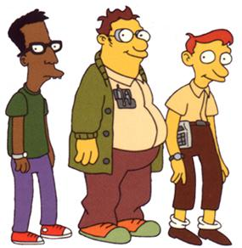
Good news/bad news
about human factors contributions to patient engagement
“The extent to which human factors research is incorporated into home-based devices, technologies, and practices will have a big influence on whether greater reliance on home health care proves to have beneficial or detrimental effects on people’s lives.”
(National Research Council, 2011)
“There are many resources available from other disciplines to help healthcare move to where it needs to be in terms of patient engagement … There are some great minds working in this space, including behavioral economists, user experience designers, community leaders, interaction designers, software developers and game designers, risk managers, data scientists, and actuaries.”
(Kish, 2012)
At least as useful as actuaries!
33

Slide 34






Thank you!
Questions?
Rich Holden, PhD, richard.holden@vanderbilt.edu
Our R&D Team
Chris Schubert, PhD
Robin Mickelson, MS, RN
Tony Threatt, PhD
Courtney Thomas, MA
Amanda McDougald Scott, MS
Russ Beebe,
MA

Slide 35
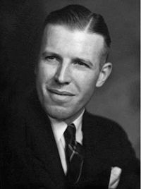
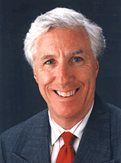
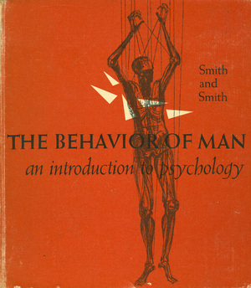

Human work performance
(1) Occurs in context & (2) Is adaptive
“We begin our adventure into the science of psychology not in the laboratory but at home, at school, at work, in all of the familiar life situations.
…
Human behavior involves a continuing series of adjustments … We can learn much by examining these adjustments as they occur in their natural settings.”
Karl Ulrich (K.U.) Smith
Michael J. Smith
Ben-Tzion Karsh
me
K.U. Smith & W.M. Smith, 1958

