Slide 1
Health Systems Leaders Panel
2013 Wisconsin Health Improvement and Research Partnerships Forum
September 13, 2013

Slide 2
Our Panelists
Bruce Van Cleave, MD, Chief Clinical Officer Aurora Health Care
Adam H. Balin, MD, Medical Director Primary Care Western Region, Dean Health Systems
Bill Priest, Chief Administrative Officer Mayo Clinic Health Systems

Slide 3
Goal
Promote an active dialogue between Forum attendees and the leaders of Wisconsin health systems surrounding issues of :
  mutual cooperation and
  collaboration in health research and practice.

Slide 4
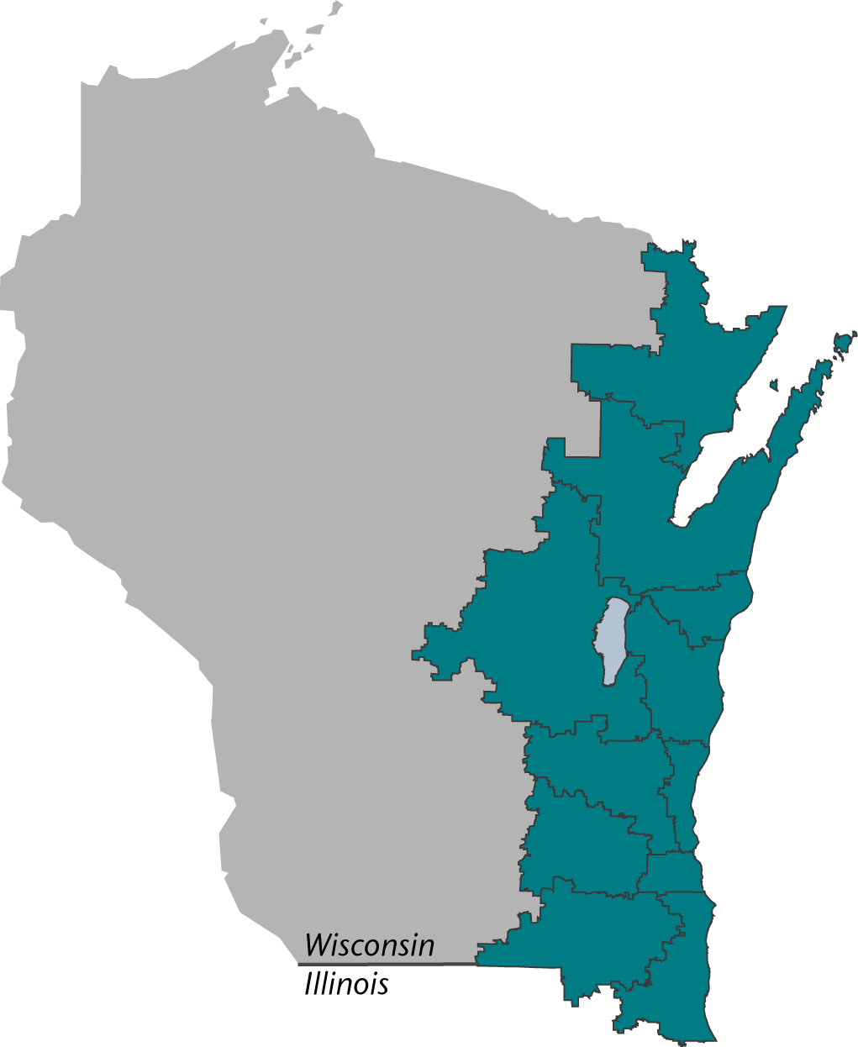
Aurora Health Care at a Glance
  Private, not-for-profit integrated health care provider
  31 counties, 90 communities
  15 hospitals
  159 clinic sites
  70 retail pharmacies
  30,000 caregivers - including 1,500 employed physicians
  Largest homecare organization in Wisconsin
  More than 1.2 million unique patients
  7.8 million patient encounters
  $4.1 billion in annual revenue

Slide 5
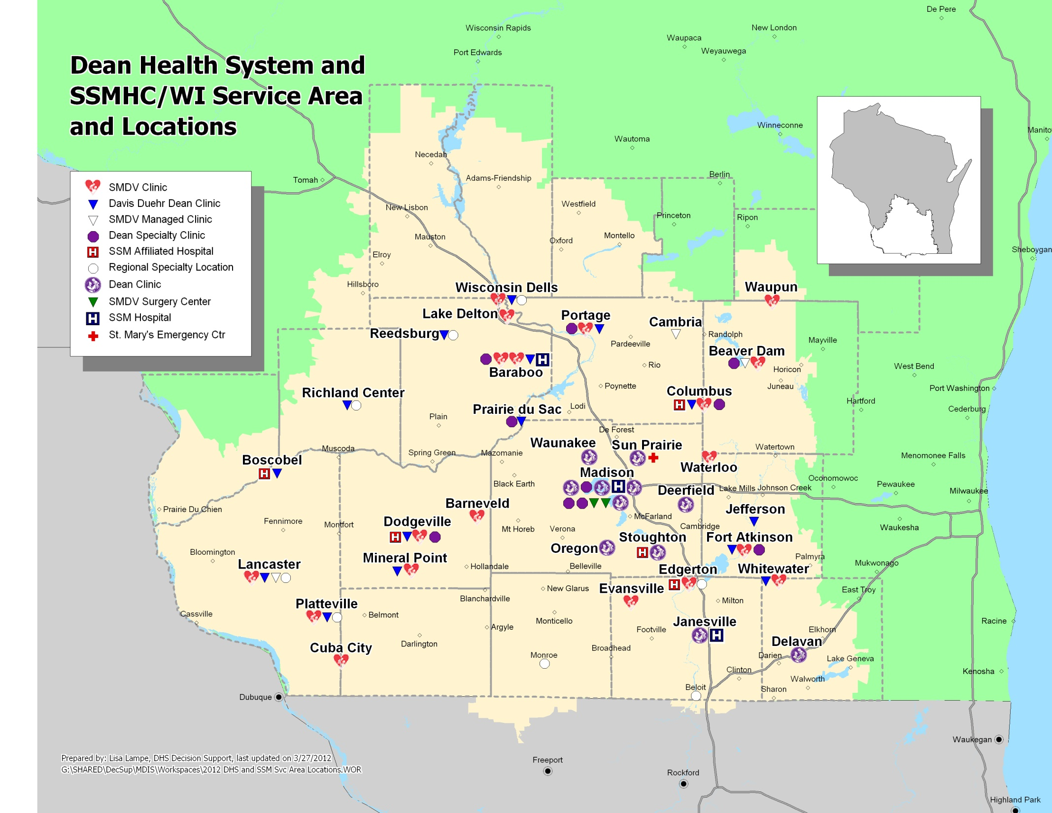
65 Clinics
786 Providers
~ 1 Mil Ambulatory Visits/year

Slide 6
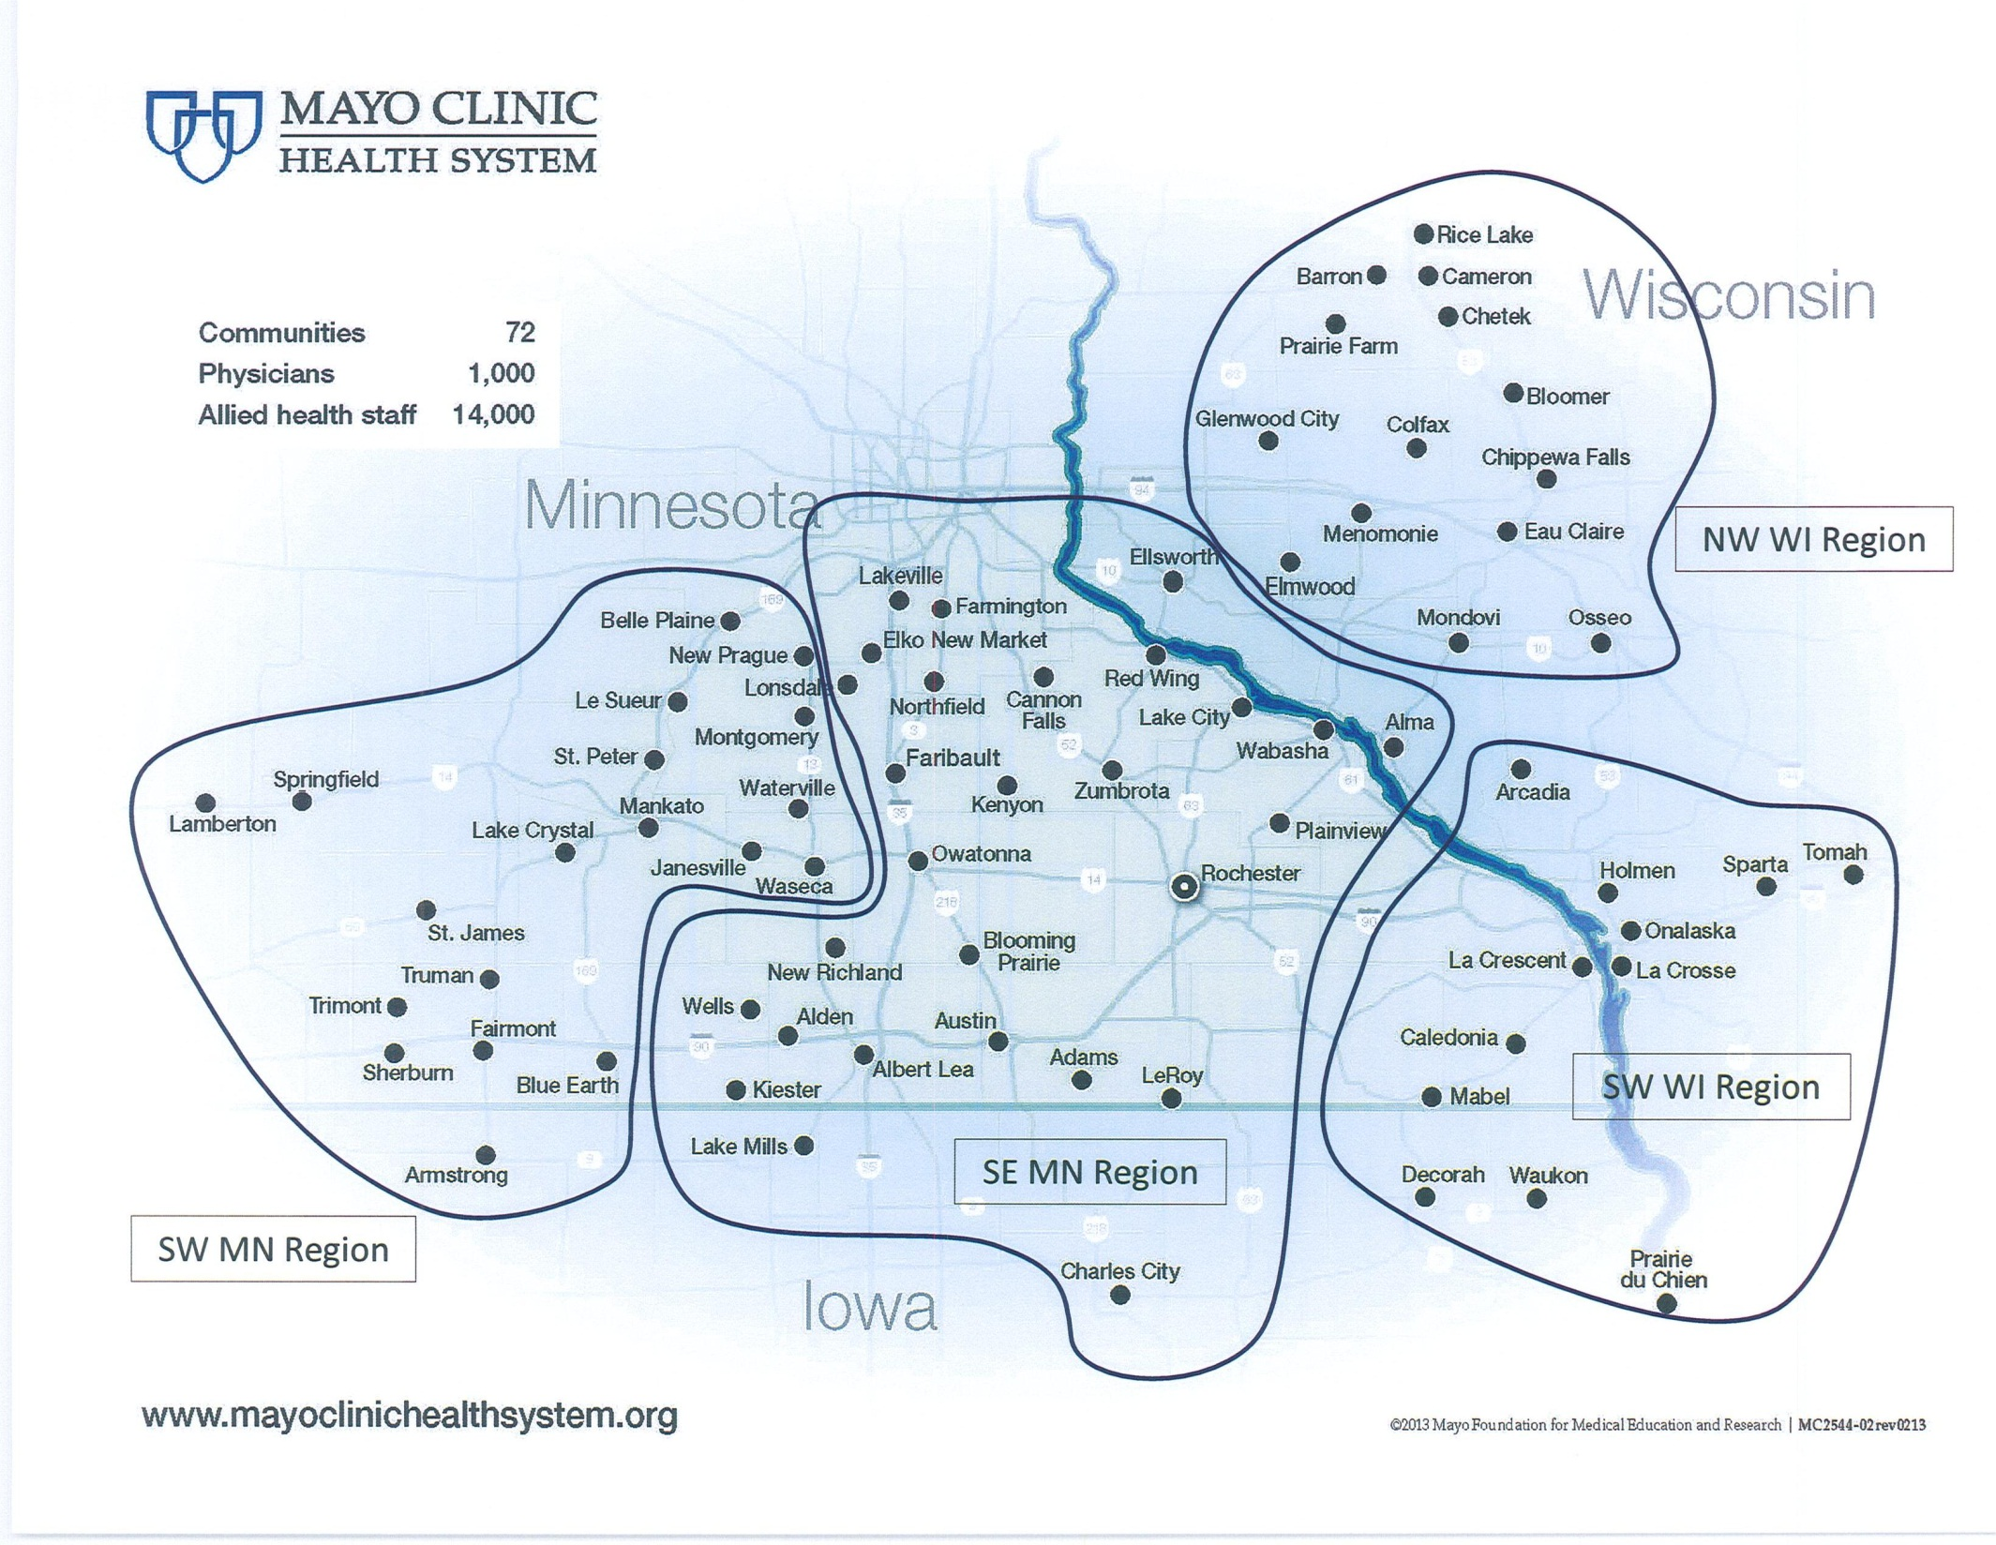

Slide 7
Questions & Discussion

