Slide 1

WREN’s 2014 Convocation
Glacier Canyon Lodge
Wilderness Hotel & Resort
Wisconsin Dells, WI
September 17-19, 2014

Slide 2
PBRNs: Past, Present and Future
John Hickner, MD, MSc
Chair, Family Medicine
University of Illinois at Chicago
School of Medicine

Slide 3
Outline
Past
Present
Future
Context and Change

Slide 4
The Times They Are A Changin’
Come gather 'round people
Wherever you roam
And admit that the waters
Around you have grown
And accept it that soon
You'll be drenched to the bone.
If your time to you
Is worth savin'
Then you better start swimmin'
Or you'll sink like a stone
For the times they are a-changin'

Slide 5


Slide 6
PBRNs Past

Slide 7


Slide 8
GP pioneers of practice based research
Sir James Mackenzie (1853-1925)
  Discovered PVCs
Will Pickles (1885-1969)
  Epidemiology in Country Practice
John Fry (1922-1994)
  Common Diseases
Frances Huygen (?)
  Family Medicine: The Medical Life History of Families
Curtis Hames (1920-2005)
  Evans County Cardiovascular Studies

Slide 9
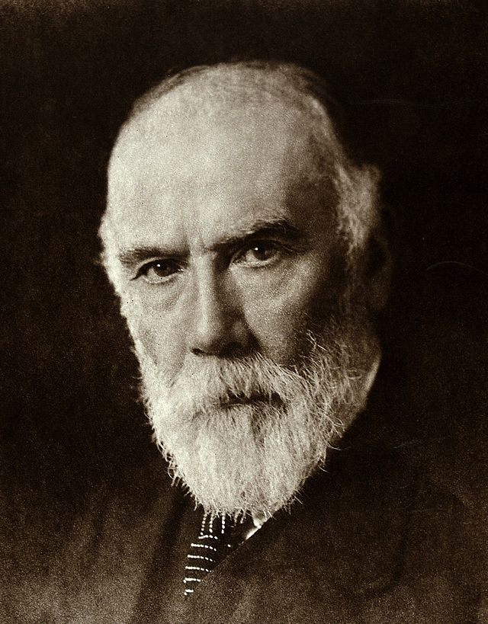
Sir James Mackenzie

Slide 10
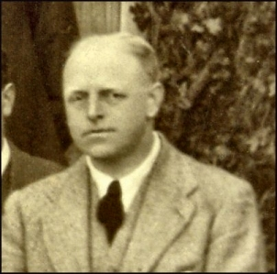
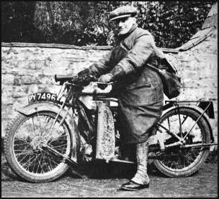
Will Pickles

Slide 11
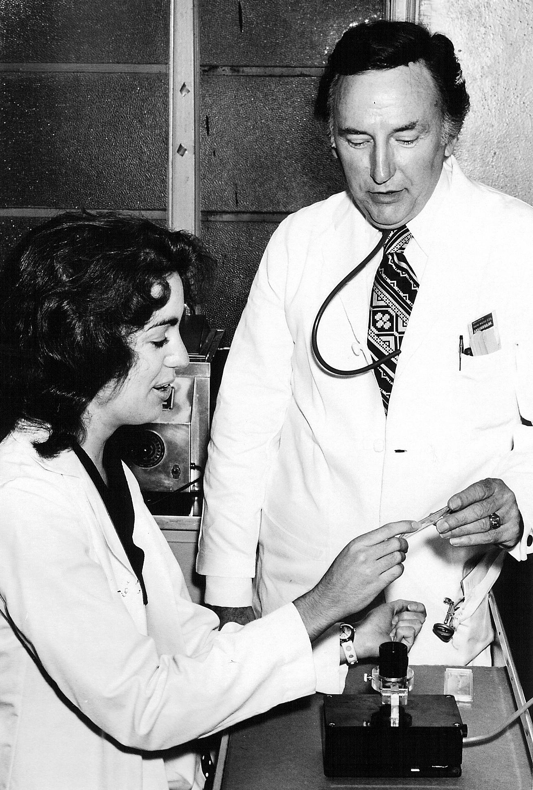
Curtis Hames

Slide 12
The pre-PBRN Era
Australian National Morbidity Survey 1962-1963
Canadian Influenza Surveillance Network, early 1970s
UK: The Oxford Record Linkage Study, 1974
Dutch Sentinel Stations – 1970
  Weekly reporting of 1% of GP encounters
  30 studies by 1979

Slide 13
Early PBRNs in the United States
Family Medicine Information System – Colorado, 1970s
Dartmouth COOP Project – 1978
  Smiley face pain scale
Ambulatory Sentinel Practice Network – 1981
Pediatric Practice Research Group – 1984
Pediatric Research in Office Settings – 1985
Other regional networks in MI., MN., WI. in mid 1980’s
WReN – 1987!

Slide 14
Characteristics of early PBRNs
Led by academic Departments of Family Medicine
Grass roots participation of many private practice, innovative physicians and renegades (Beasley, et. al.)
Passionate leaders: Larry Green, Paul Nutting and others
Annual meetings were the focal point and glue
Questioning of conventional specialty knowledge
Low tech data methods: card studies, weekly return
High level of practitioner input: ASPN Peaceful Valley Massacre
Fringe movement in the research community

Slide 15
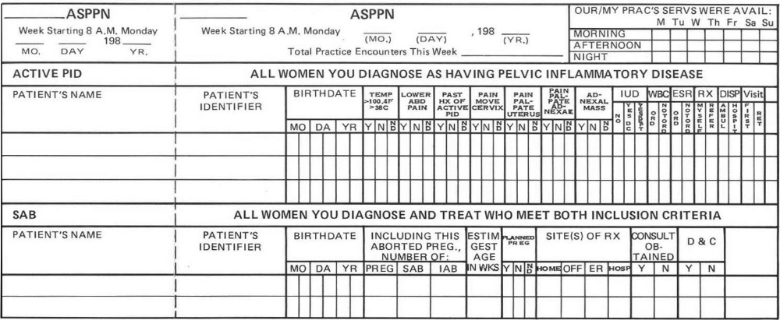

Slide 16
The spirit of early PBRNs
Sail forth—steer for the deep waters only,
reckless O Soul, exploring, I with thee,
and thou with me, for we are bound
where mariner has not yet dared to
go, and we will risk the ship, ourselves
and all.
—Walt Whitman

Slide 17
PBRNs in the 1990s through 2010
Period of sustained growth and recognition
Period of cooperation and collaboration among networks
A community of practice
Mostly descriptive studies, but some randomized trials
Some success with federal funding

Slide 18
The Federation of Practice Based Research Networks
Established in 1997 by Beasley and Hickner
25 networks initially; grew to over 50
Advocates for practice-based research
Builds capacity for practice-based research
Fosters collaboration and communication among the network members

Slide 19
The Agency for Healthcare Research and Quality
AHRQ becomes the central federal support for PBRNs in 1999
Current programs of AHRQ to support PBRNs
  PBRN Resource Center
  PBRN Registry (146 networks)
  Annual PBRN conference
  Grant programs targeted at PBRNs
  Peer Learning Groups
  PBRN literature

Slide 20
PBRNs are Discovered!
Around 2000-2004
Specific grant programs for PBRNs
NIH Institutes discover PBRNs
Other researchers discover PBRNs
Reorganization of NIH to produce research that matters – translational research
Clinical Translational Science Awards Program restructured the way medical schools receive infrastructure funding
Many CTSAs included their PBRN in funding

Slide 21
BUT. . . .
Strong winds of change have been blowing in the US healthcare system since 2010
  Increasing consolidation of healthcare organizations
  Family physicians mostly employed
  Electronic medical records are changing everything, for better and for worse
  Obamacare and the ACA

Slide 22
PBRNs Present

Slide 23


Slide 24
How are these mega-trends affecting PBRNS today?
More difficult to involve individual physicians
More external investigators wanting to use the laboratory
Less point of care data gathering
More reliance on electronic data
More IRB rules and regulations
Shifting focus of research from common clinical problems to improving primary healthcare delivery – practice improvement and implementation science
Networks of networks being formed

Slide 25
How are these mega-trends affecting PBRNS today?
Many PBRNs are now part of the established research enterprise
New funding sources
  Clinical Translational Science Awards Program CTSA
  Center for Medicare and Medicaid Innovations CMMI
  Patient Centered Outcomes Research Institute PCORI
Recognition that improving primary care services is essential for high quality health care
More external investigators knocking on the doors
Collaboration across PBRNs

Slide 26
PBRNs Future

Slide 27


Slide 28
What is the purpose of a PBRN?
“These networks are now at once both a place and a concept. As a place, they are a laboratory for surveillance and research. As a concept, they express the still unmet need for practicing primary care clinicians to accept responsibility to improve frontline clinical care by understanding what is happening in their practices.”
Green LA, Hickner J. A short history of primary care practice-based research networks: from conception to essential research laboratories. J Am Bd Fam Med 2006;19(1):1-10.

Slide 29
Some additional social forces
Retail medicine
Urgent care
Telemedicine
Healthcare technology
Competition for primary care
More powerful data systems – Big Data
Increasing competition for the healthcare dollar
Family Medicine for American’s Future – a big investment in FM

Slide 30
Hickner’s predictions
PBRNs will evolve and become incorporated into health system structures
  PBRNs will be more and more a part of the quality improvement research infrastructure of healthcare systems
PBRNs will network for larger projects
PBRNs will continue to be important components of CTSA programs in some states
The name will change to Primary Care Research Networks
It won’t get any easier to compete for funds

Slide 31
Some parting thoughts about study designs
Randomized clinical trials
Observational study designs
“outcomes” research
Patient-centered outcomes research
Quality improvement as research
  The Squires Criteria

Slide 32
Hickner’s wish list for PBRNs
They provide a strong voice for Family Medicine in health care transformation
They study healthcare system transformation
They expand their role as social networks for family practitioners
They are a learning community for family practitioners
They continue to challenge conventional wisdom
They help elevate the social status of Family Medicine as a discipline
Marketing?

Slide 33

What will WREN’s future look like?

Slide 34
Then you better start swimmin'
Or you'll sink like a stone
For the times they are a-changin'
Bob Dylan, 1964

Slide 35
Discussion
Hickner@uic.edu

Slide 36
WREN’s 2014 Convocation
Glacier Canyon Lodge
Wilderness Hotel & Resort
Wisconsin Dells, WI
September 17-19, 2014

