Slide 1

Collaborating for Health:
Early results from the primary care-public health integration study
Susan Zahner, DrPH, RN, FAAN
Vilas Distinguished Achievement Professor
2014 WREN Convocation
Wisconsin Dells, Wisconsin
September 18, 2014

Slide 2
Health Care and Public Health
U.S. has the most expensive health care system, yet health care is estimated to contribute to about 20% of the nation’s health.
Growing awareness that we need to focus on social determinants of health and the physical environment to collectively have an impact on health.
The unsustainable increases in health care costs are leaving fewer dollars for education, job development, and these other social determinants of health.
Notes:
The ACA is insuring more Americans, but it also is calling for an increased focus on population health by the medical profession. It is possible the future reimbursement models will be connected to the health of the population. In addition, an increased emphasis on health care homes and less-fragmented care, in the context of shrinking resources, has highlighted the opportunity for public health and primary care to work together towards similar population health goals.

Slide 3
Primary Care and Public Health “Integration"
The Institute of Medicine (IOM) makes a compelling case that increased collaboration between primary care and public health is crucial to population health, and the Affordable Care Act provides new incentives and expectations for such partnerships.
Mutual
Awareness
Collaboration
Isolation
Merger
Cooperation
Partnership
Primary Care and Public Health: Exploring Integration to Improve Population Health. IOM (Institute of Medicine). 2012.
Notes:
This IOM report elevated the need to understand, monitor and track the level of primary care-public health integration, especially at the local jurisdictional level.

Slide 4
Primary Care and Public Health “Integration“
Develop a national strategy and investment plan for the creation of a primary care and public health infrastructure strong enough and appropriately integrated to enable the agencies to play their appropriate roles in furthering the nation’s population health goals
Create common research and learning networks to foster and support the integration of primary care and public health to improve population health
Link staff, funds, and data at the regional, state, and local levels
www.iom.edu/primarycarepublichealth
Notes:
These statements are within the recommendations of a 2012 IOM report
The path to population health improvement will involve significant investment in the creation of linkages and alignment across many sectors. This report set out to highlight opportunities for the first steps toward this goal among stakeholders in two of the most critical fields in the realm of community health.

Slide 5
Primary care & public health integration
????

Slide 6

Primary Care PBRNs
Originating in the 1970’s, PBRNs are groups of primary care clinicians and practices working together to answer community-based health care questions and translate research findings into practice.
As of 2014, there are approximately 125 Primary Care PBRNs registered with the AHRQ PBRN initiative. AHRQ defines a Primary Care Practice-Based Research Network as having the following characteristics:
  A minimum of 50% of the membership are primary care clinicians (e.g. pediatrics, family medicine, general internal medicine, and geriatrics)
  A minimum of 5 practice locations and 15 clinicians
  A director and a mission statement

Slide 7


Public Health PBRNs
The Public Health Practice-Based Research Networks (PBRN) Program is a national program of the Robert Wood Johnson Foundation
Supports development of research networks for studying the comparative effectiveness, efficiency and equity of public health strategies in real-world practice settings
First national initiative in the U.S. to develop PBRNs for research in public health practice settings (2008)
Notes:
Public health practice-based research networks haven’t been in place for as long as those on the primary care side, but they follow a similar approach in that they seek to bring together academics and practitioners to make findings relevant and translate them into action items for policymakers and stakeholders.
Funding has been available through NCC and RWJF to promote PHSSR research and PH PBRNs. Call for PHSSR projects came in 2013 to conduct research in this area and encouraged collaboration between state PH PBRNs. Time was right to apply for funds to study PH-PC collaboration using collaborative approaches.

Slide 8
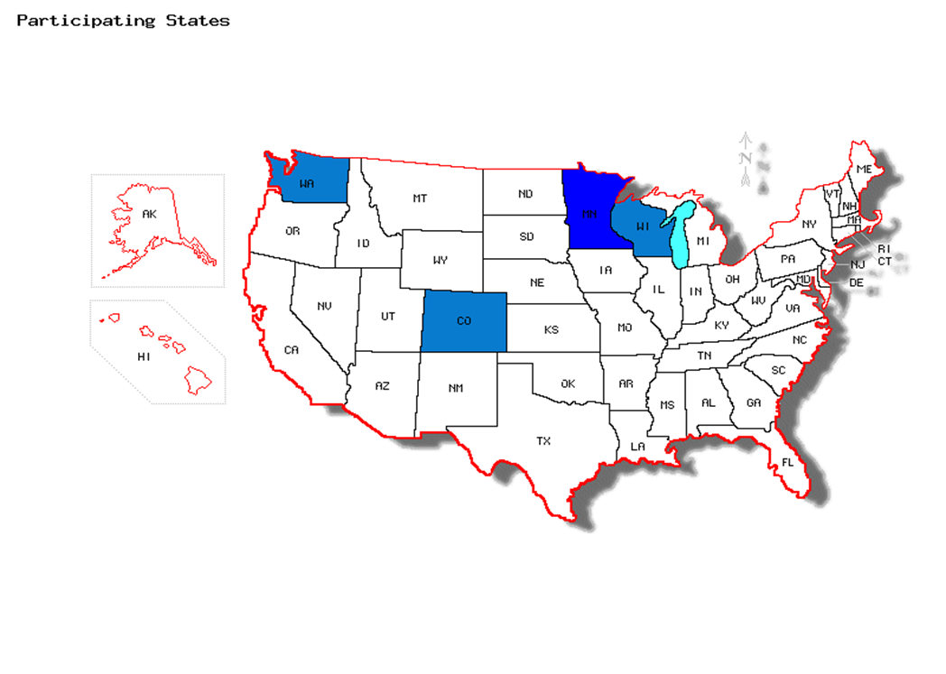

Measuring variation in the integration of primary care and public health
Purpose:
Develop measures and use them to identify differences in integration
Identify factors that facilitate or inhibit integration
Examine the relationship between extent of integration, and services and outcomes in select areas (immunizations, tobacco use, and physical activity)
PI: Elizabeth Gyllstrom
Minnesota Department of Health

Slide 9




Why is this study unique?
One of the first studies to examine
  the full range of integration at the local jurisdictional level
  local characteristics associated with differences in integration
Engaging public health and primary care practice-based research networks at each phase of the study
Wisconsin co-investigators:
  Susan Zahner, UW-Madison School of Nursing, WPHRN
  David Hahn, UW-Madison SMPH, WREN
MAFPBRN
Notes:
MAFPBRN=Minnesota Academy of Family Physicians Research Network
Minnesota Public Health Research to Action Network
WPHRN
WREN
Colorado PH PBRN
SNOCAP = State Network of Colorado Ambulatory Practices and Partners
WA PH PBRN
WWAMI Practice and Research Network

Slide 10
Why is this important?
What is needed at the local level to advance collaborative working relationships
What is needed to identify and promote infrastructure and capacity to increase collaboration
Develop and test measures that could be used to monitor changes those relationships over time
Contributes to stronger research and practice relationships, which paves the way for future collaborations
Notes:
The study gives voice to what is needed at the local level to advance a collaborative working relationship
Findings will be used to identify and promote infrastructure and capacity needed to increase collaboration
The study will develop and test measures that could be used to monitor changes those relationships over time
The study contributes to stronger relationships, which paves the way for future collaborations

Slide 11
Study aims
Describe the variation in the degree of integration between PC and PH
Examine the differences in the degree of integration by topic/service area
Identify factors that facilitate or inhibit integration
Examine the potential relationship between degree of integration and selected health outcomes

Slide 12
Study Design & Timeline
2014-2016 | Mixed Methods
February-May 2014 | Conduct key informant interviews
April – June 2014 | Qualitative analysis
July – December 2014 | Qualitative results dissemination Online survey development
Early 2015 | Online survey
2015 | Survey analysis/mixed methods analysis
2016 | Translation & dissemination

Slide 13


Qualitative methods
10 key informant interviews per state (n=-40)
  Telephone
  Digital recordings
  Transcriptions
Paired public health/primary in same geographic areas
Variation in primary care and public health organizational structures and geography
Key informants will be invited to participate in focus groups to review, refine and validate findings (2016)
Notes:
The idea is to examine the concept of integration from both the primary care and public health perspectives within the same jurisdictions. Susan Zahner and David Hahn conducted interviews by phone. Wisconsin participants chosen to assure geographic diversity/size of populations in areas served. Started with health department directors who identified Primary care representatives they believed would be good informants.

Slide 14
Qualitative Analysis
Emerging themes identified through systematic examination of the narrative data
Coding was done independently of theoretical models, allowing a fresh perspective
Qualitative analysis contributes to all of the research questions
NVivo10
University of Minnesota (Rebekah Pratt)

Slide 15
Findings
Aim #1: To describe the variation in primary care and PH integration across local jurisdictions in four states
  “Collaboration” preferred over “integration”
  Key components emerged as important:
    Aligned leadership
    Formal processes
    Commitment to a shared strategic vision
    Data sharing and analysis
    Sustainability
    Opportunity
    Partnership
    The collaboration context

Slide 16
Key aspects of collaboration
Aligned leadership: having the right people at the table to champion and lead the work
Formal processes: formal roles, structure, agreements and co-location
“Since we have relocated to (be co-located) our relationship with them has been strengthening significantly. That is the entity who I meet with their administrative team quarterly, we have very good communication back and forth and it is easy for us to identify fairly quickly in the process were we can partner on new instances or even identifying new potential community issues or problems that may not be showing up yet in the data, but both of us are seeing in our daily work. So, I think the co-location has made a significant difference in that relationship.” (Wisconsin, Public Health)
Notes:
Aligned leadership: here is a quote this if you want to use it:
Yeah, I think we work very closely and have over the years and we’ve developed a mutual respect and understanding for you know what we do and how we can work together. I think that’s important. But I also believe the leadership at the county level, the county commissioners—one of the things that stimulated the birth of the coalition was that we had a district commissioner who was also a county commissioner. So he wore two hats. And his perspective in questioning was always around “Well, why can’t we work together? We’re all in this county together.” And I think it’s bringing that leadership together at the elected officials, you know, people from the community that really drive working collaboratively. (Washington Public Health)
Formal processes: having ways that the groups are set up to work together, it might involve subcontracts, formal roles on committees or groups together. Interestingly colocation really emerged as something that had transformed some relationships and made them much more collaborative.

Slide 17
Key aspects of collaboration
Commitment to a shared strategic vision; strategic planning, particularly community health needs assessments, partner in conducting planning, and then addressing mutually identified needs.
“So we have had our primary care providers as part of our team that has done our community health assessment, which we do every five years. And then they are also a part of the team that develops our Community Health Improvement plan so once our top three health priorities are identified. And then typically those primary care providers continue to serve what we call implementation team. So, for each of our top three health priorities and our plan we have an implementation team and we have primary care representation in each of those implementation teams.” (Wisconsin, Public Health)
Data sharing and analysis; data driven identification of needs and priorities, needs shared infrastructure and/or expertise.
Notes:
These two aspects of collaboration emerged as particularly important
Commitment to a shared strategic vision: the increased need for community health needs assessments has been positive, creating where used, a mutually benefit to collaborating in order to conduct various (required) assessments.
Data sharing and analysis: working with shared information to identify priorities requires ways to be able to share data, and use the expertise across the partnership to analyze and share learnings from data – thus grounding the collaboration in the needs of the community, which offers a shared way to identify priorities… ie data driven process. An essential part of developing meaningful shared community assessments also.

Slide 18
Key aspects of collaboration
Sustainability; processes that keep partners communicating and connected, financial sustainability, sharing resources, sharing capacity.
Opportunity; building from a crisis, innovation, funded project, and some serendipity
“You’ve got to find those right moments in time. You know, I mentioned the H1N1 kind of thing. I think the—when you get a topical—a content topic that provides an opportunity to make a relationship where you’re both really interested in that, for some reason for that moment. You got to really capitalize on that. And then not lose that benefit that you just created.” (Minnesota Public Health)
Notes:
Sustainability: working to develop sustainable processes for the partnership, as well as reviewing and sharing capacity and resources when possible.
Opportunity: comes in many faces, sometimes it is a crisis which can be build from (eg H1N1 was a time of increased contact and opportunity) , sometimes it is an innovation being perused, or a funded project, but for some it is about right time, right place (which is probably not a best bet long term strategy). Highlights the need to build the role of more reliable and predictable opportunities which can become building blocks for partnership development

Slide 19
Key aspects of collaboration
Partnership
“For me it has been a huge learning opportunity. I see them as equal partners. I think that you know I have been so many times amazed with regards to what they have been able to deliver, when we have a collaboration and how dedicated they are. So I cannot say better things. It’s just great to have this opportunity. “ (Minnesota, Primary Care).
Communication
Celebrating successes
Joint projects
Respect
Shared values
Mutual awareness
Building a history over time
Notes:
Partnership: This is a large relationship oriented theme, and describes the many ways in which partnerships are build, nurtured and maintained over time, there are many aspects to partnership, with communication dominating as a central component of building, sustaining and growing the collaboration together.
Mutual awareness: Needing to have a deep understanding of each other, the nature of the discipline and work, the demands and priorities, this was seen as central to having the foundation needed to build collaboration
Building a history over time; time, it indicates it is a process that is ongoing, ie, it needs to be nurtured over time, but also, it takes time to build relationships and having experiences together, such as joint projects, is important (but takes time).
Shared values – a recognition that the collaboration is united over shared values to serve communities in a certain way that there are values embedded in doing the work, but values such as trust, patience, passion, and valuing the partnership
Respect – one of those values and mentioned as one of the most important values
Joint projects – starting somewhere, with joint work, has an enormous benefit to building the partnership, learning the values you share and work you do – highlights the value of starting somewhere together and building on that work.
Celebrating success – taking time to acknowledge the successes of what can be very tough work, and celebrate the importance of that

Slide 20
Key aspects of collaboration
The collaboration context; both PH and PC dealing with much change, understanding the particular environment of both, the role of health reform, identifying unique strength of public health as a facilitator across what can be a fragmented health sector
“He started a group where we actually pulled in the major health care organizations in town, … along with the Public Health Department and kind of created a kind of network of care. Which was just the start, I think it has become catalyst of saying, "Wow", from my perspective, I felt at least, from this all the time. Like "Wow this is great!" (Wisconsin PC)
Notes:
Lot of change in both areas, and that complicates having a deep knowledge of each other. Primary care under a lot of strain, and expect or need public health to reach out to them. Public health is uniquely placed to navigate the fragmented and potentially competing health systems – and tat is a real asset fro collaborating. Collaboration needs to be sensitive to the high level of change happening. Quote on change here if needed:
Well, I think primary care, and all health care is highly occupied with all the kind of structural changes that are occurring—consolidations and new data systems, and expectations by health plans and payers, I think that all makes it very difficult to focus on health topics, even though all that’s being done in the name of health topics, but I think it’s, yeah, it’s a hectic environment out there, you know? (Minnesota PH)

Slide 21
Findings
Aim #2: To examine the differences in the degree of integration based on health topic
  More narrowly defined topics have been easier for the development of integration between PC and PH
  Common areas of current work: immunization, CVD risk, infectious disease, mental health, obesity
  Common areas for future work: mental health, obesity, smoking cessation, environmental health, emergency preparedness
Notes:
Immunization is the clear area of most frequent collaboration, but there are many other areas of current work, really a great variety of topics, and the list here is the five most often mentioned areas of collaboration. Next, there is just as much variation in areas sites wanted to work together in, with a fair amount of interest in mental health in particular.
In saying that, for some collaborations, the role of public health in relation to immunizations is changing, away from direct service, so this may change over time.

Slide 22
Findings
Aim #3: To identify capacities and other factors that facilitate or inhibit integration.
Barriers and areas for improvement generally mirror the emerging areas of collaboration
Some of the more frequently mentioned barriers included:
  Resources
  Communication
  Data sharing
  A lack of understanding each other
  “I think sometimes the Public Health people don't always quite understand the realities of Primary Care. You know, they are sitting off in a Public Health department, well let's do this and let's have the doctors all do this. Lets have all the doctors screen for this and do that and do this and do this and do this. You know, primary doctors are all ready to quit because they have too much to do. (laughing) Do you know what I mean?” (Minnesota, Primary Care)
Notes:
So, the collaboration areas when in deficit, area barriers, eg, communication is a great asset for collaboration, and the lack of it is described as a barrier, or area for improvement.

Slide 23
Findings
  Cross training
  Relationship building
  A need to change the system
  Unmatched priorities
  “Yeah, I mean, I don’t know what actually – I mean, they talk about it that, and we are looking at the health of the this County, how we have more cancer than any other counties, we have more smokers in our county than any other places. And the drug abuse and all that is well-presented. But I am not aware of what the County Public Health has done about it. If you asked me name one thing activity they have done in that, I can’t think of anything.” (Washington, Primary Care)

Slide 24
Findings
Aim #4: To examine the potential relationship between degree of integration and selected health outcomes.
  PH mainly say there is always a benefit to health outcomes
  PC describe benefits and competing demands
  Very difficult to be measured or assessed in ways that allow the benefit to be shown
“I mean, the clients that we care for, we have in common, both as populations as well as individuals, in many ways. So the extent to which we can align ourselves with the benefit of our communities and our patients in mind, the better off we all are. I mean, its kind of a simplistic way, but our fates are so intertwined that it makes no sense for us to not always be working with each other.” (Washington, Primary Care)

Slide 25
Preliminary Conclusions
This study is identifying an emerging model of how public health and primary care collaborate
The role of shared strategic planning emerged as particularly important part of the collaboration process
Some key barriers have been identified and could be priority areas for collaboration development
This model will be further tested and refined with quantitative work
It is an exciting time of a growth of opportunity for collaboration, particularly in relation to health reform
Notes:
The work here provides a very comprehensive view of collaboration, using data from dyads that were successful and from dyads that were less successful, and this is emerging as a model for further development and review
The shared strategic planning process, supported by the new requirements for community needs assessment, had an important role to support data driven priority setting and activity.
The key barriers identified very much center on the partnership part of the collaboration model, with findings ways to communicate, understand each other better being very important. The was a limitation of resources also, limiting the ability to collaborate.

Slide 26
Limitations
Small sample size (4 states, 10 dyads per state)
This is not necessarily representative, but was sampled for a depth and breadth of experiences
The analysis could have been influenced by the perspectives of the team, although group analysis sessions and consultation with the multi-state partnership has been undertaken in order to help validate the findings

Slide 27
Next Steps
Develop and test a survey of degree of integration
Field survey to primary care and public health representatives from local jurisdictions across the four participating states
Place local jurisdictions on the continuum of integration (IOM)
Quantitative analysis
Mixed methods analysis

Slide 28

Questions?

Slide 29
Wisconsin investigators
Susan Zahner
UW-Madison School of Nursing/WPHRN
sjzahner@wisc.edu
David Hahn
UW-Madison School of Medicine and Public Health/WREN
dlhahn@wisc.edu
Wisconsin Public Health Research Network
www.wphrn.org
Wisconsin Research and Education Network
www.fammed.wisc.edu/WREN

Slide 30
Minnesota investigators
Beth Gyllstrom, PhD, MPH Kevin Peterson, MD, MPH
Beth.gyllstrom@state.mn.us peter223@umn.edu
651-201-4072 612 624-3116
Kim Gearin, PhD, MS Rebekah Pratt, PhD
Kim.gearin@state.mn.us rjpratt@umn.edu
651-201-3884 612-625-1196
Carol Lange, MPH, RD
lange076@umn.edu
612-624-3125
MN Public Health Research to Action Network:
http://www.health.state.mn.us/ran

