Slide 1


African American Women’s
Experiences of Menopause:
A Focus Group Study
Sarina Schrager, MD, MS
Makeba Williams, MD
Earlise Ward, PhD

Slide 2
Background
Little is known about African American women’s experiences with menopause.
African American women have an earlier onset of menopause than white women
They have more severe VMS, that last longer
More sleep disturbance
Less likely to be offered hormone therapy
Williams M, Richard-Davis G, Williams PL, Christensen L, Ward E, Schrager S. A review of African American women's experiences in menopause. Menopause. 2022;29(11):1331-1337.

Slide 3
Study Aims
Aim 1: Research African American women’s physical and psychological experience of menopause through focus groups
Aim 2: Explore midlife African American women’s experiences with the health care system
Aim 3: Determine sources of information related to menopause
Notes:
Where do you get information about menopause?
Many women talk about menopause with their friends and family
Some women read about menopause on the internet
Some women get information from their health care provider
How do you feel about the information you received? Was it helpful?
Where or who are you most comfortable getting information about menopause
Tell us about your experience with menopause
Do you have hot flashes or night sweats? If yes, when did they first start? How have they affected your life?
Do you have sleep issues from menopause? If yes, how have they affected your life?
Do you have mood changes (irritability or depression) from menopause? If yes, how have they affected your life?
Have you experienced any vaginal or vulvar symptoms? If yes, please describe. (Recognize that these symptoms may be present even if participants are not sexually active.)
Have you had any issues with sex after menopause? If yes, can you describe? How has this affected your intimate relationships?
Have you noticed any changes with your intimate relationships after menopause? Any changes in other relationships?
Do you have memory issues from menopause? Many women report memory problems during menopause or during the menopause transition. Have you experienced any changes with your memory or cognition? Have trouble finding the right word to say? Has this happened to you? If yes, how have they affected your life?
Have you ever talked to a health care provider about menopause or menopause related symptoms?
If yes, what was their reaction?
Did you feel like your provider was hearing what you were saying?
Did you feel ignored ?
Did your provider make any suggestions to manage your symptoms?
Did you get any treatments for your menopausal symptoms? If yes, did it help?

Slide 4
Methodology
Participants-community dwelling midlife African American women
Recruited through word of mouth, and snowball sampling
Inclusion criteria:
  Self-identify as African America
  More than a year since last menstrual period
  (or 45+ with hot flashes or night sweats)
  Access to computer/table and internet for Zoom
Potential participants answered screening questions and completed consent verbally on a phone call with research staff
Eligible participants were invited to either complete a short survey over the phone or independently using an online platform

Slide 5
Research Design
Conceptual framework of phenomenology (lived experiences)
Focus groups
Data analysis– groups audiotaped, transcribed and reviewed for content themes

Slide 6
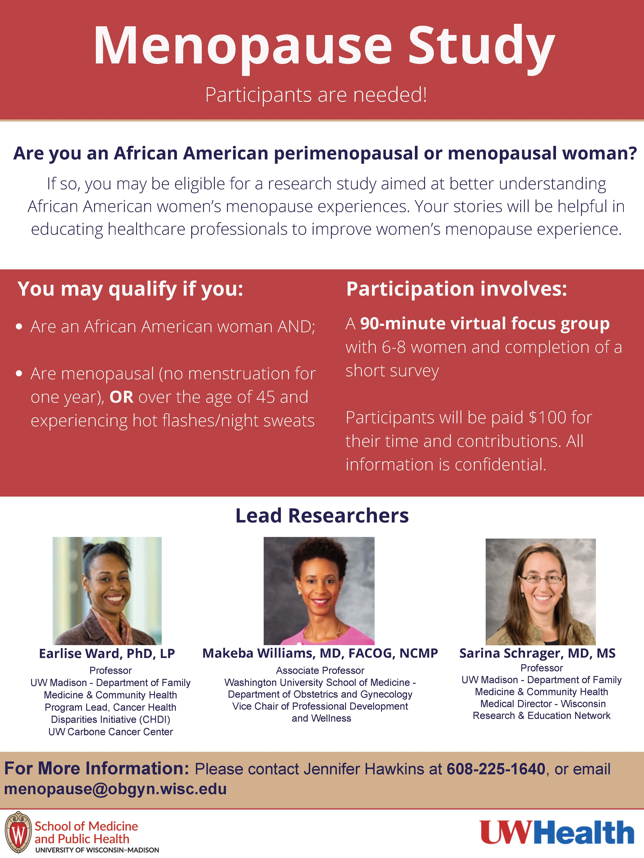
Recruitment
flyer and video
distributed in the
community

Slide 7

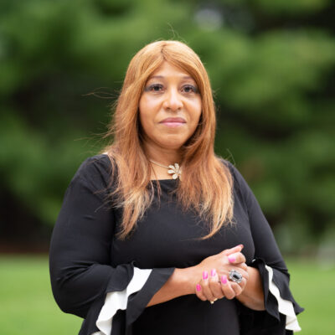
Facilitators

Slide 8
Focus Groups and Participants
Recruitment
Out of 36 potential participants
  6 could not be contacted for screening and consent
  30 were screened and invited to complete the survey
Of the 30, 4 were unable to participate in a focus group due scheduling conflicts

Slide 9
Focus Groups and Participants
Participation
26 African-American women participated in 1 of 4 focus groups
Ranged in age from 49-70 years old (mean 58)
23 of the 26 lived in WI, others in OH, NC, SC
Weekday, evening groups, held online via Zoom
Conducted between July 2022 and January 2023
$100 compensation for participating in focus group

Slide 10
Sources of Information
Source of information | Notes
Family | Women observing experiences of their mothers and other family members
Health care provider | A variety of experiences reported
Internet | From Alice – I would take out Internet, quotes were non-specific
Social networks | Learned from friends & acquaintances by asking, observing other women, and listening to their stories

Slide 11
Dissatisfaction with information given by clinician
Clinicians did not offer information about menopause unless the woman complained of symptoms
“It was very uncomfortable with the doctor because I had to bring it up, and it was just kind of dismissive”
“So I would say my primary provider was never part of a discussion. It only came up when I brought it up, and it was because of the symptoms I was having. But there was never a discussion about it.”
“I don’t think that she’s ever really talked about menopause, even though I think that she is an excellent doctor.”
“I would have to say I did not get any information from my doctor. I actually googled and talked to friends first and had to bring the subject up to my doctor.”

Slide 12
Dissatisfaction with information given by clinician
Participants expressed unmet expectations for physicians to share information about menopause, leading to dissatisfaction
“She just right away, I'll get you the brochure, and that's it…I felt ignored. I felt like that piece that I was asking for, she ignored.”
“I think it would really be helpful for doctors to ask, especially when women start getting around their 30s, I mean, late 30s, 40s, and 50s, you know, to start providing information”
“I think it's important that doctors make women aware of menopause as early as possible. Because women in the workplace may be going through changes that affect their jobs”

Slide 13
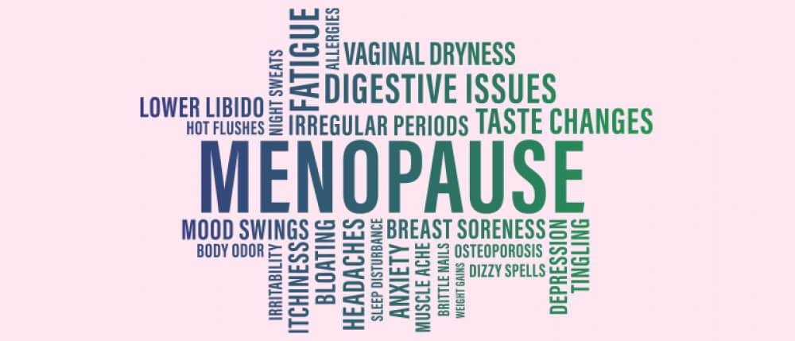
Symptom Reporting
Vasomotor symptoms (77%) and sleep disturbance (69%) were reported the most commonly
Memory issues and mood instability were also common
*Data from anonymous online survey (N=26)

Slide 14
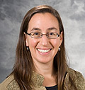
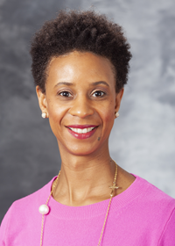
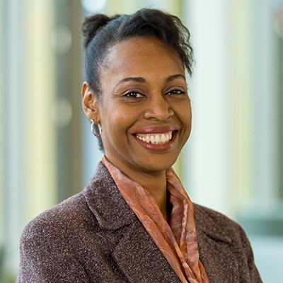
Thank you
Future work will expand focus groups to more
women in other sites.
^{www.wren.wisc.edu}

