Slide 1


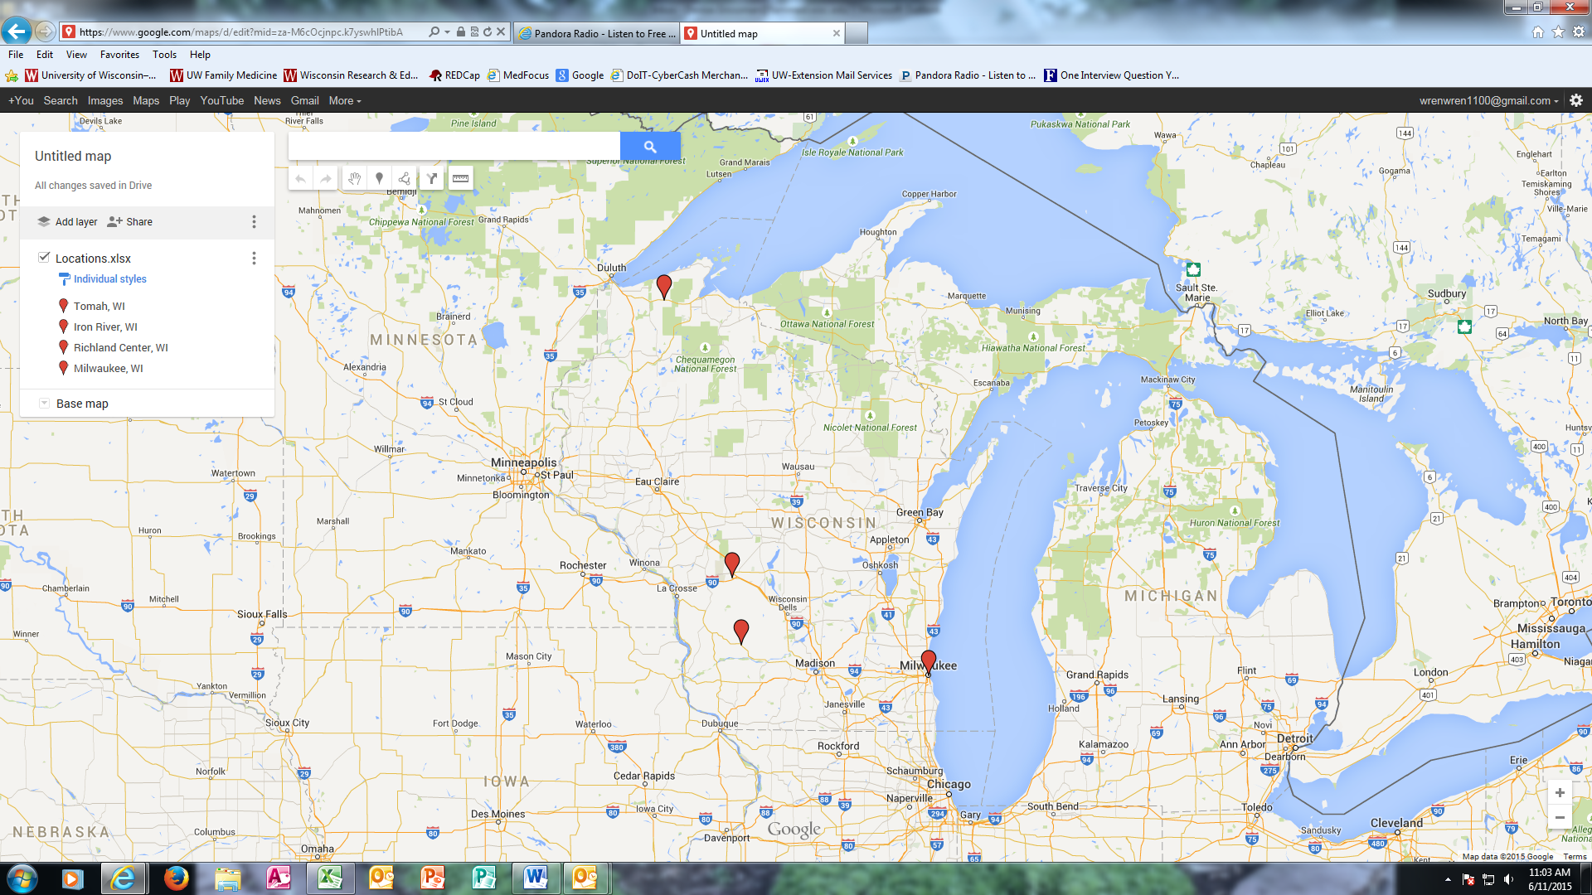
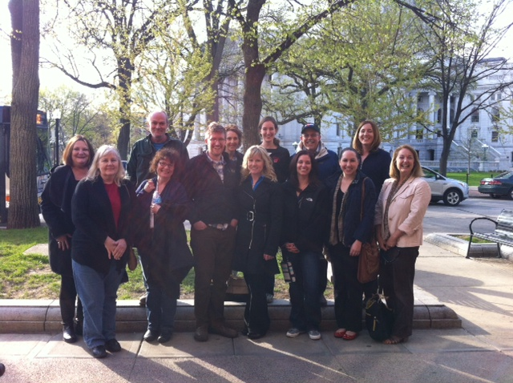
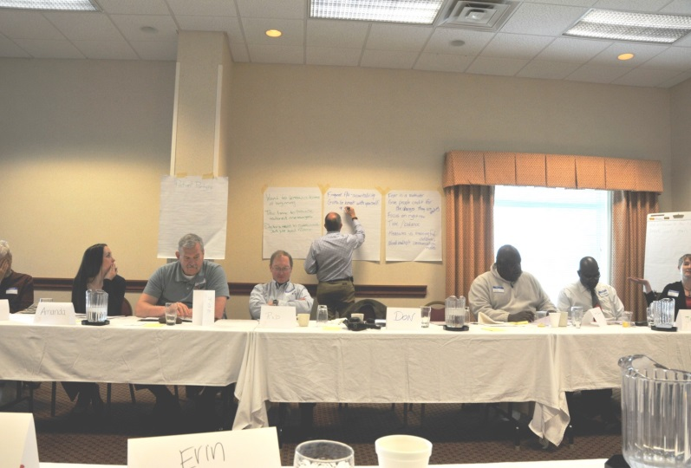
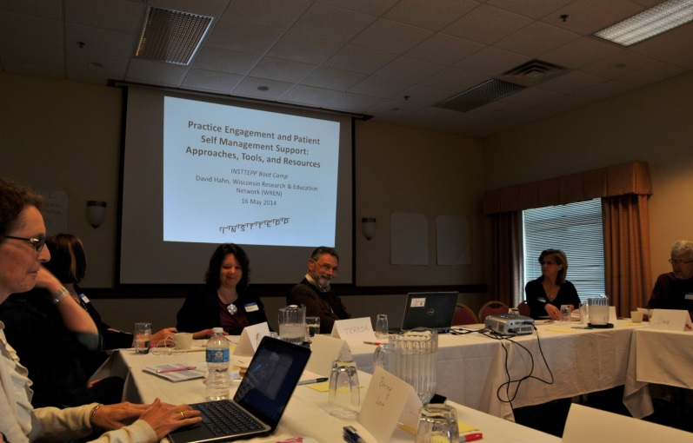
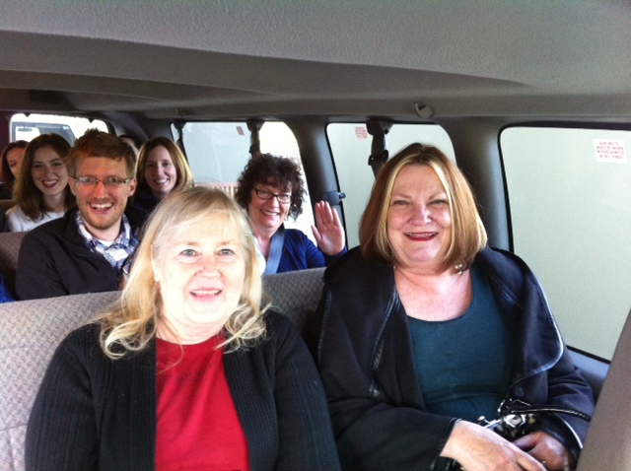
Boot Camp Translation in Primary Care Settings:
A WREN Qualitative Case Study
Kate Judge, MSSW; Amanda Hoffmann, MPH; David Hahn, MD, MS
BACKGROUND
RESULTS
Primary care clinics need effective, well-articulated methods to engage patients as partners in practice improvements and dissemination efforts.
Boot Camp Translation (BCT) is an evidence-based intervention used to engage laypeople to create culturally relevant strategies for disseminating health information at the community level.¹
To date, BCT has not been studied as a method to engage patients at the clinic level.
The INSTTEPP² trial used an abbreviated version of BCT with primary care teams working with four states’ Practice-based Research Networks (PBRNs): Wisconsin Research and Education Network (WREN), Shared Networks of Colorado Ambulatory Practices & Partners (SNOCAP), Oregon Rural Practice-based Research Network (ORPRN), and Iowa Research Network (IRENE).
Patient Participation in BCT Activities: All four clinics successfully recruited two patients (eight total). Patient participation continued throughout the two-month intervention.
2) Patient Contributions: Patients were active in conversations about SMS (see themes below)
3) BCT Activities Facilitated Working Relationships between Patients and Clinic Teams
  In each clinic, it was NEW to include patients on clinic process improvement teams.
  In at least two clinics, patients met with clinic staff between required meetings to advance project goals.
  Communication between patients and clinics continued post-project.
  All clinics expressed interest in continuing to involve patients in implementation and healthcare delivery conversations.
4) Unanticipated Result: BCT resulted in new relationships between patients and the PBRN
  Three patients attended the 2014 WREN annual convocation.
  One patient will participate on a patient panel for the 2015 WREN annual convocation.
  One patient contacted WREN about future opportunities to participate in healthcare conversations.
5) About SMS Implementation
  WREN clinics were unable to fully implement new SMS processes, largely due to the short duration of the study.
  Two clinics continue to work actively on SMS implementation activities, with patient involvement.
  One clinic applied for and received funding from WREN to continue SMS implementation and formalize a workgroup to include patients.
  Patients identified peer support as an important SMS strategy. However, this strategy was not pursued due to time constraints of the project.
OBJECTIVES
This Wisconsin (WREN) INSTTEPP Case Study will:
Describe how BCT was used to involve patients from Wisconsin in primary care implementation teams on the topic of self-management support (SMS) for chronic conditions.
Offer qualitative observations about how BCT affected patient engagement.
Quality of Life
Patient and Provider Responsibility
Making Informed Decisions
Peer Support
Action Plans
METHODS
Clinics
Recruitment criteria: small to medium-sized primary care practices that have begun to implement Patient-Centered Medical Home (PCMH) & designated staff to provide care management functions
Participants
Each clinic team consisted of:
One clinician
One care manager
Two patients
Patient Recruitment
Invited by physician (fact sheet, invitation letter, and verbal invitation)
$150 honorarium
Criteria: current patient at clinic, at least 1 chronic condition,
and comfortable offering ideas in a group setting
Two-Month Process
Kickoff All Day Retreat
  Included all four clinics (16 participants) in Madison, WI
  Goals of Retreat: (1) Define SMS, (2) Review AHRQ’s SMS toolkit, and (3) Dialogue surrounding (a) What do patients want/need to self-manage chronic illness?, and (b) What elements of the AHRQ toolkit can patients/practices use to address these needs?
Three Conference Calls
  All four clinics on the call (total of 16 participants invited)
  Focusing questions
  Three planned calls (2 weeks, 6 weeks, and 10 weeks post-kickoff); 30 minutes each
  Summary of calls provided to all participants
  WREN clinics requested a fourth phone call in hopes of making more progress toward SMS implementation
Two Site Visits
  Qualitative interviews with care manager & clinician from each clinic (1 month & 2 months post-kickoff)
Boot Camp Translation
Clinic 1 Team
Clinic 2 Team
Clinic 3 Team
Clinic 4 Team
Clinic Locations
*FQHC = Federally Qualified Health Center
BCT Kickoff Photos
Clinic 1
Iron River, WI
Rural – FQHC*
Clinic 2
Tomah, WI
Rural – Part of a large health system
Clinic 4
Richland Center, WI
Rural – Physician-owned
Clinic 3
Milwaukee, WI
Urban – FQHC*
DISCUSSION
BCT is a promising method to engage patients as members of healthcare teams in primary care settings.
WREN found that patients were actively engaged in project conversations during the initial kickoff meeting and in subsequent team phone calls, and clinic staff were motivated to engage patients.
After participating in INSTTEPP, one of the Wisconsin clinics sought assistance to develop a standing workgroup including patients to address issues relevant to chronic disease management.
Facilitators to patient involvement included strong communication early and often, accommodating the work schedules of employed patients when scheduling phone meetings, augmenting email communications with mailed copies of meeting agendas and materials, reimbursement for expenses, and nominal compensation for time.
It is not clear whether bringing clinics together from different communities facilitated implementation efforts. However, clinics with the same electronic health records did share information about tools and processes.
REFERENCES AND ACKNOWLEDGEMENTS
  ¹Norman N, Bennett C, Cowart S, et al. Boot camp translation: A method for building a community of solution. J Am Board Fam Med 2013;26:254–63. ²Implementing Networks’ Self-Management Tools through Engaging Patients and Practices (INSTTEPP). An 18 month long, Agency for Healthcare Research and Quality (AHRQ) funded trial through the Meta-network Learning and Research Center (Meta-LARC) P30 consortium of PBRNs. (AHRQ Grant #1R18HS022491-01) Many thanks to INSTTEPP Principal Investigators Donald Nease, MD, Lyle Fagnan, MD and the study teams from ORPRN, SNOCAP, and IRENE.
CONCLUSION
Primary care clinics and health systems need tools to engage patients in a meaningful way that respects their time and incorporates their experience. This WREN Case Study suggests that “Boot Camp Translation” (BCT) is a promising new method for creating a participatory environment with patients as critical members of the healthcare team.

