Slide 1


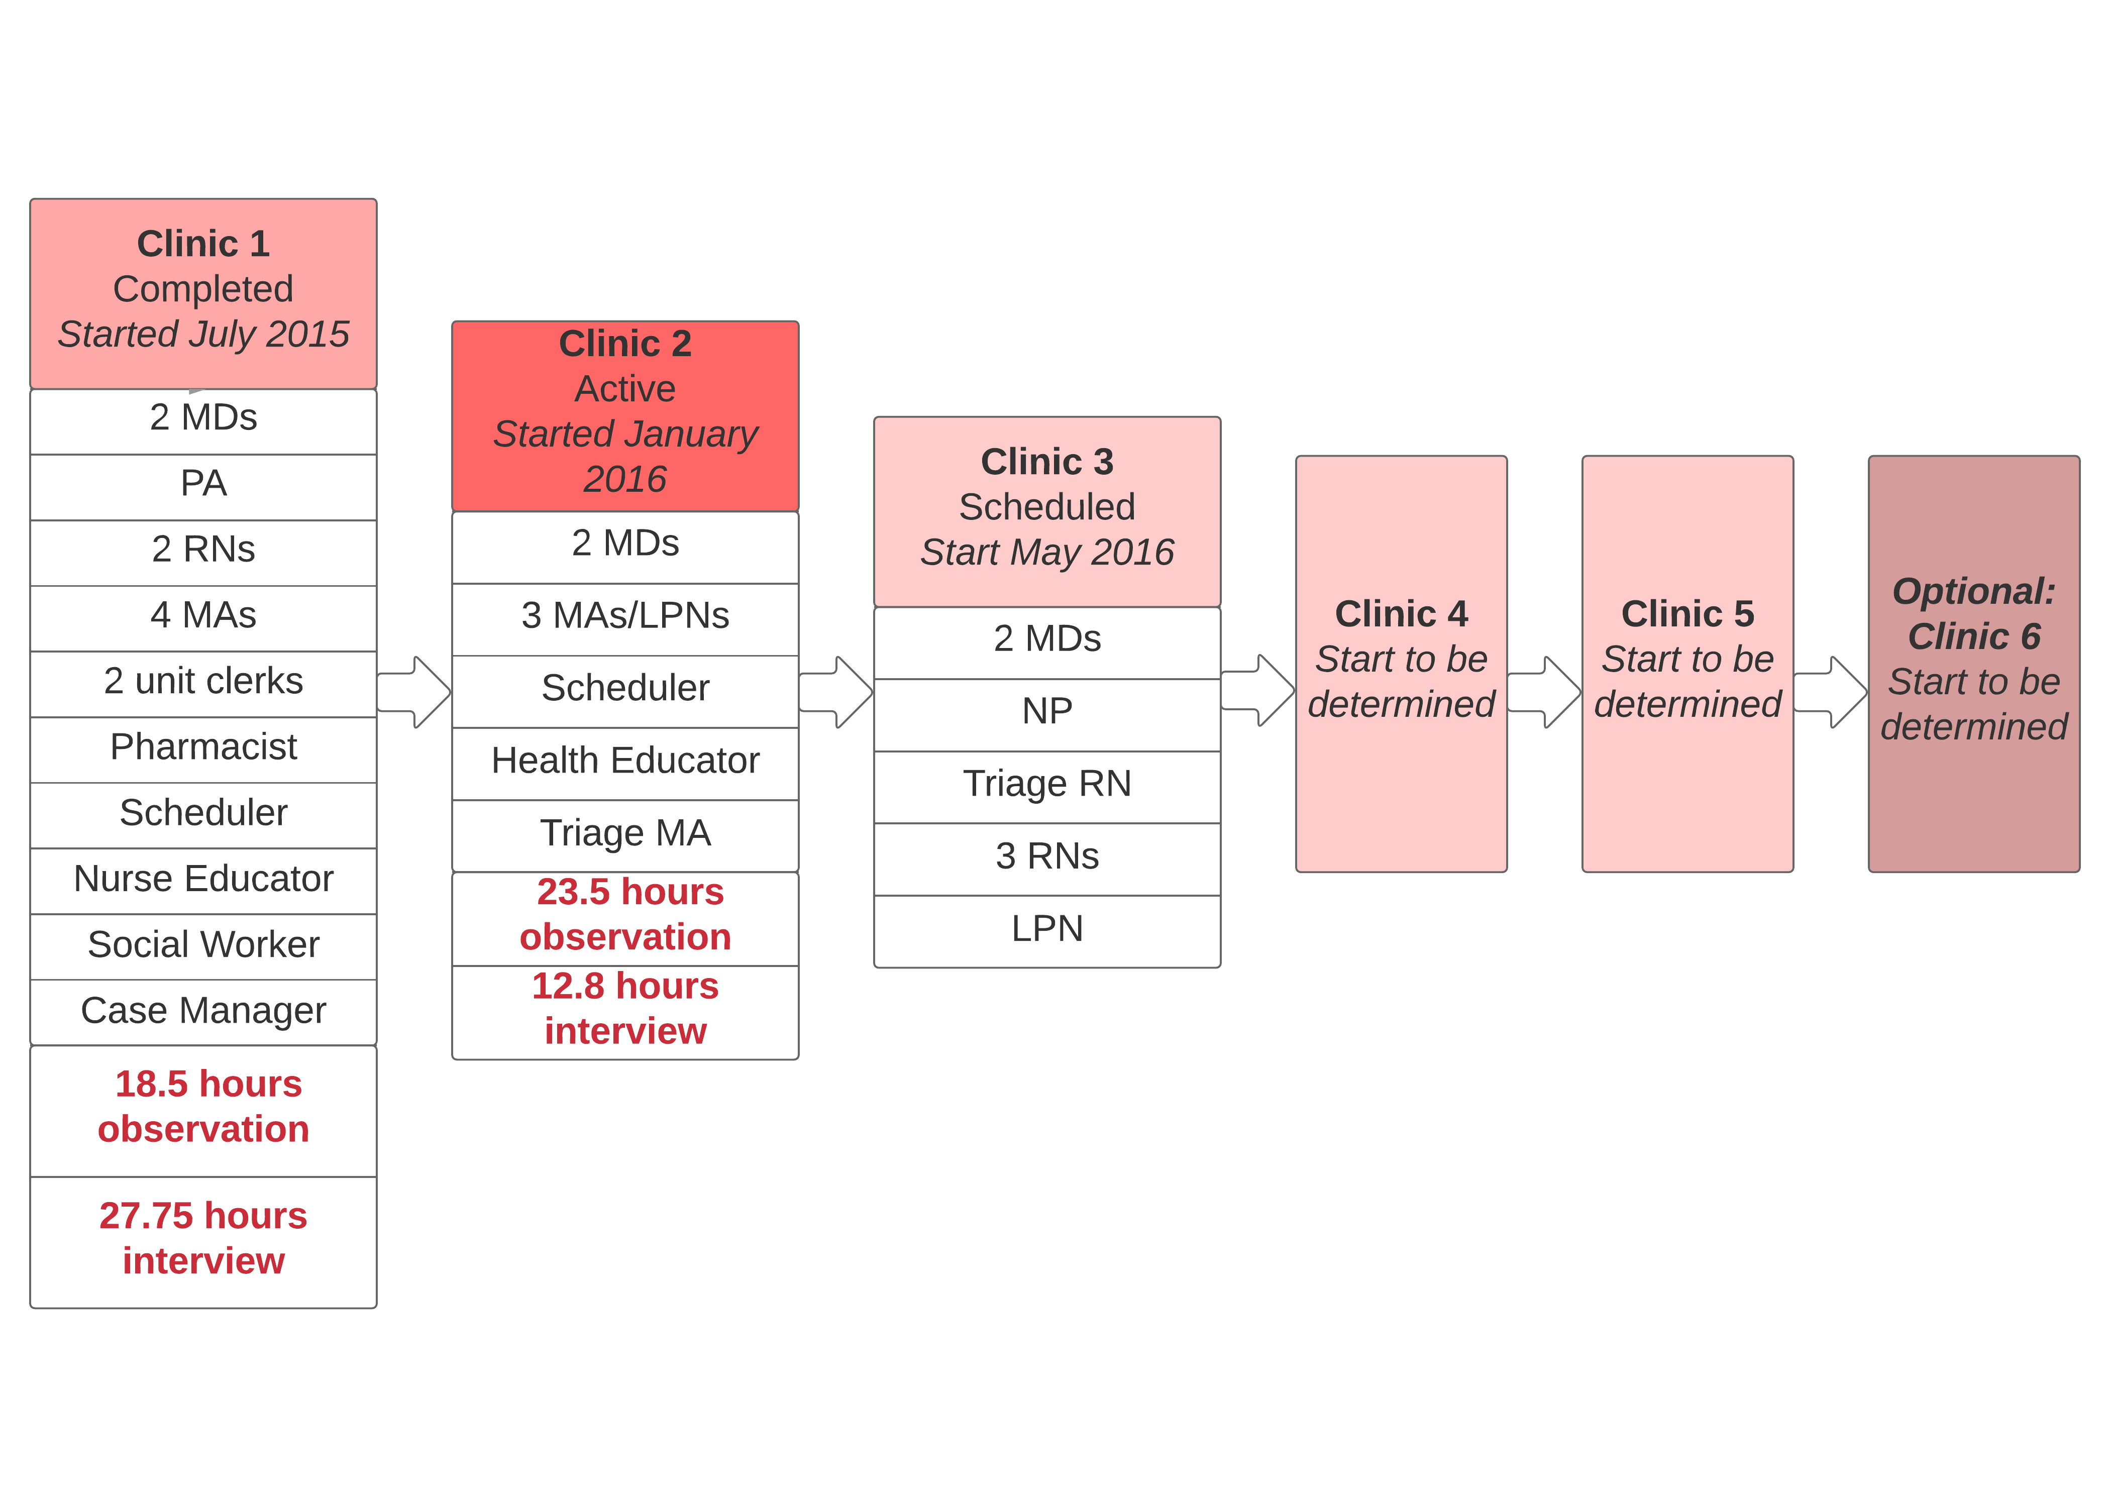
The Complicated Application of GDTA to Primary Care
Randi Cartmill, MS,¹ Abigail R. Wooldridge, MS, MEng,² Sabeena Cheema, BS,¹ Amanda Hoffmann, MPH,³ Linsey Steege, PhD,² Shimeng Du, BS,² John Beasley, MD,¹ David Hahn, MD,³ Paul Smith, MD,¹ Regina Vidaver, PhD,³ Tosha B. Wetterneck, MD, MS¹
¹University of Wisconsin School of Medicine and Public Health, ²University of Wisconsin-Madison, ³Wisconsin Research and Education Network
Introduction
Project Overview
Current EHR technology does not properly support the cognition of health care clinicians to analyze, diagnose or treat patient problems.
This lack of support can negatively impact patient care and outcomes, particularly in complex environments like primary care, which is characterized by high levels of
(A) Coordination.
(B) Information needs.
(C) Information seeking.
As primary care shifts to a more team-based approach through the patient-centered medical home model, the cognitive work of health care teams continues to be unsupported by current EHR designs.
Project Kickoff: January 2015
Conduct GDTA:
Participants:
5-6 clinics
Minimum of 2 teams per clinic
Data Collection Methods:
Observation
Interview
Output:
GDTA maps (visual representations of cognitive work requirements)
Study Objective and Aims
Objective: design EHR interfaces to support both clinician and team cognition
Specific aims:
(1) Identify the cognitive work requirements of primary care clinicians and teams
(2) Develop and test specific EHR interface design requirements by performing usability testing of EHR prototypes with primary care clinicians
Methods
Identify the cognitive requirements of primary care clinicians and team members using goal-directed task analysis (GDTA), to ascertain:
  Goals
  Sub-goals
  Decisions
  Information requirements
GDTA data collection: interviews and observations with clinicians and team members
Data analysis: develop GDTA maps using qualitative thematic analysis
Interface design will be informed by GDTA analysis and human factors design principles, followed by usability testing
Interface Design:
Based on GDTA maps
Design for situation awareness
Human factors principles
Output:
EHR interface mockups
Usability testing:
Participants:
4-5 clinics
Analysis based on human factors principles
Output:
Improved EHR interface mockups
Poster Session Goals
Share overview of project and progress to date
Gather feedback on GDTA maps
The following posters contain portions of the GDTA map for physicians, PAs and NPs.
Please write comments on the posters or talk to a member of our research team!
Interested? Questions?
Contact:
Tosha B. Wetterneck, PI – tbw@medicine.wisc.edu
Randi Cartmill, Project Manager - randi.cartmill@wisc.edu
David Hahn, WREN – dlhahn@wisc.edu
Funding provided by AHRQ: Grant # R01-HS22505
Targeted Completion: September 2020

