Slide 1





Xxxxxxxxxxxxxxxxxxxx
Lessons Learned in Multi-Network Quality Improvement Research Using Practice Facilitators

Slide 2
Presenters
Cheryl B. Aspy, PhD, OKPRN
Melody Bockenfeld, MPH, WREN
Lyndee Knox, PhD, LANET
Carol Lange, MS, MAFPRN
Paula Darby Lipman, PhD, Westat

Slide 3
Workshop Goals
Provide an overview of the CKD QI project;
Describe practice facilitation expectations for this intervention;
Describe the data collected for both process and outcome evaluation of practice facilitation;
Present 4 case studies of facilitation and lessons learned.

Slide 4
Schedule
Topic | Time | Presenter
Overview Description of PF in context of QI interventions Expectations for this intervention re: CKD Study – Brief intro of CKD study and PBRNs | 10 | Cheryl
Description of the data collected for both process and outcome evaluation of practice facilitation – Logic Model | 10 | Paula
Small Group Discussion – Recommendations for monitoring and evaluating practice facilitation. Share back with group | 15 | Cheryl/Paula
Case studies of facilitation and lessons learned | 24 | Melody Cheryl Lyndee Carol
Questions about Case Studies - Commonalities Goal Writing/Sharing How will you use the information you’ve heard today? | 20 | Carol
Response to your Questions Summary and Adjourn | 11 | Paula

Slide 5
Handouts
Bios for presenters
Logic model (CKD project)
PF visit form (CKD project)
Evaluation Checklist
Resources and References

Slide 6
Do you have questions about practice facilitation?
If yes, write them down and pass them up and we will get to them shortly.

Slide 7
Practice Facilitation Defined
PF is a supportive service provided to a primary care practice by a trained individual using a range of organizational development, project management, QI, and practice improvement approaches and methods to build the internal capacity of a practice to help it engage in improvement activities over time and support it in reaching incremental and transformative improvement goals.*
Performed by:
  Practice Facilitators (PFs)
  Practice Coaches (PCs)
  Practice Enhancement Assistants (PEAs)

Slide 8
Project Purpose
Wave I. Help 32 practices in 32 separate communities in 4 states implement National Kidney Foundation (NKF) Chronic Kidney Disease (CKD) Guidelines (KDOQI).
  We used an evidence-based multi-component implementation strategy (performance feedback, academic detailing, practice facilitation, and IT support).
Wave II. Each practice then diffuses new knowledge to two other practices through local learning collaboratives (LLCs) plus less intensive practice facilitation.

Slide 9
CKD Background Information
Stage 3 CKD occurs in 13% of the population
CKD care consumes 19% of Medicare budget
  $57 billion
CKD is a major risk factor for heart attack
  Similar to having a previous heart attack

Slide 10
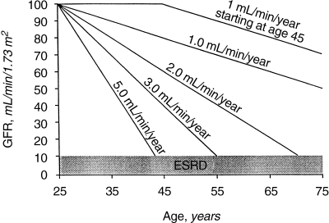
Kidney function over time
A GFR loss of > 1L/min/year starting at age 25 can result in need for dialysis within a normal lifespan
Small change in the rate of GFR decline can result in large change in time to dialysis
Lee A Hebert et al. Kidney International (2001) 59, 1211–1226

Slide 11
Guidelines
Grade A evidence for reducing mortality or progression
  BP< 130
  LDL<100
  HgbA1c <7.0
  Use of ACE inhibitors or ARB

Slide 12
Guidelines
Grade A evidence for reducing mortality or progression
  Avoid NSAIDS
  Smoking cessation
  Referral to Nephrology for GFR <30
  Avoid PICC lines for GFR <45

Slide 13
Medication Issues
ACE/ARBS definitely help
Low dose ASA still recommended by ADA and NKF
  FDA recommends discontinuing Bisphosphonates if eGFR is <30
  Unclear what to do with Metformin

Slide 14
Study Timeline
2010-2011 | 2011 | 2012 | 2012-2013 | 2013
October - March | April - December | January – June | March - March | April - September
Study Preparation Initial Data Collection | Wave I Intervention/ Post Data Collection | Wave II Recruitment and Pre Data Collection | Wave II Intervention / Post Data Collection | Data Analysis and Report Writing
4 PBRNs LANet MAFPRN OKPRN WREN 8 Practices each = 32 Total | Academic Detailing Performance Feedback Practice Facilitation IT Support | Each practice recruits 2 more for Local Learning Collaborative (LLC) = 96 Total | Academic Detailing Performance Feedback Practice Facilitation IT Support LLCs

Slide 15
Evaluating PF Quality and Outcomes
Westat is the Data Management and Analysis Center for the CKD Project
Coordinate, manage, and analyze all data
  Intervention process
  Practice change
  Practice characteristics
  Outcome data collection from patient records
Includes quantitative (survey) and qualitative (interview, focus group) data collection

Slide 16
Evaluating PF Quality and Outcomes
Assessing the fidelity of implementation of your PF intervention
Evaluating the outputs and outcomes
Drawing conclusions about effectiveness

Slide 17
Levels of Evaluation
Local monitoring of fidelity to the intervention methodology
Sharing lessons learned within your organization
Participating in a multi-site evaluation

Slide 18
CKD Study Evaluation Questions
Has the CKD project ...
  Increased implementation of CKD guidelines through practice facilitation? (Aim 1)
  Disseminated lessons learned through local learning collaboratives? (Aim 2)
  Shown improvement in practice change components (priority, capacity, content)? (Aim 3)
  Increased willingness and ability to participate in future QI projects (Aim 4)?

Slide 19
Logic Model for CKD Project
Graphic illustration of the relationship of inputs, outputs, and outcomes
Clarify assumptions about the activities, interactions, relationships, and their assumed connections to the expected outcomes
Guide data collection and analysis

Slide 20
LOGIC MODEL: Leveraging PBRNs to Accelerate Implementation and Diffusion of CKD Guidelines in Primary Care Practices
INPUTS
PROCESSES (ACTIVITIES)
OUTCOMES
  Practice Facilitators (PFs)
    Methodology/Training
    Evidence based effectiveness
  Local Learning Collaboratives
    Methodology/Training
    Evidence based effectiveness
  Information Technology Support
  Other QI Expertise (Solberg)
  Knowledge/Skills evidence-based CKD guidelines (Fox)
Hold regular Operations Committee Meetings for Planning and problem-solving
Monitor progress
WAVE I –Implementation Intervention
Recruit 32 motivated, interested practice units across 4 networks
Train practice facilitator
Enroll practices with informed consent
Practices complete initial survey forms
Conduct Initial interviews
PFs audit charts for initial feedback
Provide Academic Detailing to 32 practices
PFs provide Performance Feedback
PFs facilitate practices across 6 months – visits every other week for 1 day
PFs provide Monthly Performance Feedback to practices
PFs keep detailed diary notes of practice visits
Information Systems adapted to facilitate guideline implementation
Complete required reports
WAVE II – Diffusion Intervention
Recruit 64 additional practices in 4 PBRNs
Collect initial performance data
Set up schedule for LLCs
Conduct 32 monthly LLCs
PFs continue practice facilitation for 24 practices (3-4) visits per practice/ 6 months)
Conduct final chart abstractions that include data for pre and post time periods
Practices complete final survey forms
Conduct final interviews
Clean data and prepare for analyses
Analyze data
Write summary article for publication
Complete final reports
PRACTICES
Achieve 90% implementation of 10 key step estimated outcomes in Phase I- 85% in Phase II
Increased capacity for overall improvements in CKD care
Increased willingness and ability to conduct QI projects
CKD PATIENTS
A significant increase in the number of CKD patients who are diagnosed, treated, and monitored according to CKD guidelines including:
1. Dx of CKD (GFR < 60)
2. Dx of anemia
Metabolic control
3. BP
4. Lipids
5. HgbA1c
Starting helpful meds:
6. ACE/ARB
7. ASA
Stopping harmful meds:
8. Metformin/ NSAIDS
9. Hb Lab done
10. Labs Done - PTH, Phos, or Vit
  OUHSC Dept of Family & Preventive
  Expertise and Research Evidence from 15 years of research activity
    Other PBRN Partners
    WREN
    LANet
    MAFPBRN
  Analytic and Project Management Expertise
    Westat
  Multi-component Methodology for Quality Improvement
    Documented Effectiveness of Academic detailing, Performance feedback, Practice Facilitation, and IT Support
PBRNs
Increased capacity within PBRNs for collaborative quality improvement projects
CONSTRAINTS of the Initiative
  Competing demands for:
    Clinicians/Staff
    Patients
  Current knowledge (clinicians/staff) of CKD screening guidelines
  Lack of practice change expertise within practices
  Limited QI resources

Slide 21
PF Objectives – CKD Project
Meet with key members of each practice weekly and as needed to coordinate rapid QI cycles (Plan-Do-Study-Act).
Document the visits, including who, when, where, and for how long, and the action plans and results of the cycles.
Conduct monthly abstracts of the medical records of the last 10 CKD patients seen that month to give the practices feedback on their progress on the key action steps.
Help practices use tools from the toolkit, hold regular staff meetings, develop team-based protocols, registries, decision-support systems, and patient self-management strategies.

Slide 22
Evaluation Questions about PF (Aim 1)
Develop a systematic approach to address questions such as:
Who is the facilitator helping in the practice?
What is the facilitator doing to help?
What are the barriers and enablers of facilitation?
What are the outcomes during the intervention?
What are the outcomes after the intervention (sustainability, generalizability)?

Slide 23
Contextual Factors
Structural characteristics of practices
  Size of practice
  Systems in use
Attitudes, norms, and beliefs of staff
  Staff buy-in
Climate within practice
  Stress
  Ability to make decisions about change
Capacity and readiness for change
  Baseline performance
  History of change/prior history with PF
  Knowledge of the QI evidence

Slide 24
PF Visit Form for CKD project
Captures information on:
  Length and purpose of visit
  PF activities in practice
  Guidelines targeted
  Strategies planned and implemented
  PF and practice challenges
[handout]

Slide 25
Two Part Evaluation Focus–CKD Project
The role of the facilitator:
  Goals – what does the PF hope to accomplish this visits?
  Efforts – what specific activities do they engage in?
  Achievements – have they met their facilitation objectives?
The role of the practice: *
  Goals – what is the QI target?
  Efforts – what is the level of effort?
  Achievements – what strategies are they making progress on?
* From the perspective of the PF

Slide 26
PF Visit Form for CKD project
Quantifiable research questions
  Frequencies
  Ratings
Qualitative research questions
  Text fields
  Descriptive data

Slide 27
Quantifiable Research Questions
Facilitator goals, efforts, and achievements
  How much time did you spend preparing for the practice visit?
  How much time did you spend at the practice on specific activities (e.g., chart review, observing, creating templates, meeting with clinicians, meeting with staff, providing feedback on implementation progress)?
  Did you meet your facilitation goals this visit?

Slide 28
Qualitative Research Questions
Facilitator goals, efforts, and achievements
  What were you trying to accomplish during this visit?
  What are your objectives for the next visit?

Slide 29
Quantifiable Research Questions
Practice goals, efforts, and achievements
  What guidelines is the practice working on?
  What is your rating of practice effort between visits?
  What is your rating of practice progress between visits?
  On what strategies has practice made progress since last visit? (e.g., patient self-management, delivery system design, decision support, information systems)
  At what phase of the PDSA cycle is each strategy? (plan, do, study, adopt/adapt/abandon)

Slide 30
Qualitative Research Questions
Practice goals, efforts, and achievements
  What was the practice atmosphere during the visit?
  Describe the nature of the progress the practice has made (on a strategy).
  What will the practice try to accomplish by the next visit?

Slide 31
Positive Indicators of Impact
Participation/engagement of practice staff
Continued investment from the QI champion
Effort continues within the practice between visits
Enthusiasm may extend beyond the focus of the QI project
Staff want the project to continue
There is interest in working again with the PBRN

Slide 32
Achieving the QI Goals
Providing monthly audit data
Retrospective medical record audits

Slide 33
Preliminary Findings: Guidelines
OKPRN |  | # (%) of visits in which practice was working on guideline (Wave I)
 | Total # of visits | eGFR in chart | Addition of appropriate meds | Removal of inappropriate meds | Labs | Prevention/ Patient education | Other (e.g., registry) | None (at this visit)
OK01 | 17 | 3 (18) | 13 (76) | 12 (71) | 13 (76) | 10 (60) | 0 | 3 (18)
OK02 | 23 | 2 (9) | 16 (70) | 15 (65) | 4 (17) | 14 (61) | 3 (13) | 1 (4)
OK03 | 20 | 4 (20) | 12 (60) | 10 (50) | 4 (20) | 12 (60) | 3 (15) | 4 (20)
OK04 | 25 | 0 | 14 (56) | 13 (52) | 24 (96) | 16 (64) | 1 (4) | 1 (4)
OK05 | 22 | 0 | 9 (41) | 8 (36) | 19 (86) | 9 (41) | 0 | 3 (14)
OK06 | 17 | 0 | 2 (12) | 2 (12) | 14 (82) | 11 (65) | 13 (76) | 1 (6)
OK07 | 19 | 1 (5) | 11 (58) | 10 (53) | 17 (89) | 10 (53) | 0 | 1 (5)
OK08 | 27 | 4 (15) | 2 (7) | 2 (7) | 4 (15) | 5 (19) | 22 (81) | 1 (3)
Range | 17-27 | 0-20% | 7-76% | 7-71% | 15-96% | 19-65% | 0-81% | 3-20%

Slide 34
Preliminary Findings: PF Activities
OKPRN |  | #(%) of visits in which PF activity took place (Wave I)
 | Total # of visits | Abstracting records | Observing | Meeting with clinicians | Informal meeting with staff
OK01 | 17 | 6 (35) | 5 (29) | 4 (24) | 8 (47)
OK02 | 23 | 9 (39) | 10 (43) | 9 (39) | 15 (35)
OK03 | 20 | 7 (35) | 8 (40) | 7 (35) | 8 (40)
OK04 | 25 | 18 (72) | 15 (60) | 18 (72) | 8 (32)
OK05 | 22 | 9 (41) | 14 (64) | 7 (32) | 1 (5)
OK06 | 17 | 10 (59) | 11 (65) | 3 (18) | 1 (6)
OK07 | 19 | 14 (74) | 13 (68) | 15 (79) | 6 (32)
OK08 | 27 | 10 (37) | 3 (11) | 10 (37) | 6 (22)
range | 17-27 | 35-74% | 11-68% | 18-79% | 5-47%

Slide 35
Small Group Discussion & Report
In small groups, select a reporter
Develop 3 recommendations for ways to monitor and/or evaluate practice facilitation or practice facilitators
Reporter shares with large group

Slide 36
Small Group Ideas

Slide 37
Small Group Ideas

Slide 38
NAPCRG Small Group Ideas
Diversity of “training” of practice facilitators – don’t know who you get
Its hard to standardize personalities – both on the practice side and facilitator side – especially with distance facilitation
We don’t have a hypothesis driven idea of how to measure the effect of the practice facilitation
Exposure of facilitators to practice issues – how practices implement guidelines
With distance facilitation, the practice is still meeting after you hang up

Slide 39
NAPCRG Small Group Ideas
Want an accounting for how many people you talk to
Feedback from the practice about the PF’s effectiveness
Does facilitator have the analytic ability to understand needs of practice, anticipate next steps? Is the PF understanding where the practice is and where to go with the practice for the next meeting- does that difference allow you to identify a “good PF from one that is not as effective

Slide 40
NAPCRG Small Group Ideas
Supervisory challenge because not observing the PF role directly
Training and professionalism – how do you relate to the practice staff (develop a relationship) and maintain professional role?
How important is the relationship the t the individual PF has with the practice – interchangeable with other PF’s?

Slide 41
Four Case Studies of Practice Facilitation
WREN
OKPRN
LANET
MAFPRN

Slide 42
The WREN Experience
Multiple Transitions during project
  3 of 4 Practice Facilitators (RRCs) new at start of project
  Practice Facilitator turnover during project
  New Network Manager
  New Director
Good mix of long term member practices and new practices
The LLC framework grew our network

Slide 43
WREN CKD Practices
Practice Sites | Wave I | Wave II
UW Practices | 3 | 6
Part of a large health system | 3 | 5
Federally Qualified Health Center | 1 | 3
Free Clinic | 1 | 0
Total sites | 8 | 14

Slide 44
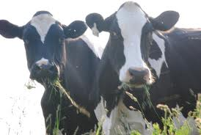
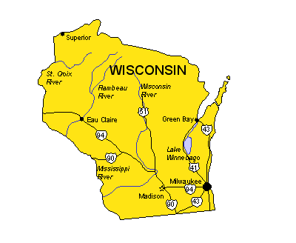
Geography: (WREN on the MOOve)
Wave I
Wave II
Notes:
Wave I sites indicated with star
Wave II triangle

Slide 45
Top 5 Lessons Learned
Create a Learning Collaborative among Practice Facilitators
  Development of chart audit feedback processes
  Weekly meetings to discuss progress at sites
  Practice Facilitators shared data reporting formats, report templates, novel implementation ideas
  Discussed strategies to deal with challenges and barriers
Notes:
Practice facilitation for this project relied on chart audit feedback. This aspect of the facilitator’s job was challenging and time-consuming, especially since most of the practices were new to WREN. These processes were not established pre-project. Learned a lot about the what is involved with chart reviews on a particular patient population.
WREN Practice Facilitators had differing levels of experience working in practices and with QI initiatives

Slide 46
2. Customize Facilitation for Each Site
Identify what decisions can be made within the practice vs. health system administration
Get to know the practice
  WI practices were large
  Not receptive to the idea of practice facilitator in clinic ½ day per week
Put the right team together
Notes:
1. Identify what decisions can be made within the practice vs. health care system administration
One of our LLCs was part of the same large health system. They wanted to work on patient education materials, but needed system-wide approval for all patient education materials. Team needed to wait for materials to be reviewed and approved. (benefit is dissemination beyond the LLC clinics within that system)
Another LLC was a 3 practice system . The Administrator, IT specialist and Lab supervisor were involved in the project. EHR and lab ordering processes developed by the group were acted upon quickly and consistent between practices
2. Get to know the practice
Many issues at the clinic level contributed to team interest, and ability to participate: other PBRN studies going on concurrently, staff turnover, switching EHR systems, competing patient priorities, other health-system initiated initiatives
During a LLC meeting, a busy FQHC told the Practice Facilitator that she had no idea what their day was like in the clinic. She suggested spending a day shadowing the clinicians. As she did this, she was able to suggest realistic ways to implement some of the improvements the team wanted to make. Her suggestions had more credibility with the LLC team, and they made improvements in their processes
3. Put the right team together
Interest in the topic/ multidisciplinary/ able to commit to the meetings and homework
At one clinic, the project was folded into an already scheduled microsystems team meeting slot, at the request of the clinic. This resulted in many more people being at the meeting than were actually working on the CKD project, negatively affected the group energy and dynamic

Slide 47
3. Build sustainability into practice improvements
Assist clinics to develop work flows around CKD practice improvements and assign accountability
Facilitate adoption of EHR changes
  Registries
  Alerts
  Standard order sets
  Patient education materials

Slide 48
4. Capitalize on training opportunities for practice facilitators
UW Quality Improvement Website
Joint training with UW Microsystems staff, Coaching self-assessment
Practice Facilitation webinars
Notes:
Because we had such a new staff, we looked for additional training opportunities to improve our QI knowledge and facilitation skills. Connecting with other QI groups within the UW System provided us with additional resources

Slide 49
5. Good Practice Facilitation Takes Time
Chart audit feedback a helpful tool, but facilitating the development of new processes most important
Single Academic Detailing meeting not always enough to assure understanding of guidelines
  Practice facilitators found ways to emphasize relevant guidelines during monthly feedback meetings

Slide 50
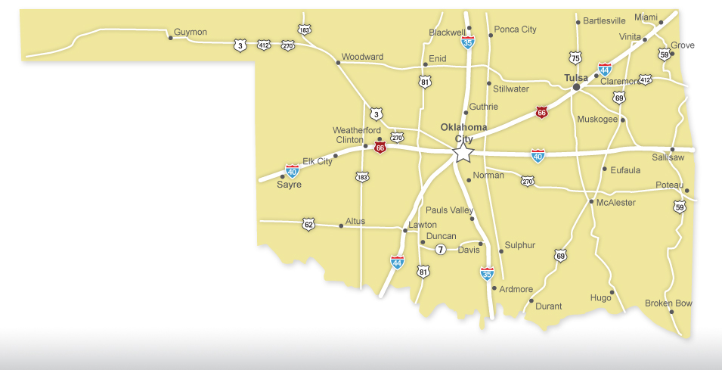
OKPRN Case Study
Location of 8 Original CKD Practices

Slide 51
OKPRN Project Realities
Small practices - often a single provider
Experienced PFs – each with more than 9 years’ experience working in OKPRN
Previous relationships with many of the clinicians
Long travel times for PFs
PFs dedicate one day per week to “administrative” activities
  Paperwork, e.g., reimbursement forms for clinics
  Review notes/progress with supervisor

Slide 52
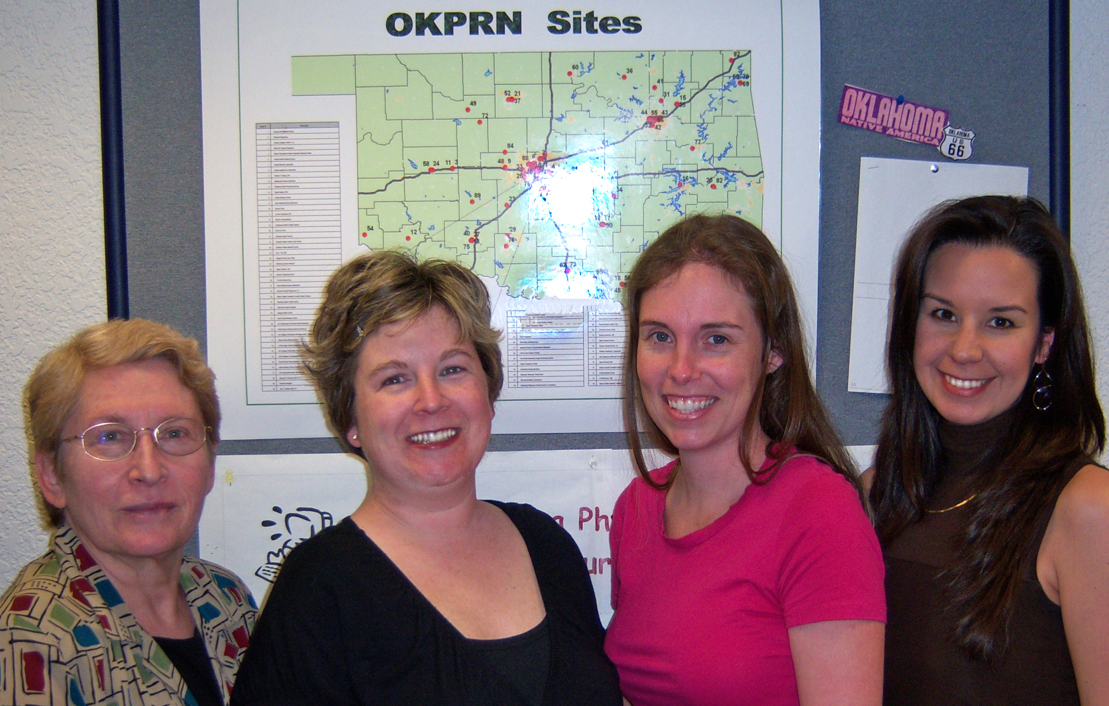

Slide 53
Typical OKPRN Facilitator Schedule
8 practices per facilitator per 6 month project cycle
½ day per practice per week so 4 days per week in practices
1 day per week in the Department
  30 minute individual debriefing session with supervisor to discuss progress in each practice and specific challenges
  1 hour group meeting to review each ongoing project (typically 5-6), with an emphasis on logistics (enrollment, milestones, challenges, opportunities, etc.)
  1 hour training
  5 hours to catch up on paperwork, research for the practices, scheduling, etc.

Slide 54
Visit Notes
Capture Process measures
Time preparing for the visit
Time in practice - (We believe that it is important for the facilitators to spend a half-day in each practice, even if they have nothing specific to do.)
  Broken down into specific types of activities
Perception of progress made toward meeting objectives

Slide 55
Lessons Learned
Having a previous relationship with a practice can be either a facilitator or detractor, e.g.,
  Outsider role – suggests change
  Insider role – sympathizes with difficulty of change
Clinicians change practice affiliations
Staff turnover within practices is very high
  Requires continual training/updating regarding project goals/responsibilities
Making Changes to EHR templates and changing laboratory reporting processes can be a challenge

Slide 56

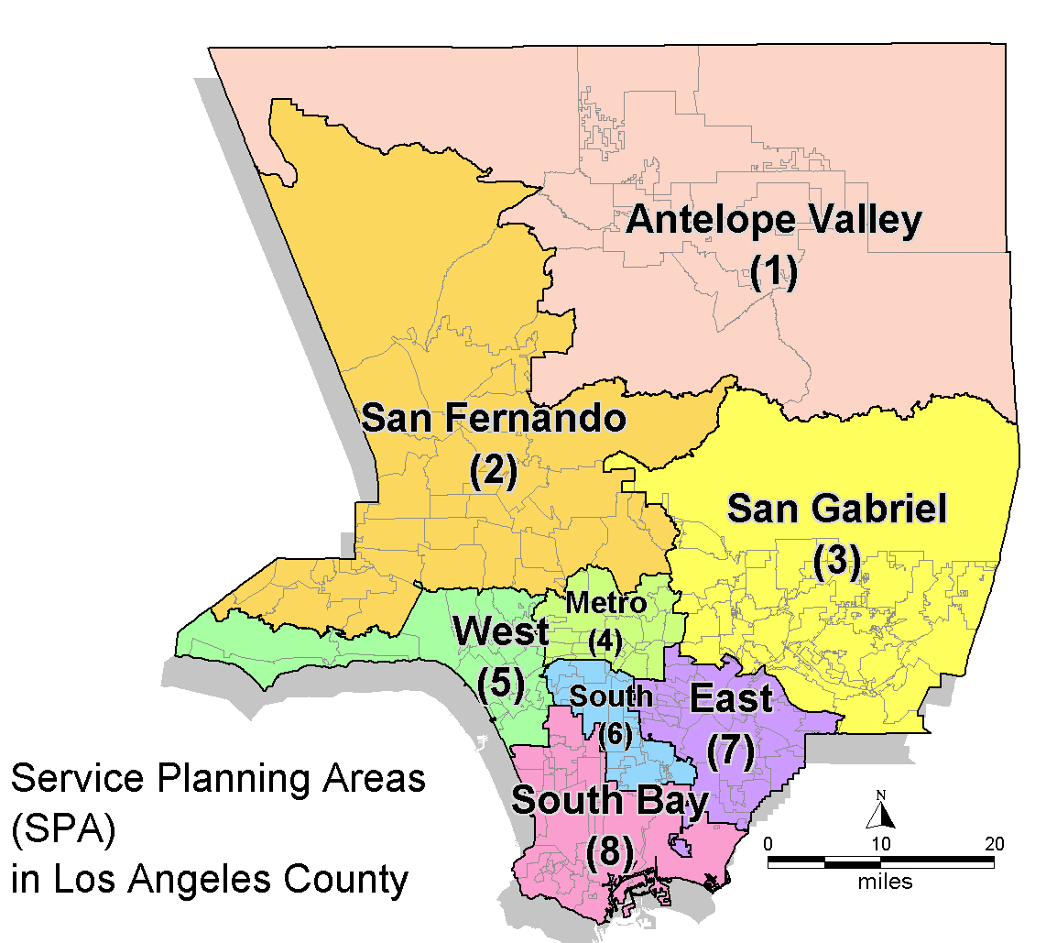
LA Net Case Example
L.A. County
Location of Wave 1 practices

Slide 57
LA Net Project Realities
Sites:
  5 Multi-site FQHCs
  1 small CHC
  1 small safety net private practice
All focused on:
  EHR implementation (est. $1 mil loss in 1st year)
  PCMH transformation/recognition
  Visit every 15 minutes
  SPD patient transition
Loss of CMO or champion at 5:8 sites
Not that interested in CKD ….

Slide 58
LA Net process
Step 1: Academic Detailing visit - Created Buy-in!
Step 2: Get data – Took forever! 6 months: 6 months
Step 3: Present data to practice team

Slide 59
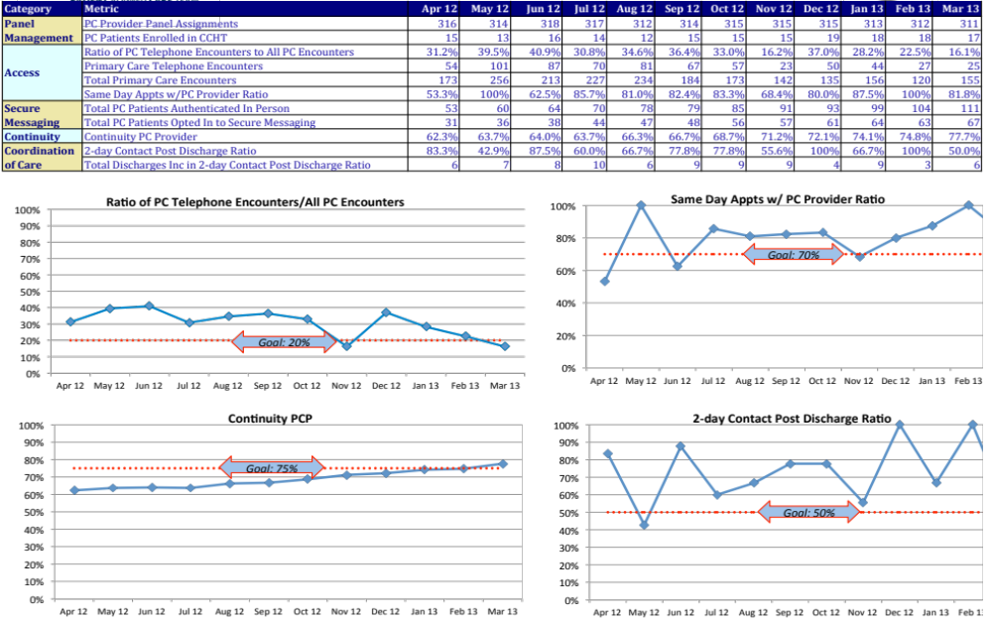
Present data to practice

Slide 60
LA Net process
Step 1: Academic Detailing visit - Created Buy-in!
Step 2: Get data – Took forever! 6 months: 6 months
Step 3: Present data to practice team
Step 4: Support changes

Slide 61
Support changes
A. HIT OPTIMIZATION
REGISTRIES. Set-up CKD patient registry and reporting for panel management and QI
  I2I tracks
  OCHIN report - $1200, 6 months to produce
DATA MAPPING. Identify and correct mapping errors in EHR
PERFORMANCE REPORTS. Performance reports at provider level on CKD metrics
TEMPLATES/REMINDERS. Set-up templates and alerts
TECHNOLOGY BASED HEALTH EDUCATION FOR LOW-LITERACY – Individualized health education using tablets/video
LIAISON W/ VENDORS. Correct registry product for AA CKD norms

Slide 62
Support changes
B. Changes to clinical processes
Change order sets – add eGFRs
Workflow mapping (which is mainly EHR mapping)
C. Clinician support
Project ECHO Knowledge Network on CKD (more academic detailing)

Slide 63
Lessons Learned from Wave 1
Improvement work is mainly about 2 things: “personalities & technologies”
Academic Detailing at the beginning of an improvement effort is vital
Data are still enormously hard to get – but also vital --- budget sufficient funds and time to get it
Processes like PDSAs are insufficient to drive change … need more robust models (Agile Development as a model)

Slide 64
Lessons learned from Wave 1
Larger organizations are more difficult to affect with a traditional PF--- but have the HIT and data systems
  PFs in these environments need deep skills in HIT
Smaller practices benefit more from PFs --- but lack the HIT and data systems
  PFs in these environments need skills in making do, reigning in unsustainable workarounds (hand entered registries), and finding low cost HIT resources

Slide 65
Lessons learned from Wave 1
CMOs must be kept in loop weekly or monthly – even if they delegate
PFs need to be monitored closely for support needs, and to assure follow-through – it’s easy for them to stop pushing esp. in large settings
  Liaise with the leadership
  Make sure work is focused on high impact
  Engage IT staff
Projects need to be mapped to PCMH, Meaningful Use, and PFP to get real uptake by orgs.

Slide 66
MAFPRN Case Study
Work within Health Systems

Slide 67
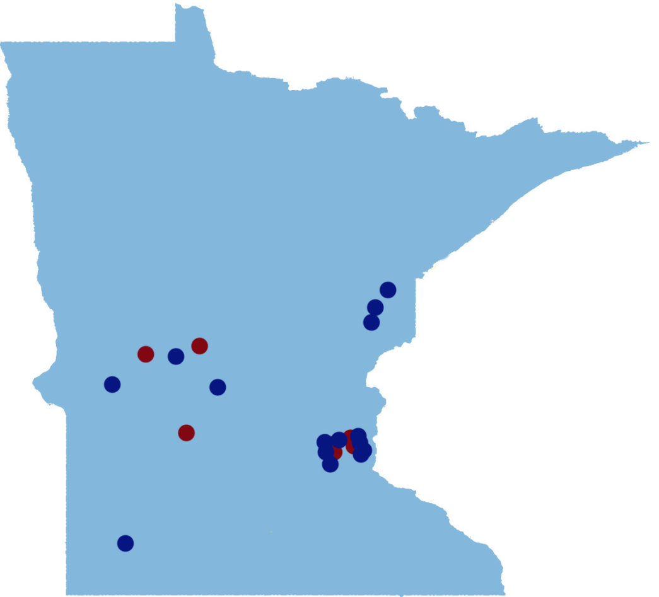
MAFPRN Participating Clinics
Wave I (Red)
3 Urban
1 Suburban
4 Rural
Wave II (Blue)
6 Urban
2 Suburban
6 Rural

Slide 68








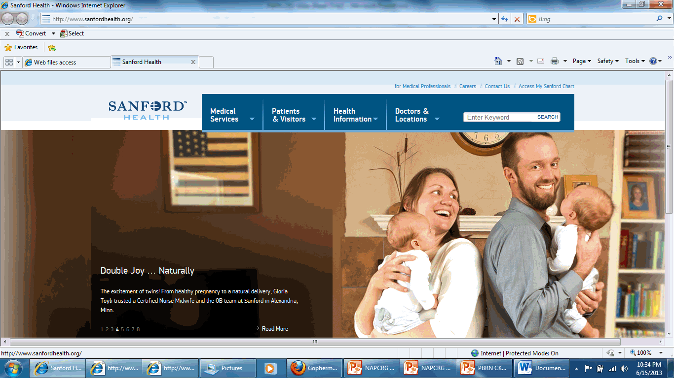

PF in Health Systems
– MAFPRN Experience
Health Systems dominate care delivery
Increased in 2011 to present as prepare for ACO’s
Urban area – mergers of Health Systems
Rural areas – remaining independent practices/hospitals “selling”

Slide 69
PF in Health Systems
Previous work with practices a key success factor.
System Medical Director has significant role.
Conflicting demands including EMR changes, staffing cuts, PCMH certification, other clinical performance measure reporting impact role of PF.
Two scenarios: Wave II not allowed to continue vs Wave “III” with sharing training/tools at Clinical Practice Committee.

Slide 70
PF in Health Systems
Scenarios
  Wave II practices not allowed to continue in two systems
  Clinics closed/merged
  System expanded project to include all clinics using work flows, pre-visit planning, order sets.
  Used internal QI staff as part of PF team for the project.

Slide 71
Small Group Discussion
What Common barriers and opportunities do you see among the four examples?
How do you plan to use this information?
Write a goal statement incorporating your plan.
  Example: By the end of January, I will have developed an evaluation plan for my practice facilitation project that will address ways to monitor and assess how PFs spend their time in practices.

Slide 72
Large Group
Small Group Reports

Slide 73
Summary
PBRNs are using PFs increasingly
Evaluation of PFs may include the following:
  Process documentation
  Outcome documentation
  Qualitative documentation
Source of Data may include
  PF documentation of visit
  Survey data (Practice and staff)
  Chart Audits
  Focus Groups

