Slide 1
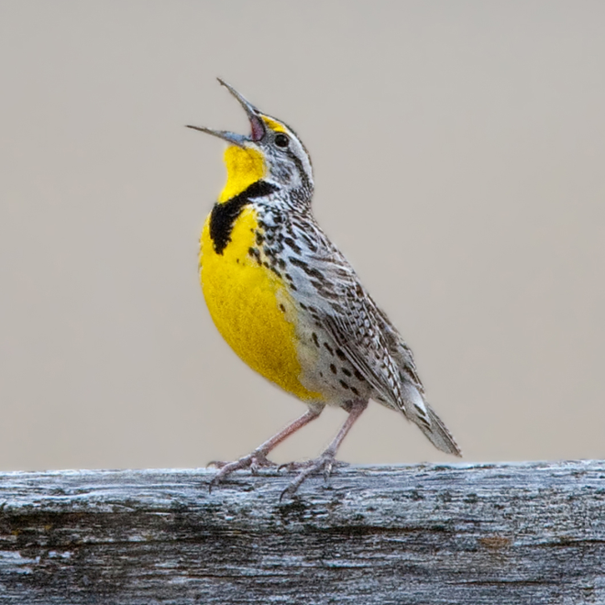
Multi Network Research Collaboration: Steps to Success
IRENE OCHIN ORPRN QPBRN SNOCAP WREN
Meta-Network Learning And Research Center (Meta-LARC)
June 18, 2013
NAPRG PBRN Meeting
Bethesda, MD

Slide 2
Workshop Outline
Introductions
AHRQ P30 RFA
Meta-LARC—who we are and how we communicate and make decisions
Rapid Response System to theAHRQ FOA: Practice-based Research to Improve Self-Management Support (PRISMS)—INSTTEP
“How could you advance PBRN research using a multi-network settting”—Focused Conversation Method (FCM)
Small group discussion using the (FCM), “What research questions could be answered by multi-network research networks”
Wrap Up and Discussion

Slide 3
AHRQ RFA, Research Centers in Primary Care Practice Based Research and Learning—P30’s
Requirements—more than 3 successful regional PBRNs, >120 practices, >10 states
Two cores—administrative and research
Infrastructure to promote novel and innovative dissemination and implementation strategies
Leveraging common resources to improve productivity, efficiency, more generalizable results and more attractive to funders
Minimal infrastructure to support the two cores for 5 years
Eight AHRQ Centers announced in September 2012

Slide 4
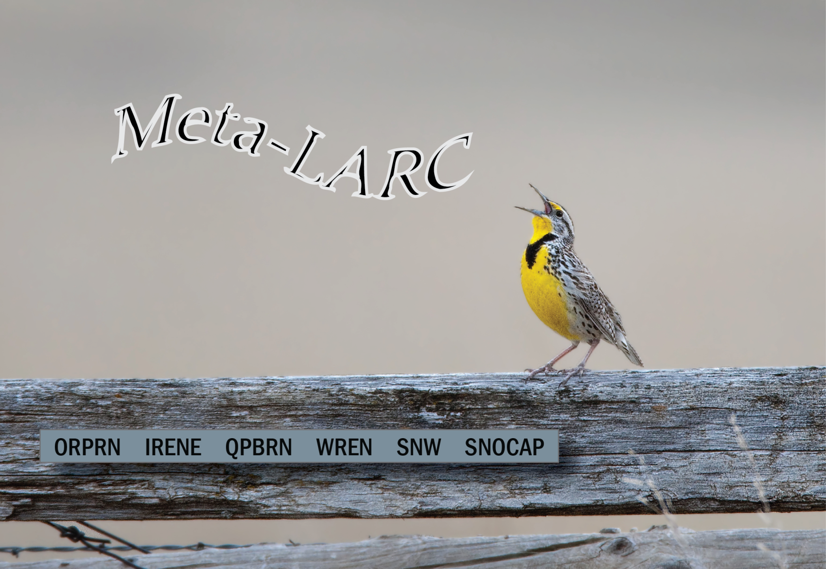

Slide 5
Meta-LARC Mission
To sustain a consortium of PBRNs dedicated to increasing the quality, effectiveness and safety of primary care through accelerated research and collaborative learning
Specific Aims
Aim 1: Foster the capabilities of six PBRNs (533 primary care practices with 6,600 clinicians caring for 3 million patients) through a robust collaboration designed to conduct research to improve the quality, effectiveness and safety of primary care.
Aim 2: Accelerate the conduct of PBRN research through a well designed, high functioning common infrastructure that enables the efficient conduct of research.
Aim 3: Promote continuous learning and sharing across Meta-LARC networks and practices to accelerate the dissemination of knowledge and bi-directional communication.

Slide 6
Network & Headquarters Location | Institutional Affiliations | Principal Investigator | Meta-LARC Coordinators | Expertise
ORPRN Portland, OR | Oregon Health & Science University | Lyle Fagnan, MD (Consortium PI) | LeAnn Michaels Nancy Rollins | Community-based participatory research & practice change
IRENE Iowa City, IA | University of Iowa College of Medicine | Barcey Levy, MD, PhD | Jeanette Daly, RN, PhD | Preventive health service delivery & cancer prevention/screening
QPBRN Quebec City, Quebec | University of Laval Medical School | France Légaré, MD, PhD | Ghislaine Tre, MSC, PhD | Shared decision making & Knowledge transfer
OCHIN Portland, OR | OCHIN, Kaiser NW, OHSU | Christine Nelson, PhD | Vance Bauer | Practice quality improvement
SNOCAP (Consortium of Three Networks) Denver, CO | University of Colorado School of Medicine | Donald Nease, MD | Tabria Winer, MPH | Practice quality improvement
WREN Madison, WI | University of Wisconsin School of Medicine | David Hahn, MD, MS | Melody Bockenfeld, MPH | Practice work flow & Health IT

Slide 7
Meta-LARC Infrastructure
Administrative Core
Research Core
Communication
Shared leadership
Study applications
Agendas, minutes, ShareCenter
Governance
Data analysis plans
Library of Survey instruments
Clinic and patient database
Recruitment methods
IRB oversight
SOP for data collection and transfer
Biostatistics Core

Slide 8
Meta-LARC Governance
Common agenda
Shared measurement system
Mutually reinforcing activities
Continuous communication
Backbone support organization
Steering Committee
  PIs, MLCs, one key clinician from each network
  Clinician Advisory Committee
    2-4 clinicians from each network called on as needed
Evaluation of Performance
  Annually through online survey in REDCap

Slide 9
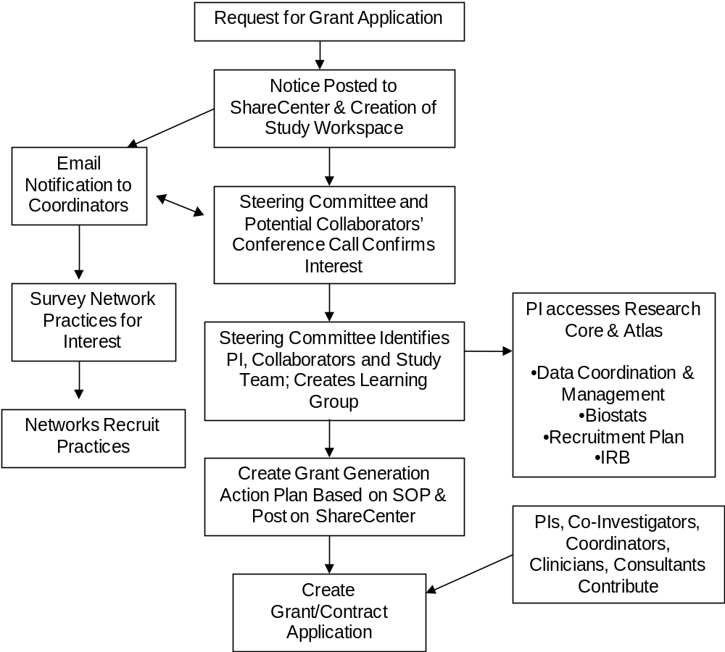
Rapid Response Plan

Slide 10
Learning Community
Learning Groups
Grand Rounds
Develop framework and methodology for each study
Data interpretation
Dissemination activities
Learning across networks and sharing between researchers and clinicians
Each network leads one training session per year
Saved on ShareCenter

Slide 11

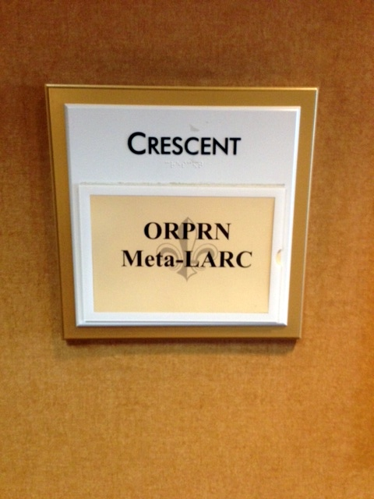
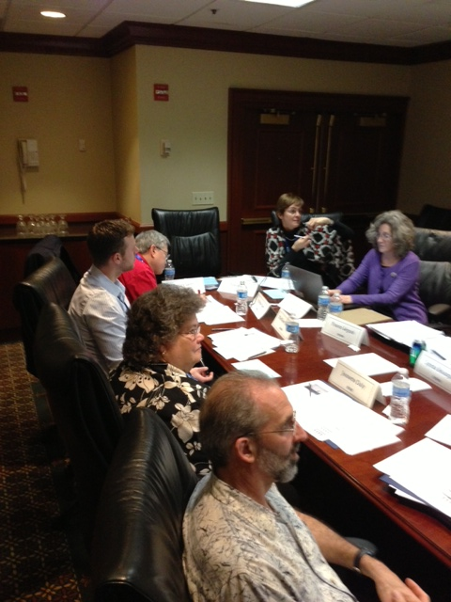
Building Meta-LARC @ NACPRG in The Big Easy, 1 December 2012

Slide 12
Consensus workshop method
Context, Brainstorm
CONTEXT
  Provide necessary background
  Introduce the Focus Question
BRAINSTORM
  Individual time to think and write responses
    Highlight top 3-5 responses
  Share in small group (3-5 people)
    Discuss ideas for clarity
  Write ideas
    Use 3-5 words
    Write boldly
    One idea per card

Slide 13
Consensus Workshop Method
CONTEXT
Explain outcome
Outline process
BRAINSTORM
Brainstorm individually
Select your best ideas
CLUSTER
Gather ideas from each group
Develop clusters
Highlight focus question
Bring to small group
NAME
RESOLVE
Discern focus of each cluster
Discuss cluster for clarity and insights
Name each cluster
Focused conversation
Create a product from the consensus
Reflect on the experience
CONSENSUS WORKSHOP METHOD: The Canadian Institute of Cultural Affairs, 1985, 1995, 1998, 2003, 2004

Slide 14
Consensus workshop method Cluster, Name, Resolve
CLUSTER
  Gather cards from each group
    Ask for interpretation when needed
    Accept and acknowledge all responses
  Ask the group to group similar cards
    Place into a column and use symbol to head the column
    Relate all extra cards and collect all of them
NAME
  Discern the focus of each cluster
  Group to name each cluster
RESOLVE
  Pull together whole picture with focused conversation
  State next steps

Slide 15
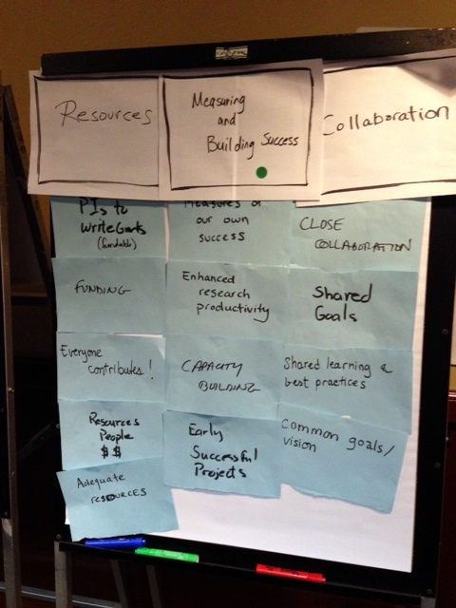
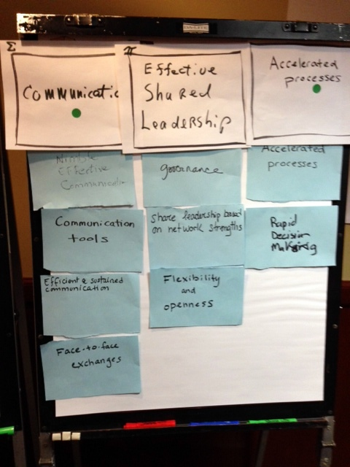
A Focused Conversation

Slide 16

What is needed to ensure Meta-LARC’s success?
Communication | Effective Shared Leadership | Accelerated Processes | Resources | Measuring and Building Success | Collaboration
Nimble, Effective Communication | Governance | Accelerated Processes | PIs to Write Grants (Fundable) | Measures of our Own Success | Close Collaboration
Communication Tools | Share Leadership Based on Network Strengths | Rapid Decision Making | Funding | Enhanced Research Productivity | Shared Goals
Efficient and Sustained Communication | Flexibility and Openness |  | Everyone Contributes! | Capacity Building | Shared Learned and Best Practices
Face-to-Face Exchanges |  |  | Resources and People and $$ | Early Successful Projects | Common Goals/Vision
 |  |  | Adequate Resources
Meta-LARC meeting December 1, 2012
NPCRG
New Orleans

Slide 17

Responding to PRISMS
AHRQ FOA: Practice-based Research to Improve Self-Management Support
Meta-LARC response: Implementing Networks Self-management Tools Through Engaging Patients and Practices (INSTTEPP)

Slide 18
Timeline
RFA announced- 12/07/12
Initial email discussion- 12/12/12
Discussion that we need to involve as many networks as possible, perhaps piggybacking is not the best-Phone call- 12/17/12
Internal discussions at CU- 12/19/12
  Don, Perry, Jack and Jodi - could we piggyback on just launching Connection to Health project?
Phone call with Perry and Meta LARC
  Decided to not piggyback so most networks could participate

Slide 19
Idea and proposal development
Development and initial presentation of bootcamp concept- Meta-LARC phone call on 12/21/12
Buy in from other networks/Email finalization of participating networks (4)- 12/22/13
Proposed budget and draft research plan Discussion- 1/4/13
  Don and LJ
Presentation of research plan and budgets to participating networks- 1/8/13
Title finalization- 1/9/13

Slide 20
Submission and...
6 letters of support from network practices in each network sent to OHSU- 1/16/13
Budgets, budget justifications, scope of work, letter of intent for each network sent to OHSU- 1/17/13
OHSU submission- 1/18/13
Final prep at each site
AHRQ Submission- 1/30/13
Critique responses- 4/15/13
IRB work- in progress

Slide 21
How could you advance PBRN research using a multi-network setting?

Slide 22
What research questions could be answered by multi-network research networks?

