Slide 1

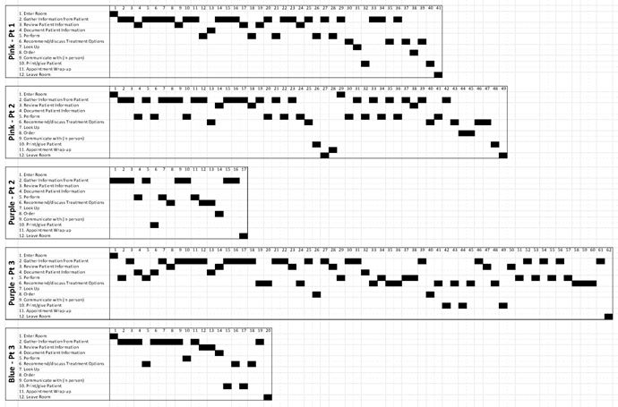

Workflow? Schmerkflow! The myth of workflow in primary care and why it matters for health IT design and implementation.
I-PrACTISE
National Laboratory for Improving PrimAry Care Through Industrial and Systems Engineering
Investigators: John W. Beasley, Jamie A. Stone, Daniel J. Krueger, G. Talley Holman, Paul Smith, Mary Ellen Hagenauer, Ben-Tzion Karsh, Jon Temte, Tosha B. Wetterneck,
UW Departments of Medicine, Family Medicine and Industrial and Systems Engineering, Wisconsin Education and Research Network. (WREN)
John.beasley@fammed.wisc.edu
Methods: 140 adult visits observed, FM and GIM, 17 clinics, 11 with EHR. Defined 12 major and 189 subtasks. The sequence of addressing 12 major tasks was analyzed for 20 of these visits.
1. Enter room
2. Gather information from patient
3. Review patent information
4. Document patient information
5. Perform (e.g physical exam, procedure, dictate, login, etc)
6. Recommend/discuss treatment options
7. Look up (e.g. treatment information, other physicians, drugs, etc)
8. Order
9. Communicate
10. Print/give patient (advice, instructions)
11. Appointment wrap-up
12. Leave room
AIM: To define the sequence in which tasks are addressed in primary care encounters.
Background: Interventions to support primary care, including EHRs need to take into account the realities of workflow during the encounter. Information chaos is a reality in primary care, and leads to hazards. Thus, we need to understand workflow to reduce chaos.
Results: There is, between entering and leaving the room, no consistent workflow. The order in which tasks are addressed is unpredictable as they respond to patient needs.
Workflow? Schmerkflow!
Implications: If we are to be efficient and safe we need EHRs that are adaptable, and allow immediate, clear access to any data needed without delay or break-in-task.
References: Wetterneck TB, Lapin JA, Krueger DJ, Holman GT, Beasley JW, Karsh BT. Development of a Primary Care Physician Task List to Evaluate Workflow and EHR Use. BMJ Qual Saf doi:10.1136/bmjqs-2011-000067
Beasley JW, Wetterneck T, Temte J, Lapin J, Wetternick T, Smith P, Rivera AJ, Karsh BT. Information Chaos in Primary Care: Implications for Physician Performance and Patient Safety. Jr Am Board Fam Med 2011;24:745-51
Work supported in part by grant 1P20HS017115 from the Agency for Healthcare Research and Quality (PI: Karsh) and by grant 1UL1RR025011 from the Clinical & Translational Science Award (CTSA) program of the National Center for Research Resources National Institutes of Health to WREN (Paul Smith).

