Slide 1


Teach Back
Fast, Efficient, and Normal
Wisconsin Health Literacy Summit
April 9, 2013

Slide 2
Objectives:
At the conclusion of this presentation, participants will be able to:
Define the teach back method and give examples of where/when it can be used in the clinic or hospital setting.
Identify some of the ways the teach back method can assist patients’ understanding of instructions and information.
Demonstrate teach back steps that improve efficiency, and improve clients’ understanding and accuracy for instructions and information.

Slide 3
Conflict of Interest
I work as an independent contractor with the non-profit Sage Words Health Communications.
I do not have any other relationships with pharmaceutical companies, biomedical device manufacturers, and/or other corporations whose products or services are related to pertinent therapeutic areas.

Slide 4
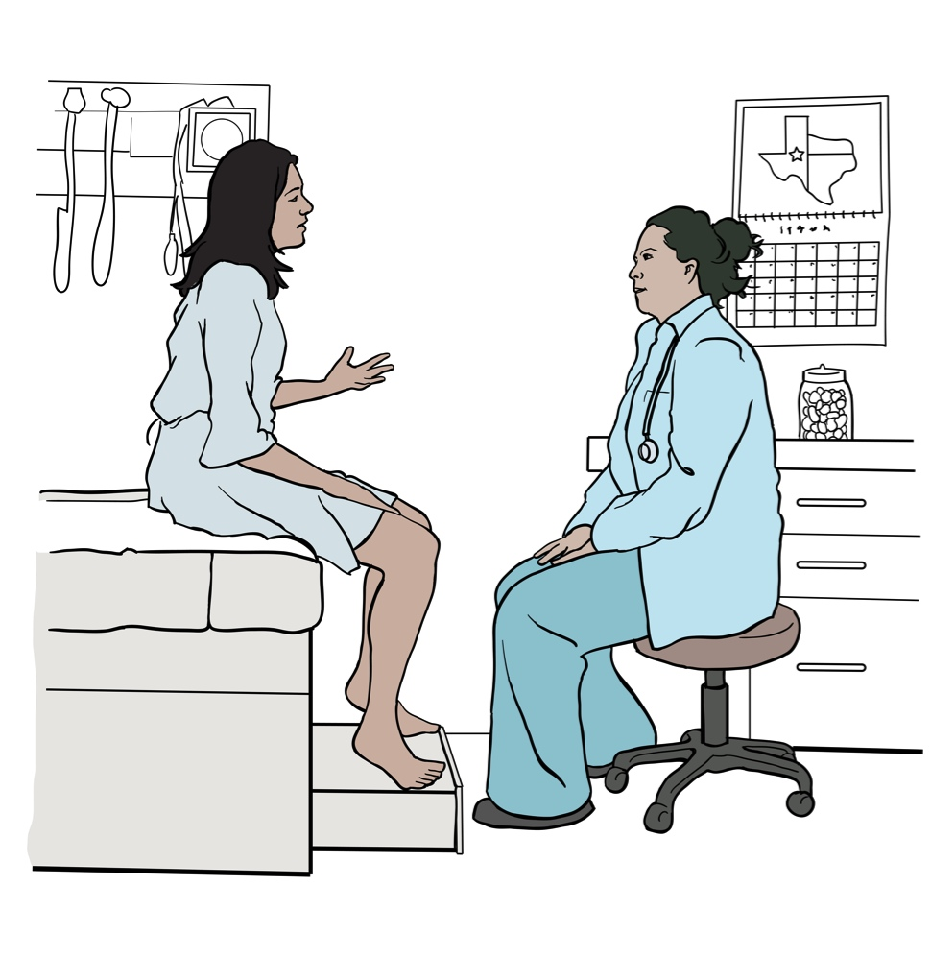
A definition from an MD
Teach-back is a way for practitioners to confirm that what they explained to the patient was clear and understood. Patient understanding is confirmed when the patient explains it back to the practitioner or does a return demonstration (instead of just saying, “Yes, I understand.”)
Darren A. DeWalt MD
Teach Back: The Benefits and Challenges.” October 10, 2011 Engaging the Patient blog
http://engagingthepatient.com/2011/10/10/teach-back-the-benefits-and-challenges/

Slide 5
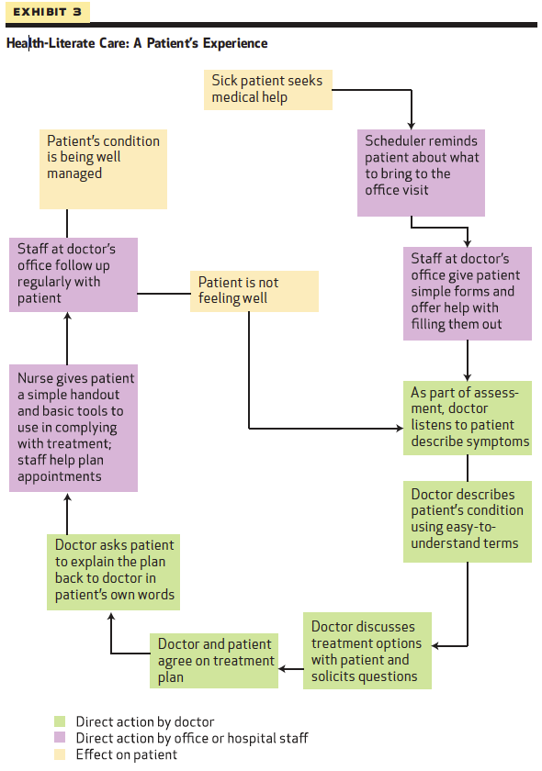
The Role of Teach Back in Health Literate Care
Source: New Federal Policy Initiatives To Boost Health Literacy Can Help The Nation Move Beyond The Cycle Of Costly ‘Crisis Care’ By HK. Koh, DM. Berwick, C M. Clancy, C Baur, C Brach, LM. Harris, and E G. Zerhusen. Downloaded from content.healthaffairs.org by Health Affairs on May 6, 2012

Slide 6
Dr. Dewalt also said
“I have to work on integrating teach-back into my own practice… because being taught how to do the teach-back method does not mean I use it when I should. In fact, I was embarrassed the first few times I taught teach-back because I knew in my heart that I didn’t use it very often.”
http://engagingthepatient.com/2011/10/10/teach-back-the-benefits-and-challenges/

Slide 7

Why is it so hard to incorporate?
Not rocket science
A few steps which can be explained in minutes
Conceptually easy to understand

Slide 8
Three Possible Answers
Difficult to change
“Many clinicians are like me and have difficulty changing their routines
and integrating new strategies.” Dr. Dewalt
Does it really work?
Takes too much time

Slide 9
Delivery and Reception
“The most amazing thing about this ‘ah ha’ moment was that I had no idea she did not understand until I asked her to teach it back to me. I was so wrapped up in delivering the message that I didn’t realize it was not being received.”
Source: North Carolina Program on Health Literacy via UW Medicine System’s University of Washington Medical Center slide show “Teach Back: A tool to enhance patient understanding. 07/2011 http://depts.washington.edu/pfes/PDFs/Teach_Back_Slideshow_7_5_11.pdf

Slide 10
Health Literate Communication
“They [paramedic on the street, a nurse in a public health clinic] have to carefully figure out how they’re going
to translate
what they know to an end user who needs that information so they can pursue optimal health and wellness.”
Richard Carmona
17th Surgeon General of the United States
http://www.healthliteracyoutloud.com/2011/05/31/health-literacy-out-loud-59-surgeon-general-richard-h-carmona-m-d-m-p-h-facs-talks-about-the-importance-of-health-literacy/#more-190

Slide 11
Yet another way of saying this:
  As communicators, we tend to do the following:
          overestimate what other people know.
          default to our own models—ie to what we know.
          then we adjust, but insufficiently.
  This tends to be especially true when the information is familiar to us. Instead, we need good models of what our patients know. And until we check in, we can’t know.
  “Numeracy, Risk, and Health Decisions” Ellen Peters PhD. Presentation, Institute for Healthcare Advancement
  11th Annual Health Literacy Conference May 11, 2012

Slide 12
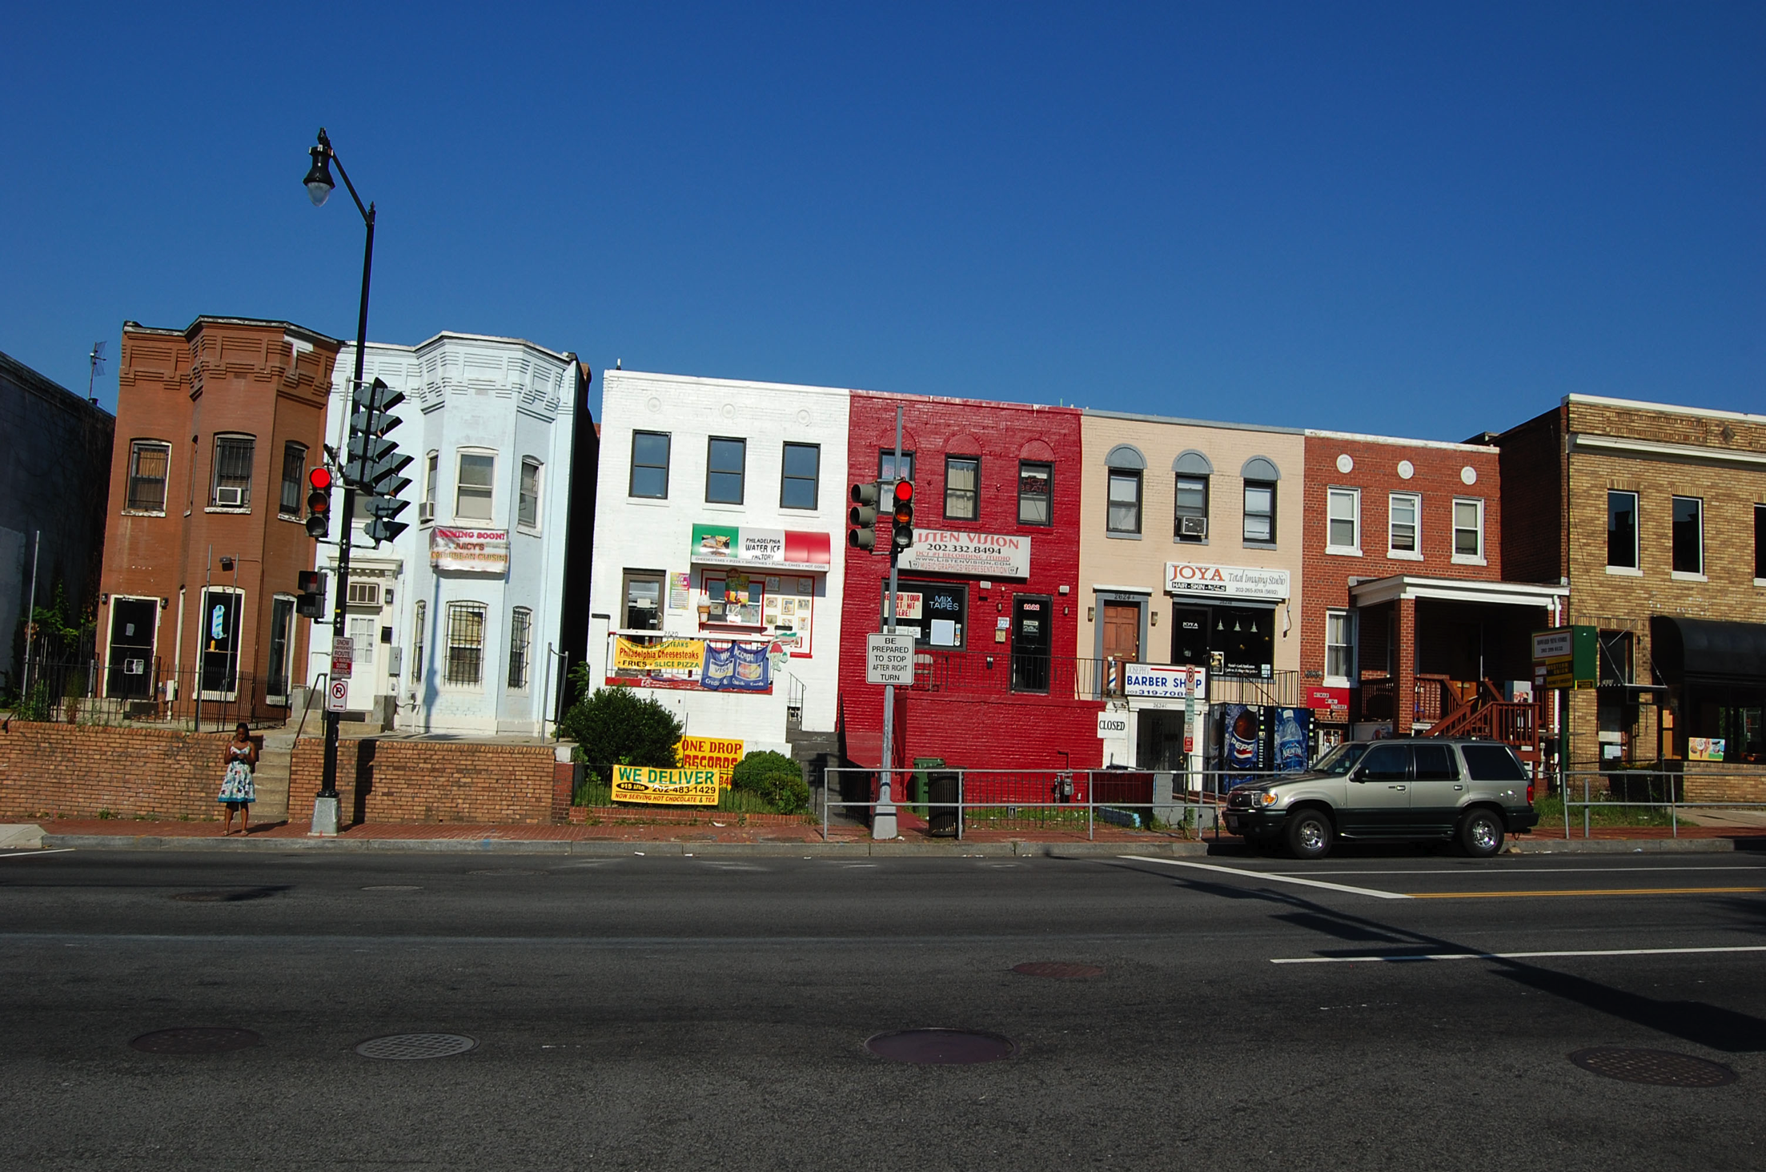
What? What is this about? What do they know that I don’t? Why are they asking me THIS question? What are they thinking about me?
“…how many sexual partners have you had in the last six months…”
This is making me kind of nervous.
Plus when I left my three-year old off at day care she was crying…
I really just need to get going. I can’t afford to lose any work time.
Gee I’ve never been to this clinic before– not sure I’m doing this right.

Slide 13
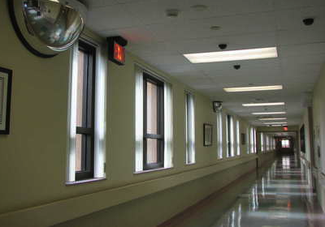
This is a routine question. We ask all our patients this question. Our goal is to understand whether or not you might be at risk for sexually transmitted diseases like Hepatitis B.
“…how many sexual partners have you had in the last six months…”
Hepatitis B is sexually transmitted.
Except during the acute phase, you may be infected but not have any symptoms.
Hep B is contagious…

Slide 14

Teach back is a way for you to check in,
to discover the gaps in information,
and missing context,
AND
This is what I need to know
a way of enabling your clients
to tell you
what they don’t understand

Slide 15



Exercise A
Group 1
Group 2
Group 3
This exercise is a variation on one offered by Jen Kimbrough, Research Assistant Professor,
UNC Greensboro, to Health and Health Literacy Discussion list HealthLiteracy@lincs.ed.gov

Slide 16
Teach Back:
Five quick steps
Step 1: Think ahead
    “Triage” the information
    Organize (chunk) information (no more than two or three key facts)
Step 2: Explain
    Plain language
    Slow, with pauses
Step 3: Ask the client to explain back to you, but take responsibility for the communication.
    “I want to be sure that I did a good job explaining about …, because this can be confusing/is complicated/is a lot of information.. Can you explain to me what I just told you… Would you mind saying back to me what I just told you
Step 4: Listen
    Allow time for the patient to respond. Try not to interrupt.
Step 5: Affirm, or if necessary, say it again.
    Rephrase, don’t just repeat. You can also rephrase the question you ask
    Ask the client to try again.
    Continue until you feel the client can say the information accurately

Slide 17
Demonstration
Provider
Kath
Patient
Theresa

Slide 18
Step 1: Think ahead
  “Triage” the information
    What’s the most important thing I want my patient to know/understand?
    What does the patient want to know?
    What is important to be able to do at home without mistakes?
    What do I really want them to remember?
              How much can I ask them to remember?
        What’s the most difficult thing for my patient to do?

Slide 19
Information
Recommended by Guidelines
General topics
Explanation of heart failure
Expected symptoms vs symptoms of worsening heart failure
Psychological responses
Self-monitoring with daily weights
Action plan in case of increased symptoms
Prognosis
Advanced directives
Dietary recommendations
Sodium restriction
Fluid restriction
Alcohol restriction
Compliance strategies
Activity and exercise
Work and leisure activities
Exercise program
Sexual activity
Compliance strategies
Medications
Nature of each drug and dosing and side effects
Coping with a complicated regimen
Compliance strategies
Cost issues
Grady et al. Circulation. 2000;102(19):2443-2456. Slide from “Addressing the Problem of Health Literacy: Practical Approaches in Practice,” Darren DeWalt, MD, MPH
& Michael Pignone, MD, MPH University of North Carolina-Chapel Hill Department of Medicine http://www.nchealthliteracy.org/teachingaids.html

Slide 20
Some other triage factors:
  How soon will you see this client again?
  How likely is she to return for her appointment?
  How easy is it for her to find and understand this information elsewhere?
  How upset is this patient?
  How able is she to retain information right now?
  Does my organization have health educators on staff?

Slide 21
Organize the information
your teach back
“C
h
u
n
k”
  Don’t try to do teach back at the end of a long conversation.
  You might need to do teach back more than once during a session, for more than one “chunk.”
  Organize your “chunk.” Eliminate “extra” information and say it in a logical order.

Slide 22

Example:
Birth Control Pills
The provider has just:
Explained how the pill works to prevent pregnancy
When to start
How to take the pill correctly, including what to do about missed pills
Some of the side effects you might experience when starting OCPs
The benefits and advantages of using birth control pills
The dangerous side effects
When you need to use a back-up method
How am I ever
going to remember
all this stuff?

Slide 23
Source: New Federal Policy Initiatives To Boost Health Literacy Can Help The Nation Move Beyond The Cycle Of Costly ‘Crisis Care’ By HK. Koh, DM. Berwick, C M. Clancy, C Baur, C Brach, LM. Harris, and E G. Zerhusen. Downloaded from content.healthaffairs.org by Health Affairs on May 6, 2012

Slide 24
Step 2: Explain
Use plain language
  Use “signpost” language
Go slowly and pause often
Pay attention to body language and facial expressions

Slide 25






An organizing tip: use signpost language
First you will need to…
It’s important to do this because…
Next I want you to…
You need to do this
because…
Now, I want to make sure
I did a good job
of explaining.
Can you tell me
what you’re going to do?

Slide 26
The good thing is…
if you haven’t done these things—
          organize the information
          use plain language
—your client will let you know in the teach back process.
“We have been surprised at times by how different what we thought we said
and what the patient heard have actually been.” Jeri Reid MD and Donna Roberts MD
“The Teach Back Method for Improving Patients’ Health Literacy” University of Louisville School of Medicine

Slide 27
Step 3: Turn the ball over to the client, but remember to take responsibility.
First say “I want to be sure that I did a good job explaining about…. because this is complicated and can be confusing. Can you tell me/show me_______?”
Or “That was a lot of information I just gave you. I’m wondering if I said it clearly. Can you tell me what you are going to do when you get home?
Or, “ When you get home and your husband asks you what the doctor said, what will you tell him?”
Or, “Now, can you tell me how you would explain this to a friend?”
Notes:
.

Slide 28
The key to efficiency is focus
Can you explain THIS to a friend?
Can you tell your wife WHAT the doctor told you?
Can you tell me about __________________?
Fill in that blank carefully!

Slide 29
What if you said--
Okay, now tell me what I just said.
Oh my, I don’t remember, this is like a test, I didn’t really get it, she’s going to think I’m an idiot, I don’t even know where to begin. And I feel sick!
I forgot.

Slide 30
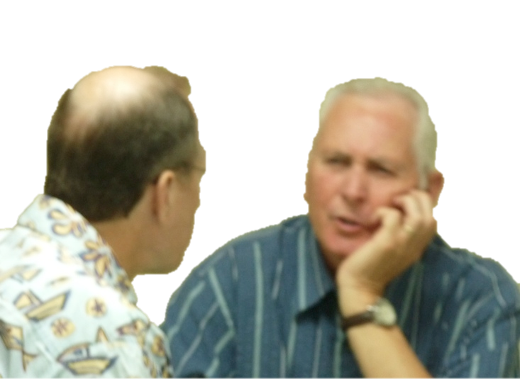
Step 4: Listen
…listening, listening, listening…
Allow the patient time to respond.
I think…….maybe….
I guess maybe….I should take one pill in the morning with breakfast?
Try not to interrupt.
…listening, listening, listening…

Slide 31


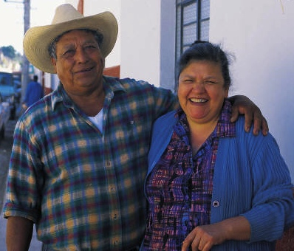
    Cues to difficulty
    Listen for vagueness and inaccuracies.
    Watch your client: facial expressions, blank looks, fear, looking lost, looking away and so on.
    Be aware, as much as possible, of the context your client comes from.
    Rely on your experience:
          What are misunderstandings or mistakes that occur over and over again with clients in your practice, and within your specialty?
      .

Slide 32
Step 5: Affirm, or if necessary, say it again
Follow up: so, let’s see if I did a better job. Show me how many pills you are going to take in the morning.
Rephrase, don’t just repeat the information. Try a different question.
Continue until you feel the client can tell you what to do.

Slide 33

Best way to make it normal, fast and efficient?
Practice!

Slide 34
Teach Back:
Five quick steps
Step 1: Think ahead
    “Triage” the information
    Organize (chunk) information (no more than two or three key facts)
Step 2: Explain
    Plain language
    Slow, with pauses
Step 3: Ask the client to explain back to you, but take responsibility for the communication.
    “I want to be sure that I did a good job explaining about …, because this can be confusing/is complicated/is a lot of information.. Can you explain to me what I just told you… Would you mind saying back to me what I just told you
Step 4: Listen
    Allow time for the patient to respond. Try not to interrupt.
Step 5: Affirm, or if necessary, say it again.
    Rephrase, don’t just repeat. You can also rephrase the question you ask
    Ask the client to try again.
    Continue until you feel the client can say the information accurately

Slide 35
Practice in “real life” and then evaluate:
        How did it go?
        What would you do differently?
        Did the patient seem to mind?
        Did the teach-back uncover any miscommunication?
        Did anything change between this time and the last time?
        How much time did it take?
Adapted from Teach Back: The Benefits and Challenges: October 10, 2011 http://engagingthepatient.com/2011/10/10/teach-back-the-benefits-and-challenges/

Slide 36
“Teach-Back” in Your Words
Nurse Practitioner: I ask the client to tell me, ‘at what point are you going to take the pill, how are you going to use the package,’ so she can show to me that she knows how to use it. I know that other staff are giving the information but I want to make sure that she understands that information, so…
Nurse: So, whatever we say, the nurse practitioner goes over it again.
Nurse Practitioner: If the client says, ‘she already told me,’ I say, ‘Okay, can you tell me what she told you?’

Slide 37
Medical Assistant: I ask the client, okay, explain to me, if you miss a pill, what should you do? If she doesn’t know how to explain it to me, right there, I already know, okay, she’s not really grasping this information.
So I go over it with her again. This is what you do if you miss one pill, this is what you do if you miss it for two days. I give her an example. I say, “Let’s say you left town for the weekend and left your pills at home. So you missed two pills. What are you going to do now?”
I also give her the pill packet. If she can’t show me what to do, I really don’t feel comfortable.
Because they’re bound to miss their pill. It’s going to happen. So it’s just like, okay you’ve got to really break it down for them.

Slide 38
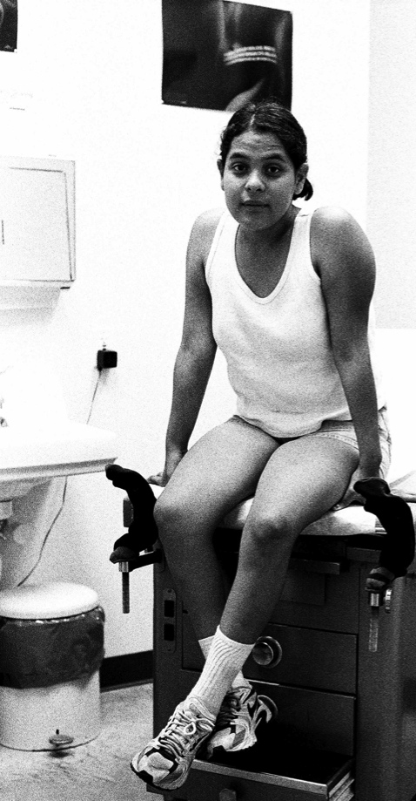
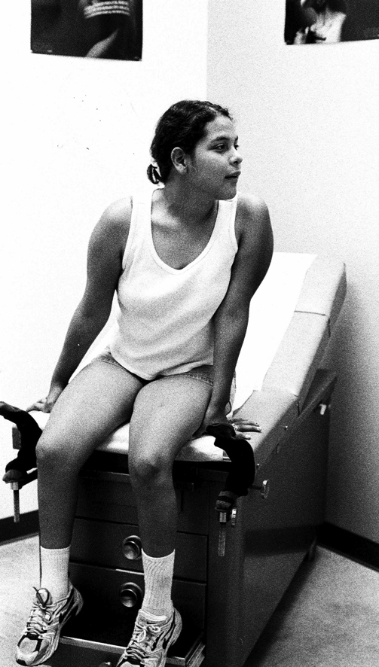
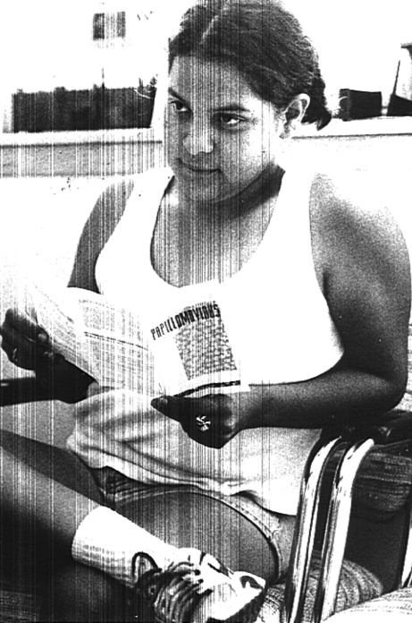
Repeat, repeat, repeat, repeat!
Help your patient to:
See it
Hear it
Take it home
Say it

Slide 39


Helps to internalize the information
I can tell you how to do this!
Teach back
Somebody told me how to do this.

Slide 40
Doesn’t it take too much time?
“Busy medical residents and practicing physicians may, however, be reluctant to adopt new interviewing behaviors that they believe will lengthen the medical encounter.”
    less than 30 seconds = assess baseline understanding
    1 to 2 minutes = teach back
Save time by
    tailoring information to the patient’s individual needs
    limiting the amount of information provided to the most important points (triage)
“The net effect on time is usually neutral; some physicians actually save time.”
Teaching About Health Literacy and Clear Communication Sunil Kripalani, MD, MSc Barry D. Weiss. J GEN INTERN MED 2006; 21:888–890.

Slide 41
Exercise A:
Does it work?
Group 1
Group 2
Group 3
Say “yes” when asked if you understand
NO questions.
NO pencil and paper.
Not invited to “say back” the information, but CAN ask questions.
NO pencil and paper.
CAN ask questions.
CAN use pencil and paper.
IS invited to “say back” the information
This exercise is a variation on one offered by Jen Kimbrough, Research Assistant Professor,
UNC Greensboro, to Health and Health Literacy Discussion list HealthLiteracy@lincs.ed.gov

Slide 42
Correct answer:

Slide 43

Thank you!
PO Box 302772
Austin, TX 78753
512 468-9419
www.sagewords.org
kath@sagewords.org

