Slide 1
Advancing Health Literacy of Transplant Patients and Caregivers
Julia G Behrenbeck, MS, MPH, RN, Rachel F Carroll MAE, BAS, William Sanchez, MD, Kathleen J Yost PhD
2013 Wisconsin Health Literacy Summit
April 9 & 10, 2013

Slide 2
Objectives
Learn how the AHRQ Health Literacy Universal Precautions Toolkit may be utilized in a Transplant Practice.
Describe how a practice and patient/caregiver assessment can identify potential areas of improvement and practice changes to help advance patient/care giver health literacy.
Identify attributes of patient education material that make it more understandable for patients and families.
Conflict of interest disclosure: None

Slide 3
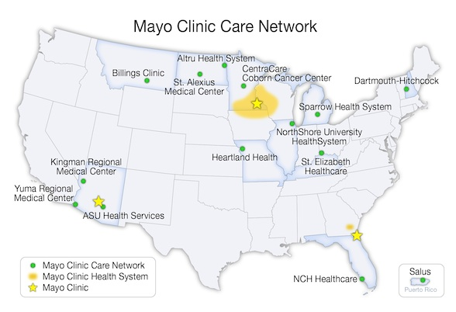
Notes:
Mayo Clinic is a nonprofit worldwide leader in medical care, research and education for people from all walks of life. Doctors from every medical specialty work together to care for patients, joined by common systems and a philosophy of "the needs of the patient come first." Mayo Clinic is governed by a 33-member Board of Trustees.
Mayo Clinic Rochester - Mayo Clinic, Saint Marys Hospital and Rochester Methodist Hospital form the largest integrated medical center in the world, providing comprehensive diagnosis and treatment in virtually all medical and surgical specialties. More than 350,000 patients from all walks of life seek answers at Mayo Clinic each year.
Mayo Clinic Health Care System – over 70 locations.
The Mayo Clinic Care Network is a network of like-minded organizations which share a common commitment to improving the delivery of health care in their communities through high-quality, data-driven, evidence-based medical care.
The network recognizes that people prefer to get their health care close to home. The main goal of the network is to help people gain the benefits of Mayo Clinic expertise without having to travel to a Mayo Clinic facility.
The network achieves this goal by developing closer relationships with community medical providers through formal collaboration and information-sharing tools, including: eConsult, Ask Mayo Expert, business processes and administrative consulting.

Slide 4

Tips For Health Care Professionals to Advance Health Literacy:
Notes:
Ran news article on Mayo Clinic intranet in Oct. 2011 with information on tips for health care professionals to advance health literacy. Section of Patient Education offered consultation for use of the AHRQ Health Literacy Universal Precautions Toolkit in a practice area.
Use various forms of communication: news center, intranet web-site, posters, seminars and lectures, grand rounds, journal clubs, etc.

Slide 5
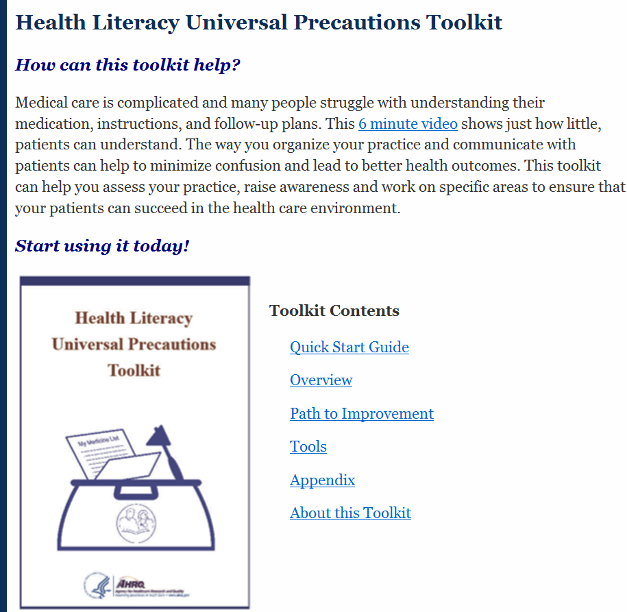
Adapt to
Transplant Practice
Notes:
Multidisciplinary team – physicians, nurses, social worker, dietician, operations manager and staff, patient education, research.
Interest and leadership support from clinical area is key.
Transplant patients and caregiver go through a complex evaluation and treatment process – one size fits all! Obvious room for improvement. Gaps are numerous. Increased time – not a good option. Patient advocacy group described information transfer as “fire hose” approach.
Two separate, but related initiatives. AHRQ – Health Literacy Universal Precautions Toolkit and standardization of transplant program patient education material.

Slide 6

Practice Assessment - Methods
Tool #2 “Assess Your Practice”
  49 questions
    Improve spoken communication
    Improve written communication
    Improve self-management and empowerment
    Improve supportive systems
    Response scale: Doing Well, Needs Improvement, Not Doing, Not Sure
  Workgroup selected a subset of 22 questions
  Also asked medical degree and transplant area “mainly” work
  Handed out at faculty & staff meetings
  Anonymous

Slide 7
Practice Assessment - Results
70 total responses
  17 MD/DO
  2 PA
  3 NP
  27 RN
  8 RD
  3 MSW
  10 other (clinical assistant, referral coordinator, missing)

Slide 8
Practice Assessment - Results
Top 5 - Doing Well | All trnsplnt areas N=70 | Kidney N=18 | Liver N=13 | Heart/ Lung N=13 | BMT N=11
Staff uses trained interpreters or language services with patients/caregivers who do not speak English well. | 77.14% | 83.33% | 76.92% | 76.92% | 63.64%
Staff creates an environment that encourages our patients/caregivers to ask questions and get involved with their care | 68.57% | 61.11% | 69.23% | 92.31% | 54.55%
Patient education materials are concise, limit jargon, and are designed using standard techniques to make them easy to read. | 61.43% | 38.89% | 84.62% | 69.23% | 54.55%
Staff talks with patients/caregivers about educational materials provided and emphasizes important information. | 57.14% | 61.11% | 69.23% | 53.85% | 54.55%
Our practice requests and is open to feedback from patients/caregivers. | 52.86% | 44.44% | 46.15% | 76.92% | 36.36%

Slide 9
Practice Assessment - Results
Top 5 - Needs Improvement/Not Doing | All trnsplnt areas N=70 | Kidney N=18 | Liver N=13 | Heart/ Lung N=13 | BMT N=11
Staff encourages patients/caregivers to state key points in their own words (i.e. teach-back) to assess understanding. | 68.57% | 88.89% | 61.54% | 69.23% | 54.55%
Staff uses clear oral communication techniques (e.g. use plain, everyday language, limit to 3-5 main points, avoid medical jargon, define necessary medical terminology, etc.) | 65.71% | 83.33% | 53.85% | 38.46% | 72.73%
Staff assesses patient's/caregivers non-medical barriers and takes initiative to address them and provide appropriate referrals or extra support (i.e. adult literacy, stop smoking, weight loss, etc.). Staff confirms (by mail or phone) patient/ caregiver follow-through. | 62.86% | 72.22% | 46.15% | 46.15% | 81.82%
Staff members who have patient/caregiver contact can identify behaviors that may indicate literacy problems. | 60.00% | 50.00% | 61.54% | 69.23% | 63.64%
Staff encourages patients/caregivers to ask questions using open-ended questions such as: "What questions do you have?" instead of "Do you have any questions?" | 58.57% | 66.67% | 46.15% | 61.54% | 63.64%
Clinicians and staff have clear roles and responsibilities about teaching patients self-management skills. | 58.57% | 61.11% | 30.77% | 53.85% | 63.64%

Slide 10
Patient/Caregiver Assessment - Methods
Adapted practice assessment for patients/caregivers
Defined “staff”
Example:
  Practice question: Staff uses clear oral communication techniques (e.g. use plain, everyday language, limit to 3-5 main points, avoid medical jargon, define necessary medical terminology, etc.)
    Doing Well, Needs Improvement, Not Doing, Not Sure
  Patient question: Staff used simple language without a lot of medical jargon or terms when talking with me.
    All staff did this, Some staff did this, None of the staff did this
Not all practice questions had a patient/caregiver equivalent (e.g., Clinicians and staff have clear roles and responsibilities about teaching patients self-management skills.)
Asked health literacy screening questions and demographics

Slide 11
Patient/Caregiver Assessment - Methods
Survey packets sent to patient 1 week after evaluation visit
  Includes (1) patient cover letter & survey, (2) caregiver cover letter & survey, (3) return envelop
Single mailing, no follow-up of non-respondents
Anonymous
Goal of 50-75 dyads
Estimated data collection Feb 2013 – May 2013

Slide 12
Patient/Caregiver Assessment – Results
Preliminary findings based on first ~20 dyads

Slide 13
Next Steps
Prioritize opportunities for improvement based on practice and patient/caregiver assessment results
Design intervention
Assess impact on outcomes
  Potential outcomes: comprehension, CAHPS™ item set for health literacy, pre-transplant hospitalization, overall survival, graft survival

Slide 14

Patient Education Material
Written in plain language
Combined several materials together
Went from 52 to 40 pages
Notes:
Core content was developed

Slide 15
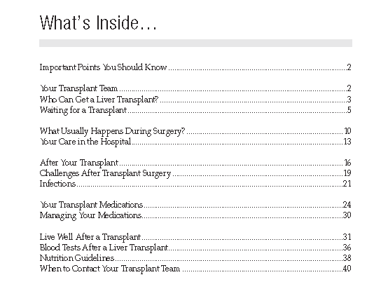
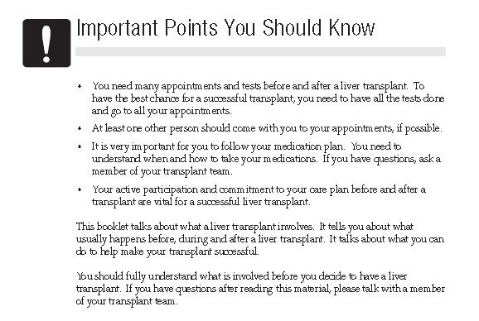
Liver Transplant Manual
Clear Direction
Highlighted with Icons

Slide 16
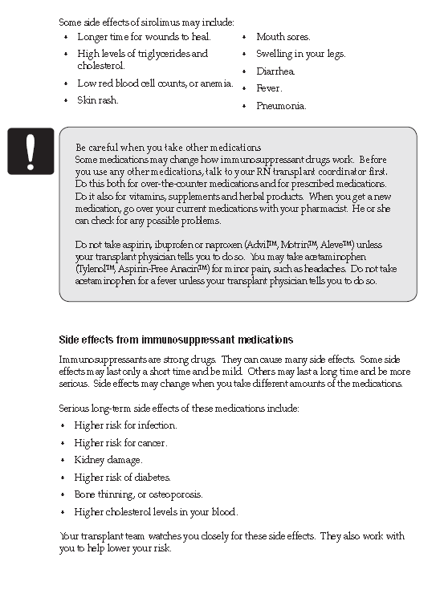
Design Was Key

Slide 17
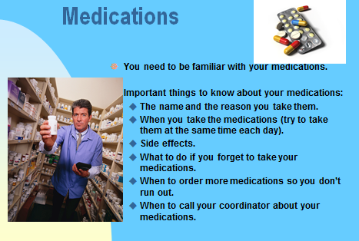
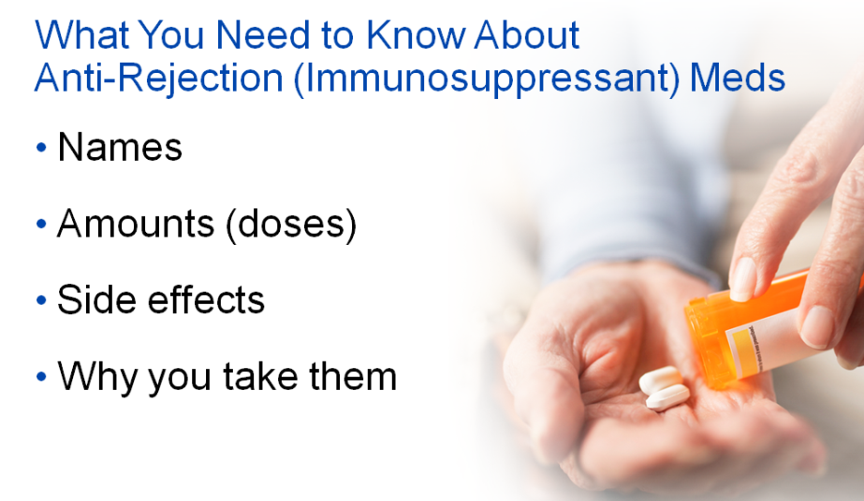
Classes Were Also Revised
Previous Class Slide
Updated Version

Slide 18
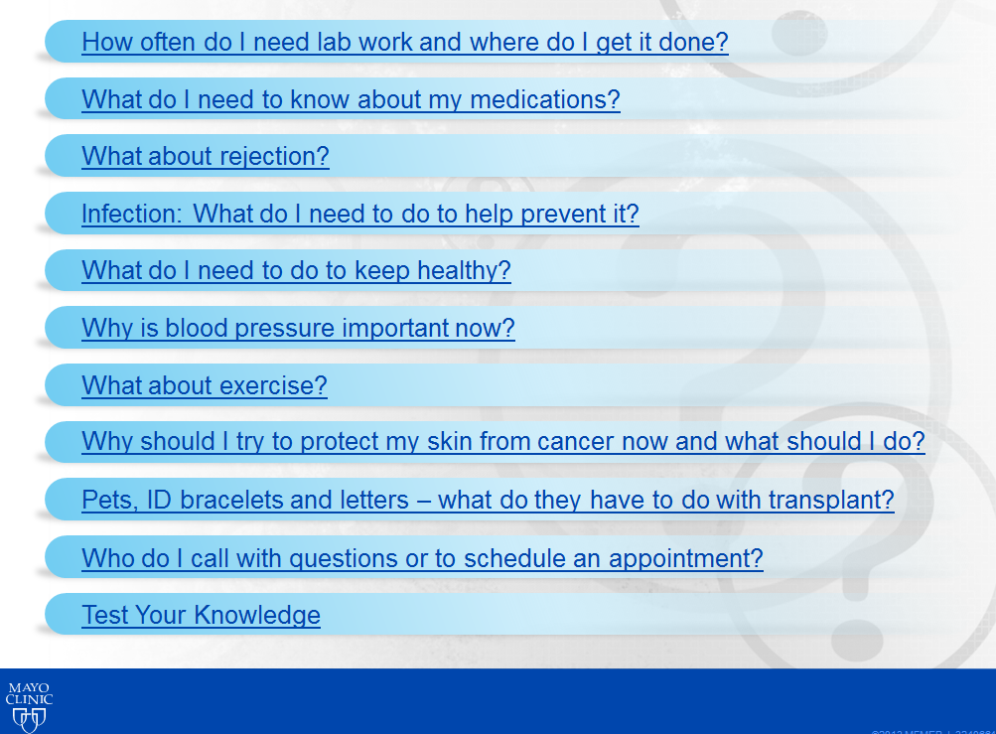
Patient Driven Class

Slide 19
Lessons Learned
Assessment of current materials
Development of core content
Active engagement from a variety of staff

Slide 20
Questions & Discussion

