Slide 1

Health Literacy:
A Health Priority in Sheboygan County
Jean Beinemann and Mary Paluchniak
Healthy Sheboygan County 2020

Slide 2
Both Mary and Jean have no conflicts of interest to declare.

Slide 3
Healthy Sheboygan County 2020 Coalition
A community-based coalition in existence since 1993.
Making positive changes in the health of
Sheboygan County

Slide 4

2009-2010
Community Assessment Completed and Distributed
Available at Healthy Sheboygan County Website: www.healthysheboygancounty.org

Slide 5
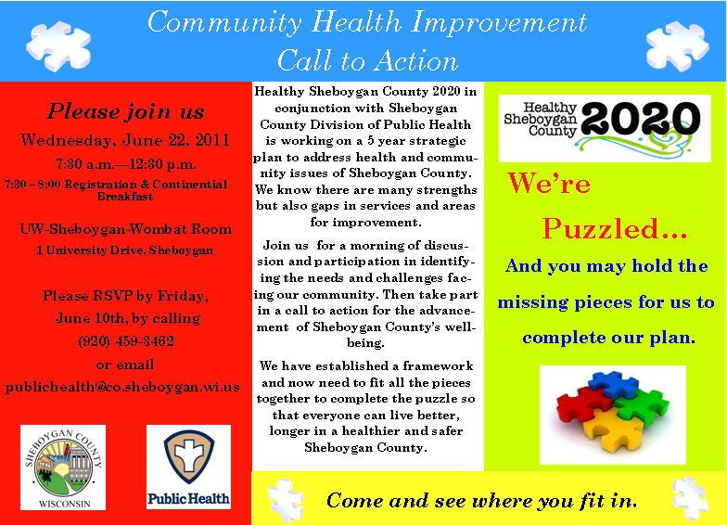
Community Call To Action Event June 2011

Slide 6
Five Health Priorities Selected
Dental Access
Mental Health
Health Literacy
Alcohol, Tobacco and Other Drug Abuse
Physical Activity, Obesity and Nutrition

Slide 7
Local Findings which further substantiate Health Literacy as a Priority
Health Policy Brief, 2009, by JA Vernon PhD estimates the annual healthcare costs attributable to low health literacy in Sheboygan County to be $112,484,240. (Wisconsin Literacy, Inc.)
The Estimated Health Literacy Rankings of Wisconsin Counties, 20011, Josephine Mancuso, PhD ranks Sheboygan county 34 out of 72 counties. (Health Literacy Wisconsin)

Slide 8
Fall 2011 - Development of Health Literacy Action Plan
Plan developed with assistance of a facilitator
Funding for facilitator was supported with infrastructure dollars which were available for preparation for DPH accreditation process
Incorporated into the Sheboygan County Community Health Improvement Plan (CHIP)

Slide 9

Community Health Improvement Plan (CHIP)
---The Health Literacy Action Plan is Incorporated into this 2012-2014 CHIP
Available at Healthy Sheboygan County 2020 Website: www.healthysheboygancounty.org

Slide 10
Health Literacy Mission and Vision Statements Guide our Work
Mission Statement:
To help people find, understand and use health information and services to make informed decisions.
Vision Statement:
People understand health.
Adopted from Health Literacy Wisconsin

Slide 11
Action Plan:
Assessments
  Health Care Provider (HCP) Survey – Spring 2012
  Community Member Survey – December 2012
Interventions
  Health Care Provider Education Program – October 2012
  Focus groups – Spring/Summer 2013
  Community Awareness Campaign – October 2013

Slide 12
Health Care Partner Survey
Goal: To assess how community healthcare facilities are addressing health literacy to positively impact patient understanding and satisfaction.
Sixty-Five Respondents

Slide 13
Health Care Survey - Top 3 focus areas:
  Staff Awareness
  Community/Staff education
  Cultural considerations

Slide 14
67% of HCP were interested in receiving training in health literacy.
Executive Summary of Survey results link below:
http://www.healthysheboygancounty.org/resources/healthliteracysurveyexecutivesummary9703.pdf

Slide 15
Fall 2012 Community Survey
Purpose: To learn more about health literacy and factors that influence levels of health literacy in Sheboygan county
1082 Responses
Responses largely collected via Survey Monkey and written surveys entered into Survey Monkey
Sites including work sites, senior meal sites, schools, community events, public health clinics, and social service organizations.

Slide 16
Fall 2012 Community Survey
It is reasonable to conclude that those least likely to be “health literate” are also least likely to have filled out this survey.
  Consequently, the results are probably only a conservative picture of the real depth of the problem.

Slide 17
Significant Findings:
Health literacy difficulties most prominent in the ER and Free/Reduced Cost Clinic settings.
Those who are not receiving adequate information from their HCP do not aggressively fill their information gap through other sources.
Individuals in the 26-35 year range have somewhat more difficulties than would be expected.
Younger individuals are less comfortable asking their health care provider questions than older individuals are.

Slide 18
Significant Findings Continued:
Non-Caucasian individuals do not ask their HCP questions at higher percentages than would be expected based on their proportion of the survey respondents.
Numerous subgroups of respondents had questions regarding their prescriptions.
Many of the respondents in all subgroups had doubts about what to do when they are sick.
Gender does not seem to be a factor for persons asking follow-up questions when they don’t understand what their HCP has told them.

Slide 19
Next Step: Focus Groups
  To ensure that we did not miss anything in the big picture via survey process
  To gather further input from community which may require attention as we develop Community Health Literacy Campaign
  Facilitated by UW Extension Staff – Kevin Struck and Jane Jensen

Slide 20
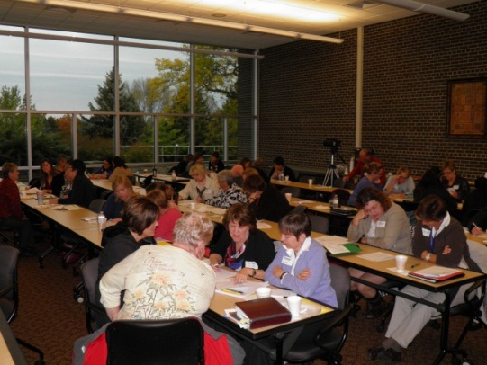
October Health Literacy Training
                Dr. Paul Smith and Erin Aagesen Presenters
                36 Attended
                Feedback Very Positive – Increased
                Awareness
                DVD Available of Event Available
                Increased Committee Membership for Future Health Literacy Work

Slide 21
Additional Interventions to Date
Weekly Healthy Sheboygan County 2020 Press Articles
Website
Community Presentations

Slide 22

Community Awareness Campaign
Will be developed based on the results of the Community Survey and information learned as a result of the Focus Groups
October 2013 targeted rollout

Slide 23
For More Information Contact:
Jean Beinemann, RN, BSN
Program Supervisor
Sheboygan County Health and Human Services
Phone: 920-459-6438
Jean.beinemann@sheboygancounty.com
Mary Paluchniak, RN, BSN
Program Development Specialist
St. Nicholas Hospital
Phone: 920-451-7282
Mary.Paluchniak@hshs.org

