Slide 1

Health Literacy and the Affordable Care Act
Presented by
Bonnie Braun, PhD
Professor, Extension Specialist and Faculty Scholar,
Horowitz Center for Health Literacy
University of Maryland College Park
bbraun@umd.edu
Wisconsin Health Literacy Summit
April 10, 2013

Slide 2

http://www.iom.edu/~/media/Files/Activity%20Files/PublicHealth/HealthLiteracy/Commissioned%20Papers/Health%20Literacy%20Implications%20of%20Health%20Care%20Reform.pdf
October 2010

Slide 3
Direct References to Health Literacy
Section 3501
Requires AHRQ research be available to the public ... to reflect varying needs of … providers and consumers and diverse levels of health literacy.
Section 3506
“Decision aids must reflect varying needs of consumers and diverse levels of health literacy.”
Section 3507
“To consult with … experts in health literary.”
Section 5301
Preferences for training grants in cultural competence and health literacy.

Slide 4
Indirect References in 6 Domains
Insurance Reform, Outreach and Enrollment
Individual Protections, Equity n Special Populations
Workforce Development
Health Information
Public Health, Health Promotion and Prevention & Wellness
Innovations in Quality and Delivery and Costs of Care

Slide 5
Consumer Challenge Posed by ACA
“The ongoing evolution of the health care system is leading US households toward greater responsibility for their own well-being.
With this responsibility, however, comes an increasing need to be able to find, trust, use, and act on relevant information to make informed choices.
Yet there continues to be a substantial mismatch between the high literacy burden of health information materials designed to
support such choices and the health and financial literacy
skills of individuals who use them.” p. 874
Martin, L. T. and Parker, R.M. (August 9, 2011). Insurance expansion and health literacy. Journal of American Medical Association On-line. http://jama.jamanetwork.com/article.aspx?articleid=1104248

Slide 6
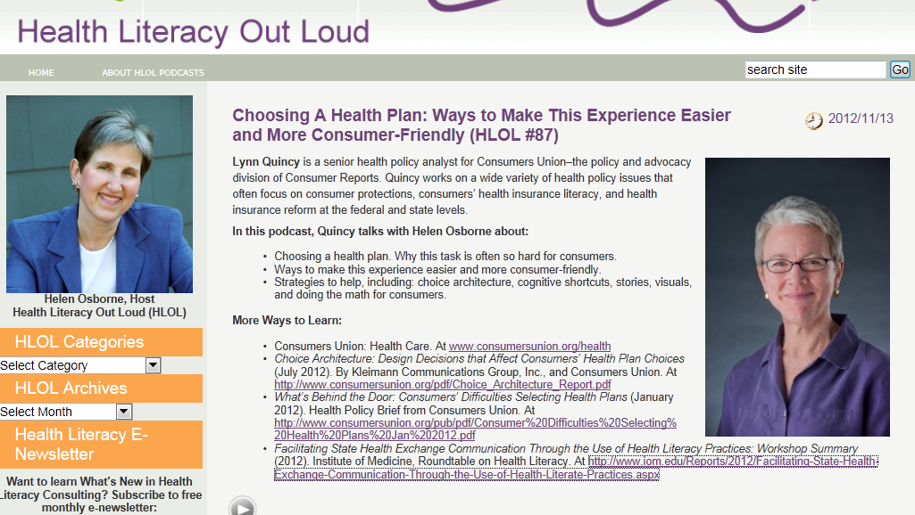
http://www.healthliteracyoutloud.com/2012/11/13/health-literacy-out-loud-87-choosing-a-health-plan-ways-to-make-this-experience-easier-and-more-consumer-friendly/comment-page-1/?rcommentid=32777&rerror=incorrect-captcha-sol&rchash=e2f7cb1195cfceb62b745d842821936b#commentform

Slide 7
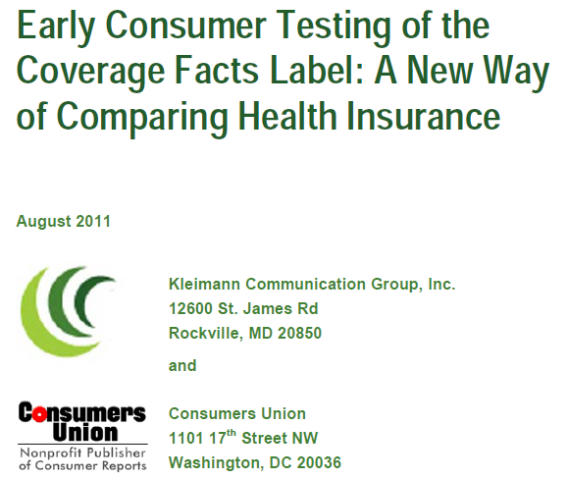
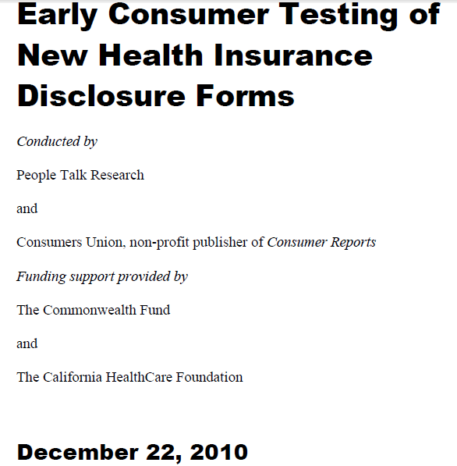
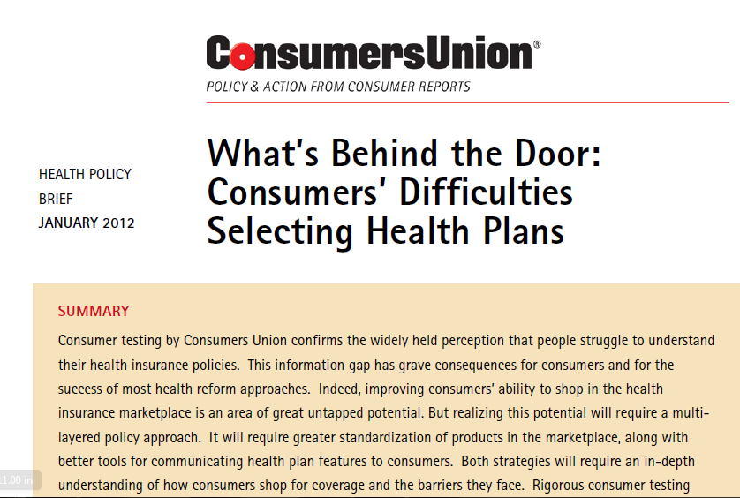
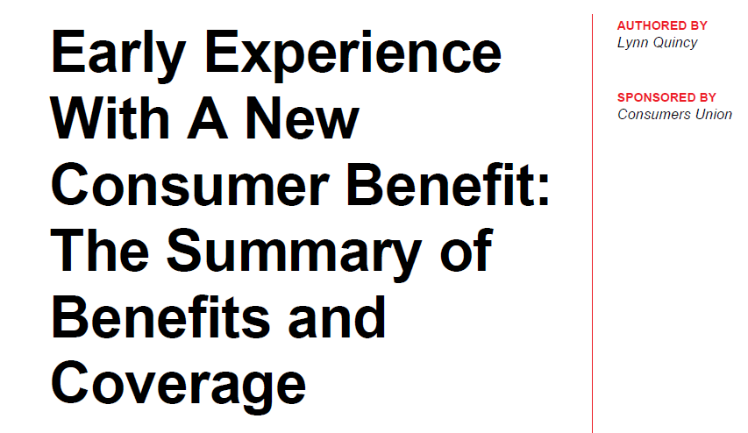
February 2013

Slide 8

Consumer Confusion Has Grave Consequences
Consumers find themselves underinsured, too often leading to medical bankruptcy
Under-insured consumers act like uninsured consumers – they delay getting care
Inability to effectively compare plans
Undermines the health plan marketplace

Slide 9







Slide 10
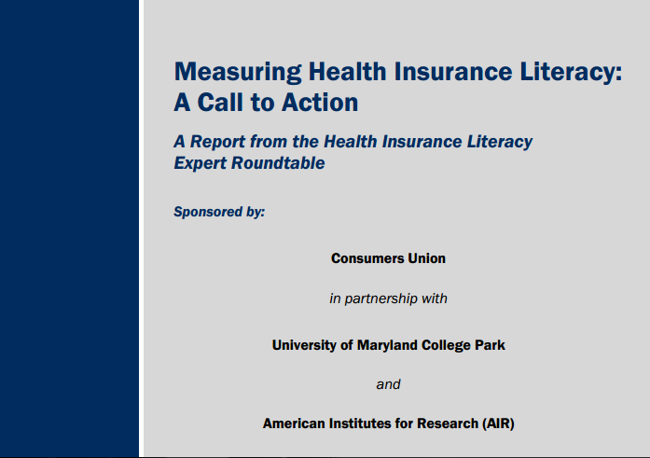
November, 2011

Slide 11
Health Insurance Literacy
The degree to which individuals have:
a) The knowledge, ability, and confidence to
find and evaluate information about
health plans;
b) Select the best plan for his or her family’s
financial and health circumstances, and
c) Use the plan once enrolled.
Measuring health insurance literacy: A call to action and report from the health insurance literacy expert roundtable. (2011), Washington, D.C.: Consumers Union. Available at: http://www.consumersunion.org/pub/Health_Insurance_Literacy_Roundtable_rpt.pdf

Slide 12
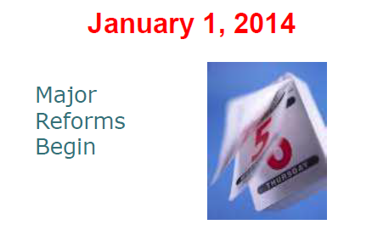
Cooperative Extension
Multi-state Health Insurance Literacy Initiative (HILI)
Launched April 2012

Slide 13
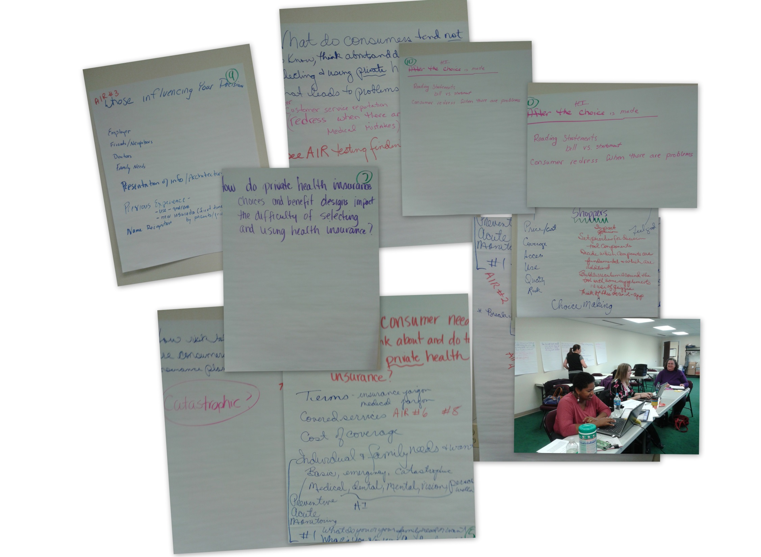
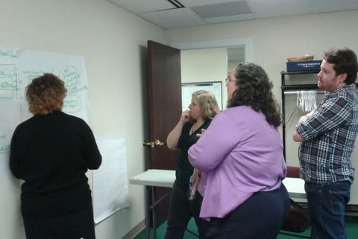
University of Maryland and University of Delaware Health Insurance Literacy Team
Identifying Key Concepts
1-10-13

Slide 14


Slide 15
RC + IC + IC = Smart Choices
Reduce Confusion +
Increase Capability + Increase Confidence
=
Smart Choice

Slide 16

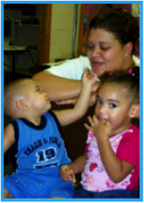

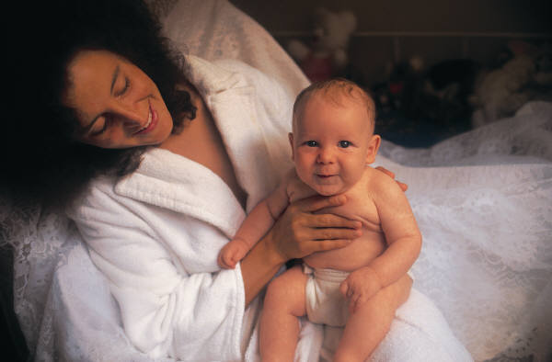

My Smart Choice Health Insurance Guide
Asking key questions
Making sense of answers
Using simple tools to choose
Picking out smart choices
Feeling good about your choice

Slide 17
Key Questions I Need to Answer
Why?
Why do I need health insurance?
What?
What do I need and want?
What are my choices?
How?
How much will it cost?
How much can I afford?
Why is it important?
My Smart Choice
Notes:
Here is what research and experts say are important things to consider and address when making health insurance decisions.
First, you need to understand the “why”- why should I want health insurance, etc. and
why is this important.
After you understand the why, we will consider the “what”, as in helping you figure out what are your needs and wants in health insurance coverage and how can you compare available options.
Finally, you need to understand the costs of your health insurance options and what you can afford.
Being able to answer these key questions will help you make a smart health insurance choice.

Slide 18
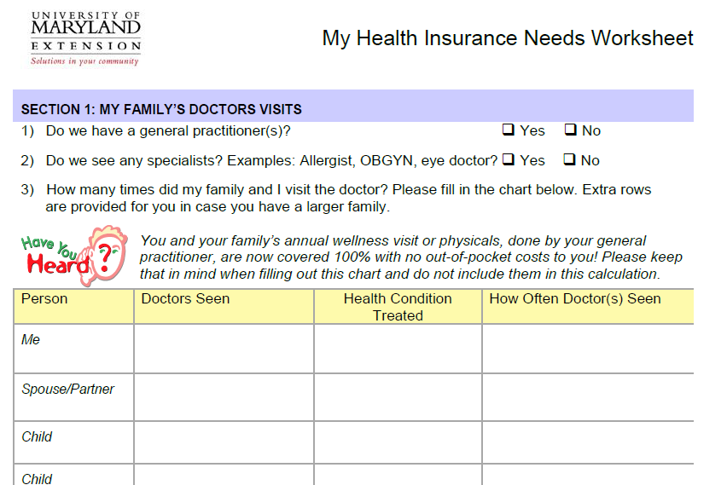

Slide 19
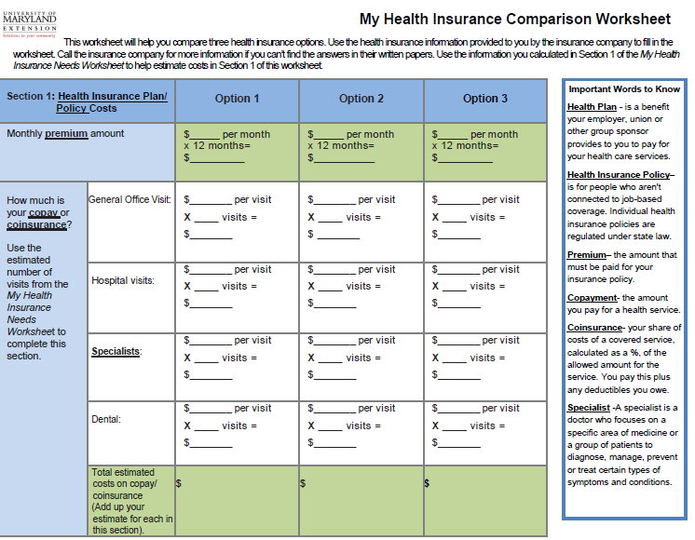

Slide 20
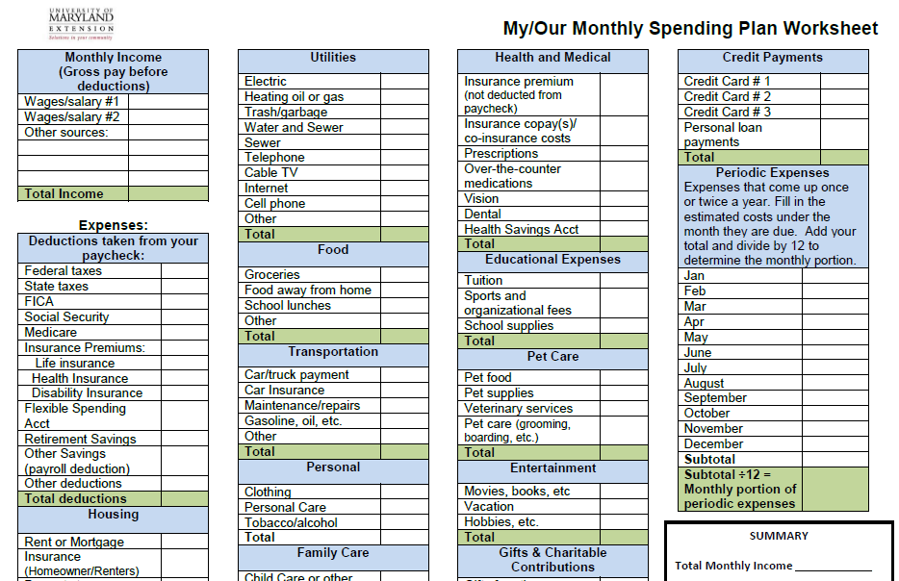

Slide 21
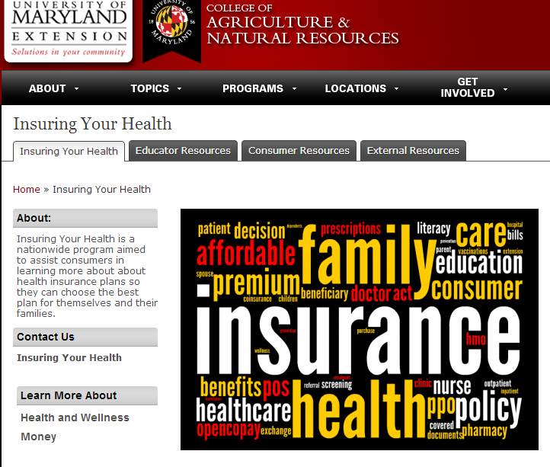
http://extension.umd.edu/insure

Slide 22
Given their stage of change, to what extent do consumers increase their:
A) Confidence,
B) Competence and
C) Control after using
My Smart Choice Health Insurance Guide?
Impact Evaluation Question:

Slide 23
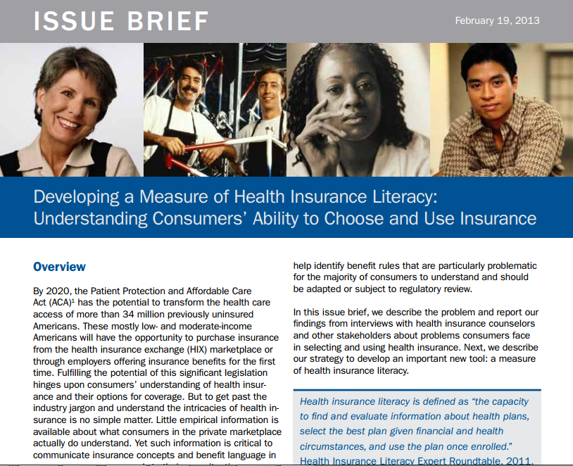

http://www.air.org/files/Health_Insurance_Literacy_Issues_Brief_2.25.13.pdf

Slide 24
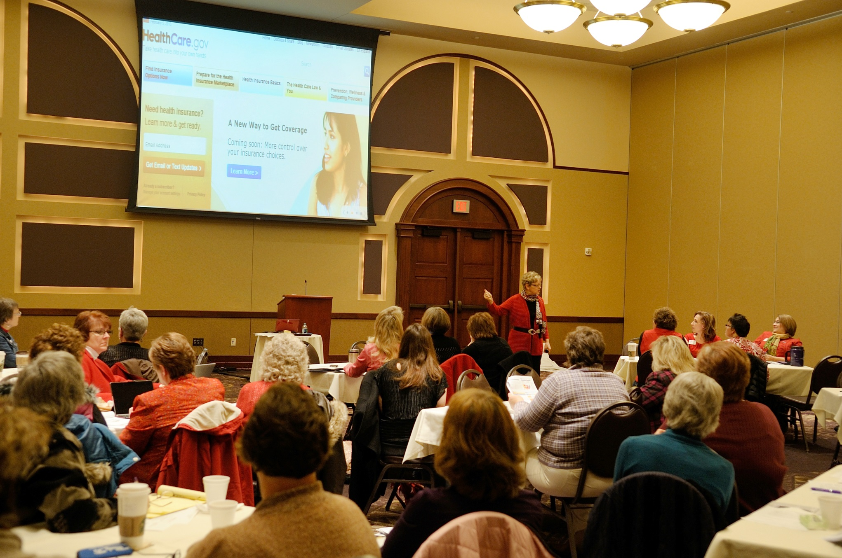

Slide 25
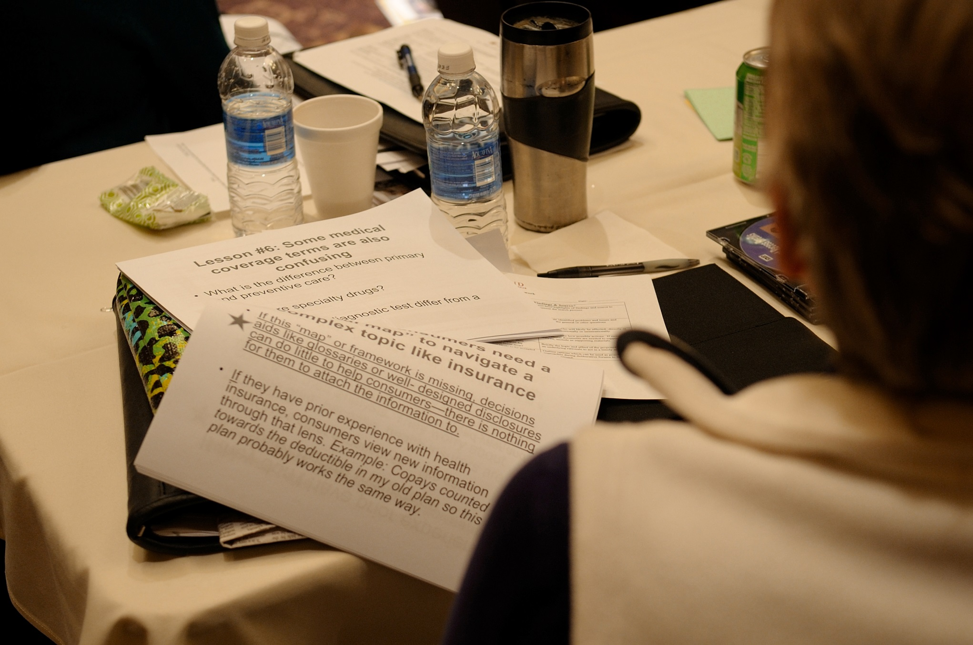

Slide 26
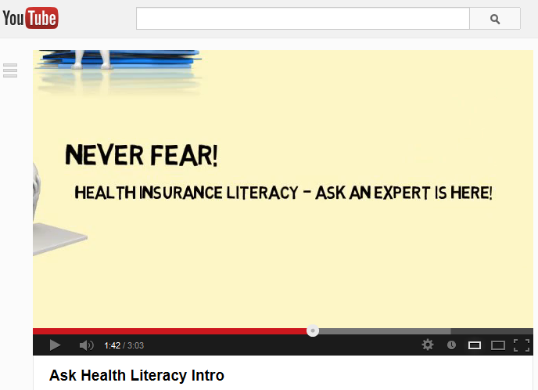
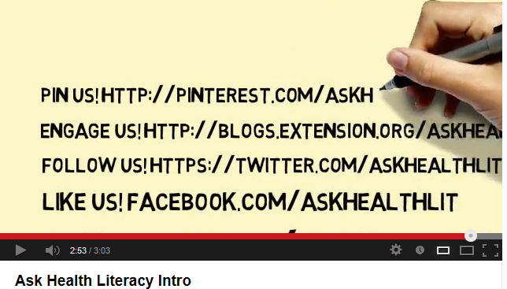
http://www.youtube.com/watch?v=7e4ubbzAV14

Slide 27

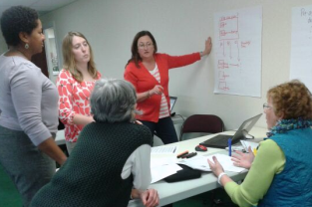
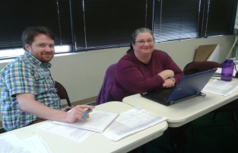
Acknowledgements
This pilot project was developed with funding from the University of Maryland Extension and an eXtension Fellowship
Program Development team:
University of Maryland Extension:
Bonnie Braun, Virginia Brown, Shannon Dill, Nicole Finkbeiner, Christine Garcia, Jinhee Kim, Lynn Little, Teresa McCoy, Mia Russell, Crystal Terhune, and
Andrew Williams
University of Delaware Extension: Maria Pippidis

