Slide 1
Building a Community Partnership Around the “What to Do When Your Child Gets Sick” book

Slide 2
Introductions
Margarete Cook
  NW Regional Literacy Consultant, Wisconsin Literacy, Inc
Nancy Wheeler
  Literacy Coordinator, ICAA Crossroads Literacy
Jay Shrader
  Community Benefit and Prevention Program Manager, Wellness Manager, Security Health Plan

Slide 3

Overview
History of the project
How our partnerships were formed
Review of the Train the Trainer workshops
Data Collected
What You Can Do

Slide 4
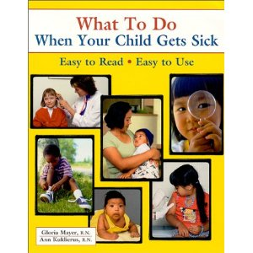
The Beginning
South Dakota
Small area grants
AHEC grant with ICAA and WL
  37 Head Start instructor in 3 - 6 hr. Train the Trainer Workshops
  Books for 695 kids in 15 Head Start Centers
  438 surveys
Security Health Plan

Slide 5
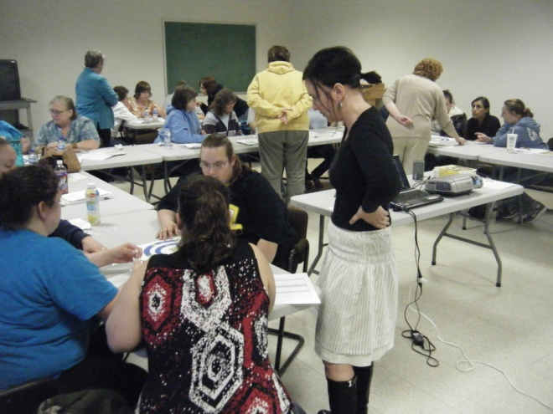
The Project
Train the Trainer Workshops -
  Head Start
  Day Care Providers
  Family Resource Center
4 sites = 55 participants
Provided 603 books
Got 204 surveys

Slide 6
Partners
Wisconsin Literacy, Inc./Health Literacy Wisconsin
Security Health Plan
ICAA Crossroads Literacy
Northwest Connection Family Resources
Rusk County Health & Human Services – Public Health Department
Clark County Health Department
Child Care Resource and Referral of Central WI
Notes:
Jay

Slide 7
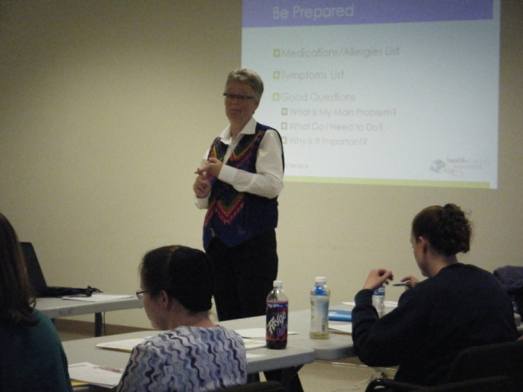
Train the Trainer
What is Literacy?
Health Literacy 101
Red Flags for Literacy Issues
Interventions
Project Details
Pre and Post tests

Slide 8
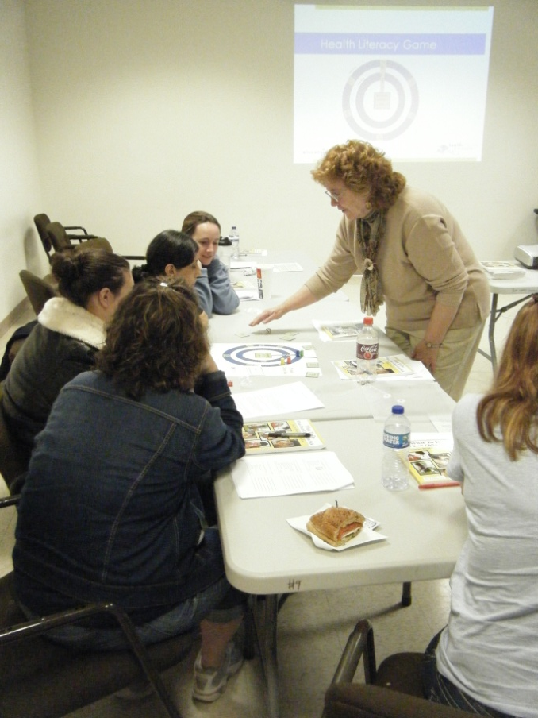
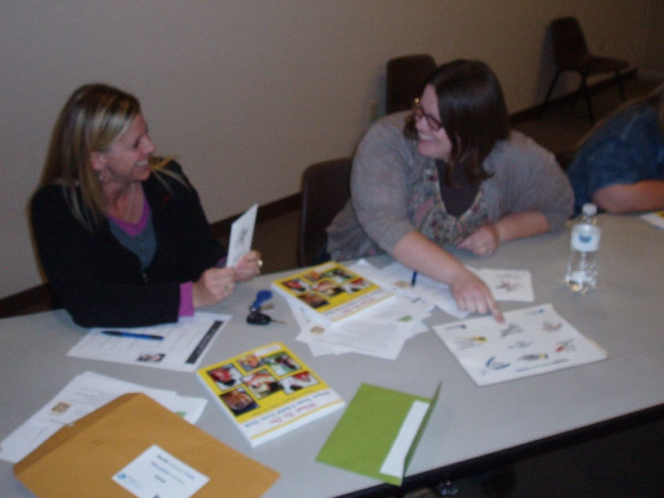
The HL Game

Slide 9
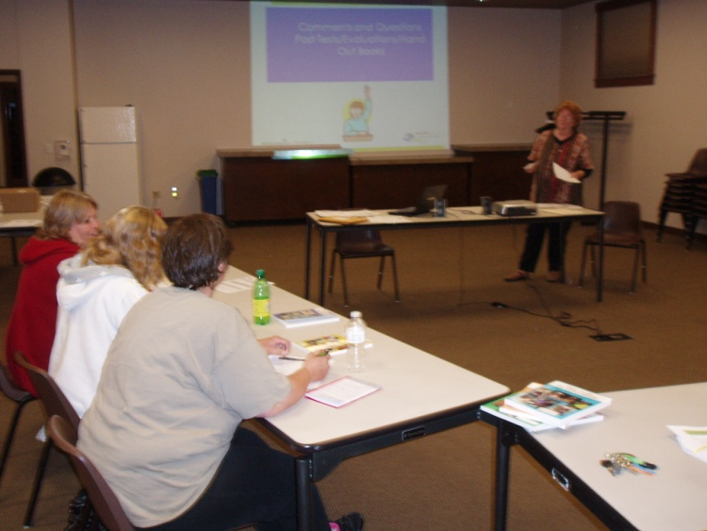
Workshop Pre and Post Tests
5 HL Knowledge Questions
  Avg. Pre Test Score = 46%
  Avg. Post Test Score = 79%
Quality of workshop
  Excellent = 82%
  Very Good = 15%
  Uncertain = 3%

Slide 10
Introduction of Books
Grant from IHA
Previous Project
  Comparison of “Just Handed Out” vs “introduction”
  Significantly more use of book with “introduction”
SHP Grant
  Took time to brainstorm how to introduce the book

Slide 11
Introduction Suggestions
Checklist
Scavenger Hunt

Slide 12
Data Collected
204 surveys
391 Kids

Slide 13
Most Used Chapters

Slide 14
Do You Have Health Insurance?

Slide 15
Insurance

Slide 16
Did the book help you deal with a health problem, instead of CALLING a hospital or clinic?

Slide 17
Did the book help you deal with a health problem, instead of GOING to the ER or UC?
116
66

Slide 18
Digging Further
Did the book help you deal with a health problem, instead of CALLING a hospital or clinic? Yes

Slide 19
Saving Healthcare Dollars
21

Slide 20
Combining Surveys

Slide 21
Did the book help you deal with a health problem, instead of CALLING a hospital or clinic?
359
125
Yes No

Slide 22
Did the book help you deal with a health problem, instead of GOING to ER or UC?
332
175
Yes No

Slide 23
Security Health Plan
SHP started a Community Benefit Program in 2011
Health Literacy & Kid’s Health identified as a priority
Focus on root causes of health
Medical cost avoidance (e.g. ROI)
Notes:
Jay

Slide 24
Challenges
Data Collection
  Hard to get back surveys
    Incentives??
  Self Reporting
  What data do we want next?
  Where does data get stored?
Do we do more workshops?

Slide 25
Opportunities
Future Conversations
New Partners
  How Can You Do This Type of Project?
  How Can We Help You Do This?

Slide 26
Requests or Questions
Margarete@wisconsinliteracy.org
Nancy.Wheeler@indianheadcaa.org
SHRADER.JASON@securityhealth.org
http: //www.wisconsinliteracy.org
http: //www.healthliteracywisconsin.org
http://www.indianheadcaa.org
Margarete Cook

