Slide 1

Resources For Wisconsin and the Affordable Care Act
From the Toolbox to the Toolshed
Caroline B. Gomez, MSW
Health Literacy Wisconsin Conference
April 10, 2013

Slide 2
Covering Kids & Families (CKF)
Based at UW-Madison, affiliated with UW-Extension
Statewide coalition
Key project: School based outreach to support BadgerCare+ assistance in schools and share health care resources with school staff
More recently, CKF has been collaborating with UW-Extension to build an Affordable Care Act (ACA) curriculum for UW-Extension county faculty to use in their communities
Notes:
Based at University of Wisconsin Madison, and affiliated with University of Wisconsin-Extension, Covering Kids and Families (CKF) is a coalition of more than 65 statewide organizations that includes academic and health care institutions, state agencies including WI Department of Health Services and Department of Public Instruction, Community Based Organizations, county agencies and more. CKF is dedicated to reducing health disparities and improving the overall health in Wisconsin by enhancing the capacity to maximize participation in BadgerCare+

Slide 3
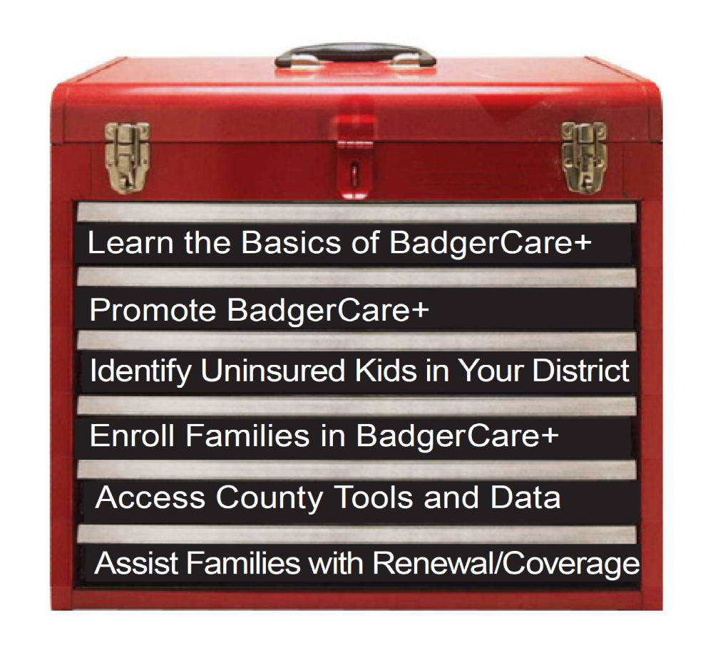
Online CKF BadgerCare+ Toolbox
http://ckfwi.org/toolbox.html

Slide 4
Using the BadgerCare+ Toolbox
Learn the Basics of BadgerCare+: Who’s eligible, services covered, how families can apply
Promote BadgerCare+: Bookmarks, newsletter articles, school lunch/calendar ads
Identify Uninsured Kids in Your District: Templates to obtain student Health Insurance Status and strategies to reach out to families
Enroll Families in BadgerCare+: Links to important Fact Sheets, community partners, and steps to offering Express Enrollment
Access County Tools and Data: County One-Page Brochures for useful programs in the state
Assist Families with Renewal/Coverage: Links to find a provider or clinic that accepts BadgerCare+
http://ckfwi.org/toolbox.html

Slide 5
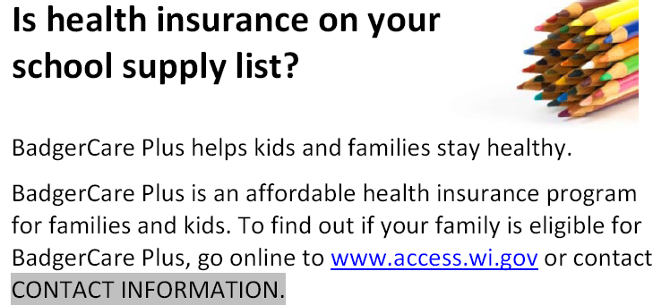



Outreach: Sample Tools
Customized bookmarks, flyers,
Ads or blurbs for school newsletters, lunch calendars
Add BadgerCare+ application assistance to your school events: parent/teacher conferences, open house, etc.
Notes:
5
BadgerCare+ outreach materials and strategies are found in two drawers. English and Spanish versions are available for several documents.
Covering kids & families can assist school districts with customizing Bookmarks with local contact information which can be printed by the schools and mailed or distributed to families in the library or during school events. School staff can adapt the Multi-month calendar blurb/promos that are found in the Promoting BadgerCare+ drawer. These 10 small promos are found on one page, each with a different theme that you can save as your own, adding local contact information on each. Schools may add these to school newsletters or lunch menus that are distributed to all families.
The Helpful Programs in (Your) County is a full-page resource ready to download and print with county-specific contact information already on the document for many public programs. Some schools target distribution of materials to families who are eligible for Free and Reduced Price Lunch. Others who collect Health Insurance Status can target those families who state they have no current insurance. Targeting helps manage costs and allows for more intensive personal contacts. Helpful Programs in (Your) County are called Benefit One-Pagers and are found in the ACCESS County Tools and Data drawer. The one-pager prints in color nicely, but also looks good in black-and-white on lightly colored paper.

Slide 6

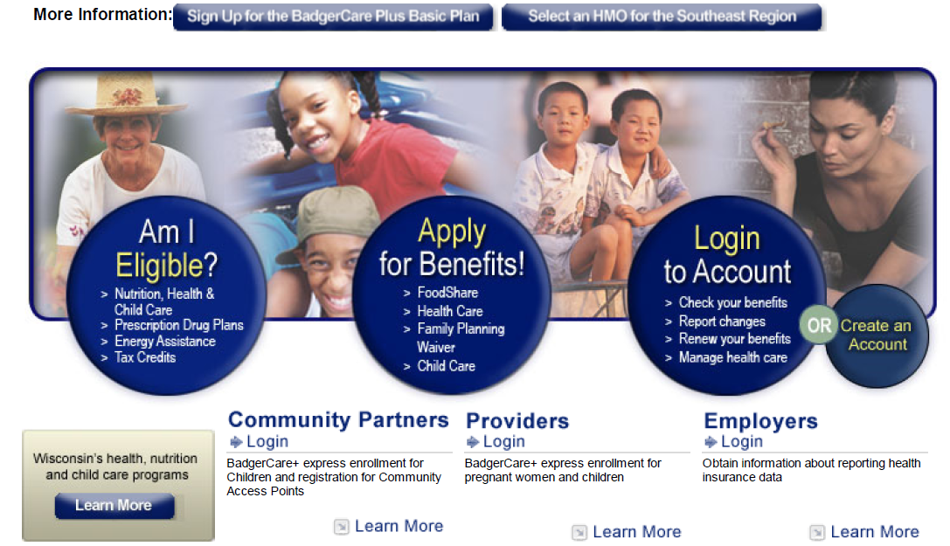
Website: www.access.wi.gov
Notes:
In this presentation we are highlighting the application process through the state’s online portal, ACCESS. ACCESS - found at www.access.wi.gov
If an applicant is a Spanish speaker, there is a link in the top right hand corner which says ‘Espanol’. Clicking this link takes the applicant to a Spanish version of the portal. This link can be used to toggle back and forth between the English and Spanish language versions if needed.
Access can be used to determine potential eligibility for benefits, to actually apply for benefits, and then, once enrolled, can also be used for checking benefits, reporting changes such as address or income changes, and even renewing benefits annually.
6

Slide 7
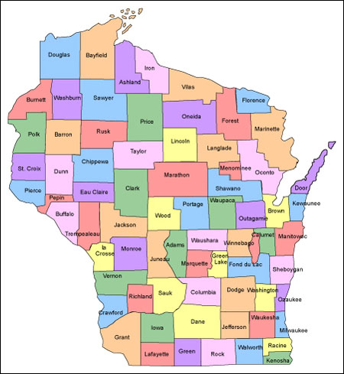

ACA UW-Extension Curriculum
UW-Extension faculty represent all 72 Wisconsin counties. Using the ACA curriculum developed by CKF, UW-Extension faculty can work with community partners to act as an ACA resource to:
Small Businesses
Farmers
Community Agencies
Providers
Consumers
Notes:
7

Slide 8
ACA UW-Extension Curriculum
Along with professional development workshops specific to UW-Extension faculty, CKF is developing resources for UW-Extension and other community partners to use:
PowerPoint slides with talking notes
Sub-population specific factsheets
Small group activities
Poster board displays
Press release templates
Any more…
Notes:
8

Slide 9
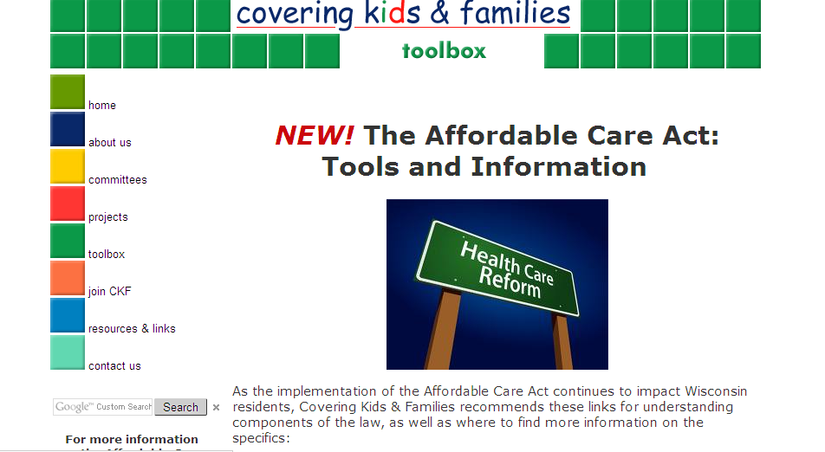
Health Care Reform Resources
CKF website, blog, and listserv:
http://www.ckfwi.org/affordablecareacthome.html
Notes:
This is the Covering Kids and Families ACA page. Obviously there are dozens of sites out there for you to peruse and gather information from. CKF will review that information for you provide you with the basics through its blog, question of the week, and web page with links to other resources. We will also be creating fact sheets with the basics.

Slide 10

Fact sheets and resources can be found on the new CKF Affordable Care Act Webpage!
http://www.ckfwi.org/affordablecareact home.html
Notes:
Here is an example of one fact sheet you can find on the CKF web page. This fact sheet provides an overview of the ACA.

Slide 11


Health Care Reform Resources
For up-to-date ACA information see our ACA blog:
http://ckfwiaca.wordpress.com/
And follow us on Facebook:
https://www.facebook.com/ckfwi

Slide 12
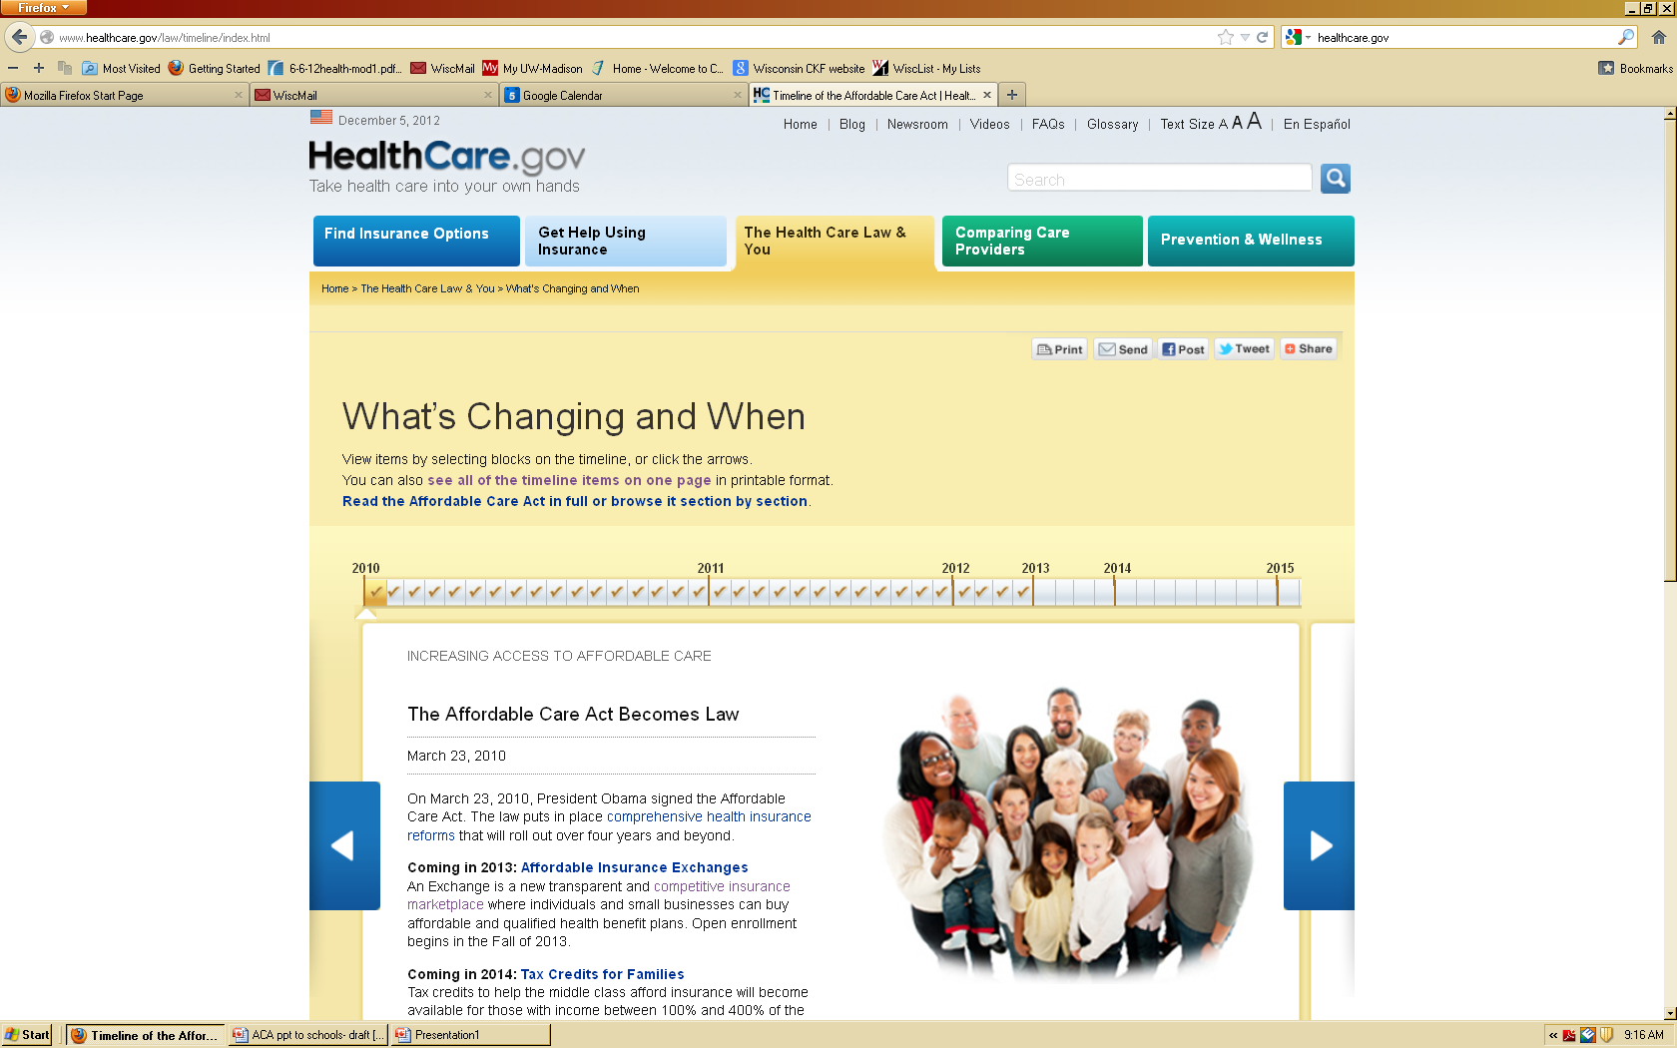
www.healthcare.gov
Notes:
One last valuable resource is the federal government’s website on health reform: www.healthcare.gov. This provides additional information on ACA, including more fact sheets, time line about what is changing and when and FAQs that are presented in an easy to understand manner.

Slide 13

Questions, Discussion
Inform CKF of your questions and we will help answer them!
Covering Kids & Families
Info@ckfwi.org
www.ckfwi.org
608-261-1455
Caroline B. Gomez, MSW
Healthcare Outreach Specialist
cbgomez@wisc.edu
Notes:
If after reviewing the CKF site and other resources provided, you are looking for additional information or material, please let CKF staff know and we can work to connect you to it or create it for you.
We (do/do not)have time for questions from the audience. Feel free to contact Caroline Gomez or the CKF ACA team for additional information.
Thank you.

