Slide 1

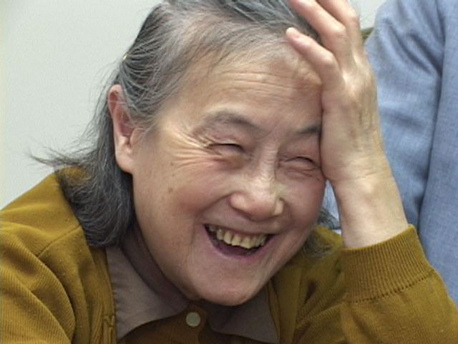


Making the Case for Health Literacy:
Policy, Outcomes and Your Bottom Line
Wisconsin Health Literacy Summit
April 9-10, 2012
Notes:
1 hour presentation

Slide 2

Who We Are
Literacy Coalition of Central Texas improves the quality and availability of literacy services to create a community that is 100% literate, employable and engaged.
Health Literacy Forward provides QI consulting and trainings for hospitals and clinics on patient-centered care with a focus on effective communication and health literacy.
Notes:
2

Slide 3
What we’ll cover…
Quick (very quick!) intro to health literacy
Implications of low health literacy – making your case
Resources to get you started
Q&A
Notes:
3

Slide 4
What is Health Literacy?
“The degree to which individuals have the capacity to obtain, process, and understand basic health information and services needed to make appropriate health decisions.”
- Healthy People 2020
Health literacy is a shared responsibility
Notes:
Many different definitions of Health Literacy….this is most widely used and accepted.
What do you think is missing from this definition? Healthcare providers get let off too easy in this definition…Health literacy is a shared responsibility.

Slide 5
“
“Health Literacy is the currency of success for everything that we do in health, wellness, and prevention.”
”
- Richard H. Carmona, M.D., M.P.H., FACS
17th U.S. Surgeon General

Slide 6
Literacy Facts
Most health information is written at the 10th grade reading level or higher, but…
  The average American reads at the 8th grade level
  40 - 50% of African-Americans, Latinos and Senior Citizens read at or below the 5th grade level
Notes:
I imagine most people in this room have Bachelor’s, Master’s or Doctorate degrees. If you are like me, you still have trouble understanding health-related information. Imagine trying understand this information if you are were reading how you did in the 5th grade!
This major discrepancy between literacy levels of our community members and the health information we expect them to understand is directly affecting patient-outcomes.
Here we’re just talking about literacy level…the number of people struggling to understand and act on health information is even more shocking!

Slide 7
Framing the Issue
The American Medical Association found that poor health literacy is a “stronger predictor of a person’s health than age, income, employment status, education level and race.”
AMA estimates 90 million low health literate Americans
AHRQ stated, “9 out of 10 Americans may lack the knowledge and skills needed to manage their health and prevent disease.”
Notes:
How many people are actually suffering from low health literacy?
Read stats. Then pass onto Peter to talk a little more about health literacy, what’s happening at the national level, and what Health Literacy Forward is doing to address the issue in Texas.

Slide 8
How to get your leaders on board
All agencies:
  Health implications and increased costs
  Legal risks and sentinel events
  Quality of care and trust in organization
Hospitals:
  Preventable Readmissions
  New Joint Commission requirements
Recipients of Federal Dollars
  ACA implications
  Plain Writing Act of 2010
Notes:
Should only have used 5 minutes up to this point.
8

Slide 9
a case for all agencies

Slide 10

Health Implications of Low Health Literacy
In peer reviewed research, low health literacy has been linked to:
    Reduced ability to understand labels and health messages
    Limited ability to follow medication instructions
    Lower likelihood of accessing/receiving preventive care
    More hospitalizations
    Greater use of emergency departments
    Worse overall health status
    Higher mortality among the elderly
    Shorter life expectancy
    Worse physical and mental health
Notes:
2 minute

Slide 11

Financial Implications
Low health literacy costs…
$7,500 more per person annually
$238 billion annually in the U.S.
$685,000,000 in Central Texas
1) Lack of preventative health → 2) Overuse of emergency services → 3) Longer hospital stays → 4) Inability to follow treatment instructions→ 5) Hospital re-admittance
  Vernon, John A., PhD.“Low Health Literacy: Implications for National Health Policy.” Pfizer Health Literacy.
Notes:
2 minutes

Slide 12
Legal Risks and Sentinel Events
Communication problems are the most common cause of medical
errors
Miscommunication is leading cause for patient dissatisfaction,
which increases risk for lawsuits.
Increased malpractice cases ruled in favor of patients who were
not appropriately informed about medical decisions
Patients who miss appointments may have a viable lawsuit if they
can prove their failed appointment resulted in harm due to a
doctor’s unclear, inadequate, or omitted instructions
  1. American Medical Association, Helping Patients Understand: Manual for Physicians, 2007.
2. Huntington, Beth and Nettie Kuhn. Baylor University Med Center. 16(2): 157–161 Communication gaffes: a root cause of malpractice claims. 2003 April
Notes:
Communication gaffes: a root cause of malpractice claims
Beth Huntington, BSN, MSN, JD¹ and Nettie Kuhn, RN, BSPA, CPHRM¹
Overwhelmingly, the dominant theme in these studies' findings was a breakdown in the patient-physician relationship, most often manifested as unsatisfactory patient-physician communication. Study participants described the perceived communication problems as follows: physicians would not listen, would not talk openly, attempted to mislead them, or did not warn them of long-term neurodevelopmental problems (in the case of newborn injury). Other communication problems cited included perceptions that doctors deserted patients or were otherwise unavailable, devalued patient or family views, delivered information poorly, or failed to understand the patient's perspective.

Slide 13
Legal Risks and Sentinel Events
65% of sentinel events reported to Joint Commission have communication failure as root cause
Providers are increasingly held liable for errors due to miscommunication and lack of patient understanding that result in harm to patients (AMA)
Communication issues are among most cited causes underlying medical malpractice lawsuits (JAMA)
Hickson Gerald B., Federspeil, Charles F., Pickert James, “Patients Complaints and Malpractice Risks,” JAMA, 2002:2951-3297

Slide 14

Legal Risks and Sentinel Events
Notes:
Play hysterectomy video

Slide 15
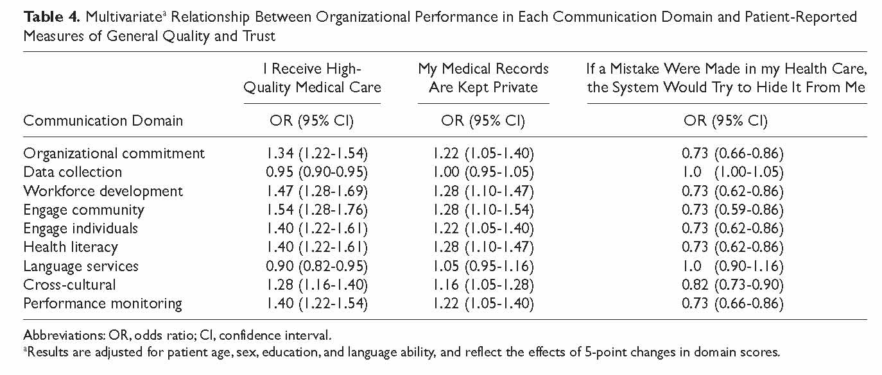
Quality of Care and Trust in Organization
AMA’s Communication Climate Assessment Toolkit (C-CAT):
  American Medical Association, Validation of an organizational communication climate assessment toolkit. 2010
Notes:
AMA examined correlations between differences in domain scores and patient-reported measures of quality and trust. Results for 5-point changes in domain scores are shown in Table 4 and demonstrate that scores on most of the domains are significant predictors of patient-reported quality and trust, after adjusting for patient age, education, sex, race, ethnicity, and language (English vs non-English). For example, a 5-point increase in score on the community engagement domain corresponds to a 54% increase in the odds that patients at that organization will report receiving high-quality care. Similarly, a 5-point increase in score on the health literacy domain corresponds to a 28% increase in the odds that patients will trust the organization to protect their confidential records and a 27% decrease in the odds that patients will think the organization would hide an error in their care.

Slide 16
a case for hospitals

Slide 17
Preventable Readmissions
18.7% of patients are readmitted to the hospital with the same or similar condition within 30 days of discharge.
75% of readmissions are preventable. –CMS
75% of preventable readmissions are a result of
miscommunication. –Joint Commission
Mean charge per stay for uninsured patient: $22,161
Mean charge per stay for Medicare patient: $38,320
Reducing Medicare and Uninsured patient readmissions by
1% in Texas would save nearly $440,000,000 annually
  Statistical Brief, 2007 Dept. of State Health Services; Texas Hospital Inpatient Discharge Public Use Data File

Slide 18
Joint Commission requirements
PC.02.01.21 “The Hospital effectively communicates with patients when providing care, treatment and services.”
  Hospital identifies patient’s oral and written communication needs, including preferred language
  Hospital communicates…in a manner that meets the patient’s oral and written communication needs.
RI.01.01.03 “The hospital respects the patient’s right to receive info in manner he/she understands.”
  Provides info tailored to age, language and ability to understand.

Slide 19
Joint Commission Requirements
RC.02.01.01 “Medical record contains info that reflects the patient’s care, treatment and services.”
  Medical record contains…[name, sex, race, etc] and the patient’s communication needs, including preferred language for discussing health care.
RI.01.01.01 “The hospital respects, protects, and promotes patient rights.”
  The hospital respects the patient’s right to and need for effective communication.

Slide 20
a case for recipients of fed $

Slide 21
Implications of the Affordable Care Act
Sec. 5301 – Training grants will be made available; preference for awards to those who “provide training in enhanced communication with patients…and in cultural competence and health literacy.”
Need for plain language writing and effective oral communication mentioned explicitly and woven throughout ACA
Medicaid Expansion: new Medicaid population will be largely at high risk for low health literacy
Center for Health Care Strategies, Inc. Health Literacy Implications of the Affordable Care Act, Nov. 2010

Slide 22
More opportunities to explore
Health disparities and equity
Health Information Technology – EHR and MU
Patient Centered Medical Home
National Health Goals
Medicaid expansion and Consumer Assistance Programs
Patient-centered care, Patient-empowerment
Center for Health Care Strategies, Inc. Health Literacy Implications of the Affordable Care Act, Nov. 2010

Slide 23
Top Resources
Attributes of a Health Literate Organization
CDC Making Health Literacy Real: Organization Action Plan
Joint Commission Roadmap for Hospitals
National Action Plan to Address Health Literacy
AHRQ Universal Health Literacy Precautions Toolkit
American Medical Associate – Patient-Centered Communication

Slide 24

Contact Information
Follow us online!
WillRead.org
Twitter.com/HlthLitForward
Facebook.com/ReachTeachUnite
Peter B. Morrison
Director of Health Literacy
Pmorrison@willread.org
512-735-2531
Notes:
Peter – 30 seconds
Open it up for questions.

