Slide 1
Clear Health Communication Training Series
Verbal Communication
Health Literacy Missouri
Sam Pettyjohn, MPH
Notes:
Thank you for coming to this training. Before we get started, I/we want to make sure that each of you has signed in and completed the pre-survey.
(Go around the group and ask for brief introductions, depending on size)
This training builds on other HLM trainings, in which you learned about the term “health literacy”, associated statistics, communication strategies/techniques, materials, health literacy resources, etc.
We know that the importance of recognizing health literacy as a barrier for patients to achieve their optimum health.
Think about a an interaction you recently had with a patient.
Do you feel like they really understood when you were finished?
Did you think of another or better way to explain after the conversation?
Do you feel like you are having an impact on your patient’s understanding?

Slide 2
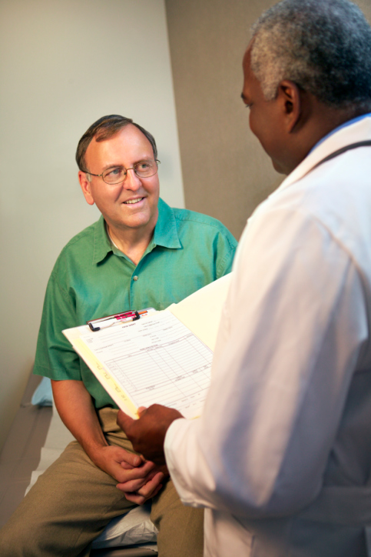
What factors impact health literacy?
  Communication skills
  Knowledge of health topics
  Culture
  System demands
  Demands of the situation
Notes:
Health literacy is dependent on both individual and systemic factors:
Communication skills of patients and professionals
Communication skills include literacy skills, oral communication skills, and comprehension
Communication skills are context specific. For example, someone who is an accountant may have excellent reading and writing skills and functions well in another environment may still have low health literacy.
Knowledge of patients and professionals of health topics
People with limited or inaccurate knowledge about the body and the causes of disease may not understand the relationship between lifestyle factors (e.g., diet, exercise) and health outcomes or recognize when they need to seek care
Health information can overwhelm even people with advanced literacy skills.
Culture
Culture affects how people communicate and understand health information, how people think and feel about their health, when and from whom to seek care, and how to respond to recommendations for lifestyle changes or treatments
Demands of the healthcare and public health systems
Individuals need to read, understand, and complete many kinds of forms in order to receive treatment and payment reimbursement
Individuals need to know about the various types of health professionals and services and how to access care.
Demands of the situation/context
Health contexts are unusual compared to other contexts because of an underlying stress or fear factor and may involve unique conditions such as physical/mental impairments due to illness.
Health situations are often new, unfamiliar, and intimidating.

Slide 3
What we know: Literacy levels
One in five adults reads at or below 5th grade level
Two in five adults aged 65 years and older read at or below 5th grade level
— NAAL, 2003
Most education materials are written beyond patients’ ability to understand
— IOM 2004
Notes:
Low literacy affects approximately 90 million people in the US.
That is 36% of the adult population
That is the same number of Americans who watched the SuperBowl in 2009
In Missouri, 1.6 million are affected by low literacy. This is approximately the number of people in St. Louis City, St. Louis County, and St. Charles County
An Institute of Medicine report in 2004 demonstrated that 1 in 5 adults read at or below a 5th grade level. This increases to 2 in 5 when you look at the 65 and older population. Even patients who read at the college level have been found to prefer health information written at the 7th grade level. Simply put, most materials are written at levels that patients can’t understand.
--U.S. Department of Education's 2003 National Assessment of Adult Literacy (NAAL)

Slide 4
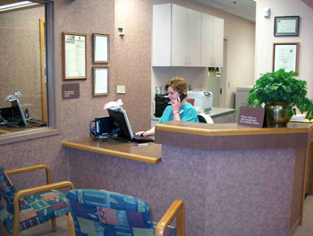
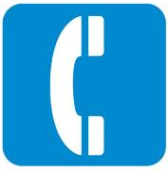
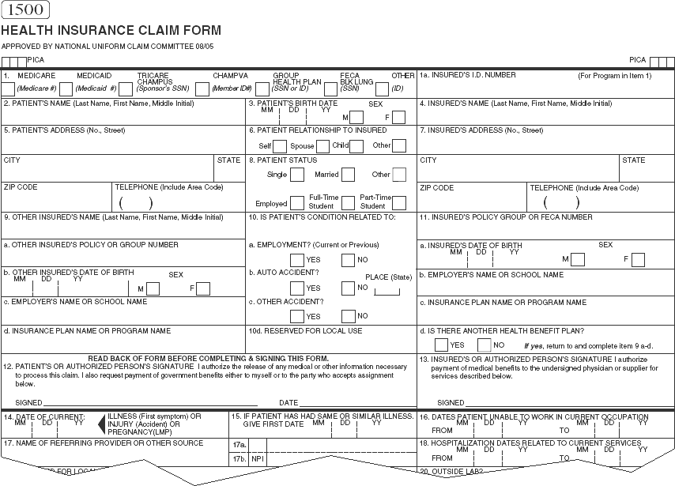
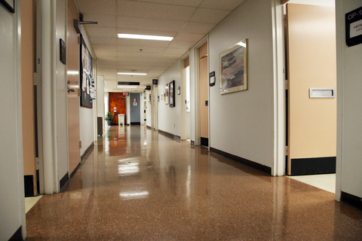
Put yourself in the mind of a patient
Notes:
(Sam and Diane) – Group Discussion
Have any of you in your professional career dealt with a patient that was lost? Have any of you ever been a patient that was lost? Have you ever gone to a new doctor in a new town for the first time?
(Share personal story of being patient, work with audience to share their own)
Put yourself in the mind of a patient. Think about all the activities and tasks that you must be mindful of as the patient seeks care in a healthcare facility.
Use The internet to find a facility or a doctor that will take your insurance
Use google maps or other software to find the location of your facility and the proper route
Call on the telephone and navigate through the phone tree
Find the right check-in desk
Fill out a form at a 9th to 11th grade reading level
Notice that at this point you still have not seen a doctor. All of this is in anticipation of actually discussing your condition with the physician.

Slide 5
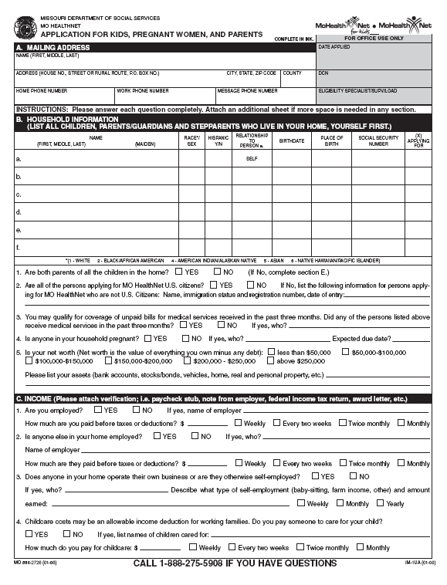
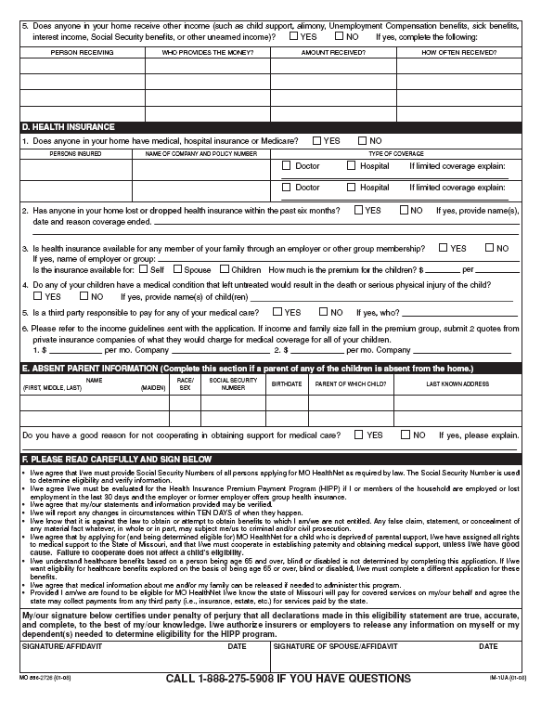
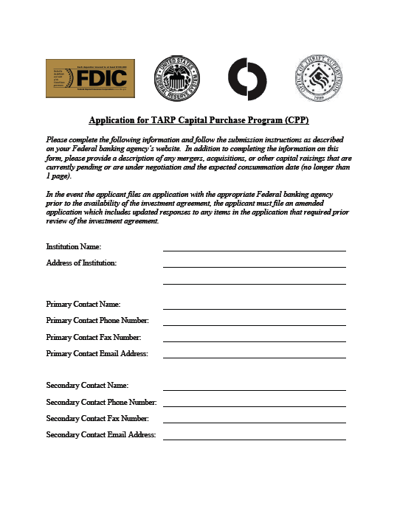
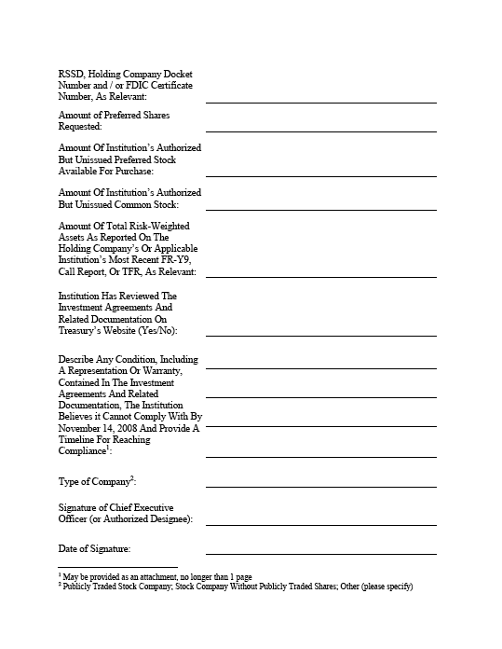
Put yourself in the mind of a patient
Notes:
Note: This is the generic slide that remains hidden. Try to find examples of forms or other aspects of the organization’s work (confusing signage at a hospital/clinic, etc) that you can use to illustrate barriers that patients and others have to deal with. If there are no examples, unhide this slide and use it.
Here is the general form the all applicants must fill out to obtain MO HealthNet services. Once a person learns about the program and figures out that they may qualify, this is the first hurdle they must clear. Let’s compare this with the TARP Bailout Application shall we. Applying for a TARP Bailout is much easier.
Think about all that we’ve discussed so far, including this form – what are some other barriers to health literacy that people may encounter?
Look for answers that fit into these categories. Try to pull it out of audience. If they don’t want to give it, give a couple of these as examples.
Cultural & social barriers (e.g., literacy level, age, language, cultural/religious beliefs)
Informational barriers (e.g., lack of medical knowledge, complex medical information and instructions, increasing responsibility to manage one’s health)
Structural barriers (e.g., time with providers, patient forms, navigation of the health care system)
Emotional barriers (e.g., fear, anxiety, depression, embarrassment, intimidation, perception of risk)
Communication skills of health professionals (e.g., level of complexity and novelty of the health information, cultural and linguistic stability of health information and service, existing public health infrastructure)

Slide 6
Today you will learn:
Patient-centeredness
Flip it
Teach-back
Analogies
Chunk and check
Notes:
At this training, you will learn:
Patient-centeredness
How to best use plain language
How to “Flip It”
Engage patients in the teach back method
Use analogies to best explain complex information
“Chunk and check” large blocks of information into more manageable lists for patients.

Slide 7
What is health literacy?
“The degree to which an individual has the capacity to obtain, communicate, process and understand health information and services in order to make appropriate health decisions.”
— Patient Protection and Affordable Care Act (Title V, Section 5002)
The demands placed on patients
by health care systems
Health Literacy
The skills and abilities of patients
Notes:
This is the definition of health literacy taken from the ACA. We see health literacy as both a system and a patient problem. This training is focused more on the system.
You may remember from earlier that most material and language from doctors and providers (including insurers) is written and spoken at a 10th to 12th grade level, and most patients read and understand at a 5th to 7th grade level.
Through better understanding of the problem, trainings, and policy changes, organizations to start to lower the demands.

Slide 8
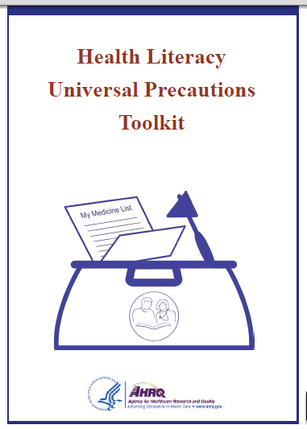
The Toolkit
Notes:
This is the tool where we get a lot of our health literacy skills from. This manual is available free online. There is also a link on the Health Literacy Missouri website.
This tool is available free online. (If available in hardcopy at the training, please mention)
It is important to be familiar with this document at least at the managerial level if there is going to be a sustained health literacy effort.
Health Literacy Universal Precautions Toolkit – This tool was originally intended for doctors offices, private practices, and smaller settings. Much of it deals with clinical implementation, but most importantly, it focuses on introducing a culture of health literacy into an organization.
All tools should be customized for your facility and populations served. Sometimes you will need to draw from a variety of resources to meet the needs of your facility.

Slide 9
The problem…
Patients may have negative feelings and emotions related to their limited reading ability or limited understanding.
Institute of Medicine, 2004
  Practice universal precautions around health literacy
  Create a shame-free environment for our patients
  Be culturally competent and sensitive
Notes:
The Health Literacy Universal Precautions Toolkit highlights several problems that we as providers face when dealing with patients.
Often, patients have a certain amount of shame in the fact that they suffer from low literacy. Our society places a huge stigma on those people that cannot read, or have limited literacy.
It is important that we remember to be culturally competent and practice universal precautions. There are indicators for patients that have low health literacy. Instead of focusing on those factors it is more important that we automatically assume that everyone we interact with has low health literacy. This helps to remove any stigma that may be associated with being low literate.
Just as the dentist wouldn’t ask you if she needs to wear gloves so she doesn’t catch your cold or flu, we shouldn’t ask our patients if they need help or a simple, clear explanation.

Slide 10
The problem…
The health care environment can make it hard for patients to tell us they don’t read well or do not understand.
  Patients may be able to adapt to learn skills for work, but the health system offers new challenges
  Patients cannot move forward until forms are complete, or there is a deadline to finish.
  There can be shame in asking for help
  in a group setting.
Notes:
So, we as providers, are also patients. We have all been to the doctor at one point or another, we have all enrolled in insurance plans. We understand that the system was not necessarily created with simplicity and ease as a chief concern.
It is important that we are aware of these issues.
Even if a patient is proficient at their job, they may struggle in medical situations because of stress, sickness, and lack of experience in the medical system.
Also, Imagine sitting among a group of peers and announcing that you are having trouble understanding what do do with paperwork while everybody else seems to work without trouble.

Slide 11
The problem…
Patients often hide a lack of understanding with coping techniques.
Parikh N Pt Educ and Counseling 1996
  Read one word at a time.
  Take things literally
  Avoid reading all together
  Stop reading once the find a plausible answer
  Retain little to none of the information
  Clear and Simple: Developing Effective Print Materials for Low Literate Readers, NCI
Notes:
Patients try to mask their lack of understanding, but there are cues that we can pick up on to help identify those that are struggling.
You may notice people:
Reading one word at a time, they spend all of their cognitive energy on understanding the words and not the message
They tend to interpret what they read very concretely. They may have trouble understanding more abstract ideas posed in the text
Make excuses to avoid reading. “I don’t have my glasses”, “My husband looks at all of this for me”, “I’ll read it later”
Stop reading when they reach what they assume is the main point or answer to their questions.
Not be able to recall more than one point from the information presented.
(Ask participants if they have ever encountered this behavior, or things like it. Ask them to share any methods they have developed in coping with low literacy patients)

Slide 12
Today you will learn:
Patient-centeredness
Flip it
Teach-back
Analogies
Chunk and check
Notes:
At this training, you will learn:
Patient-centeredness
Plain Language
Teach Back
Analogies
Chunk and check
(And finally) *Not listed on slide*
Culture and Policies

Slide 13


Notes:
STORY:
This cub might look familiar. It is handed out with most liquid generic medications. This was given to one of our employees with written instructions to dose their family member with “2 Teaspoons” of this antibiotic liquid. This cup has no “2 teaspoon” marking. It has a total of 25 different markings, but not the one that is needed. Also, the instructions stated give “2 teaspoons” in written form while all markings on this cup are abbreviations. Our employee also struggled because of the lack of oral communication offered by the pharmacist and the staff. Often, a simple explanation can overcome the barriers that are created by imperfect tools.
This cup was chosen by the pharmacy because it is a market centered solution. This cup serves the largest number of purposes (i.e. it can be used with a wide variety of drugs at the pharmacy for the lowest amount of money)
A better way of thinking is to be patient centered. Simple instruction from the pharmacist, or use of a different cup specific to the dose of medicine could have stopped this from becoming an issue.
It is important for every organization to ask themselves if they are doing everything the can to be patient centered.

Slide 14
Being Patient Centered
Use Universal Precautions – assume your next patient has low health literacy
Slow Down – Friendly conversational tone is 110 to 150 words per minute
National Center for Voice and Speech ncvs.org
Prioritize Information – What do patients need to know?
Self Assess – Pick one interaction a day and analyze yourself
Notes:
The most important thing that we can stress in this training is the use of Universal Precautions
It is also worth noting that even the way that the way you engage with patients outside of the content you provide can influence their understanding.
Slow Down! Often, when we are giving information that we understand we can have a tendency to rush. The recommended speed of friendly, conversational language is 110 to 150 words per minute.
Know your information ahead of time, and understand what are the most important points to get across.
Self Assess. We can only get better by practicing.
(Optional Dumb Joke: “What did the man say when he was asked how to get to Carnegie Hall?, Practice, Practice, Practice.”
Ask for several volunteers for the 150 words in 1 minute exercise.

Slide 15
Today you will learn:
Patient-centeredness
Plain language
Flip it
Teach-back
Analogies
Chunk and check
Notes:
Now we are going to talk about Flip It.

Slide 16
Elements of plain language
  When speaking, slow down
  Most to least important
  Chunk information
  3 – 5 main points
  Use simple language and common analogies; define technical terms
Notes:
Plain language when used in verbal communication has some key elements which include:
Slowing down – we all have a tendency to speak quickly when we’re talking about something that we are very familiar with
Move from points that are the most important for patients to know to the least important. Also flip it – tell patients what they need to know or need to do before you give them facts about the physiology of their condition
Break down complex information into chunks
Limit yourself to 3 – 5 main points – really most people only remember 3
Use simple language (“living room language) and analogies that your patient may understand (e.g., cholesterol can be like oil clogging drain when speaking about a heart condition); define any technical terms that someone may not be familiar with. However, if English is a second language, be cautious about using analogies.
It also is helpful to use visuals. Diagrams and pictures can help people understand what you are explaining and act.
Focus on “need to know/need to do”; be specific/concrete, not general; demonstrate, draw pictures, use models; repeat/summarize; be positive, hopeful, empowering; create a shame-free environment; encourage questions
Good time for personal story from the trainer or a real-life example
Activity—Complex Words Activity(5-7 minutes total)
Make sure that everyone has a copy of the worksheet. Ask them to, in their own spots, break up into small groups of 3 or 4 (Note: Depending on the size of the group, you may want them to work on this individually or be in slightly larger groups, but I would suggest no larger than 5). They should work together in these small groups to develop plain language explanations for the medical terms given and then report back to the larger group.

Slide 17
Today you will learn:
Patient-centeredness
Plain language
Flip it
Teach-back
Analogies
Chunk and check
Notes:
Now we are going to talk about Flip It.

Slide 18
Flip it
You are suffering from primary hypertension
You need to find a way to exercise more often
You are suffering from primary hypertension
Notes:
(Sam)
Flip it is this very simple idea based on the fact that the The Actional information should come first.
Sometimes it is not as cut and dry as the example above, but it all relates back to the importance of need to know information.

Slide 19
Today you will learn:
Patient-centeredness
Plain language
Flip it
Teach-back
Analogies
Chunk and check
Notes:
Now we are going to talk about Teach-back.

Slide 20
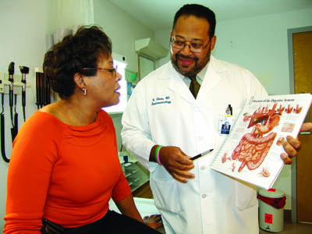
Teach-back
Explain new concept
Ask the patient to explain the concept
Clarify or repeat any points the patient might have missed
Ask the patient to explain the concept again
Use Examples
Use Analogies
Make sure they use their own words
Focus on points the are struggling the most with
Modified from Schillinger D, Piette J, Grumbach K, Wang F, Wilson C, Daher C, Leong-Grotz K, Castro C, Bindman A. Closing the Loop Physician Communication With Diabetic Patients Who Have Low Health Literacy. Arch Intern Med/Vol 163, Jan 13, 2003
Notes:
Talk through teach-back loop.
In a study, physicians who used the teach-back technique with their diabetic patients achieved better glycemic control.
(Schillinger D, Piette J, Grumbach K, Wang F, Wilson C, Daher C, Leong-Grotz K, Castro C, Bindman AB. Closing the loop: physician communication with diabetic patients who have low health literacy. Arch Intern Med. 2003; 163: 83–90.)
I like using teach-back for myself as well because it gives me piece of mind. I know that the patient left with information they didn’t have when they started.
There is also evidence mounting that the quality of the interaction is better while the time spent with each patient can actually diminish slightly.

Slide 21
Teach-back prompts:
  “I want to ensure I explained things clearly; can you tell me in your own words what we discussed today?”
  “How will you explain this to your family?”
  “What do you think will work best for you when you get home?”
— Schillinger D, Piette J,Grumbach K, et al. Closing the loop. Physician communication with diabetic patients who have low health literacy. Arch Internal Med. 2003; 163:83-90
Notes:
Teach back is a method for ensuring that patients understand what they have been told regarding their health
The provider should:
–Ask the patient to describe concepts in their own words
–Have the patient explain or demonstrate how they will undertake a recommended treatment or intervention
–Take responsibility for adequate teaching
If the patient does not explain correctly or correctly return the demonstration; re-teach the information using alternative approaches.
When asking patients to ‘teach back’, it helps to put them at ease by placing the burden on yourself. You want to know what information the patient understood.
Focus the teach back on 1 or 2 points. If I asked you right now to tell me what I have shared with you in the last hour, you might recall 1 or 2 concepts, but this is not effective for assessing your knowledge. It would be more effective for me to assess your understanding of the impact of health literacy. I might say, for example, “We have covered a lot of information today. In order for me to be sure that I explained health literacy correctly (placing the burden on myself), tell me two things you can do to improve communications with patients (focuses the teach back on one point).”

Slide 22
Today you will learn:
Patient-centeredness
Plain language
Flip it
Teach-back
Analogies
Chunk and check
Notes:
Now we are going to talk about Analogies.

Slide 23

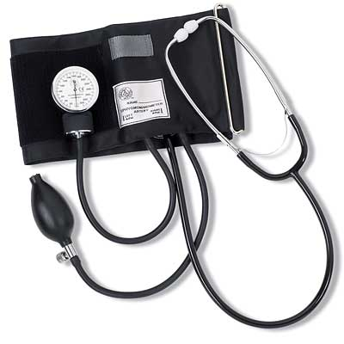

Let’s try some analogies
Notes:
*Offer some medical based analogies from previous experience. These could include:
Stroke as clogged pipe or blown pipe
Blood pressure as RPMs in an engine
Food as fuel
Moles or skin spots as rust on a tractor
Nerves as electrical lines
(Ask Sam if you need further explanation of analogies)
Are there analogies you have heard in your line of work?
Do you find situations where you have heard an analogy and it has helped you understand a complex topic? (discuss with group.)

Slide 24
Today you will learn:
Patient-centeredness
Plain language
Flip it
Teach-back
Analogies
Chunk and check
Notes:
Now we are going to talk about Analogies.

Slide 25
Chunk and check:
New Concept
Be Patient- centered
Use Plain language
Flip it
Use Teach-back
Use Analogies
New Concept
Be Patient-
centered
Use Plain language
Flip it
Use Teach-back
Use Analogies
New Concept
Be Patient- centered
Use Plain language
Flip it
Use Teach-back
Use Analogies
Notes:
Chunk and Check is putting it all together.
When we speak with patients, we typically have to explain more than one concept. Chunk and check is a method of including all of the other aspects of this training we have discussed into a single technique.
We know that patients struggle to understand long lists of things to do, and yet this is often the way information is presented in the medical field.
Often times, if a patient has a question over any one point in a conversation, they may save their question until the end. Holding on to this question can effect their ability to understand the rest of what is being said. This method addresses that concern by stopping the conversation to insert teach-back and other techniques to ensure understanding

Slide 26
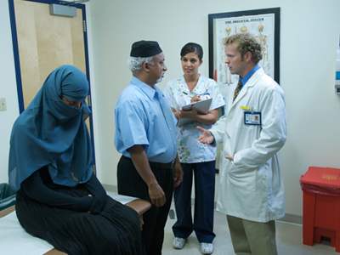
Cultural Competency
  Elements that will influence health outcomes
    Beliefs
    Traditions
    Language preferences
    Health practices
Notes:
Cultural competency is the ability of health organizations and practitioners to recognize elements like cultural beliefs, values, attitudes, traditions, language preferences, and health practices in populations to create positive health outcomes.
It includes the acknowledgement of differences and requires respect.

Slide 27
Canadian Case Study
Arriving in Canada, newcomers are generally
as healthy as or healthier than Canadian-born individuals.
However, their health status may deteriorate in the years following immigration.

Slide 28

The Culture of your organization
Ensure health literacy best practices are incorporated into facility policies
Notes:
Key Point:
It is important to ensure health literacy best practices are incorporated into policies
Consistency of health literacy within the organization beyond individual staff members ensures regular assessment and support of staff engaged in health literate practices
Sustainability is important
Make sure policies and procedures are integrated into orientation and trainings for all staff and volunteers
Creating a health literate organization requires a cultural shift among the staff, but it is also a system level problem. Even if you cannot get staff to “buy-in” you can at least start a conversation around key terms and ideas. Once these terms and ideas are understood, policies that require and support clear communication practices can be put in place.

Slide 29
The End
Do you understand?
Do you have any questions?
A lot of people have questions about our work…
What questions do you have for me?

