Slide 1
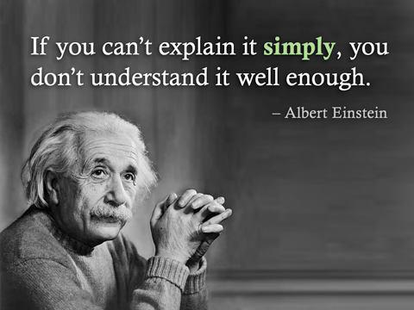
Make your health care materials easy to understand
Health Literacy Missouri
Megan Rooney, MEd

Slide 2
Objectives
Discuss evidence-based plain language principles to ensure clear health communication
Practice skills plain language principles
Evaluate and modify health materials to follow evidence-based plain language principles
No conflict of interest
Notes:
Check to make sure everyone has a material to assess.

Slide 3
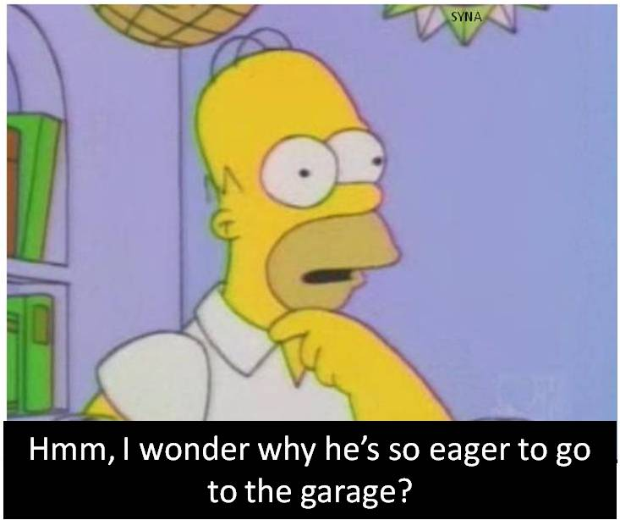
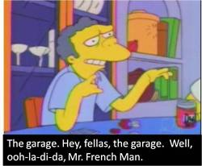
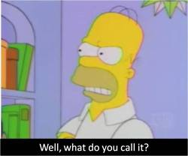
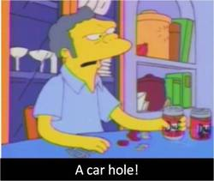
Plain language isn’t…
Notes:
So we’ll start by defining plain language. (Have Sam read?)
Plain language isn’t just simple words—sometimes the simplest words can sound awkward or unnatural.

Slide 4
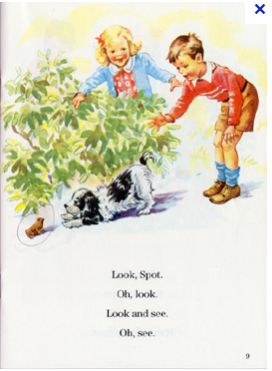
Plain language isn’t…
A pretty a day
(and every fades)
Is here and away
(but born are maids to flower an hour in all, all)
— ee cummings
Reading level
Just simple words
Dumbed down
Notes:
It’s also not just about reading level. This is at the 1st or 2nd grade reading level, but that doesn’t mean it’s clear.
And it is not ‘dumbed down’— the goal is not to oversimplify, but to avoid unnecessary complexity. We want succinct language, but not so succinct that it is awkward

Slide 5
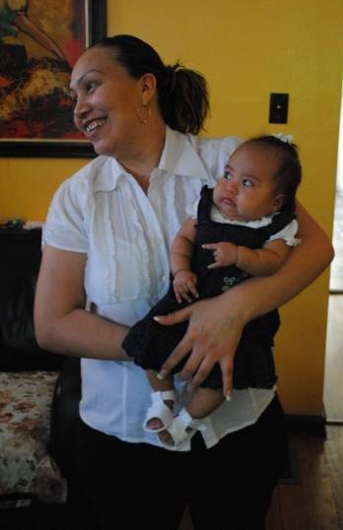
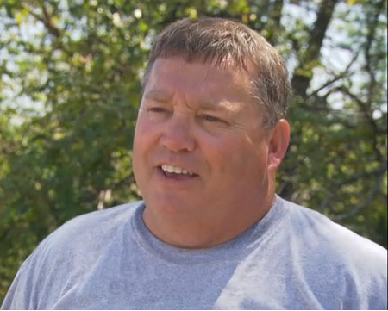
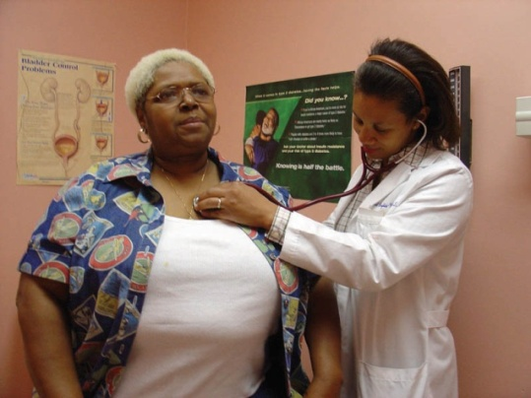

Plain language isn’t…
Writing so that
everyone
can understand.
Notes:
It is not writing so that everyone can understand.

Slide 6
Plain language is…
Writing so your readers can:
Find what they need
Understand what they find
Act on that understanding
Notes:
NEED NEW TRAINING MANUAL SCREENSHOT
Now we’ll begin our discussion of the top things you can do to make your materials easier for your audience to understand. We’re going to cover a lot of information today, but we will follow our manual closely so you can write notes in it as we move along.
Using this manual will help you answer these questions: Can your readers:
Find what they need?
Understand what they find?
Act on that understanding?
--In order for people to read your materials, they have to look good—it doesn’t have to look fancy with expensive pictures, and it doesn’t have to cost a lot of money. These tips will teach you how.
--In order for people to use and act on the information you send out, it has to be able to be understood or digestible.

Slide 7

Plain language is…
Writing so that
your intended readers
can understand.
Notes:
It’s all about audience. It is not writing so that everyone can understand. It’s writing so that your intended readers can understand.
You need to know your audience in order to communicate the messages they need and in a manner they can understand—if your audience is medical personnel, you could probably get by using some medical or complex words; if your audience is elderly with limited English, you will want to use simple language—we know this by demographics. The more you match up your messages to your audience, the more likely they will be to act.

Slide 8
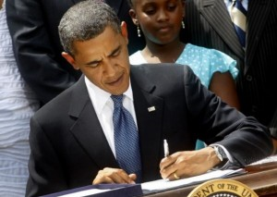
Plain Writing Act of 2010
President Obama signing the law, October 2010
www.plainlanguage.gov
Notes:
Congress passed the Plain Writing Act in 2010. The bill requires the federal government to write all communications with general public (except regulations) such as: documents, tax returns, federal college aid applications, and Veterans Administration forms, in simple language.
The law requires that federal agencies use "clear Government communication that the public can understand and use.“ The Act passed the U.S. House of Representatives in March and the Senate in September of 2010.
Just a note: the act is moving very slowly. Don’t expect any action immediately. Much of it is supposed to take effect in 2014, but it is questionable whether or not all of it will be implemented.
Plain writing report card was published in June 2012, all agencies are behind, some are doing better than others.
By October 13, 2011, all agencies must have this in place. Learn more at plainlanguage.gov
Additional Details:
(1) AGENCY.—The term ‘‘agency’’ means an Executive
agency, as defined under section 105 of title 5, United States
Code.
(2) COVERED DOCUMENT.—The term ‘‘covered document’’—
(A) means any document that—
(i) is necessary for obtaining any Federal Government
benefit or service or filing taxes;
(ii) provides information about any Federal
Government benefit or service; or
(iii) explains to the public how to comply with
a requirement the Federal Government administers
or enforces;
(B) includes (whether in paper or electronic form) a
letter, publication, form, notice, or instruction; and
(C) does not include a regulation.
(3) PLAIN WRITING.—The term ‘‘plain writing’’ means
writing that is clear, concise, well-organized, and follows other
best practices appropriate to the subject or field and intended
audience.

Slide 9
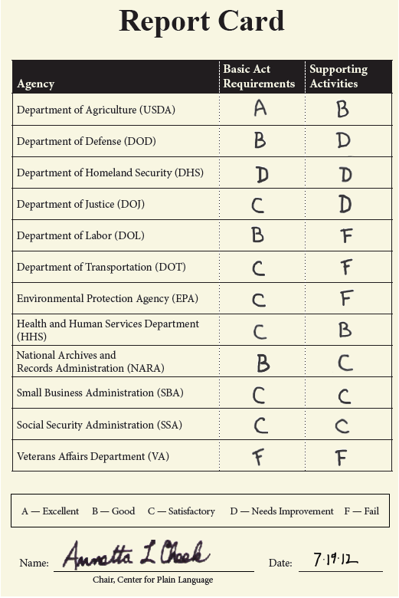
Plain Writing Act of 2010: report card
Health and Human Services
Notes:
The Center for Plain Language, a group that advocates for clear writing in government documents, released a scorecard showing agency progress towards meeting the requirements of the Act. The Report Card tracks the progress of how well agencies are following the Act.
It found mixed results at many agencies—demonstrating that we still have a long way to go to make government forms and documents simpler and easier for taxpayers to understand. Some federal agencies have embraced the Plain Writing Act, and others haven’t.
The 1st score is based on the specific requirements in the Plain Writing Act. They include:
-appoint a senior official
-create an implementation plan
-file a compliance report
-create a plain language page on their website that links from their home page
-provide a mechanism for public feedback
-educate employees in plain language
-Use plain language in documents
The 2nd score is based on supporting activities that embrace the spirit of the act, such as:
-Implementation plan
-Compliance report
-Measurement of their progress
-list contact info for lead official on pl page?
-who must take trainings
-how long is the training

Slide 10

Why plain language?
Notes:
Here’s a quick story to demonstrate why plain language is important, and how not using plain words can lead to harmful or lethal situations.
A young mother reads a label and sees the word ‘oral,’ then pours a drug that is supposed to be taken by mouth into her baby’s ear, perforating the eardrum.
What is a way this could have been avoided? What could the writers of the instructions do to make it clearer?
Medical instructions can be written at a low reading level, with clear word choice, and visuals whenever possible—if there were a picture of a mother giving the child medicine by mouth, this might have been avoided.
Real quickly, we’d like to hear from you—have you ever run into problems like this yourself or with the people you serve?
(Each of these examples provided by health care workers or patient advocates, ‘Many Americans have poor health literacy,’ February 28, 2011, Washington Post)

Slide 11
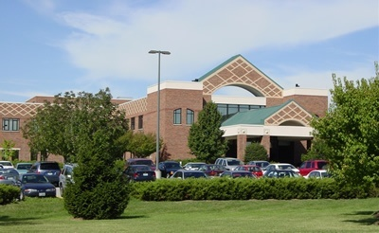
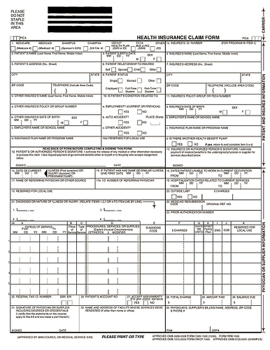
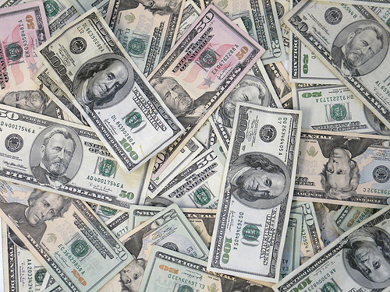
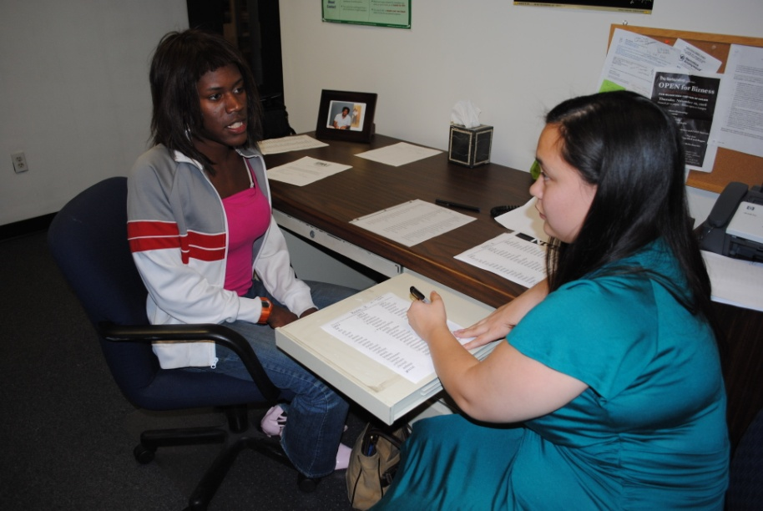
Why plain language?
Notes:
Here are some of the benefits of plain language:
-improve understanding of your communications and help your clients understand rules or take correct actions;
-improve understanding of your forms and applications
-reduce the need for your clients to seek clarification from your staff—reducing their time spent clarifying
-reduce the number of errors that are made and thus the amount of time and effort correcting them.
-reduce resources spent on enforcing rules, tracking clients down, and increases efficiency
Source:
MEMORANDUM FOR THE HEADS OF EXECUTIVE DEPARTMENTS AND AGENCIES
FROM: Cass R. Sunstein Administrator, Office of Information and Regulatory Affairs
SUBJECT: Final Guidance on Implementing the Plain Writing Act of 2010

Slide 12
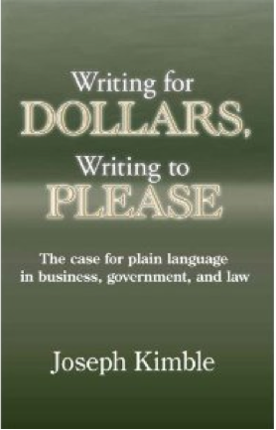
Why plain language?
Notes:
This book does a great job providing evidence for using plain language. It collects the empirical evidence for the value of plain language in business, government, and law.
It summarizes 50 studies showing that using plain language can save organizations and agencies a ton of money:
The Cleveland clinic revised a billing statement using plain language: recovered an extra 1 million a month in the following months AND had an 80% increase in patient payments
Los Angeles County dept of consumer affairs redrafted scores of docs, simplified recorded phone messages and conducted plain language workshops: had an annual savings of $50,000; improved readability by 4 grade levels and reduced consumer calls by 30%
It also explains that readers strongly prefer it to legalese and officialese, they understand it better and faster, they are more likely to comply with it, and they are more likely to read it in the first place. It also talks about how pl builds trust with an audience.

Slide 13
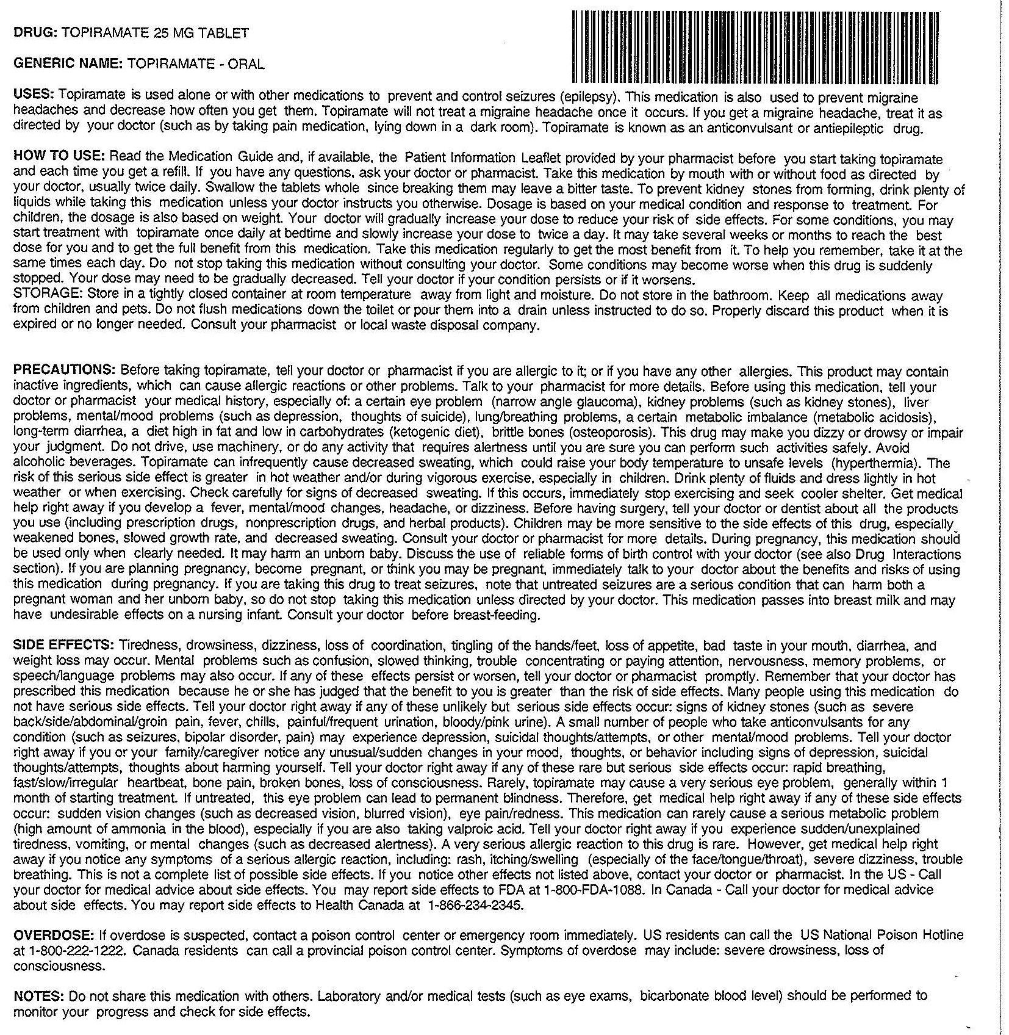
Why plain language?
Notes:
We need principles of plain language because of materials like this. Can you imagine giving this out to the public? If this contained steps to obtain something or directions, can you imagine all of the phone calls you would receive? All of the hours your staff would put in to explaining it to people? Not to mention the frustration your clients would have with you for the difficulty and confusion it causes.
Now we’re going to get to the documents…we’ll discuss the top things you can do to make your materials easier to read.

Slide 14
Top plain language tips
Audience
Reading level
Make it look easy
Clear words
Engage your readers
Notes:
Now we’ll start our discussion of the top things you can do to make your materials easier for your audience to understand.
Here are 5 simple plain language tips. We actually look at many more principles when reviewing a document, but we are keeping it simple for the introduction to plain language.
These are a few tips to keep in mind when developing materials:
--In order for people to read your materials, it has to look good—it doesn’t have to look fancy with expensive pictures, and it doesn’t have to cost a lot of money.
--In order for people to use and act on the information you send out, it has to be able to be understood or digestible.
As I said, audience is so important, we’ll begin with this.

Slide 15




Audience
Who is my audience?
What do they know? What questions might they have?
Is it accessible?
Is it easy to understand?
Is it culturally appropriate?
What are some barriers?
Notes:
The first thing you should ask yourself when you’re writing or revising your materials is: Who is my material intended for? Materials are most effective when they are targeted to a very specific audience. Remember, it’s not writing so that everyone can understand—it’s writing so that your intended readers can understand.
To match your content to your audience, ask yourself these questions:
Who is my audience? What do you know about them--race, ethnicity, age, location, other demographics. This will drive what you include in your message and how you deliver it.
What does my audience already know? What questions might they have? Will this be useful given their needs and concerns?
Is it accessible to my audience? Given their use of technology or their disability-related needs. You also want to meet your audience where they are. For example, sample dissemination strategies by age:
18–34: Digital, social media
35–49: Worksite campaigns
50–64: Reach spouses as influencers
65+: Doctors’ offices, faith-based campaigns
Is it easy to understand? Given their reading ability, language and knowledge
Is it sensitive to their cultural issues, beliefs and backgrounds? Which we will talk more about in a minute.
What are some barriers and challenges to reaching this audience? Audience feedback can help gather this information.

Slide 16
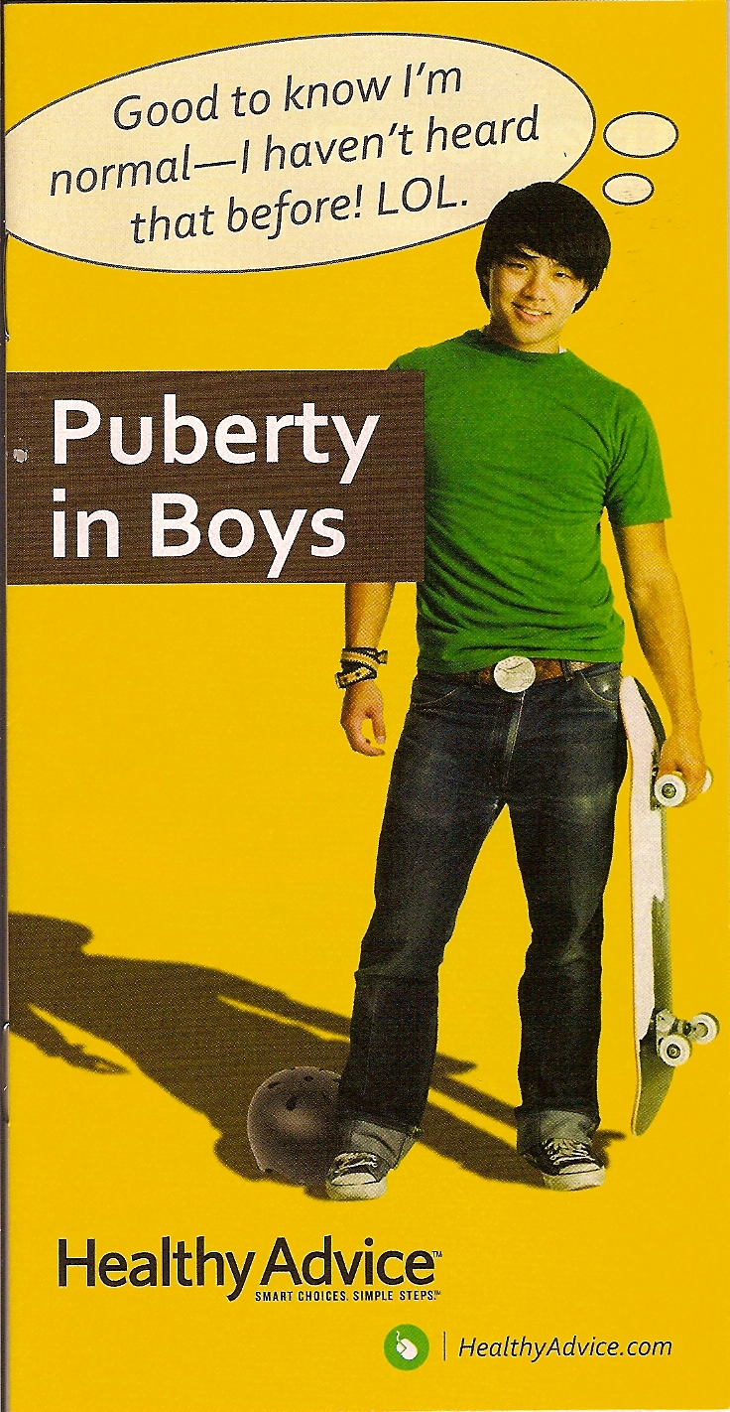
Audience
Notes:
What do you think about this brochure? Is it clear who it is for? Who is it for?
This booklet is targeted to boys going through puberty—portrays a hip, teen boy, doing a typical activity (skateboarding), and uses language familiar to that population (LOL).
Here are a few questions to ask yourself about your material:
Is the audience clear?
Does it look appealing to the audience?
Does it portray the audience positively?
Is the content tailored to the specific concerns and needs of the audience?
What questions might my audience have? (And then include this in the order they may ask)
Was the audience involved in developing the material? (Did they help to decide the content? Did they review the material after it was written?)

Slide 17
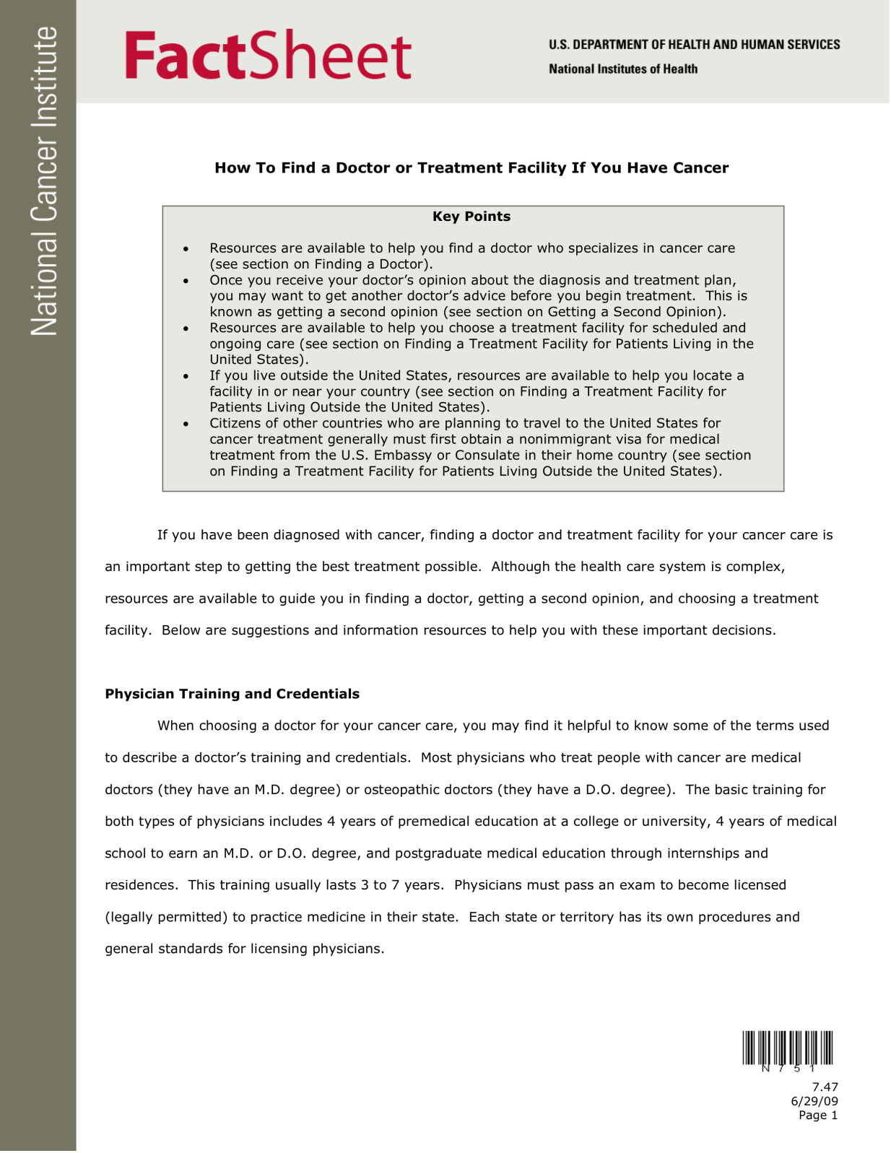
Audience
Notes:
What about this brochure? Is it clear who it is for? Who is it for?
This sheet is for cancer patients. But, there are so many types of cancer, and so many subtypes. This is for a generic audience, so the content is going to be generic and not meaningful or relevant to any one person.

Slide 18
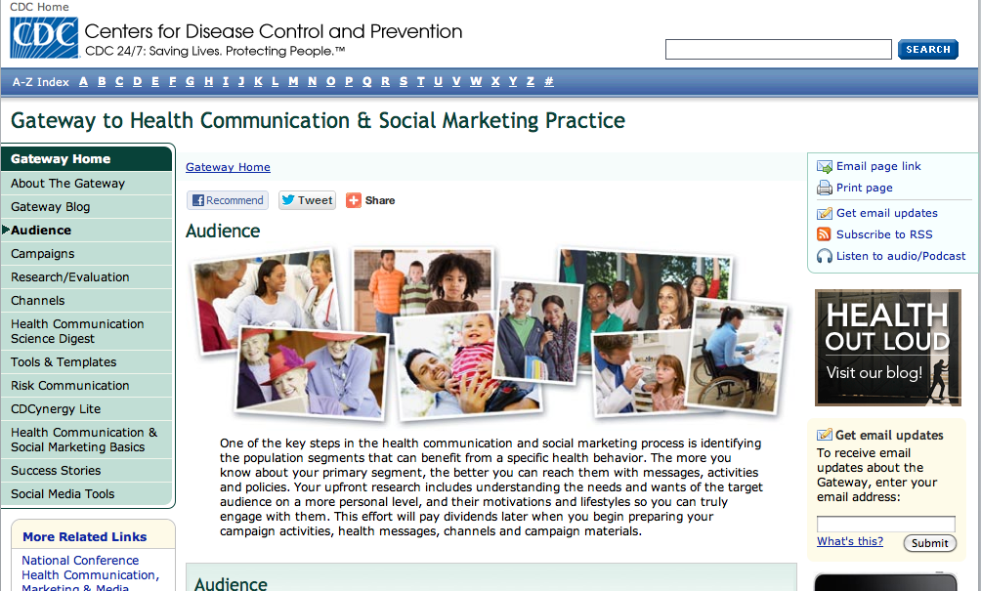
Audience: CDC Insights
http://www.cdc.gov/healthcommunication/Audience/
Notes:
I’m going to share some information about what we know about different audiences—This CDC website offers evidence-based insights into different audience types. The site analyzes different target audiences for public health so that you can more effectively communicate with them to influence their behavior.
While this is all evidence-based, I always like to note that these should be used with caution and should not substitute for learning about your specific audience. The data on this site is very general and leans towards stereotyping in my opinion, and doesn’t take into account many features of region, dialect, idiosyncrasies or the complexity of culture.

Slide 19

Audience
Peripheral cultural
strategies
Notes:
HLM asks ‘Is the material culturally appropriate?’ This means that it reflects the culture of the intended audience--content or graphics are representative of the audience, for example: a fact sheet for St. Louisans contains images of people by the arch, not at the beach.
HLM asks if several components are used to be culturally appropriate. In our manual, we assess these 4 strategies to match culture
First we’ll discuss peripheral strategies.
Who is the audience here? Is it appropriate for their culture? This is a booklet for Spanish-speaking women about cervical cancer; There are photographs of women from different Spanish-speaking cultures throughout the booklet. This document uses Peripheral strategies, which are ‘surface’ features to appeal to or reflect the audience—visuals that make the material comfortable and familiar, making it more relevant to the readers. Visuals could match:
Age, Sex, Race or ethnicity, Education level, Income, Occupation, Country of origin, Geographical location, Health status
Examples:
Photographs, Line drawings, Clip art/ cartoons/ spot illustrations, Graph/ chart, Diagram/ flow chart, Stylized fonts, Colors
*Note: do not include logos

Slide 20
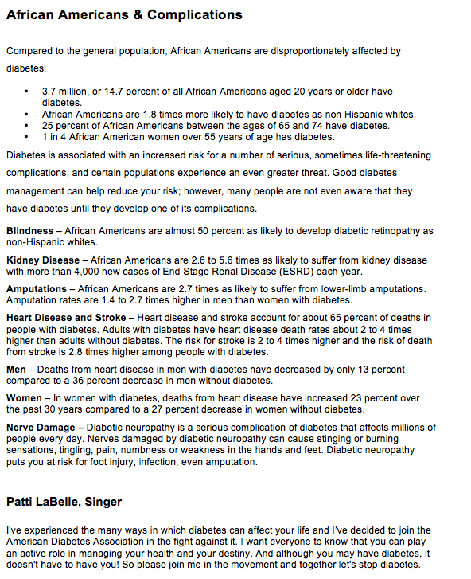
Audience
Evidential cultural strategies
Notes:
This isn’t the prettiest document, but it does something really well. This is text from the American Diabetes Association website that uses research about diabetes in African Americans, making it more relevant to this audience.
It uses Evidential strategies: material provides evidence specific to the readers’ concerns—epidemiological data (how many people have a condition, how many people die, etc.), role modeling or testimonials.
Examples:
-Data: Numbers may be “written out” or show numerical relationships, such as most, majority, half, millions, etc. A material for doctors about patient communication might say “the average patient comes to every visit with 6 questions.” A material for hospital administrators might say “employing health literacy principles can save a hospital $12 million/year.”
-Role- modeling or testimonials: A popular person that a group looks up to—sports figures, movie stars, etc.
*Note: the evidence does not need to be about the intended audience—a material targeted to nurses may contain evidence about patients.

Slide 21
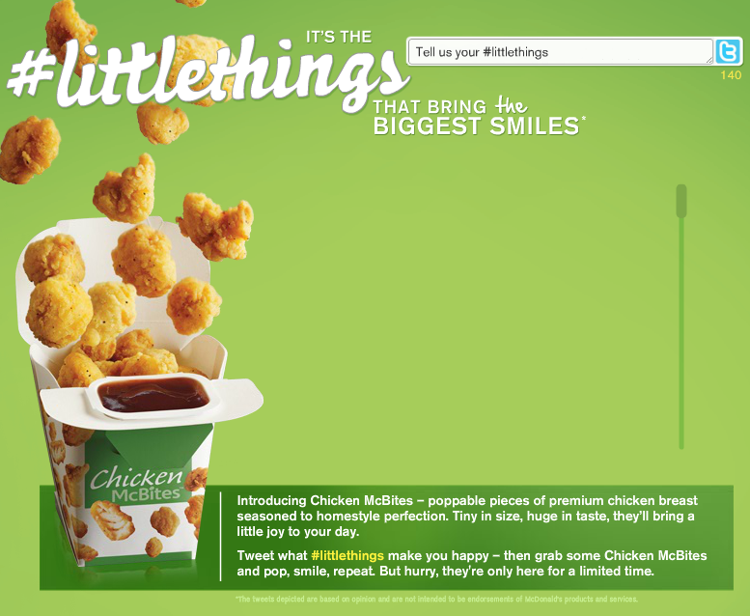
Audience
Linguistic cultural strategies
Notes:
In this screenshot from McDonald’s website, they are using social media language ‘tweet’ and the hashtag symbol to appeal to their youthful audience.
This is a Linguistic strategy: material uses the intended audience’s dominant or native language or frequently used phrases that are meaningful to the audience.
Examples:
Slang: ‘LOL’ for younger readers
Idiomatic phrases: “What’s up?”
Technical jargon: “I need an EKG, stat!” or ‘the nurse will check your vitals’

Slide 22
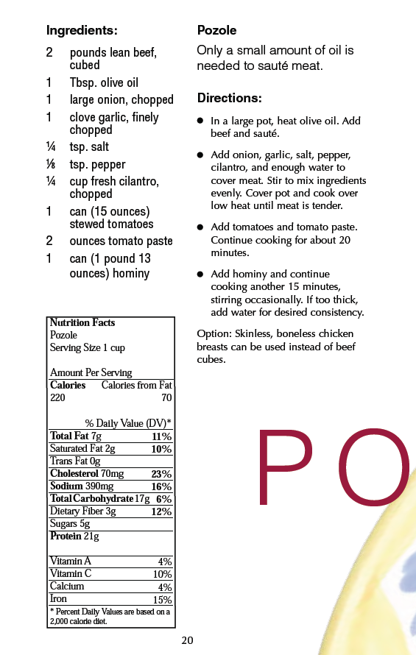

Audience
Sociocultural strategies
Notes:
This recipe book includes healthier versions of traditional Hispanic foods--pozole is a ritually significant, traditional pre-Columbian soup or stew from Mexico.
This uses Sociocultural/sociolinguistic strategies: material matches the “deep structure” of culture—broader cultural beliefs, values, and behaviors shared by the target audience. This makes it more relevant to the readers.
This could include: Eating, Cooking, Leisure and work activities, Self- care or health habits, Customs and traditions, Media exposure, Attitudes, A focus on family
Examples:
A pamphlet for an Indian population about caregiving includes information about family…A pamphlet for a Native American population about caring for babies is careful to include grandparents in the discussion.

Slide 23
Audience testing
Individual interviews and Focus group questions:
Is it attractive?
Do you understand it?
Does it provide the information you need?
Do you feel you can carry out the behaviors?
Is it culturally suitable?
How could it be improved?
Notes:
We’re now going to practice with the person next to you. And here are some good questions to ask. You can ask open & Closed questions and also give scenarios: ‘If you need to find out where we are located, where would you look?’ and ask how it could be improved.
Is it attractive to the audience?
-It needs to attract them, if they don’t look at it, there’s no chance for influence -Is it appealing enough to carry the patient into the message? -Are the visuals of interest? -Do the colors fit the tone and mood of the subject? -For audio/video, is the voice easy to listen to? Is the diction distinct? Is the speed reasonable? Is the accent understandable? Any aids needed?
Can people understand it?
-Can the patients tell you in their own words what the message means? -What other interpretations are possible? -Are there so many actions asked for that the patients become confused? -Are there concept, category or value judgment words used that may not mean to patients what they mean to you? -Can readers show or tell you what they believe they are supposed to do as a result of being exposed to your message? (comprehension occurs when they can convert the message from one format to another)
Do they feel they can take the actions described? Can they carry out the behavior?
-Do they feel confident they have enough info and skill to carry out any instructions? -If uncertain, what kind of additional instruction is needed? -Would other people in the community likely follow this advice? -What might this instruction say that would make it more helpful?
Is it culturally suitable?
-Is the message offensive? -Is it perceived as true? -Are there annoying elements? -Are deeper elements, Hair styles, jewelry, dress, child-rearing practices, roles of men and women, views of birth and death enhance or detract?

Slide 24
Reading level
The average reading skill of adult Americans is between 8th and 9th grade level.
1 in 5 adults reads at or below 5th grade level.
2 in 5 adults aged 65 years & older read at or below 5th grade level.
– NAAL, 2003
Most education materials are written beyond patients’ ability to understand.
– IOM 2004
Notes:
Most materials written at the 10th grade level or above. We like to aim for the 6th grade level for most health care instruction.
Even people with a college education prefer to read ‘easy to read’ materials.
Comprehension is typically 1-2 grade levels below reading level.
Readability is only one small piece of writing in plain language.

Slide 25
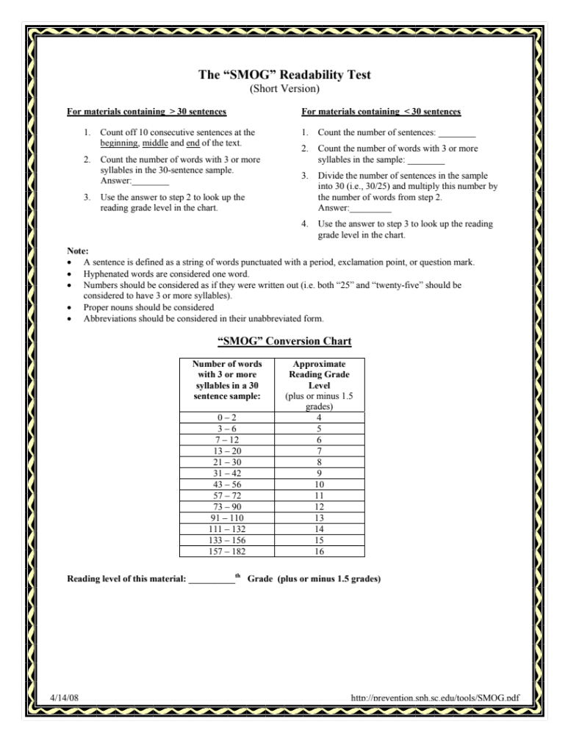
Reading level
SMOG:
http://prevention.sph.sc.edu/tools/SMOG.pdf
Notes:
We recommend striving for 6-8th grade, but match your audience.
-A good average sentence length is 12-15 words
-The two tests we use: SMOG and FRY,
-The Flesch-Kincaid Grade Level is another that is in Word documents. We tend not to use this because it underestimates grade level.
We can give you more information on reading level after the presentation if you’d like.

Slide 26
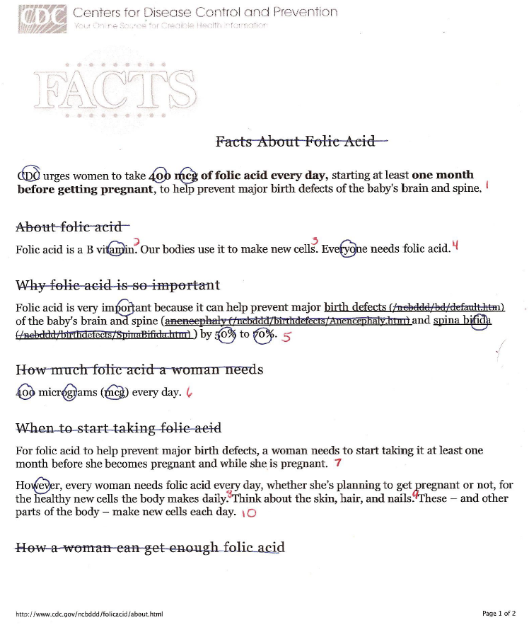
Reading level: SMOG for short materials
Notes:
-Here is an example of a document we did a SMOG assessment on. You will get some practice in a minute. For now, use your SMOG sheet to follow along with me—you don’t need to memorize it, you can always reference this sheet.
-You’ll see on your sheet that there are 2 different versions: for short materials with 29 or fewer sentences and for longer materials with 30 or more.
-This is an example of a short material. The SMOG can be used to visually identify problem areas in the document.
-There are little rules and tricks to calculating correctly, such as how to assess bulleted lists, titles, abbreviations, hyphenated words, numbers, proper nouns and web addresses. You can find these on the last few pages of your SMOG sheet.
-If you look at the document here ‘Facts about folic acid,’ you’ll see that this this doc has fewer than 30 sentences, so we’re using the short form. Here’s what we did:
-We counted 10 sentences in red
-And then circled each word that has 3 or more syllables. We counted 13 words.
-Next, we just follow the steps in the smog: divide the words by the sentences=1.3
-Subtract the number of sentences from 30=20
-Multiply 20 by the 1.3=26
-Add that number to the number of words=39
-Take the square root=6
-Add 3=9, so 9th grade reading level

Slide 27
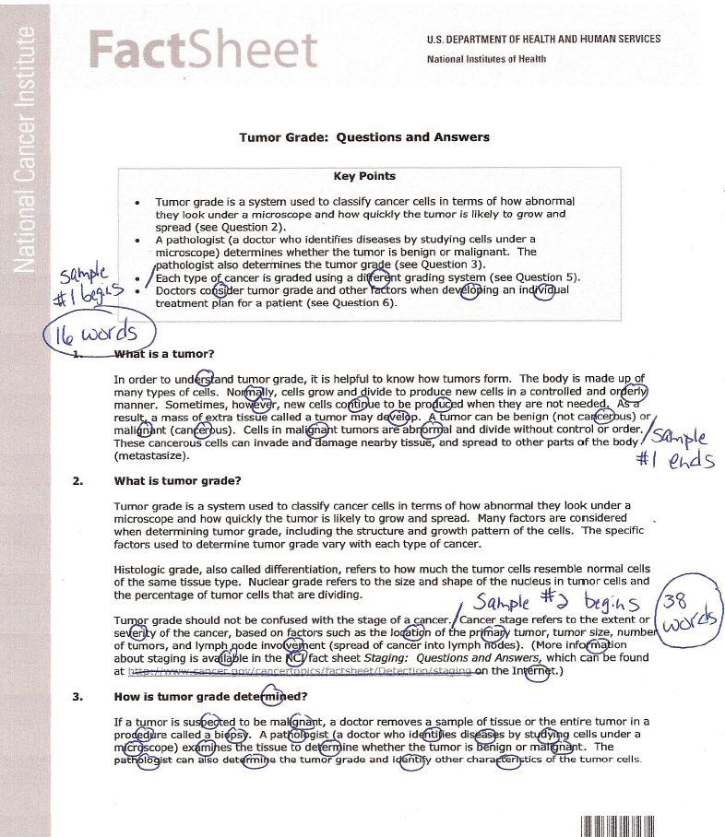
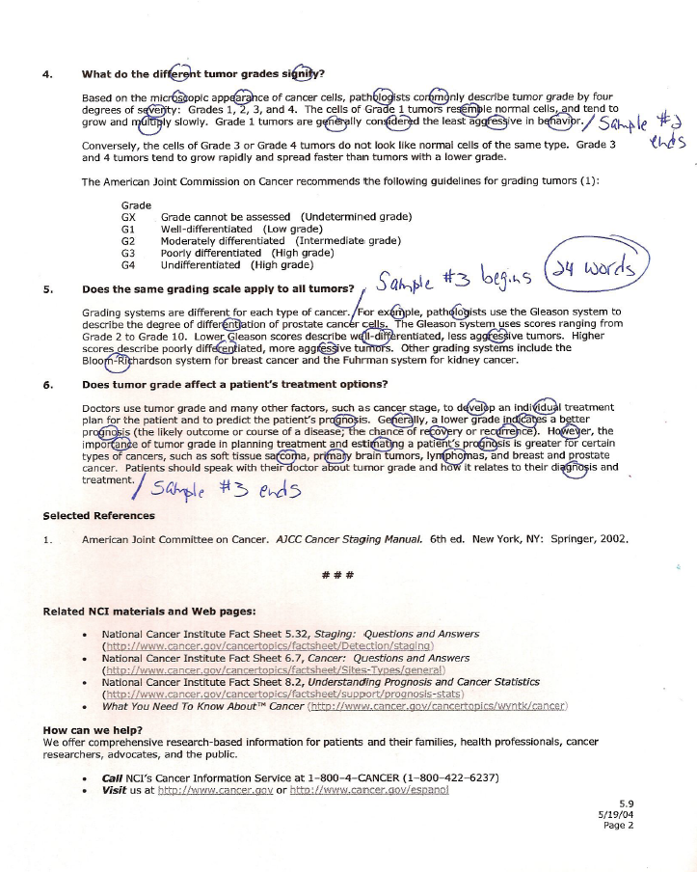
Reading level: SMOG for long materials
Notes:
Here is an example of a longer document we did a SMOG assessment on with 30 or more sentences. There are only 6 steps and it’s actually a much shorter process:
-You select 3 sections from the beginning, middle and end
-Count the # of words with 3 syllables or more=16, 38 and 24
-Add these sections together=78
-Then refer to the chart on the SMOG sheet to choose the closest number in the chart=81
-Take the square root=9
-Lastly, add 3=12
-There is also an online calculator, but you must clean up your document significantly to use it. (website: http://www.readabilityformulas.com/free-readability-formula-tests.php)

Slide 28
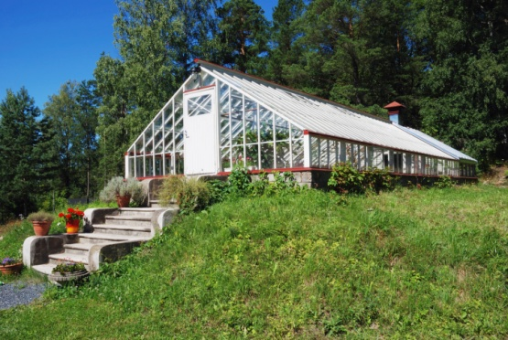


Reading level
Lithodial fragments ought not to be projected by the inhabitants of vitreous abodes.
People who live in glass houses shouldn’t throw stones.
A perissodactyl ungulate may be propelled toward a body of aqueous fluid, but such ungulate cannot be compelled or forcibly induced to imbibe such fluid.
You can lead a horse to water, but you can’t make him drink.
Insufficient instruction to an aged canine will not result in its ability to undertake fresh strategies.
You can’t teach an old dog new tricks.
Notes:
What does this mean to you? Can you parse this apart?
These are simple phrases written at a really high reading level unnecessarily.

Slide 29
Reading level: Activity
Instead of… | Try…
1. Involuntary undomiciled | 1.
2. Vehicle appearance operative | 2.
3. Vocation relocation policy | 3.
4. Expeditious | 4.
5. Heretofore | 5.
6. Oral | 6.
7. Remuneration | 7.
8. / | 8.
9. Referral | 9.
10. Eligible | 10.
Instead of… | Try…
11. Deem | 11.
12. Environmental hygienist | 12.
13. Tissue | 13.
14. Appreciable | 14.
15. Addressees are requested | 15.
16. Be advised | 16.
17. Anticipate | 17.
18. Commence | 18.
19. In the event that | 19.
20. Diet | 20.
Notes:
As in every field, professionals use euphemisms or jargon. Here is a sheet with some common jargon from the health and public health field.
Now we’ll look at the sheet you have. As you’re learning, there is more to plain language than just switching out complex words for short words, but this technique will reduce the reading level. We’re going to do a little practice. This sheet lists some complicated words we often come into contact with in our work, and that you may have seen as well. Take a few minutes to think of your own substitutions to reduce the reading level.
[Give participants a few minutes, then discuss substitutions they came up with as a group]

Slide 30
Reading level: Activity
Instead of… | Try…
1. Involuntary undomiciled | 1. The homeless
2. Vehicle appearance operative | 2. Car washer
3. Vocation relocation policy | 3. To fire
4. Expeditious | 4. Fast, quick
5. Heretofore | 5. Until now
6. Oral | 6. By mouth; out loud; verbal; spoken
7. Remuneration | 7. Pay; payment
8. / | 8. And; or
9. Referral | 9. Request
10. Eligible | 10. Qualify; able
Instead of… | Try…
11. Deem | 11. Believe; consider think;
12. Environmental hygienist | 12. Cleaning staff; janitor
13. Tissue | 13. Skin; part of your skin or body
14. Appreciable | 14. Many; much
15. Addressees are requested | 15. Please (or delete)
16. Be advised | 16. (delete)
17. Anticipate | 17. Expect
18. Commence | 18. Begin; start
19. In the event that | 19. If
20. Diet | 20. What you eat; eating habits
Notes:
What are some words you come across that you have difficulty with? Or that your clients can’t understand?
8. Avoid slashes
15.And 16. Avoid pleasantries (‘Remember’)
Legal language and mandated documents can be hard to change. One option is to rewrite the complicated language underneath. You can define terms in a side bar.

Slide 31
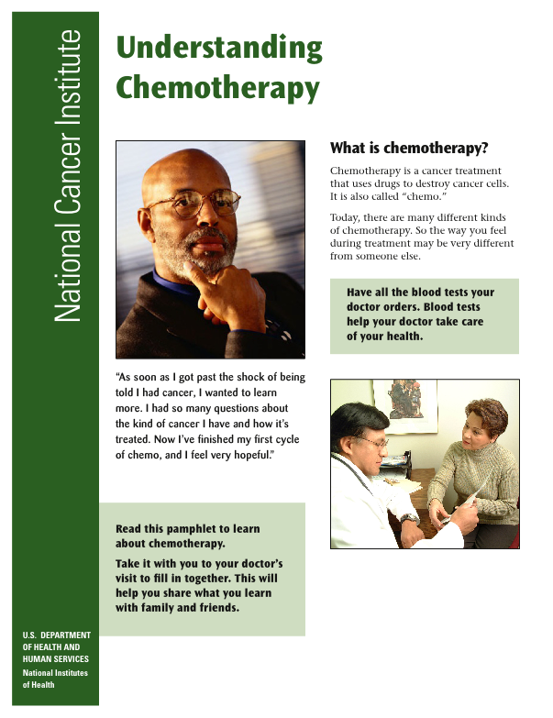
Make it look easy
White Space
Notes:
The third concept is Clear Design. This is actually quite complicated, but we’re focusing on a few aspects: white space, visuals, headings and organization.
This is a document from the National Cancer Institute.
This is a great example of white space.
It uses white space:
-in between paragraphs
-in all margins
-around headings and pictures
This allows:
-pictures to jump out
-chunking—which breaks up long passages and makes content less intimidating; the white space makes it look short and manageable

Slide 32

Make it look easy
Not enough white space
Notes:
How about this one? There are some nice characteristics. What do you see that you like?
Here are some ways to achieve more white space:
Increasing space in between paragraphs
Increasing leading (space between lines) or kerning (space between characters)
Chunking longer paragraphs
Deleting content–especially content that is ‘nice to know’

Slide 33
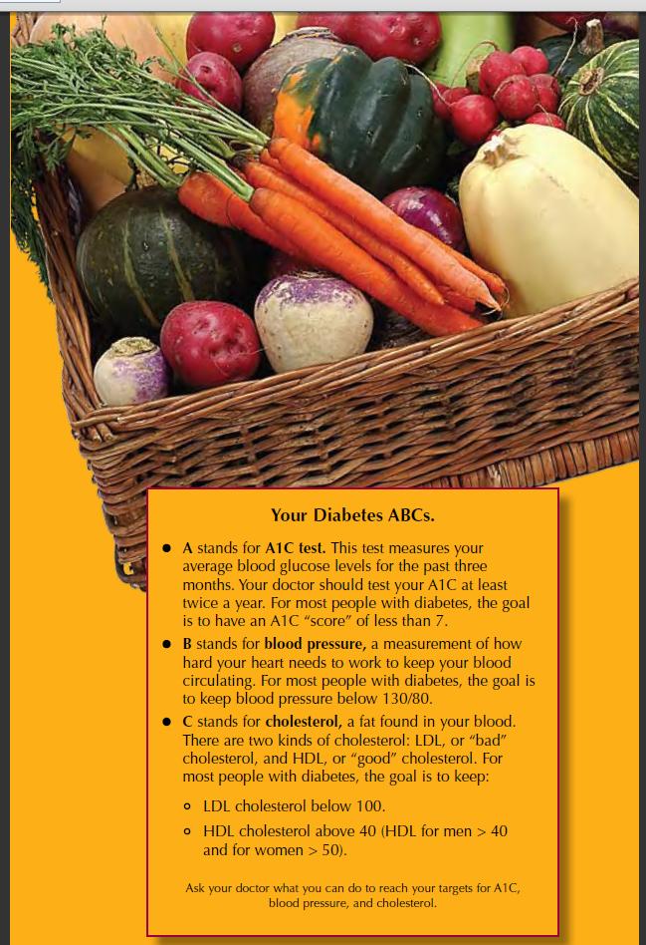


Make it look easy
Visuals
Notes:
Here’s a great example of the use of graphics.
This is one page of a document on diet for diabetic patients. The pictures used are so vivid, it draws your attention to it and invites the reader in.
Graphics and Pictures don’t have to be expensive. There are many free photo sites out there.
Visuals help:
-define your audience/make appealing to the audience
-low literate readers understand
-make more engaging
-explain complex topics
-explain the purpose
A few principles to keep in mind:
-Make sure the graphics are related to the content.
-Do not obstruct content
Here’s another visual demonstrating how not to pick up a heavy box.
This picture demonstrates 2 important points about using visuals:
-Display actions you should do; not actions you shouldn’t do (we do not recommend including pictures that use the cross-out sign)
-Explain specific action steps (as the step-by-step does in the top picture)

Slide 34
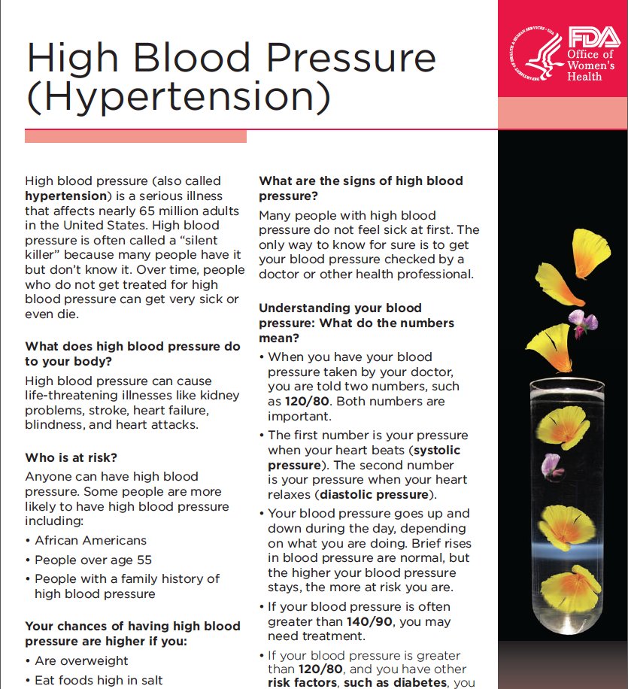
Make it look easy
Inappropriate visuals
Notes:
What do the petals have to do with hypertension here?
• Presents graphics related to purpose and main points
Graphics include:
Photographs
Line drawings
Clip art/cartoons/spot illustrations
Graph/chart
Diagram/flow chart
Stylized fonts
*Note: do not include logos

Slide 35
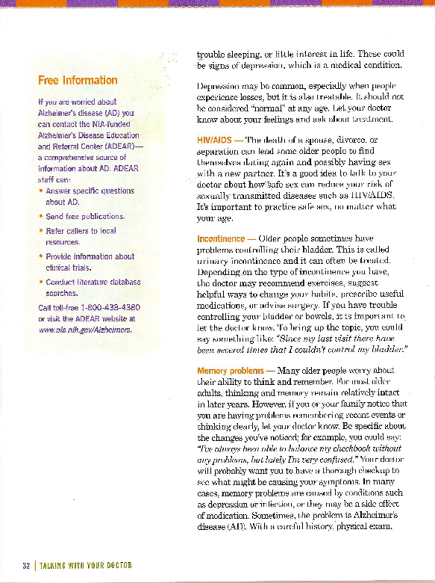
Make it look easy
Headings
Notes:
This document shows how important headings can be for your document:
-Using difference colors help them stand out for easy scanning for the topic the reader is most interested in
-Headings ‘chunks’ the information by topic.
Typography [Presenter can explain typography details if appropriate for audience, ie., if they are advanced enough or have requested it. Otherwise, keep the discussion of headings simple and don’t explain typography. This includes:
-Typography: serif versus sans-serif and easy to read.
-It uses:
Serif or sans serif font for body text
11-14 size font
Left justification
It DOESN’T use:
Small, condensed, fancy, or decorative fonts for body text
ALL CAPS for body text
All bold for body text
All italics for body text]
Traditionally, experts recommend sans serif for headings and serif for body copy. But, now the 2 are used interchangeably, and it doesn’t really matter as long as they are clear.

Slide 36
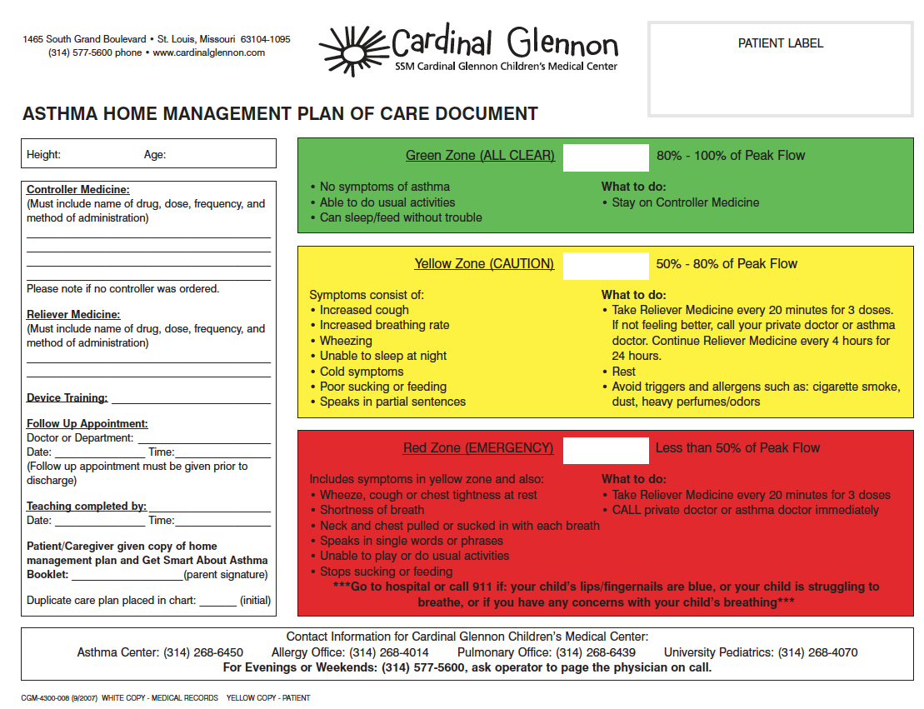
Make it look easy
Important info first
Notes:
The last aspect of design is putting the most useful info up front.
This is an asthma mgmt plan sent home with parents of children with asthma leaving the hospital:
-What is the most important information on here?
What to do in an emergency. The most important information should be first--look at red box at bottom—this is the most important information on the sheet, but it’s at the bottom
-What else might be important on this sheet?
Phone numbers, address, emergency procedures, etc. This is buried at the bottom in small print.

Slide 37
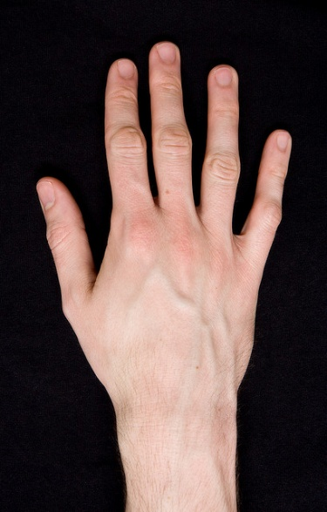
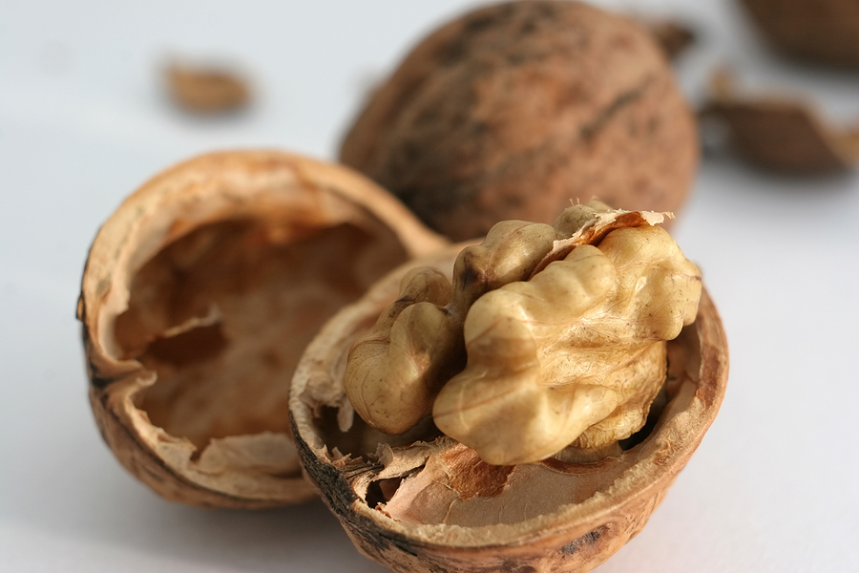

Make it look easy
4 cm is equal to which of these?
(Pinky finger)
Notes:
Let’s talk about numbers for a minute: say you needed to explain an injection site, which is 4 inches from the belly button. Show me 4 cm with your fingers.
One health literacy technique is to use visuals or analogies.
4 cm is equal to which of these: about the size of a walnut in its shell, a pen cap, or the average pinky finger?
Notes:
-Use visuals and analogies when possible, but make sure you choose correct examples that are relatable to your audience.
-Measurement, especially in metrics, can be abstract to most people
-By linking the quantity with something familiar, a person may more easily understand what is being talked about
-Explain amounts and measurements using simpler terms
-Link volume and amounts to something familiar in everyday life; use analogies

Slide 38
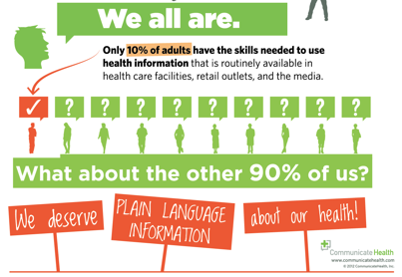
Make it look easy
Notes:
Can you read this? (Read if they can’t) Are these numbers easy to understand?
Percents are difficult to clearly communicate and understand as are decimals, fractions and ratios, use percents accompanied by a visual as seen here
Talk about weight loss in pounds instead of percentage of body weight.
Use the same denominator when comparing different probabilities--Use the smallest possible denominator--choose 100 or 1000
Use positive and negative framing: 50 out of 1000 get skin rash, that is 5%. This means that 950 don’t, or 95%

Slide 39
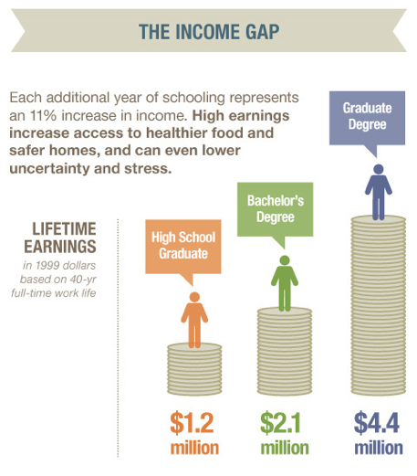
Make it look easy
Notes:
Pictures can help explain money or large numbers

Slide 40
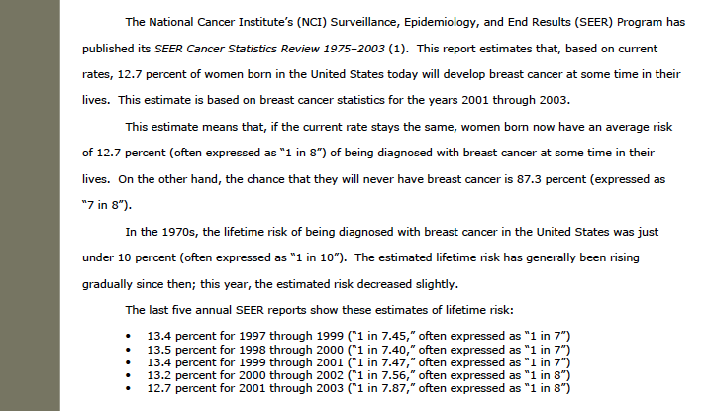
Make it look easy
Notes:
This document is in your manual. Are these numbers easy to understand? This uses numbers in narrative form and a confusing list.
Use “chance” or “more likely” or “less likely” instead of “risk.”
Talk about weight loss in pounds instead of percentage of body weight.
The word ‘risk’ should never be used--Use “chance” or “more likely” or “less likely” instead of “risk.”

Slide 41
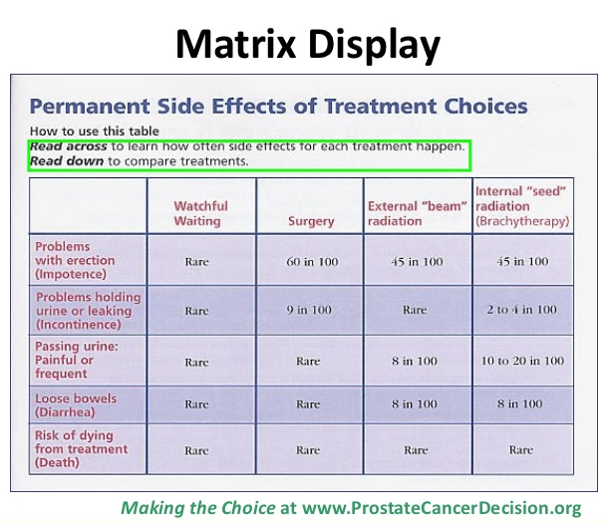
Make it look easy
Notes:
Many people ask me about charts, graphs and tables, and they are tricky—they are a great tool to explain data or complex information, but they are also shown to be difficult for low literate readers to interpret.
If you are using them, include as few rows and columns as possible and consider adding directions as in this example.

Slide 42
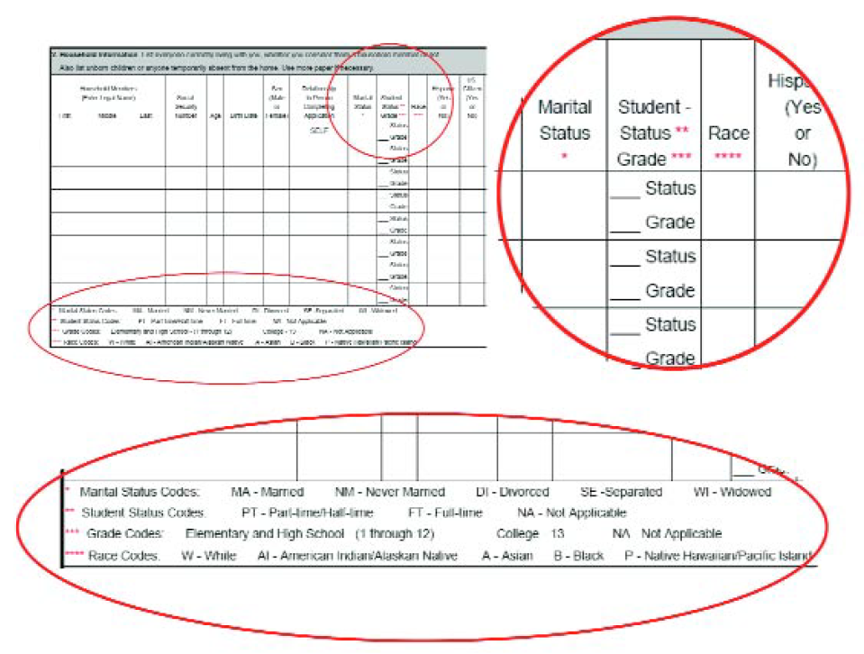
Make it look easy
Notes:
Avoid cross-referencing: columns, coding, asterisks—this forces the reader to move their eyes up-down-back-forth. It’s easy to lose their place. Many readers will not understand asterisks.

Slide 43
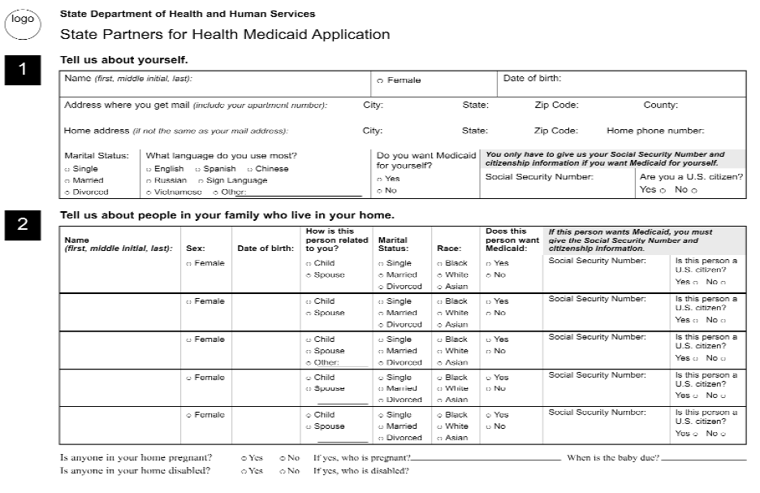
Make it look easy
Notes:
Put options (race, sex) within a field to reduce how much the reader has to move their eyes around.

Slide 44
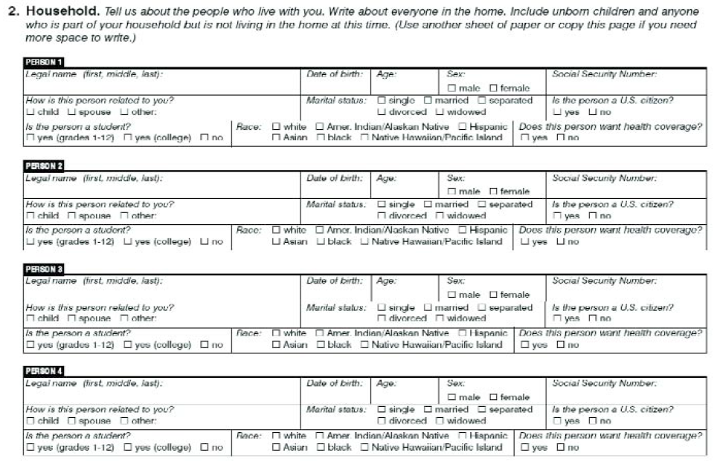
Make it look easy
Notes:
Another great way to avoid cross-referencing is to repeat information in several boxes so that readers can focus on 1 thing at a time and not have to refer to a column head repeatedly

Slide 45
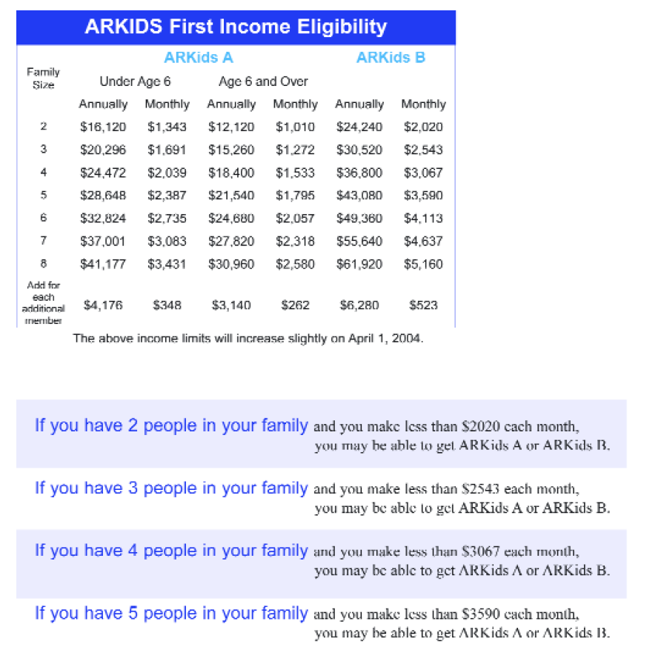
Make it look easy
Notes:
You can also summarize in a narrative form—good for income charts.

Slide 46

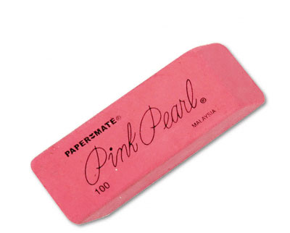

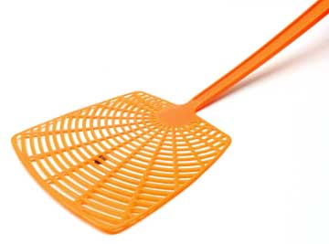

Clear words
Cubic containment system
Misapplication elimination device
Follicle redistribution mechanism
Vermin de-infestation apparatus
Horizontal tranquility terminal
Notes:
Know what these are?

Slide 47
Clear words
Plain language:
You must
You will be asked
The patient can check in at 7:00pm
We will issue you a check
Take your script to the pharmacy
Persistent pain
5 food groups
Notes:
Now we’re going to move on to using simple language. These are tips to make your writing simple and to have an impact on your audience.
We spoke about common words in the activity you just did. We’ll move on to short sentences.
This is probably natural to you. Plain language means that the content is conversational. [Click for animation for each box]
Friendly tone. Not a clinical or academic tone.
For example: Try to instead of You must
Active voice. It limits passive voice (some passive voice is ok).
For example: We will ask you instead of You will be asked
Second and first person voice. Limit third person voice
For example: You can instead of The patient can
Common words—the audience should understand all terms. When technical terms are present, clearly explain with helpful example, analogies or visual aids.
For example: Send rather than issue
Limited jargon—the audience should understand all jargon.
For example: Prescription rather than script (physicians, OTC, vitals, evidence-based, capacity-building, the economically marginalized, meaningful statistical downturn, etc.)
Judgment and value terms are explained.
For example: Pain that lasts for 4 hours instead of persistent pain.
(Exs: Optimal, moderate, modest, adequate)
Avoids classes of information or categories without an explanation.
For example: Five food groups—fruits, veggies, grains, protein, dairy

Slide 48
Clear words:
Before
When the process of freeing a vehicle that has been stuck results in ruts or holes, the operator will fill the rut or hole created by such activity before removing the vehicle from the immediate area.
After
If you make a hole while freeing a stuck vehicle, you must fill the hole before you drive away.
Notes:
Simple, direct sentences.
What is another way you might say this? What’s the point?
Here is the gist of this statement. Much simpler—just get right to the point, using:
-Short sentences
-”You” and direct language (not ‘the operator’)

Slide 49
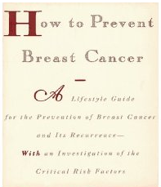
Clear words:
Notes:
You also want to make sure you are choosing your words wisely and saying only what you need to say to get your point across to your audience.
Do you think this document does this? This is the title page to a guide on preventing breast cancer.
If no response, prompt: Think about the wording here. Notice anything that could be confusing to readers?
Can we really prevent breast cancer? We can reduce risk factors and reduce likelihood, but can’t exactly prevent bc. We must choose our words carefully so as not to confuse or give false hope.

Slide 50
Clear words: Activity
1. “Supportive community services include assistance with accessing prenatal care.”
2. “Oxygen therapy may be ordered for you if you are having a hard time breathing.”
3. “You must pay the non-client fee in the amount of $30.00.”
4. “Adequate sleep prevents daytime fatigue.”
From 2011 Plain Language Works, LLC
Notes:
Now we’re going to do a little practice rewriting wordy statements. On your sheet you will find these 4 sentences. Take a minute to rework these to use the principles of simple language we just discussed: common words, short sentences, & the use of ‘you.’
Use shorter, conversational words; Make your writing personal:
-If you are pregnant, you have options. Call us for help.
-You can find help for you and your baby right in your own community.
Use strong, direct language:
-If you cannot breathe as you normally do, we can help you with oxygen treatment.
-We can help you breathe better with oxygen treatment. Just ask your doctor.
-If you are having trouble breathing, we can order you oxygen treatment.
Don’t use unnecessary words:
-You owe $30.00.
-Please pay this amount: $30.00
Avoid abstract concepts and technical words:
-Get 8 hours of sleep at night. You will have more energy during the day.
-Getting 8-10 hours of sleep at night keeps you from feeling tired during the day.

Slide 51
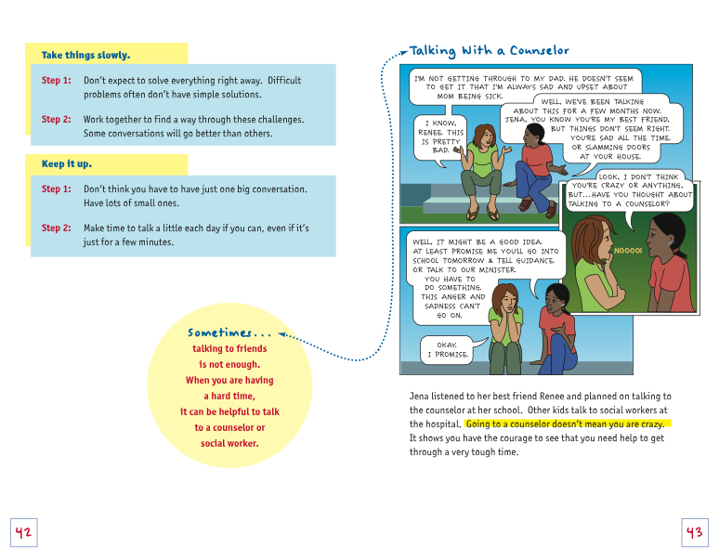
Engage your readers
Notes:
This document uses engaging strategies that match the audience of teens. This is one page in a booklet for teens about dealing with a parent with cancer. It uses vignettes, story telling, pictures, pull quote, colorful boxes, fun graphics.
Engaging:
‘If you wouldn’t want to read it, why would others?’
Interactivity means the content encourages learning:
-Defines key terms.
-Explains important concepts.
-Relates new concepts to familiar ones
-Tells a story to illustrate a point
-Uses sidebars to highlight pieces of related information
-Repeats and rephrases main points
-The content encourages active participation:
-It asks the audience to DO something.
-It gives the audience specific places to respond.
-The format of the content varies (quiz, advice column, stories, fast facts, recipes, etc.)

Slide 52
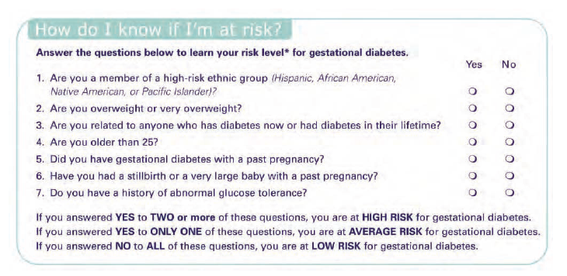
Engage your readers
Varied format
Notes:
Teasers, such as ‘What are your chances of getting the flu??’
Fast facts or “Did you know?”
Quiz or game

Slide 53
Moving forward
How can you implement health literacy into your work?
Train staff on plain language principles
Include in new staff orientation
Require all written information be in plain language
Additional training on verbal and website plain language principles
Include health literacy and plain language into goals, objectives and strategic plans
Include health literacy and plain language in grants and contracts
Notes:
Here are a few ways health literacy and plain language can be implemented for system-level change.

Slide 54
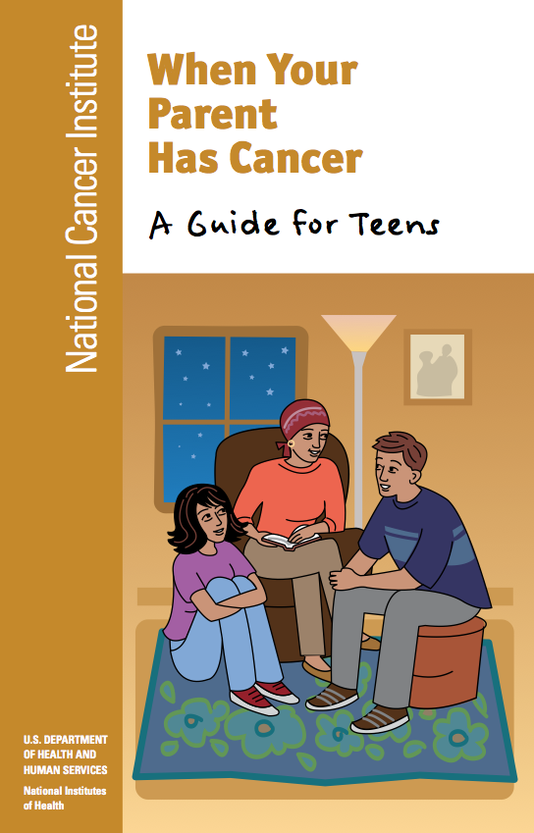
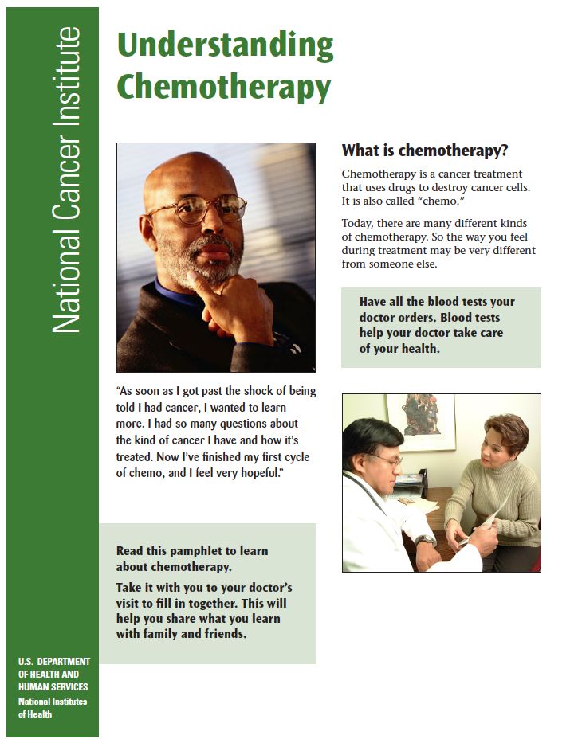


Putting it all together: Your documents
Audience
Reading level
Make it look easy
Clear words
Engage your readers

Slide 55
Questions?
For more information about other trainings, please contact:
Meghan O’Connell
moconnell@healthliteracymissouri.org
Visit us on the web
www.healthliteracymissouri.org

