Slide 1
Developing Two System-Level Approaches to Address Health Literacy Barriers Among Rural Cancer Patients
Norma-Jean Simon, MPH, MPA Carbone Cancer Center
Michael Helle, MHA, Beaver Dam Community Hospital
Julie Marks, RN, Beaver Dam Community Hospital
Notes:
PC – Rural Oncology Literacy Enhancement Study

Slide 2
Objectives
Identify health literacy barriers encountered by cancer patients
Discuss two strategies to address health literacy barriers
Examine strengths and weaknesses of each strategy in practice

Slide 3
Health Literacy
Degree to which individuals have the capacity to obtain, process, and understand basic information and services needed to make appropriate decisions regarding their health.
-Institute of Medicine, 2004
Notes:
Familiar definition.
Good to restate.

Slide 4
Health Literacy & Cancer
Health literacy can significantly decline during times of stress
Low health literacy results in inadequate health care utilization and poorer health outcomes.

Slide 5
Health Literacy & Rural Communities
Rural residence associated with low health literacy
  Greater concentration of individuals of older age
  Lower educational status
Medically underserved2
33% of rural cancer patients in Wisconsin experience health literacy difficulties3
(1) Halverson et al., 2013; (2) Yabroff et al., 2005 (3) Trentham-Deitz, 2005
Notes:
Poverty, inadequate or lack of insurance and usual source of care more
Older adults
Absence of usual source of care
Availability of medical care
Distances from cancer treatment facilities
May reflect distribution of resources

Slide 6
Implications
Increased mortality1
Increased hospitalizations & use of emergency services2
Diminished ability to understand health information, medication directions, manage health issues 3
Lower Quality of Life4
(1) Berkman et al., 2011; (2)Hemdon et al., 2010; DeWalt et al., 2004; (3) Amalraj et al., 2009; Befman et al., 2011; (4) Haverson et al., in preperation

Slide 7
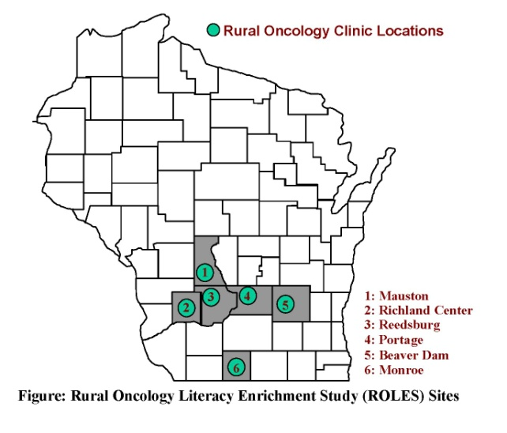
Study Aims
1. Complete an assessment of the health literacy barriers and patient navigation needs of rural cancer patients in Wisconsin
2. Develop and evaluate a pilot intervention addressing the needs identified by our formative assessment

Slide 8

Formative Assessment
Methods
  Patient interviews: (N=53) & phone surveys (N=51)
  Test of HL: STOFHLA (N=44), Vital Signs (N=30)
  Staff Focus groups: (6) & interviews with staff (N=45)
  Self-administered communication assessments (N=45)
  Shadowing of appointments (N=34)
  Community Research Advisory Board
  Review of the literature
Notes:
Assessing feasibility and, to some extent, effectiveness
Refine model and processes (implementation, evaluation)
Preliminary study for future larger trial

Slide 9
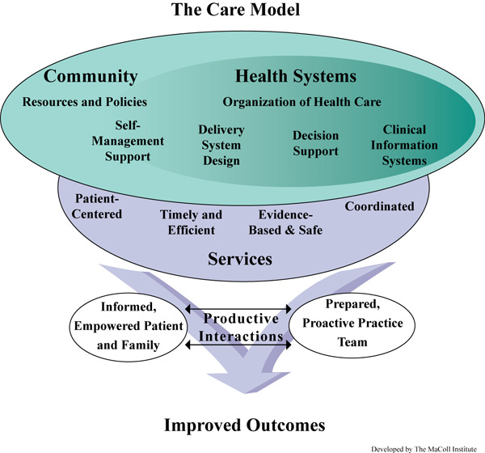
Organization of Findings

Slide 10
Key Findings: Community Resources
Reluctance of patients to ask for “help” or “support”
Limited availability of formal community support services
Staff recognize need for improved linkages with community resources
“ […], if I don't ask, they're not gonna tell me...” (Staff)
Notes:
Reliance on family, friends, neighbors, and faith communities

Slide 11
Key Findings: Self Management Support
49% of patient report having trouble reading written materials
Little use of written treatment plans (<20% of patients)
27% of clinic staff reported that they “need improvement” to encourage patients to ask questions
Notes:
Patients want more opportunities for improved decision making

Slide 12
Key Findings: System Design
Need for greater levels of care coordination
  Insufficient support for referrals and tests results
  Need for additional follow up after chemo
  Need for separate teaching sessions
  Limited linkage to resources within and outside the clinic

Slide 13
Key Findings: Decision Support
Notes:
Patients struggle with understanding the purpose of tests, procedures, and treatment plans and outcomes
Patients are too overwhelmed and scared to process information and/or ask questions
No system in place to identify patients with low health literacy

Slide 14
Implications for Action
Evidence of unmet needs and opportunities for improvement, especially:
  Increased care coordination
  Mitigation of non-medical barriers
  Improved patient-provider communication
Previous research suggests as promising strategies:
  Implementation of patient navigation programs (Koh et al. 2011; Petereit et al. 2008; Fiscella et al. 2012)
  Adoption of universal health literacy practices (Epstein, 2007; Ferreira et al. 2005)
Notes:
Research indicates that PN programs have a positive effect on adherence to cancer screening, timeliness of care, utilization of cancer counseling services, and quality of life. (Ell et al., 2007; Rahm et al., 2007; Christie et al., 2008; Ferrante et al., 2008. Studies have shown an association between PN programs and decreased barriers to care, including fewer treatment interruptions (Koh et al., 2011; Petereit et al., 2008; Hunnibell et al., 2012). PN programs have shown to increase satisfaction with care among cancer patients, especially among those experiencing financial, education, and/or language barriers (Fiscella, et al., 2012; Hendren 2012).
Despite a growing number of studies focused on the impact of PN programs on cancer care and patient outcomes, there is a dearth of research on the effectiveness of these programs in rural cancer care settings. Few studies have tested care coordination and barriers-focused navigation programs with rural cancer patients (20,33) and rarely have these studies entailed the use of strong, rigorous experimental study designs.

Slide 15
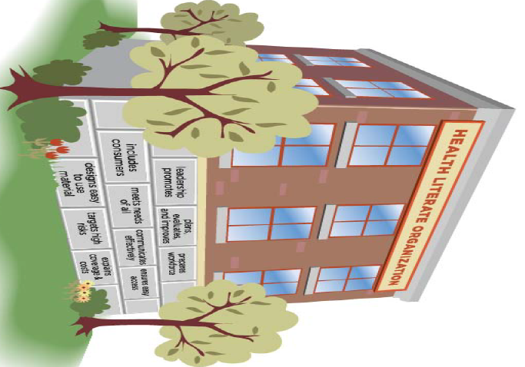
Institutionalizing Change
A Health literate organization makes it easier for people to navigate, understand, and use information and services to take care of their health.
- Institute of Medicine 2012
Notes:
Beginning the conversation for institutionalized change

Slide 16
Pilot Interventions
High Dose (Beaver Dam Community Hospital)
  Patient Navigation Program
  Health literacy provider trainings
Low Dose (Richland Hospital)
  Health literacy provider trainings only
2
5
Notes:
Focused on addressing the health literacy pare

Slide 17
Patient Navigation

Slide 18
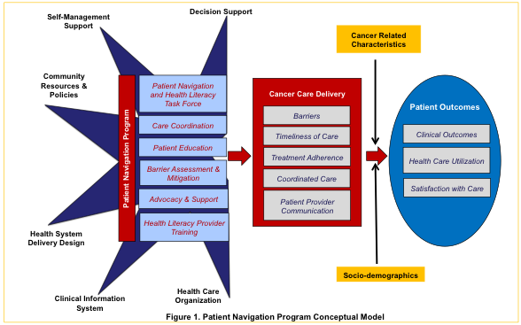
Conceptual Model

Slide 19
Building A Cancer PN Program
UW Research Team
3 nurse navigators and administrator
Cancer PN Task Force
Provide oversight & advice
Established patient navigation role and process
Customized patient navigation tools
Multi-disciplinary team
Institutionalized into BDCH quality control and cancer accreditation goals
Meeting facilitators
Find evidence, identify resources
Evaluation plan, instruments
BDCH Planning Team
Research protocols
Attended trainings
Recruited HL experts
Notes:
Goal: Accreditation from American College of Surgeons Commission on Cancer

Slide 20
Patient Navigation Process
The cancer navigator is a source of information and support for patients. Cancer navigators are “connectors” not “fixers.”
Referral
Intake Assessment
Prior to or same day as oncology
All new patients schedule ONC appointment
Cancer navigator notified
Medical and Non-medical barriers screened and addressed
Weekly Follow-Up
1st Follow-Up
Provide support
Reassess barriers
Clarify understanding
Referral to other departments
Referral to Cancer Navigator
Discharge
30 day
60 day
90 day
Navigator calls patient
Staff Nurse Reassess Barriers
Navigators sit-in on oncology appointment
Notes:
Weekly → While they are visiting clinic for chemo. If more than 1 visit in a week, just assessed on first visit.
After chemo or when visits are more spaced out, distress tool still administered every time they come in.
Discharge plans: This is what ideally they would like to be able to do. Not yet in place.

Slide 21
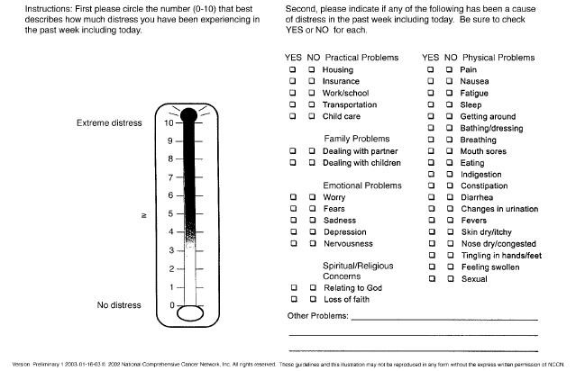
Emphasis on Barrier Assessment
Notes:
A tool developed by the National Comprehensive Cancer Network, included in the NCCN’s Clinical Guidelines for Oncology: Distress Management.
NCCN included a standard that “[a]ll patients should be screened for distress at their initial visit, at appropriate intervals, and as clinically indicated, especially with changes in disease status” (p. DIS-3).
The distress thermometer and problem checklist are efficient assessment tools that can be incorporated into normal practice.
Research has shown that nurses in a busy oncology radiation clinic were able to assess distress, provide educational and referral resources, and increase patient satisfaction through planned implementation of an assessment and intervention process (Fulcher et al. Clinical J of Onc Nursing, 2007;11(6).

Slide 22
Connecting Patients
Patient
Primary care
Surgery
Lab
Pharmacy
Oncology
Social Work
Hospice
Home Health

Slide 23
Navigation Program Highlights
Four PN leading members “trained”
March 2013 ~ 30 new cancer patients navigated
Task Force meets monthly; new members added
PN staff continues incorporating new elements to program
  Patient Massage – July 2013
  Selection of patient education resources

Slide 24
In Practice
Strengths
  Better connections with other departments
  Referrals are better facilitated
Challenges
  Three navigators working with patients
  Difficult to communicate with inpatient
Next Steps
  Medication reconciliation
  Staff Huddles
Notes:
Patients; Value – patients don’t feel as lost in the system. Have someone they know they can follow up with. Not just hanging out there. Relie on Nurse Navigators familiar faces.
We have three nurse navigators, getting to know each one is difficult, don’t always want to talk to each other. Need to come in for another appointment. Another visit, more paperwork
Nurse Navigator: Developed more positive relationships with other departments. Referrals, they know where they are coming from. Respect the judegments of nurse. Navigators more educated regarding diagnosis and sit in with doctors, want them included, feel like more of a team.
Negative – no current way to filter information through electronic medical record. Difficult to see inpatients with current schedules and communicating that information. Time to walk throughs thorugh the department, touch base with patients and families. Right now don’t seem to have time do that.

Slide 25
Health Literacy Training

Slide 26

Goals of the Training
Increase knowledge of Health Literacy barriers and needs
Promote use of plain language
Improve communication skills
Increase self-efficacy and intention to implement techniques with patients

Slide 27
Planning the Training
Identified regional and national health literacy experts
  Paul Smith, MD
  Erin Aagessen, MS, MPH
  David Hahn, MD
  Sue Gaard, MS, RN
Tailored objectives based on standards
Offered CME credit for physicians

Slide 28
Training Providers & Staff
Reduce
HL
Barriers
Health Literacy 101: Increasing Provider Awareness
Keeping it Simple: Communicating for Patient Understanding
Communicating Numbers: Ensuring Shared
Decision-making
Empowering Patients: Responding to Patient Concerns
Notes:
National and regional health literacy experts as trainers.

Slide 29
HL Training Highlights
115 non-unique participants (23-37 per module)
Pre/Post provider self-administered surveys
Participants included physicians (14%), nurses (64%), and other medical staff (21%)
High reported satisfaction with training
Statistically significant changes pre and post

Slide 30
In Practice
Strengths
  More aware of limiting jargon and available patient education materials
Challenges
  Low participation from Oncologists
Next Steps
  Incorporation of Health Literacy Training in all new nurse orientation
Notes:
Gave nurses dinfferent persepective on how we communicate with patients and how we need to change it up
Negative: getting to some of the things is different. Getting individuals engaged is difficult, is really hard. We really felt like we would have more doctors there. They are the first ones that talk to the patient, would hope they go to a literacy.

Slide 31
Evaluation

Slide 32
Evaluation - Ongoing
Implemented in BDCH and RH
Patient Reported Outcomes
  Two cross-sectional mail surveys in Beaver Dam and Richland Hospital (Control)
    September 2012
    April 2013
Pre/Post provider self-administered surveys
    Each module assessed independently
    Assess learning and intent to incorporate best practices

Slide 33
Lessons Learned

Slide 34
Lessons Learned
Community-based participatory research is a process that requires lots of time
Clinics all have different cultures
  Barriers to quality cancer care are the same
Important to gain perspective from patient and providers in assessment and program development
PN programs share similar tasks, tools and materials must be tailored to each setting
Notes:
Very important to understand the community, system you are working with
Identify Key person(s) who can leverage resources, push for change

Slide 35
Acknowledgments
UW-Madison
  Ana Martienz-Donate, PI
  Julie Halverson
  Jeanne Schaff-Strickland
  Rebecca Linskens
  Amy Trentham-Dietz
  Paul Smith
  David Hahn
  Sue Gaard
BDCH
  Michael Helle
  Melissa Schuett
  Julie Marks
  Connie Knight
  Task Force Members
Richland Hospital
  Cindy Hanold
  Sue Dean
  Linda Tyler-Doudna
  Ellen Bushee
UW CCC
  Noelle LoConte
  Ticiana Leal
  Samuel Lubner
  William Shellman
  Thomas McFarland
  Robert Hegeman
  Mark Juckett
  Walter Longo
  Rosanne Hepner
  Dan Mulkerin
  Toby Campbell
  Amy Williamson
  James Cleary
Staff at Mile Bluff Medical Center, Monroe Clinic, Divine Savior Healthcare, Reedsburg Area Medical Center
Wisconsin Literacy, Inc.
UW SMPH Wisconsin Partnership Program

