Slide 1
ASK ME FOR THE HEALTH OF IT
COMMUNITY HEALTH LITERACY
OUTREACH PROJECT

Slide 2
Introductions
Nancy Wheeler, Coordinator, ICAA Crossroads Literacy
Margarete Cook, WI Literacy Regional Consultant
Allison Machtan, Health Educator, Security Health Plan

Slide 3
Evolution of an idea
Began following the Health Literacy Summit in 2011
  Heard about the need for health literacy for Seniors
  Heard about the difficulty in getting them to the great workshops being presented
Our solution? Take the information and support to where Seniors already gather

Slide 4
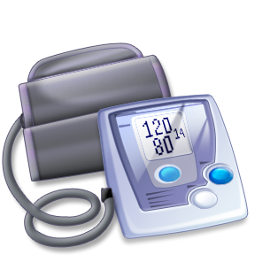
First Steps
Recruited retired nurse volunteers
Talked to Connections thrift store about setting up a booth
Made up a small display board
Main focus is on health literacy
  answering questions
  offering support in a relaxed, informal setting.
Blood pressure checks are simply a good “hook” to get people to stop by.
Notes:
We were fortunate to have two retired nurses among our literacy tutors who were especially interested in health literacy and they began staffing the booth in July 2011.
.(Gordy’s bus and free lunches on Wednesdays…)

Slide 5
Expansion #1
To bring more people to the booth, we received two small grants from the Enbridge and Plum Creek Foundations.
This allowed us to:
  Purchase blood pressure cuffs
  Make a more professional looking and engaging display
  Expand the project to a second site at an outlying senior community center during the noon senior meal time

Slide 6
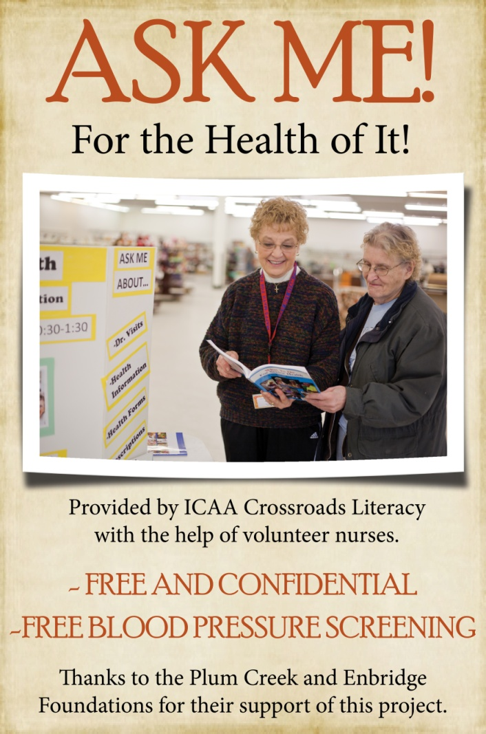
Before the final version of the display was printed, Jay Shrader of Security Health Plan suggested the new title “Ask Me for the Health of It”
Notes:
You can see what the original display looked like on the left side of the picture. This is the center panel of the display

Slide 7
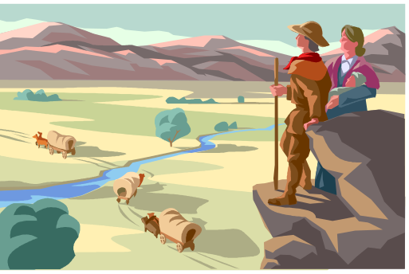
Expansion #1 a
A retired nurse wanted to offer this service in her community on the far western side of Rusk County.
Rusk County Home Health was no longer providing blood pressure checks in the county.
Minimal investment
  another display board
  a third “Ask Me” information/materials kit
She took the booth “on the road.”
  4 sites now in Rusk County
Notes:
Not that Rusk County is as rural as the picture depicts…. Sometimes just seems that way. We decided to focus on these simple concepts:
Understanding prescription drug labels
Filling out health forms
Answering questions about health information
Providing suggestions for making the most of a medical visit
“Ask Me Three” questions
Topics from Health Literacy Program for Minnesota Seniors

Slide 8
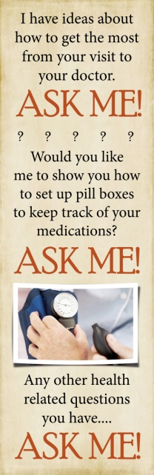
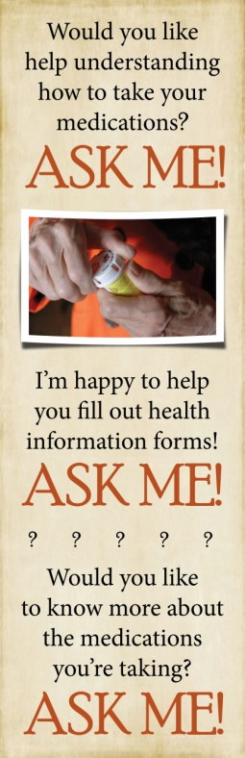
What the Booth Really Offers
The Real Story
Notes:
“Yesterday I sat and listened; the gift I had to offer to most that came to my table.
Today I offered a different gift. A lovely young woman with laughing eyes asked me to take her blood pressure.
‘I’ve never had it done.’ She saw the concern on my face as I turned the meter toward her. ‘It’s high?’
Yes – much, much too high. You must see a doctor, soon.
‘It’s that serious?’
Yes – that serious.
‘I will make an appointment, thank you.’
Tomorrow I may again listen, but today – oh today! I may have saved a life.
We care.”
Here’s a story that one of our Ask Me nurses wrote about her interaction with a young 20-something woman last summer. I thought you might be as moved by it as I was…
Amazing
In her note to me with this story, Julia pretty much sums up the Ask Me health literacy project: “We listen, give limited advice and most of all we care.”

Slide 9


Expansion #2! Collaboration

Slide 10
Why Does SHP Care?
As part of our mission SHP started a Community Benefit Program in 2011
Health Literacy identified as a priority
Existing partnerships with Wisconsin Literacy Inc. and ICAA Crossroads Literacy
Business Needs (e.g. medical cost savings, HEDIS, NCQA)
Notes:
Allie

Slide 11
Goals of the new phase:
Evaluate the effectiveness of this type of health literacy outreach
Design a “model” that can be replicated by any literacy or community health program. Include:
  guidelines for the set up process, partners, etc.
  training materials
  plain language sample materials
  suggestions for the resource kit and display board
  guidelines on how to use technology for patient education

Slide 12
Steps of Phase 2:
Involve a local literacy agency & their local thrift store
Create standardized, changeable display boards
Purchase iPads for nurses
  access to medical information online that can be printed out
  teach customers about internet sites for reliable information
  conduct a SurveyMonkey to evaluate effectiveness
Develop plain language handouts on current topics of interest
Establish training module for retired nurse volunteers
Create Nurse recruitment materials
Develop and evaluate Health Literacy Discussion Starter Cards
Notes:
(this will be a half step, actually, because we’ve chosen to involve the literacy program and Connections stores in two other ICAA counties) But this will give useful information on how to create the process for when a literacy program wants to start their own outreach project.
In general, our goals for the new phase are to develop and experiment with what are the most effective elements of this type of community health literacy outreach project.
And then, with that experience, put together a “model” project that other organizations could take to likely partners to fund and help implement.
With further funding, we would like to take it a step further and actually recruit other literacy programs to implement this project and “mentor” them through the process.

Slide 13
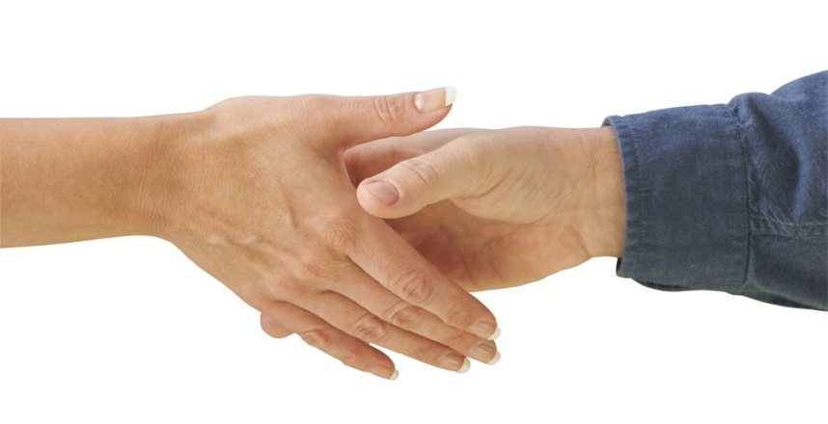
It’s Possible Because of Partnering!
Enbridge Foundation
Plum Creek Foundation
WI Literacy
Security Health Plan Foundation
WI Health Literacy
ICAA Crossroads Literacy
Rusk County Senior Services (for permission to use their sites)
Connections store

Slide 14
Spin-Off
With the commitment to take literacy out to the people, ICAA Crossroads Literacy, with the support of Heritage Credit Union, has started an “Ask Me for the Wealth of it” financial literacy booth that is staffed by the local financial institutions and Crossroads Volunteers every Friday from 11-1:00 at the Connections thrift store. This booth offers help with setting up a budget, understanding credit scores, tips on saving and managing money, etc.

Slide 15
Resources:
margarete@wisconsinliteracy.org
nancy.wheeler@indianheadcaa.org
shrader.jason@securityhealth.org
http: //www.wisconsinliteracy.org
http: //www.healthliteracywisconsin.org
http://www.indianheadcaa.org

Slide 16

Questions

